Slide 1
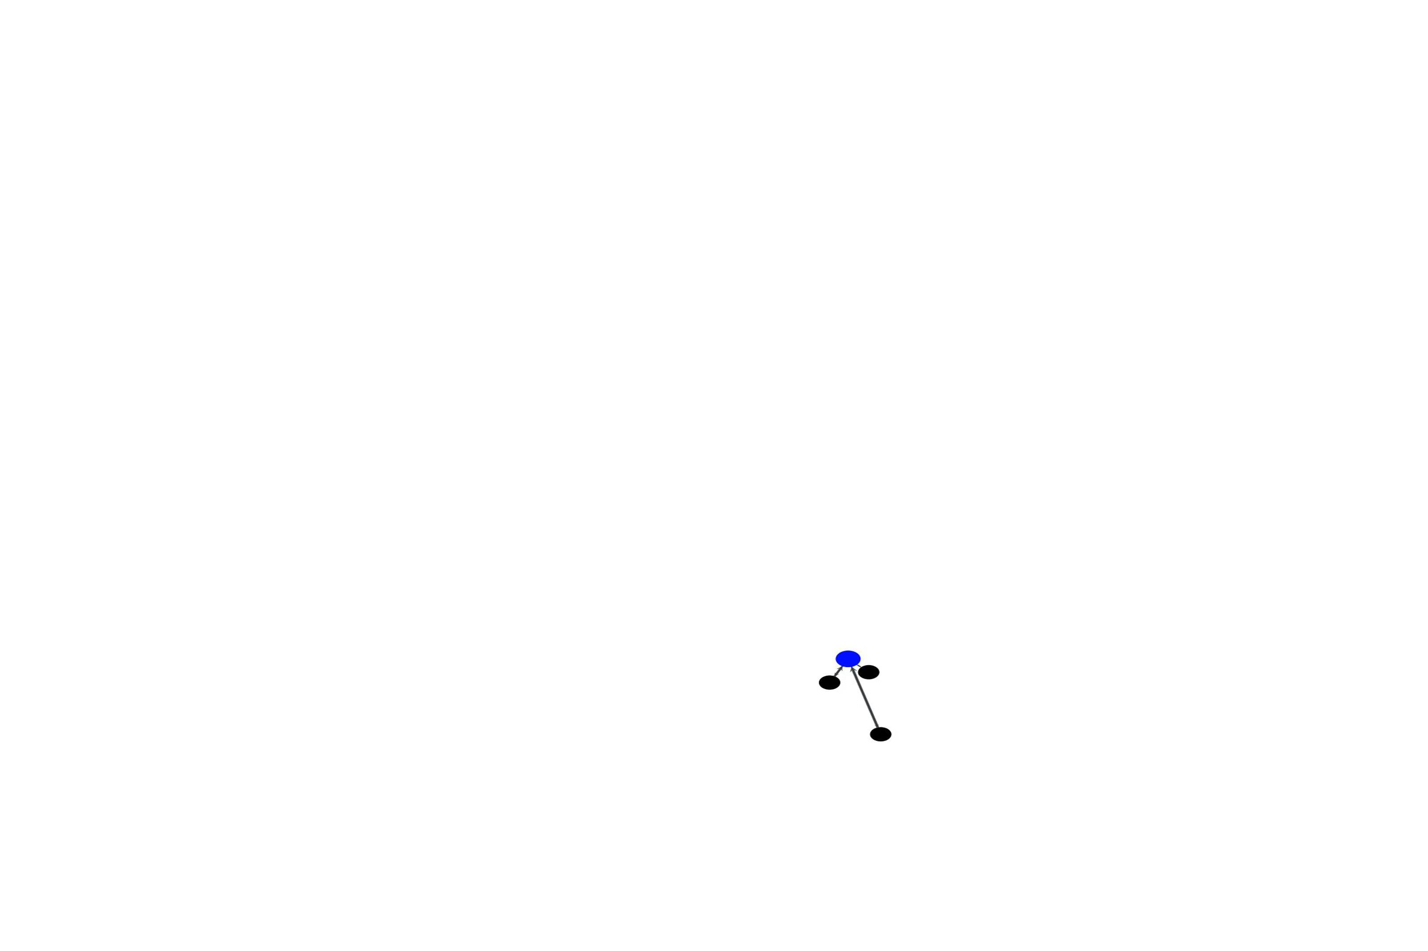
Creating a network of states
Graph representation: Vogiatzis, G.G.; van Breemen L.C.A.; Hütter, M.
Macromol. Theor. Simul. 2019, 190036.

