Slide 1
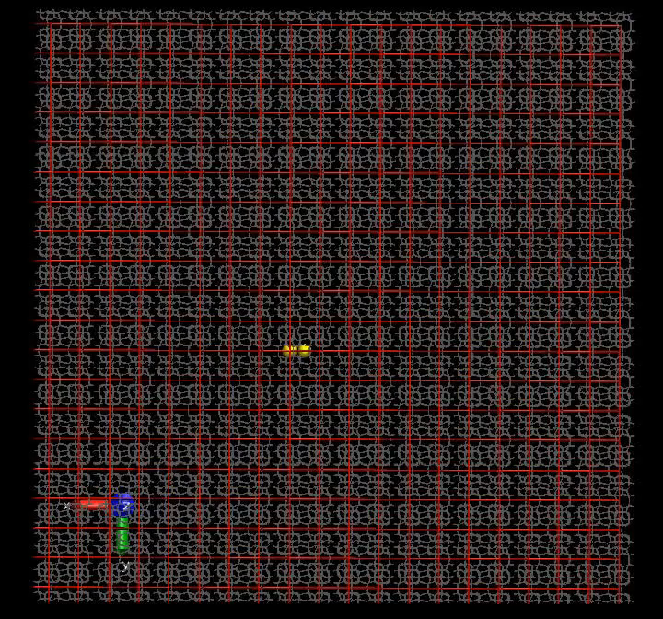
KINETIC MONTE CARLO

Slide 2
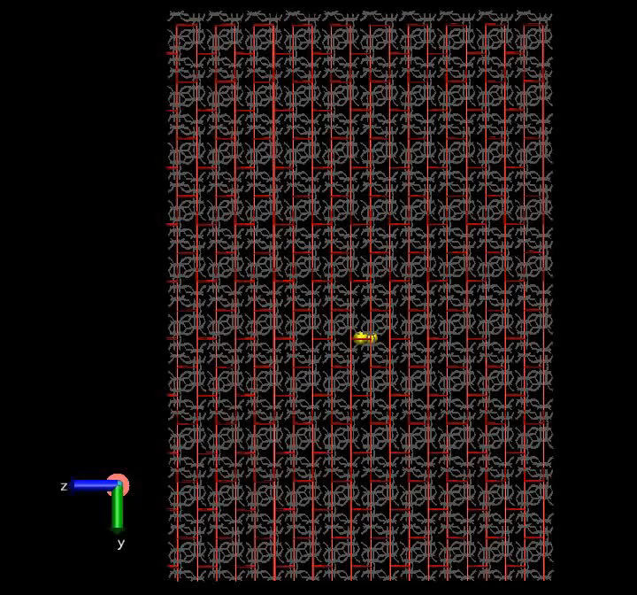
KINETIC MONTE CARLO
Einstein, 1905

Slide 3
SOLUTION OF THE MASTER EQUATION
Cell 1
Cell 2
. . . . . .
Cell 2^{ν} -1
Cell 2^{ν}
2^{ν} unit cells n states/unit cell PBCs at the ends n=12, ν=7
Cell 2^{ν-1}
Cell 2^{ν-1} +1
L_{d}
2L_{p}
Initially only two central cells 2^{ν-1} and 2^{ν-1}+1 filled, all others empty
Approaches:
• Direct diagonalization of 2^{ν}n× 2^{ν}n matrix .
• Recursive reduction of dimensionality (MESoRReD), ultimately expressing the eigenvalues and eigenvectors of in terms of those of 2^{ν} matrices of dimension n×n, pertaining to the unit cell.
• Numerical solution of the Master Equation by Euler method.
Panagiotis D. Kolokathis

Slide 4
SOLUTION OF THE MASTER EQUATION
Cell 1
Cell 2
. . . . . .
Cell 2^{ν}-1
Cell 2^{ν}
2^{ν} unit cells n states/unit cell PBCs at the ends n=12, ν=7
Cell 2^{ν-1}
Cell 2^{ν-1}+1
L_{d}
2L_{p}
♦ 1×10⁻⁸ s
* 2×10⁻⁸ s
• 4×10⁻⁸ s
Points: MESoRReD
Line fits: continuum diffusion problem
Histograms: Euler method 1×10⁻⁸ s
P.D. Kolokathis

Slide 5
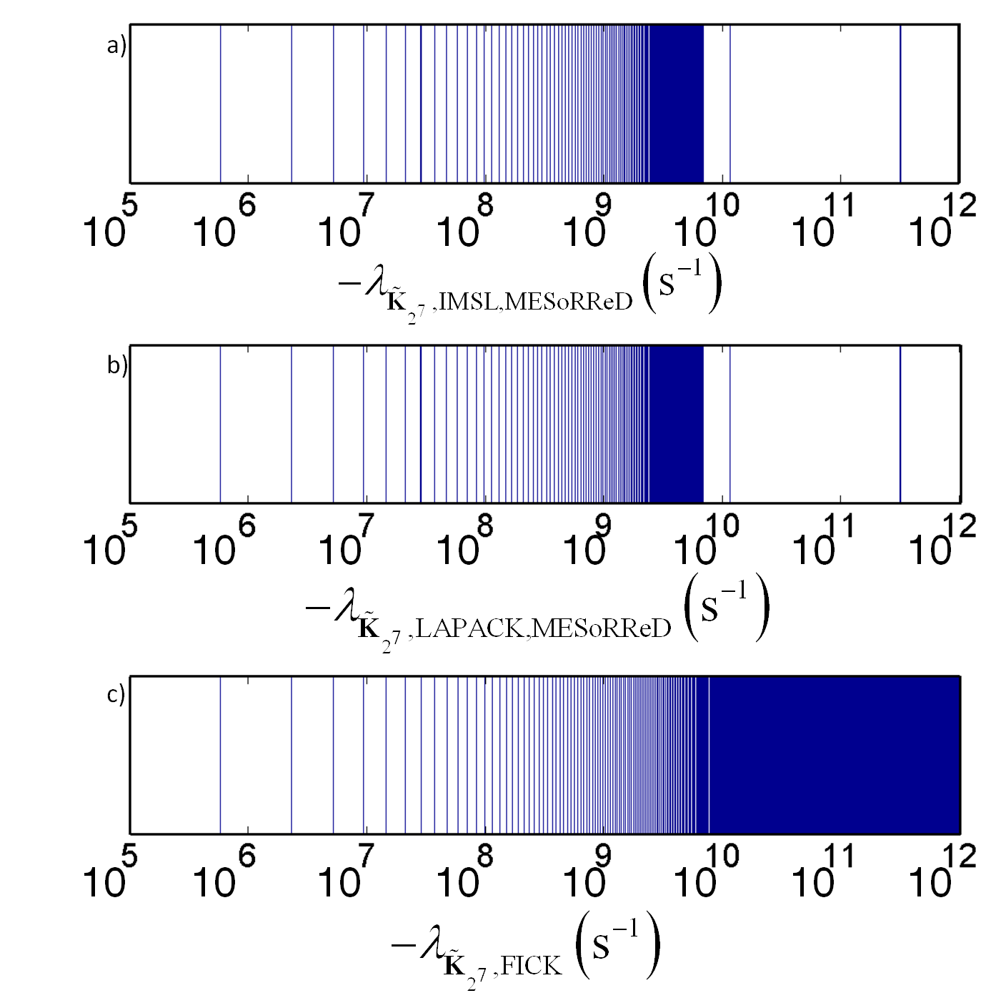
Solution to Master Equation:
Solution to Continuum Diffusion Equation:
D_{αα} obtainable from nonzero eigenvalue of symmetrized rate constant matrix with smallest absolute magnitude.
−λ_{m} (s⁻¹)
D_{xx} ( fπ/L_{p})² (s⁻¹)
Notes:
Found a way to calculate lim_{L_p \rightarrow \infty} (- \lambda_1) by diagonalization of a matrix pertaining to a single unit cell. The matrix is an explicit function of \nu.

Slide 6
Xe/Silicalite-1 at 150 K TST DIFFUSIVITIES FROM VARIOUS METHODS
Method | D_{xx} (10⁻¹⁰ m² s⁻¹) | D_{yy} (10⁻¹⁰ m² s⁻¹) | D_{zz} (10⁻¹⁰ m² s⁻¹) | D (10⁻¹⁰ m² s⁻¹)
KMC-TST^{1,2} | 9.67±0.14 | 11.62±0.25 | 1.71±0.05 | 7.66±0.14
Direct Diagonali-zation-TST, fit continuum soln.¹ | 9.7088±0.0029 | 11.676±0.002 | 1.7627±0.0093 | 7.7157±0.0044
MESoRReD¹-TST fit continuum soln. | 9.7088±0.0029 | 11.676±0.002 | 1.7627±0.0093 | 7.7157±0.0044
MESoRReD¹-TST from λ₁ | 9.7132 | 11.684 | 1.7531 | 7.7171
Euler Method¹-TST | 9.70 | 12.5 | 1.83 | 8.01
KMC-DC TST² | 5.1 | 7.3 | 0.83 | 4.41
MD² | 4.3 | 10.0 | 0.99 | 5.1
PFG NMR³ | − | − | − | 1.6
¹P.D. Kolokathis and DNT, J. Chem. Phys. 137, 034112 (2012).
²R.L. June, A.T. Bell, DNT J. Phys. Chem. 95, 8866 (1991)
³J Kärger, H. Pfeifer, F. Stallmach, N.N. Feoktistova, S.P. Zhdanov Zeolites 13, 50 (1993).

Slide 7
Xe/Silicalite-1 at 150 K COMPUTATIONAL REQUIREMENTS
Method | CPU time (s) | Memory (MB)
KMC-TST^{1,2} | 6183.46 | 6
Direct Diagonalization-TST, fit continuum soln.¹ | 37.81 | 38
MESoRReD¹-TST, fit continuum soln. | 2.83 | 44
MESoRReD¹-TST from λ₁ | 0.0059 | 2
Euler Method¹-TST | 23760 | 401
MD² | 309173
¹P.D. Kolokathis and DNT, J. Chem. Phys. 137, 034112 (2012).
²R.L. June, A.T. Bell, DNT J. Phys. Chem. 95, 8866 (1991), normalized

Slide 8
Xe/Silicalite-1 at 150 K COMPUTATIONAL REQUIREMENTS
Method | CPU time (s) | Memory (MB)
KMC-TST^{1,2} | 6183.46 | 6
Direct Diagonalization-TST, fit continuum soln.¹ | 37.81 | 38
MESoRReD¹-TST, fit continuum soln. | 2.83 | 44
MESoRReD¹-TST from λ₁ | 0.0059 | 2
Euler Method¹-TST | 23760 | 401
MD² | 309173
¹P.D. Kolokathis and DNT, J. Chem. Phys. 137, 034112 (2012).
²R.L. June, A.T. Bell, DNT J. Phys. Chem. 95, 8866 (1991), normalized

Slide 9
Xe/Silicalite-1 at 150 K COMPUTATIONAL REQUIREMENTS
Method | CPU time (s) | Memory (MB)
KMC-TST^{1,2} | 6183.46 | 6
Direct Diagonalization-TST, fit continuum soln.¹ | 37.81 | 38
MESoRReD¹-TST, fit continuum soln. | 2.83 | 44
MESoRReD¹-TST from λ₁ | 0.0059 | 2
Euler Method¹-TST | 23760 | 401
MD² | 309173
¹P.D. Kolokathis and DNT, J. Chem. Phys. 137, 034112 (2012).
²R.L. June, A.T. Bell, DNT J. Phys. Chem. 95, 8866 (1991), normalized

Slide 10
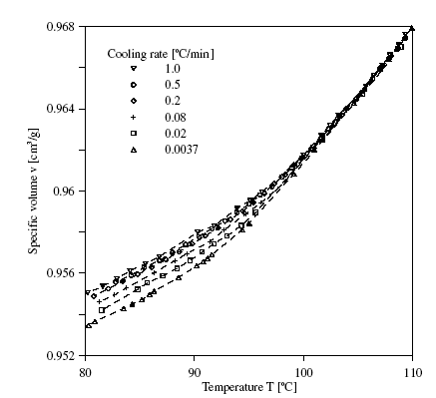
GLASSES ARE NON-EQUILIBRIUM MATERIALS
atactic Polystyrene (aPS)
M_{w}=145 kg/mol
M_{w}/M_{n}=1.03
LIQUID
Glass structure and properties depend on the rate of cooling from the melt.
GLASS
J. Hadač, P. Slobodian, P. Říha, P. Sáha, R.W. Rychwalski, I. Emri, J. Kubát, J. Non-Cryst. Solids, 353, 2681-2691 (2007)

Slide 11
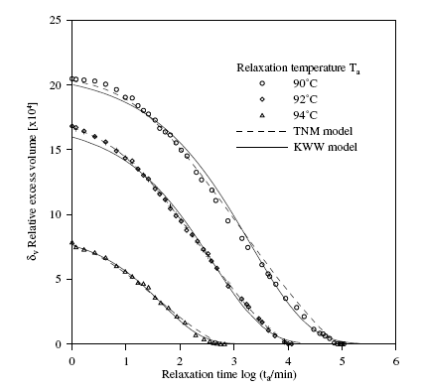
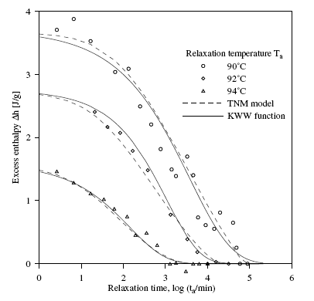
GLASSES ARE NON-EQUILIBRIUM MATERIALS
Glass properties change with time (physical ageing)
aPS, M_{w}=145 kg/mol, M_{w}/M_{w}=1.03, T_{g}(1ºC/min)=97.8±0.2ºC
J. Hadač, P. Slobodian, P. Říha, P. Sáha, R.W. Rychwalski, I. Emri, J. Kubát, J. Non-Cryst. Solids, 353, 2681-2691 (2007)

Slide 12
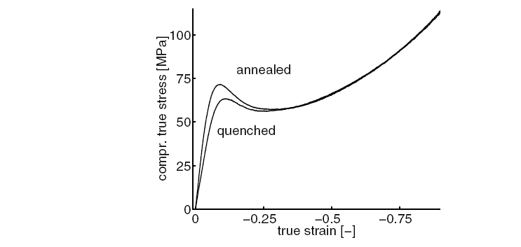
GLASSES ARE NON-EQUILIBRIUM MATERIALS WITH COMPLEX MECHANICAL BEHAVIOUR
PC in compression: Effect of ageing
H. Van Melick, Ph.D. Thesis, Technical University of Eindhoven, 2002

Slide 13
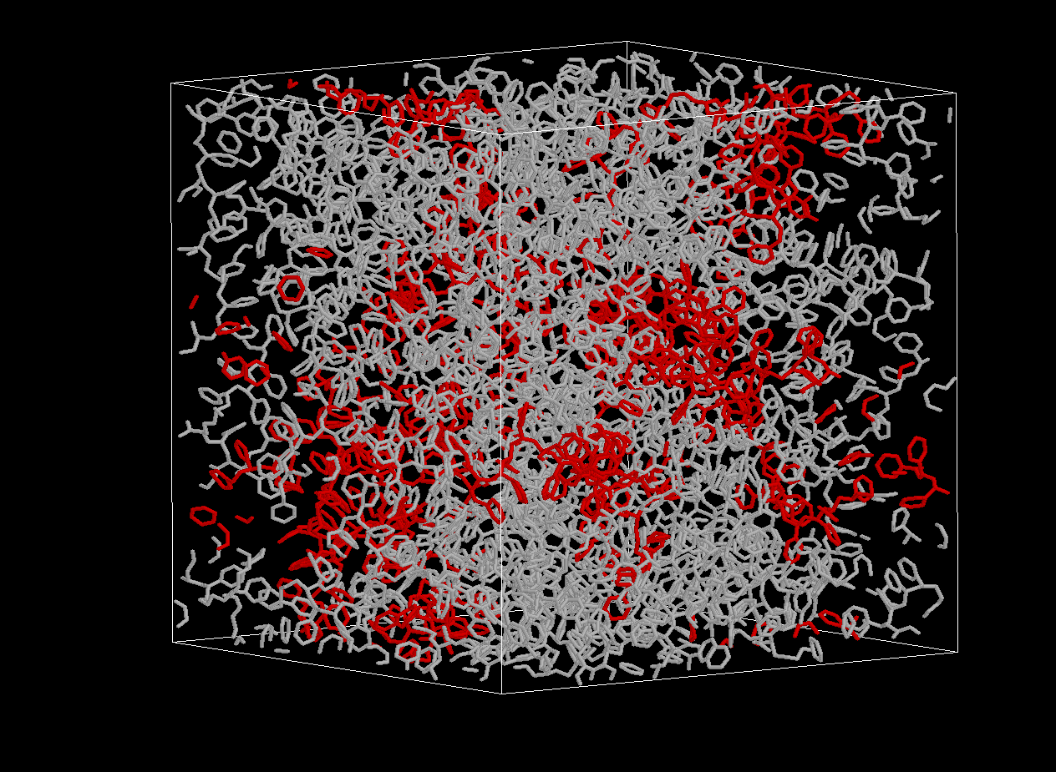
ENERGY LANDSCAPE-BASED MODELING OF GLASSY ATACTIC POLYSTYRENE
Starting point: Well-equilibrated melt configurations
T. Spyriouni, C. Tzoumanekas, DNT, G. Milano, F. Müller-Plathe, Macromolecules, 40, 3876-3885 (2007).

Slide 14
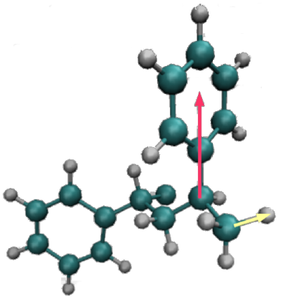
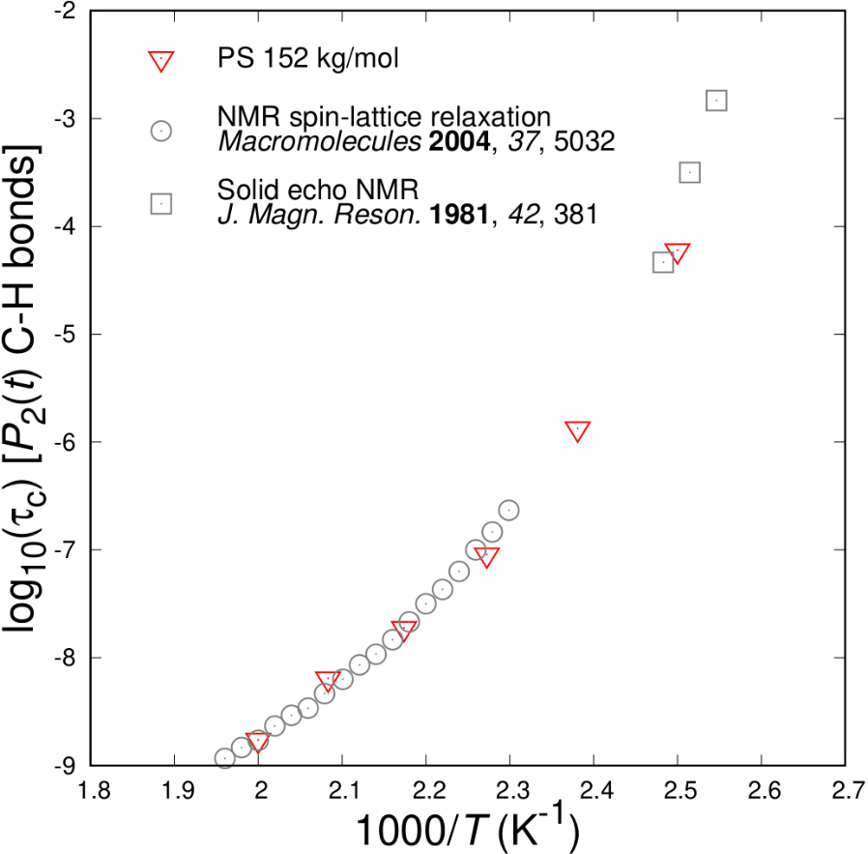

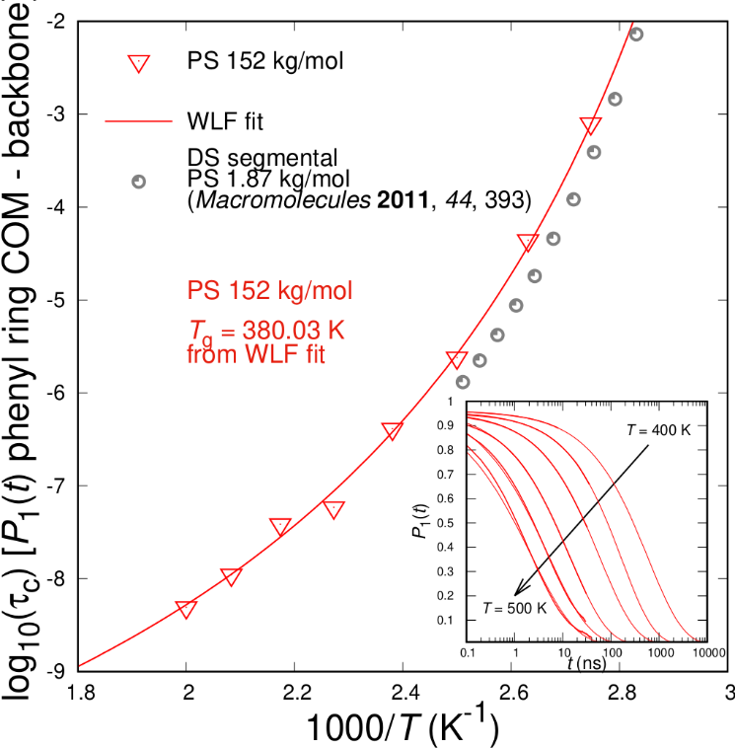
Segmental Dynamics and Glass Transition: atactic Polystyrene
Atomistic Molecular Dynamics
Fit to empirical Williams–Landel–Ferry relation ^{[1]:}
Experimental T_{g} ^{[2]} : 373 K
Ferry, J. D. “Viscoelastic Properties of Polymers”, 3rd ed. Wiley, New York, 1980.
Hintermeyer, J. et al. Macromolecules 2008, 41, 9335.
Vogiatzis G.G.; DNT Macromolecules 2014, 47, 387.

Slide 15
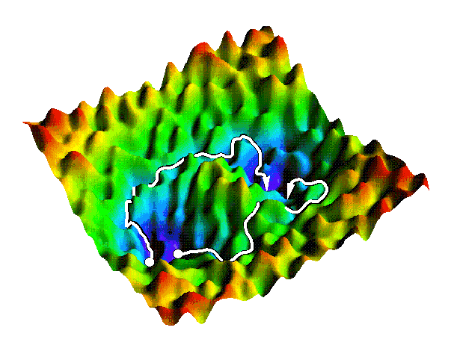
Energy Landscape Picture of a Glass
V
Inherent structure
x
Basin
Metabasin
(C. Dellago)
Configuration fluctuating in the neighborhood of local energy minima: “Inherent structures” : Stillinger, F.H. Science 1995, 267, 1935. See also work by P.G. Debenedetti, D.J. Lacks, A. Heuer, G. Parisi, F. Sciortino, D. Wales, T. Keyes, T.M. Truskett, DNT and U.W. Suter.
Transitions between minima inhibited by high energy barriers.
Glass properties: arithmetic averages of properties of individual “basins of attraction”. Restricted equilibrium established within each basin.
Glassy computer specimens generated by rapid cooling of the melt.
Notes:
Quasi-harmonic approximation within basins

Slide 16
In-basin motion: Quasi-Harmonic Approximation (QHA)
Mass-weighted coordinates
Second derivatives of the potential energy
Eigenvalue problem
Normal mode angular frequencies
Helmholtz energy
V (x₀) =V_{inh} and ω_{i} are functions of the spatial extent of the system.

Slide 17
GIBBS ENERGY MINIMIZATION OF A BASIN UNDER GIVEN STRESS STATE
Quench from melt by classical MD
V_{k}= V_{o},…,V_{f}
Inherent structure
Vibrational free energy
G_{k}(T, P, V_{k})
Atactic polystyrene modified A.Lyulin et al. (2003) model isotropic dilation/contraction
N.P. Kopsias and DNT, J. Chem. Phys. 109, 8573 (1998). D. Tsalikis, G.C. Boulougouris, DNT.

Slide 18
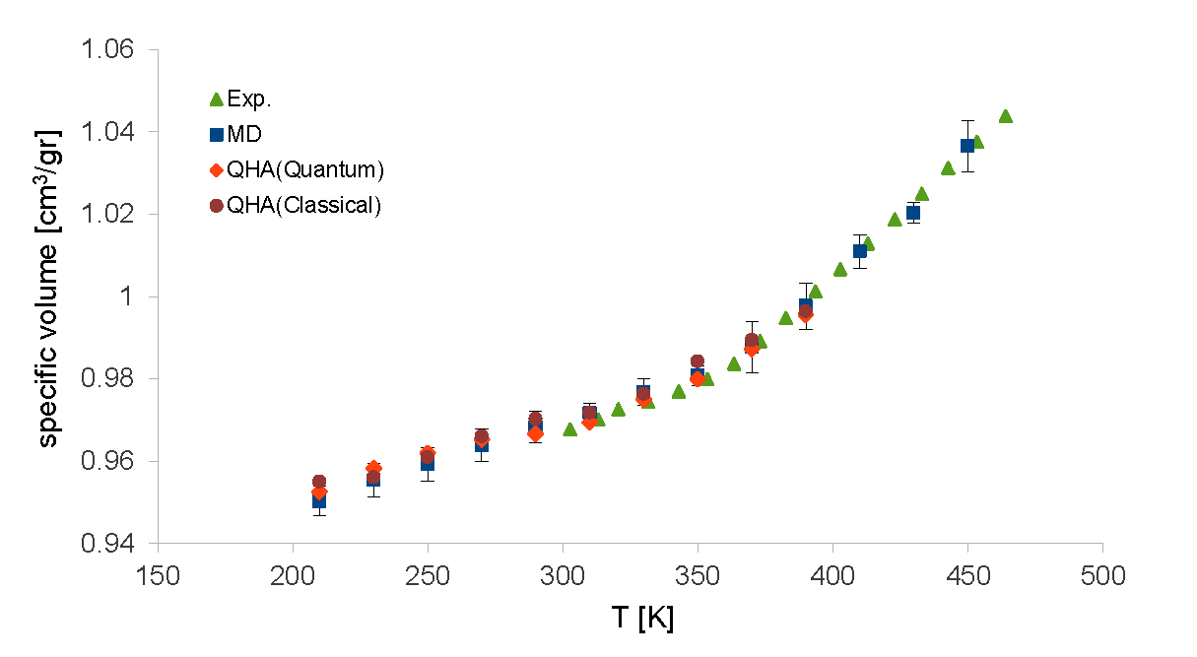
Volumetric Behavior: QHA vs. MD
Atactic polystyrene, modified A.Lyulin* model
Pressure 1 bar
MD cooling rate 0.5 K/ns
641 united atoms
Averages over 5 basins
Lempesis, N.; Vogiatzis, G.G.; Boulougouris, G.C.; van Breemen, L.C.A.; Hütter, M.; DNT, Mol. Phys. 2013, 111, 3430.
Exp: Zoller, P.; Walsh, D.J. Standard Pressure-Volume-Temperature Data for Polymers. Technomic: Lancaster, 1995.
*Lyulin, A.V.; DeGroot, J.; Michels, M. Macromol. Symp. 2003, 191, 167.
Notes:
Debye temperature around 100 K

Slide 19
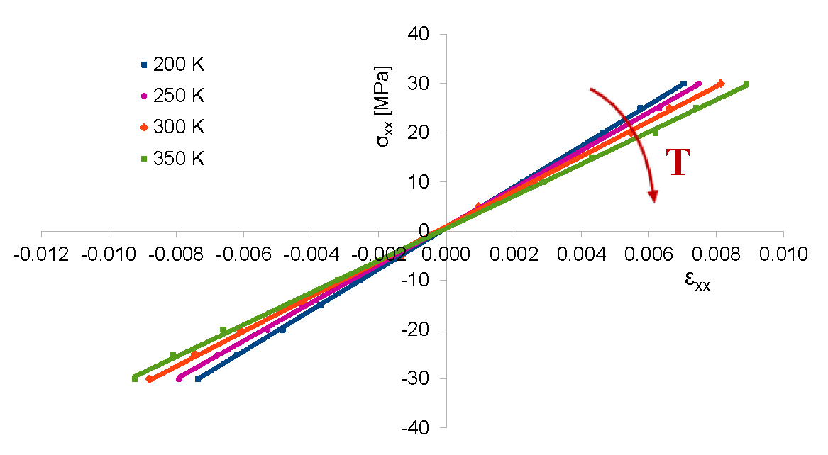
Elasticity of Polymer Glasses: Quasi-harmonic approximation
200 computational “specimens”, p=1 bar
Glassy atactic polystyrene (PS) | Computation | Experiment
Young’s modulus E (GPa), 300 K | 3.55 | 3.2-3.7
dE/dT (MPa/K) | -6.0 | -4.48
Poisson ratio ν | 0.35 | 0.33
dν/dT (K⁻¹) | 0.00022 | 0.00015
Lempesis, N; Vogiatzis, G.G.; Boulougouris, G.C.; van Breemen, L.C.A.; Hütter, M.; DNT, Mol. Phys. 2013, 111, 3430.

Slide 20

Relaxation in glasses: Energy landscape picture
Determine saddle points
out of initial basin A.
Discover new minima
Through each saddle point, determine reaction path
Calculate transition rates
C
B
A
D
network topology
energy landscape
‡
C
B
D
A

Slide 21
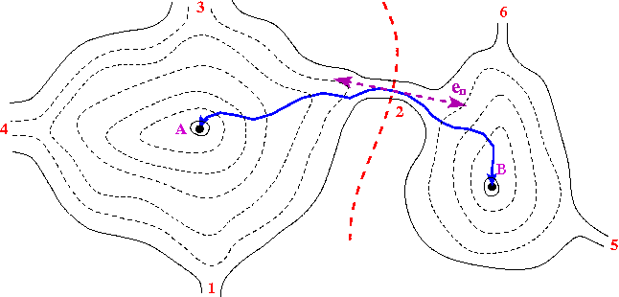
ELEMENTARY TRANSITIONS BETWEEN BASINS
‡
Determine saddle points (1, 2, 3, 4, …) out of current basin A. “Dimer method”, G. Henkelmann and H. Jónsson, J. Chem. Phys. 111, 7010 (1999).
Through each saddle point, determine reaction path “Intrinsic Reaction Coordinate”, K. Fukui Acc.Chem.Res. 14, 363 (1981).
First step on either side in the direction of the eigenvector correspon- ding to the negative eigenvalue of the Hessian:
Subsequent steps in steepest descent direction:
Estimate transition rate constants via Transition State Theory
‡
Quasi-harmonic approximation

Slide 22
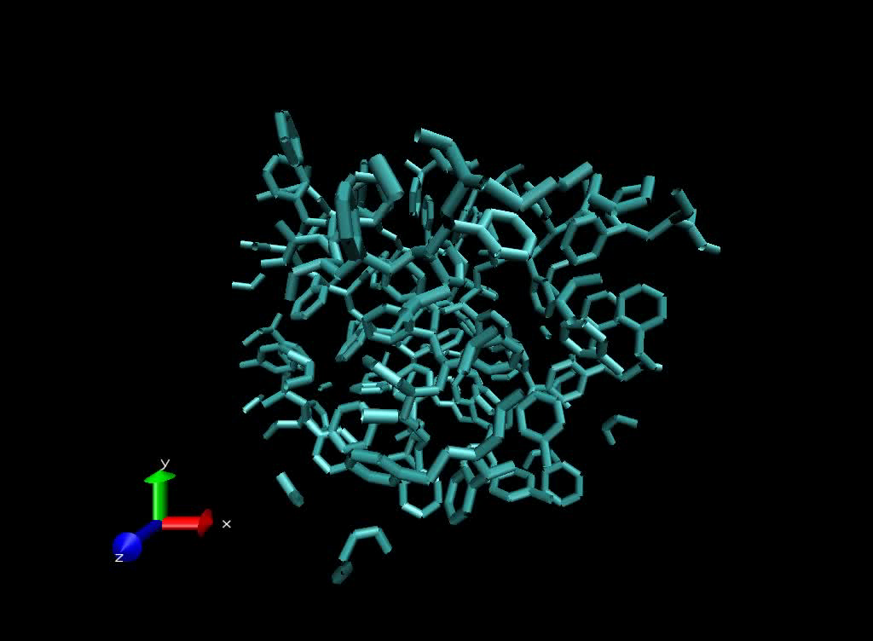

Slide 23
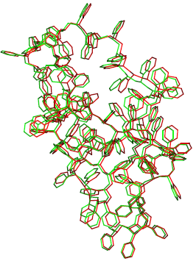
Energy profile along an elementary transition
a-PS, T=250 K ,P = 1 bar, β=1/(k_{B}T)
βV
, Å

Slide 24
TRACKING THE EVOLUTION OF THE PROBABILITY DISTRIBUTION
AMONG STATES BASED ON A FIRST PASSAGE SAMPLING SCHEME
Distinguish between “explored” states (paths leading out of them determined), and “boundary” states (connected to explored states but not yet explored themselves).
Explored
Boundary
Time-dependent probability of occupancy of each explored state determined by analytical solution of master equation:
Set of explored states augmented by appending a boundary state at an appropriately chosen time based on first passage time analysis.
Analytical solution of master equation, with atomistically calculated rate constants, in a network of states that is progressively augmented “on the fly”
Set of boundary states updated by including neighbours of newly added state.
“Dynamical Integration of a Markovian Web” (DIMW): G. Boulougouris and DNT, J. Chem. Phys. 127, 084903 (2007)

