Slide 1
TRACKING THE DYNAMICS OF SYSTEMS EVOLVING THROUGH INFREQUENT TRANSITIONS IN A NETWORK OF DISCRETE STATES
Doros N. Theodorou
School of Chemical Engineering, Department of Materials Science and Engineering, National Technical University of Athens, Zografou Campus, 157 80 Athens, GREECE
doros@central.ntua.gr

Slide 2
MOTIVATION
Atomistic molecular dynamics simulation: μs time scales. [see, however, ms-long simulations of K.Lindorff-Larsen, S. Piana, R.O. Dror, D.E. Shaw, Science 334, 517-520 (2011)].
Dynamics of most physical, chemical, materials, biological systems: s to years.
In many cases, dynamics is slow because the system spends most of its time trapped within relatively narrow regions of configuration space and only infrequently jumps from region to region.

Slide 3
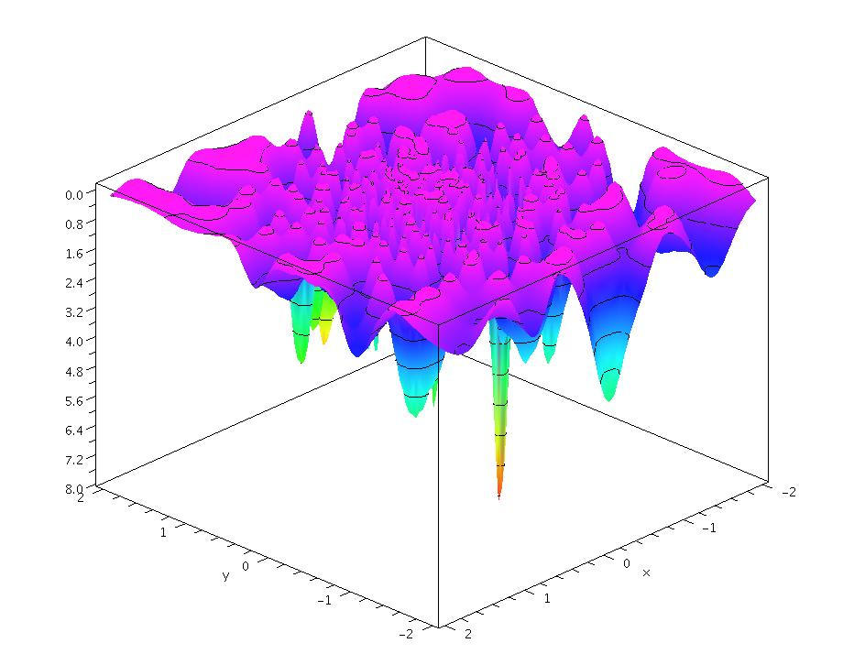
RUGGED ENERGY LANDSCAPES
Potential energy V (x), or
potential of mean force U(x)
atomic coordinate or collective variable (“order parameter”)
x₂
x₁
Minima: “inherent structures” F. H. Stillinger, Science 267, 1935 (1995).
(Collections of) basins of attraction around minima: “states”.
The entire x-space can be tessellated into states.

Slide 4
EXAMPLES OF PHENOMENA INVOLVING EVOLUTION ON RUGGED ENERGY LANDSCAPES
Diffusion of defects and impurities in metals and semiconductors
Permeation of gas molecules through amorphous polymers
Diffusion of bulky hydrocarbons in zeolites
Structural relaxation and plastic deformation of glassy materials
Protein folding
Nucleation in first order phase transitions
Phase transitions in molecular and atomic clusters
Kinetics of networks of chemical reactions

Slide 5
OUTLINE
Infrequent events, calculation of transition rate constants
Kinetic Monte Carlo simulation
Master Equation: its analytical solution and calculation of time correlation functions
Low-temperature diffusion of Xe in Silicalite-1: Comparative application of various methods
The energy landscape picture for glasses
A method for tracking structural relaxation in glasses: Application to atactic polystyrene
The lumping problem

Slide 6
TRANSITION RATE CONSTANT
Time scale separation: Mean waiting time for transition out of a state is long in comparison with the time required for system to establish a restricted equilibrium among configurations in the state.
t_{cor} << t_{rxn}
By the time it exits a state, the system has lost all memory of how it entered there (Markovian character of a sequence of infrequent events).
Rate constant k_{i→j}: Probability per unit time that a transition to state j will occur, provided the system is in state i.

Slide 7
COMPUTATION OF RATE CONSTANTS
Input: Energy hypersurface and masses associated with degrees of freedom.
Molecular dynamics (MD), reduction to an inherent structure trajectory and hazard plot analysis [E. Helfand, J. Chem. Phys. 69, 1010 (1978)]
Temperature-accelerated dynamics [M. R. Sørensen, A.F. Voter, J. Chem. Phys. 112, 9599 (2000)]
Transition-State Theory estimate from free energy difference between the system confined to the boundary hypersurface of state i and the system allowed to sample the entire state i. Calculation of dynamical correction factor through short MD trajectories initiated on the boundary hypersurface [C.H. Bennett, 1975; D. Chandler, J. Chem. Phys. 68, 2959 (1978), A.F. Voter and J.D. Doll, J. Chem. Phys. 82, 80 (1985)].

Slide 8
COMPUTATION OF RATE CONSTANTS
Determination of reaction path (e.g., by Fukui’s intrinsic reaction coordinate approach) and computation of free energy profile along the path by umbrella sampling or “blue moon ensemble” simulations [T.R. Forester, W. Smith J. Chem. Soc. Faraday Trans. 93, 3249 (1997)]
Flux-tempered metadynamics [S. Singh, C.C. Chiu, J. de Pablo J. Stat. Phys. 144, 1 (2011); A. Laio, M. Parrinello, Proc. Natl. Acad. USA 99, 12562 (2002)]
Transition path sampling [P.G. Bolhuis, D. Chandler, C. Dellago, P.L. Geissler Annu. Rev. Phys. Chem. 53, 291 (2002); C. Dellago, P.G. Bolhuis, P. Geissler Adv. Chem. Phys. 123, 1 (2002)]

Slide 9
CALCULATING RATE CONSTANTS FOR TRANSITIONS BETWEEN BASINS
Definitions:
Hazard rate h(t): Conditional probability that a system, which has survived a time t since its last transition, will undergo a transition between t and t+dt is h(t) dt.
Cumulative hazard H(t):
Probability that a transition occurs in time less than t since the last transition:
Poisson process: h(t) = λ, a constant. H(t)= λt, P(t)=1−exp(− λt)
Notes:
P(t) = cumulative probability density function for residence times.
One has: 1-P(t+Δt) = [1-P(t)] [1-h(t)Δt]

Slide 10
CALCULATING RATE CONSTANTS FOR TRANSITIONS BETWEEN BASINS
Hazard Plot Analysis Helfand, E. J. Chem. Phys. 69, 1010 (1978)
In the course of MD simulation, for any visited basin, β, record residence times between entry to and exit from the basin. Also record the basins γ to which exits from β occur.
Order residence times in β:
Estimate cumulative hazard corresponding to residence time t_{k}:
Linear plot going through the origin indicates a Poisson process.
Residence time t_{k} (ps)
Slope of plot, λ_{β} = total rate constant for exiting basin β.
Rate constant
Notes:
By definition, H(t) = -ln[1-P(t)]
with P(t) = probability for a transition out of the state to have occurred in time less than t.
Estimate of P(t) based on recorded transitions: P(t) = k/n
The sum on the right hand side of H^hat(t_k) can be viewed as an approximation of integral, from 0 to k/n , of 1/(1-x) dx.= -ln(1-k/n)

Slide 11
SEQUENCE OF INFREQUENT EVENTS IS A HOMOGENEOUS POISSON PROCESS
Numbers of occurrences counted in disjoint time intervals are independent of each other.
Probability distribution of occurrences counted within any time interval only depends on the length of the interval.
No counted occurrences are simultaneous.
Number of observed occurrences within a given time interval follows a Poisson distribution:
Waiting time until the next occurrence follows an exponential distribution:
Several Poisson processes i occurring in parallel constitute a Poisson process with rate constant .

Slide 12
KINETIC MONTE CARLO (KMC) SIMULATION
Generation of stochastic trajectories as sequences of transitions between states in a network of n states
Deploy N >> n independent walkers among the states according to a prescribed initial probability distribution: N_{i} (t) ≈ N P_{i}(0), i=1, 2, …, n
For each state i that is occupied at time t, calculate expected fluxes R_{i→j}(t) = N_{i} (t) k_{i→j} , overall flux R(t) = Σ_{i}Σ_{j}R_{i→j}(t) and conditional probabilities q_{i→j}(t) = R_{i→j}(t)/ R(t).
(ii) Pick time until next transition Δt=−ln(1−ξ)/R(t), where ξ [0,1) is a uniformly distributed pseudorandom number. Pick type i→j of next transition according to q_{i→j}(t).
(iii) Of the N_{i} (t) walkers present in state i pick one with probability 1/ N_{i} (t) and move it to state j.
(iv) Advance simulation time by Δt. Update array keeping track of current positions of all walkers. Set N_{i} (t+ Δt) = N_{i} (t) − 1, N_{j} (t+ Δt) = N_{j} (t) + 1.
(v) Return to step (i).

Slide 13
MASTER EQUATION
P_{i}(t): Probability of being in state i at time t.
Transition rate constant matrix
i
k_{i→j}
vector of state probabilities
k_{j→i}
or
j
t→∞ : dP/dt=0, k_{i→j} P_{i}(∞)= k_{j→i} P_{j}(∞)
equilibrium state probabilities
(microscopic reversibility)
Need to solve the master equation starting from an initial probability distribution among states P(0).

Slide 14
MASTER EQUATION: ANALYTICAL SOLUTION
P(0) given
Define reduced state probabilities:
given
Matrix is symmetric (microscopic reversibility)
Matrix is negative semidefinite
Real eigenvalues λ₀=0 ≥ λ₁ ≥ λ₂ ≥ … ≥ λ_{n-1}
Eigenvector corresponding to λ₀=0 is
K.E. Shuler, Phys. Fluids 2, 442 (1959).
J. Wei, C.D. Prater, Advan. Catal. 13, 204 (1962).
N. V. Buchete, G. Hummer, J. Phys. Chem. B 112, 6057 (2008).
G. Boulougouris, DNT, J. Chem. Phys. 130, 044905 (2009).

Slide 15
MASTER EQUATION: ANALYTICAL SOLUTION
Diagonalization of permits writing down an analytical solution to the master equation.
Eigenvalues λ₀=0 ≥ λ₁ ≥ λ₂ ≥ … ≥ λ_{n-1}
Eigenvectors
Orthonormality:
,
Solution of the master equation:
K.E. Shuler, Phys. Fluids 2, 442 (1959).
J. Wei, C.D. Prater, Advan. Catal. 13, 204 (1962).
N. V. Buchete, G. Hummer, J. Phys. Chem. B 112, 6057 (2008).
G. Boulougouris, DNT, J. Chem. Phys. 130, 044905 (2009).

Slide 16
EROPHILE: Eigenvalue Representation of Observables and Probabilities in a HIgh-dimensionaL Euclidean space
For any observable A, which has well-defined values A_{i} within each state i, nonequilibrium ensemble average value at time t is:
Time autocorrelation function is:
where
Eigenvalues and eigenvectors of symmetrized n×n rate constant matrix describing transitions among n explored states (relaxation modes)
∞: equilibrium among the n explored states.
G. Boulougouris and DNT, J. Chem. Phys. 130, 044905 (2009)

Slide 17
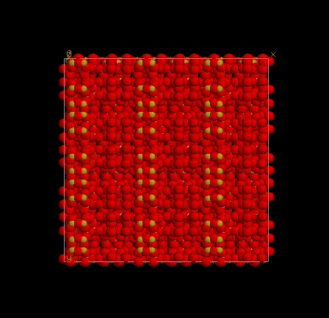
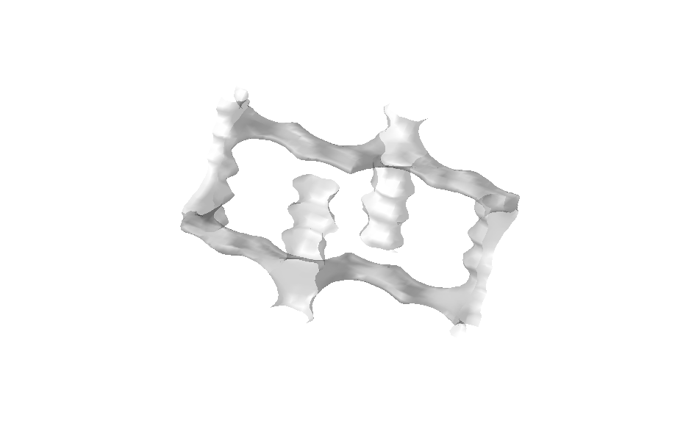
EXAMPLE APPLICATION: LOW TEMPERATURE, LOW OCCUPANCY DIFFUSION OF XENON IN SILICALITE-1
Silicalite-1 (MFI)
Si₉₆O₁₉₂
Pnma
a = 20.07 Å
b = 19.91 Å
c = 13.42 Å
(3 × 3 × 3
unit cells shown)
y
x
z
Made up of SiO₄ tetrahedra sharing vertices.
Straight and sinusoidal (zigzag) channels of diameter ≈ 5.5 Å

Slide 18
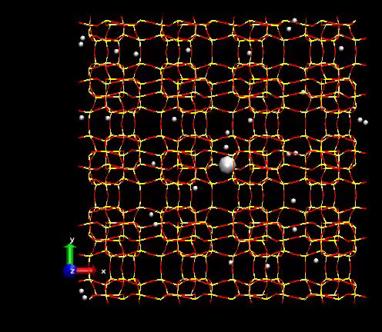
Xe/SILICALITE-1, 300 Κ
MD simulation
E. Pantatosaki and G.K. Papadopoulos
Notes:
8 unit cells shown. Concentration 4 molecules per unit cell. 300Κ.

Slide 19
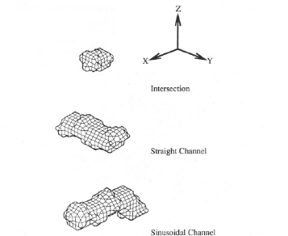
TRANSITION STATE THEORY ANALYSIS OF Xe/Silicalite-1, 150 K
I
S
Z
-a/4, b/2
a/4, b/2
y
1
2
3
4
6
5
x
1
3
y
2
z
-a/4, 0
a/4, 0
x
R.L June, A.T. Bell, and DNT J. Phys. Chem. 95, 8866 (1991)
Notes:
8 unit cells shown. Concentration 4 molecules per unit cell. 300Κ.

Slide 20
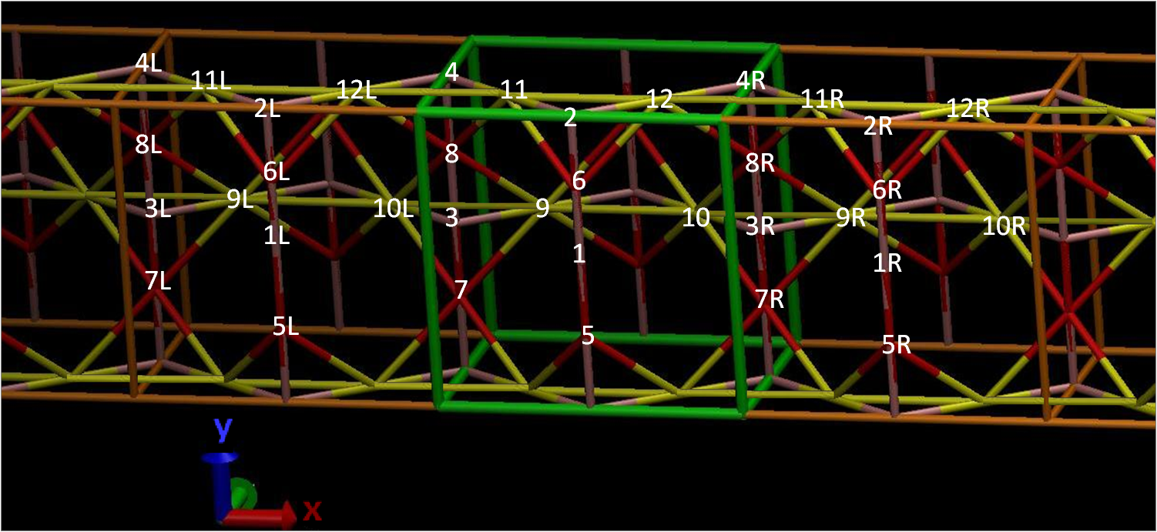
P_{I}(∞) | 0.014
P_{S}(∞) | 0.412
P_{Z}(∞) | 0.574

