Slide 1
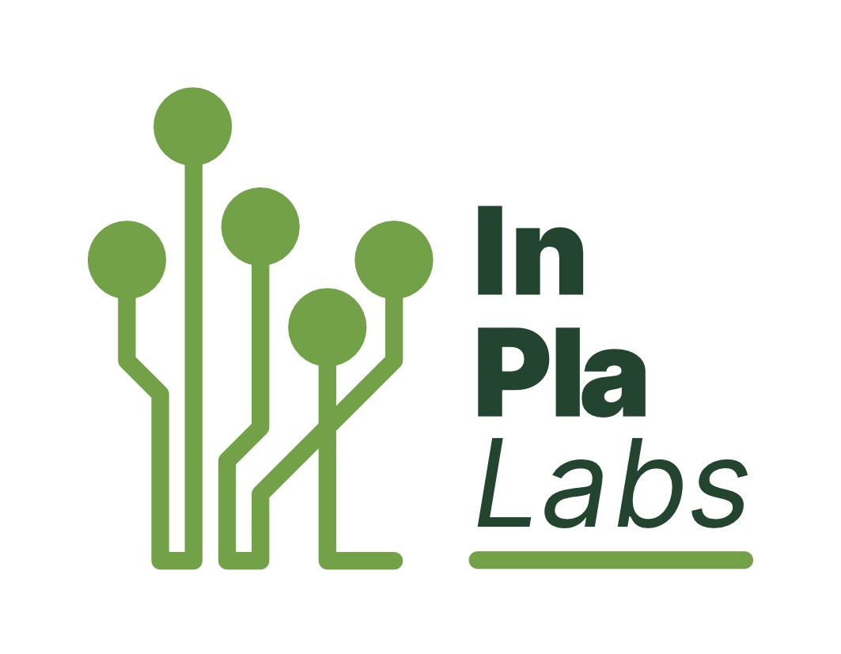







Transnational Network of Integrated Planning Labs:
Co-creating knowledge on forward-looking transdisciplinary planning perspectives addressing climate change and urban life in the post-pandemic city
Project number: 2023-1-EL01-KA220-HED-000160477 Erasmus+
Tools (digital and physical) for participatory planning
June 5th, 2025
Project: Erasmus+ 2023-1-EL01-KA220-HED-000160477
Co-funded by the European Union. Views and opinions expressed are however those of the author(s) only and do not necessarily reflect those of the European Union.
Neither the European Union nor the granting authority can be held responsible for them.

Slide 2

Selection Criteria
Number of participants
Geographical & thematic scope
The level of stakeholder engagement
Spectrum of Public participation
The mode of communication
Type of methods
Knowledge needs and the mode of working
The planning phase
Skills and resources required

Slide 3
Participatory Tool Categories
Physical
Digital (Synchronous and Asynchronous)
Hybrid

Slide 4
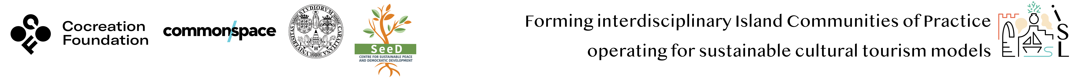
Workshop Goals
Mapping
Brainstorming
Collective walks
Good Practices
Visioning
Co-creation of cultural routes
* to map local cultural elements and create routes
*to shape together the future image (vision) of a sustainable tourism model for the island as it emerges from the values of the people who are active in the fields of culture and tourism on the island
*to learn to work together to achieve a common vision

Slide 5
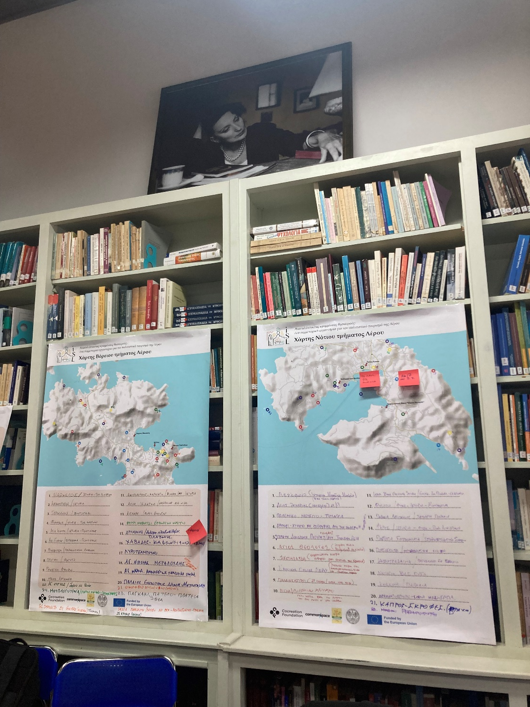
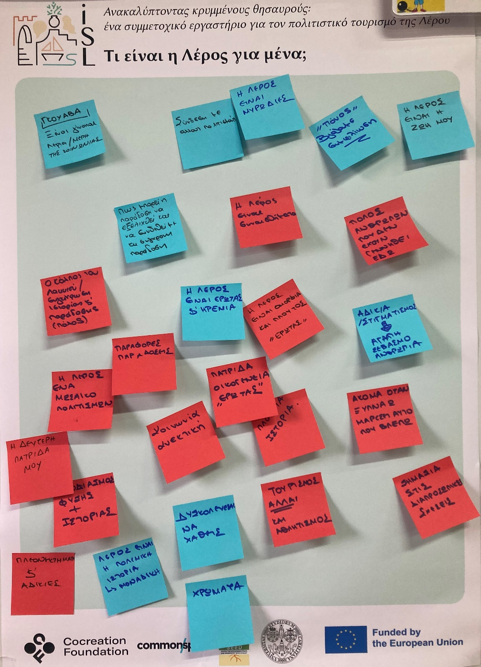
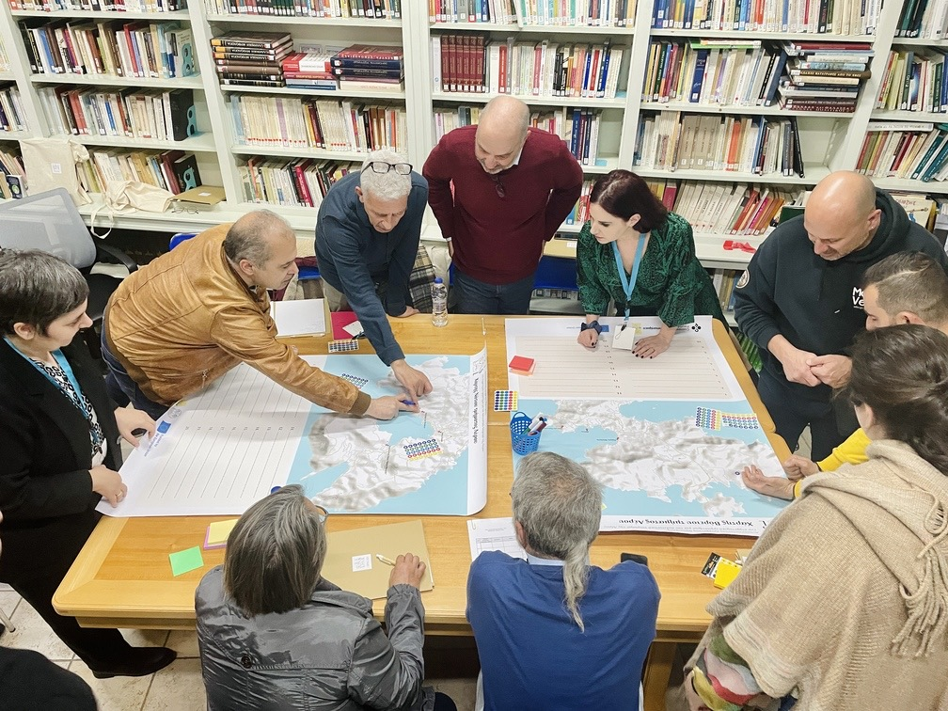
1st Stop: Leros island, Greece
More than 50 points on the map
People expressed that Leros means: “their home”, “hospitality”, “acceptance”, “friendship”
More than 50 points on the map mostly representing the military history of the place

Slide 6
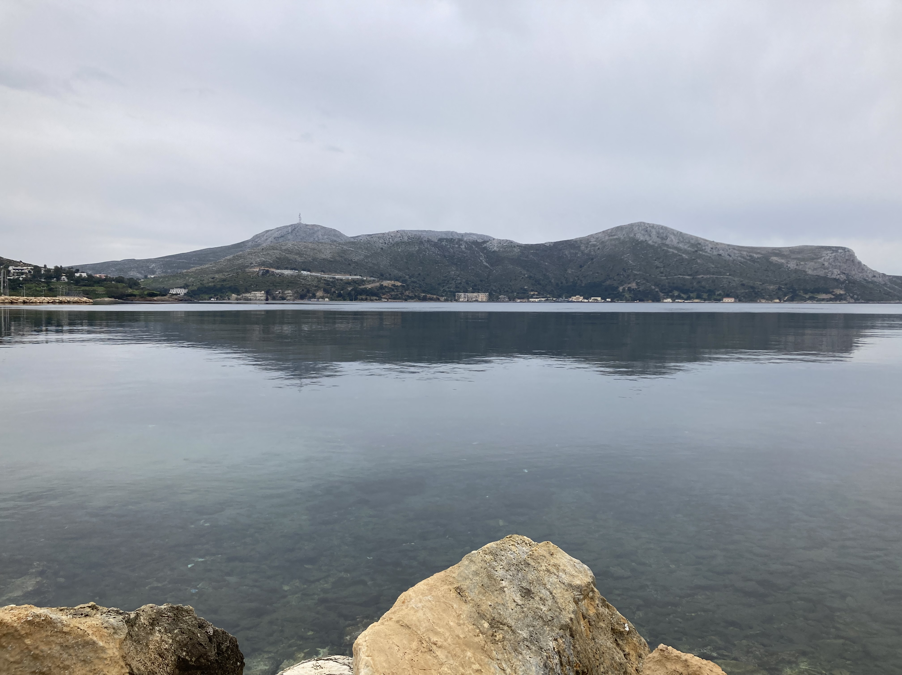
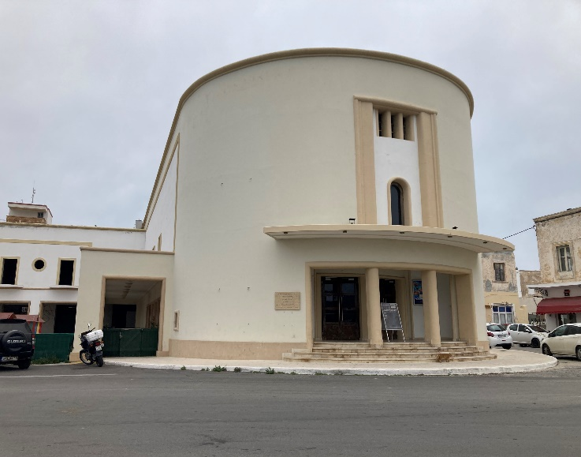
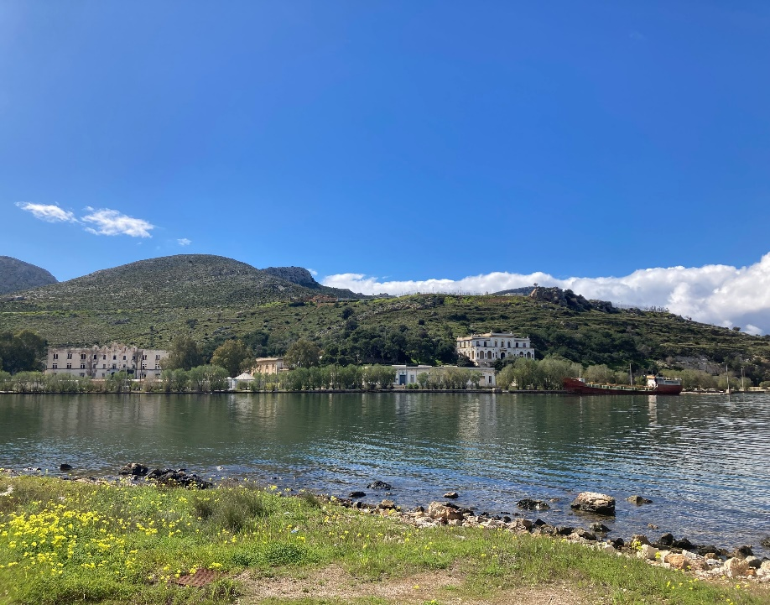
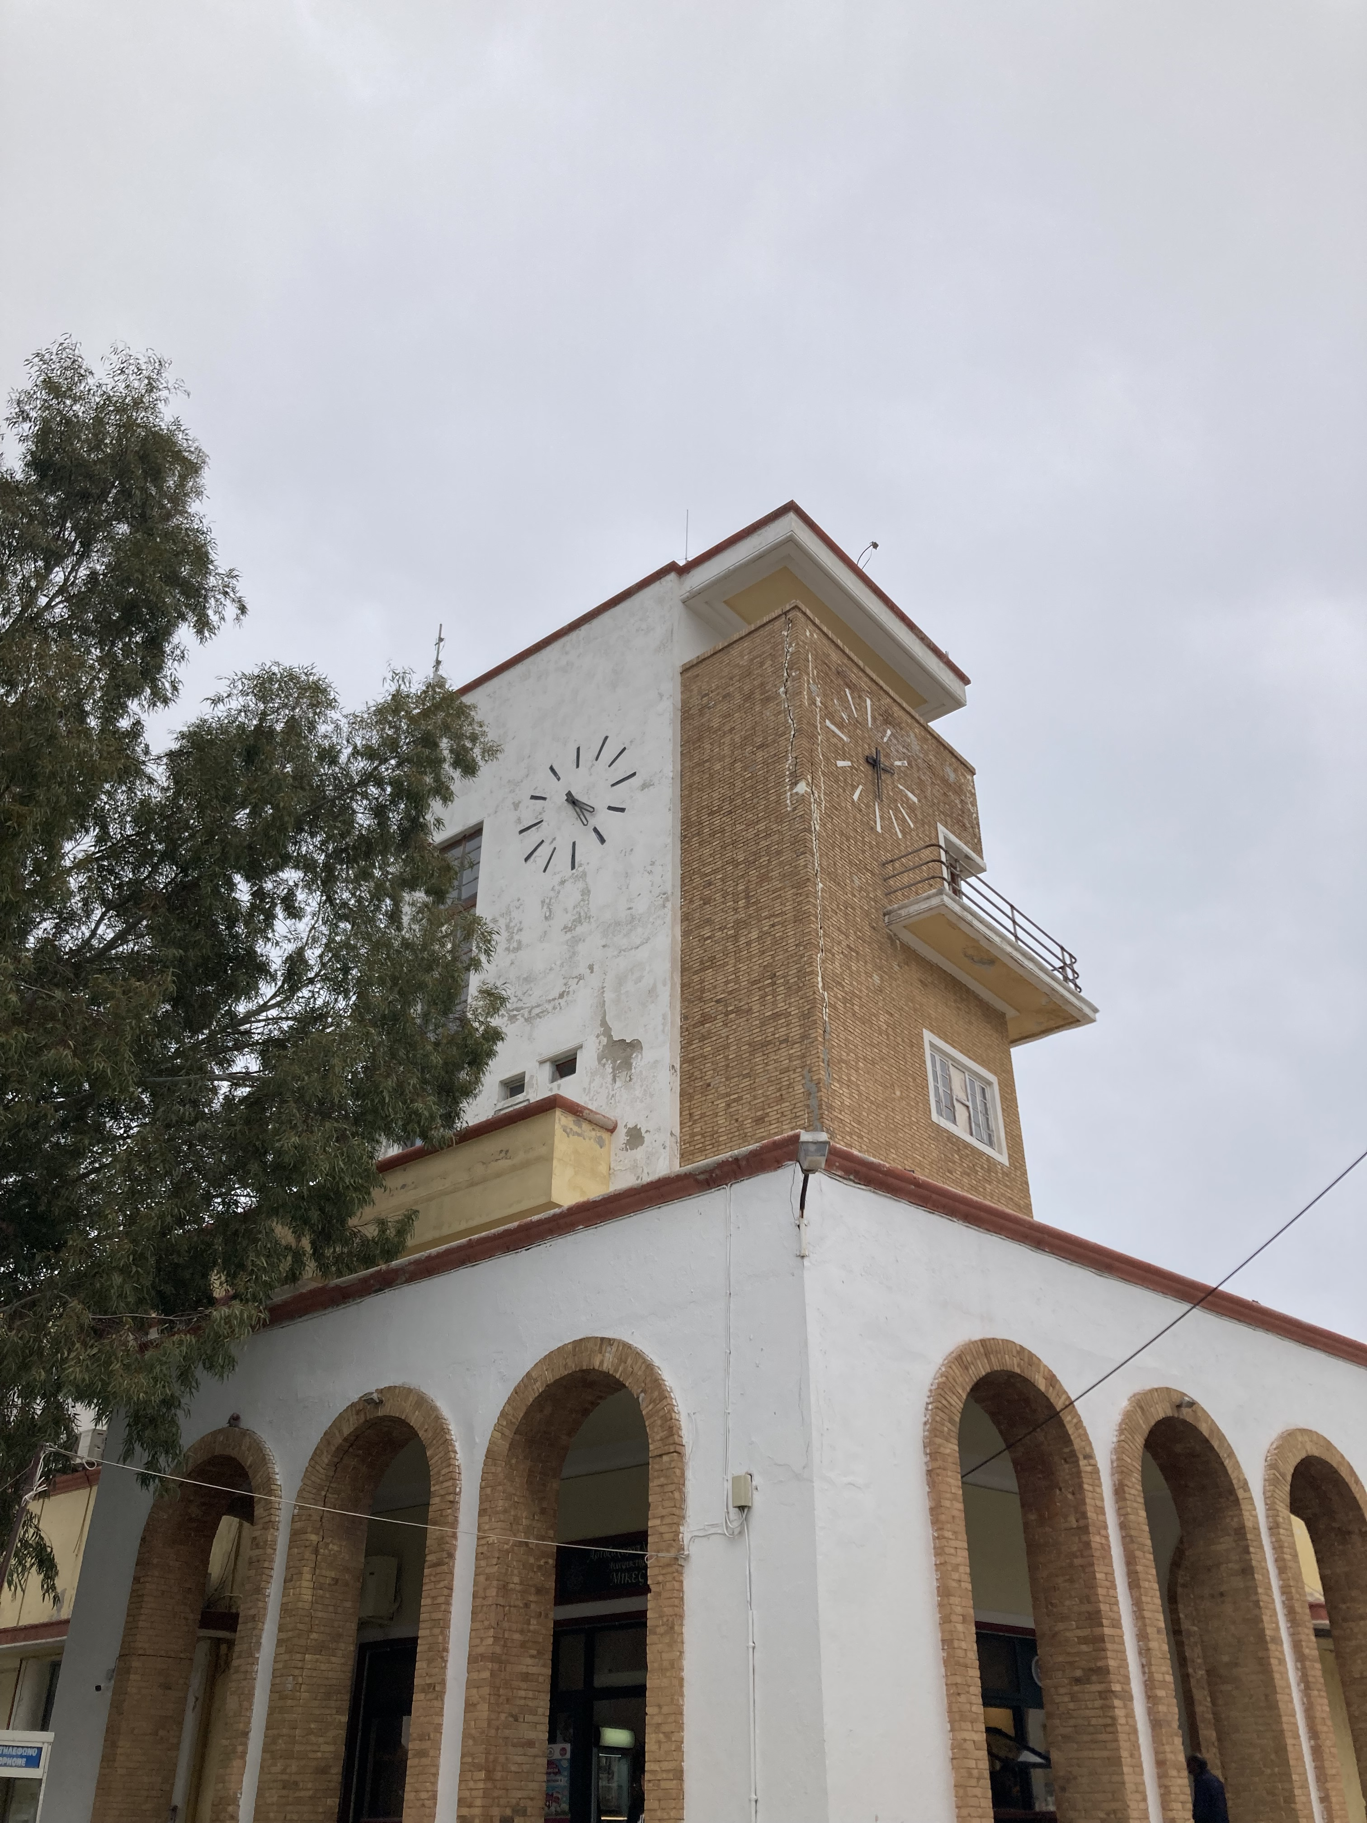
Collective Walk

Slide 7
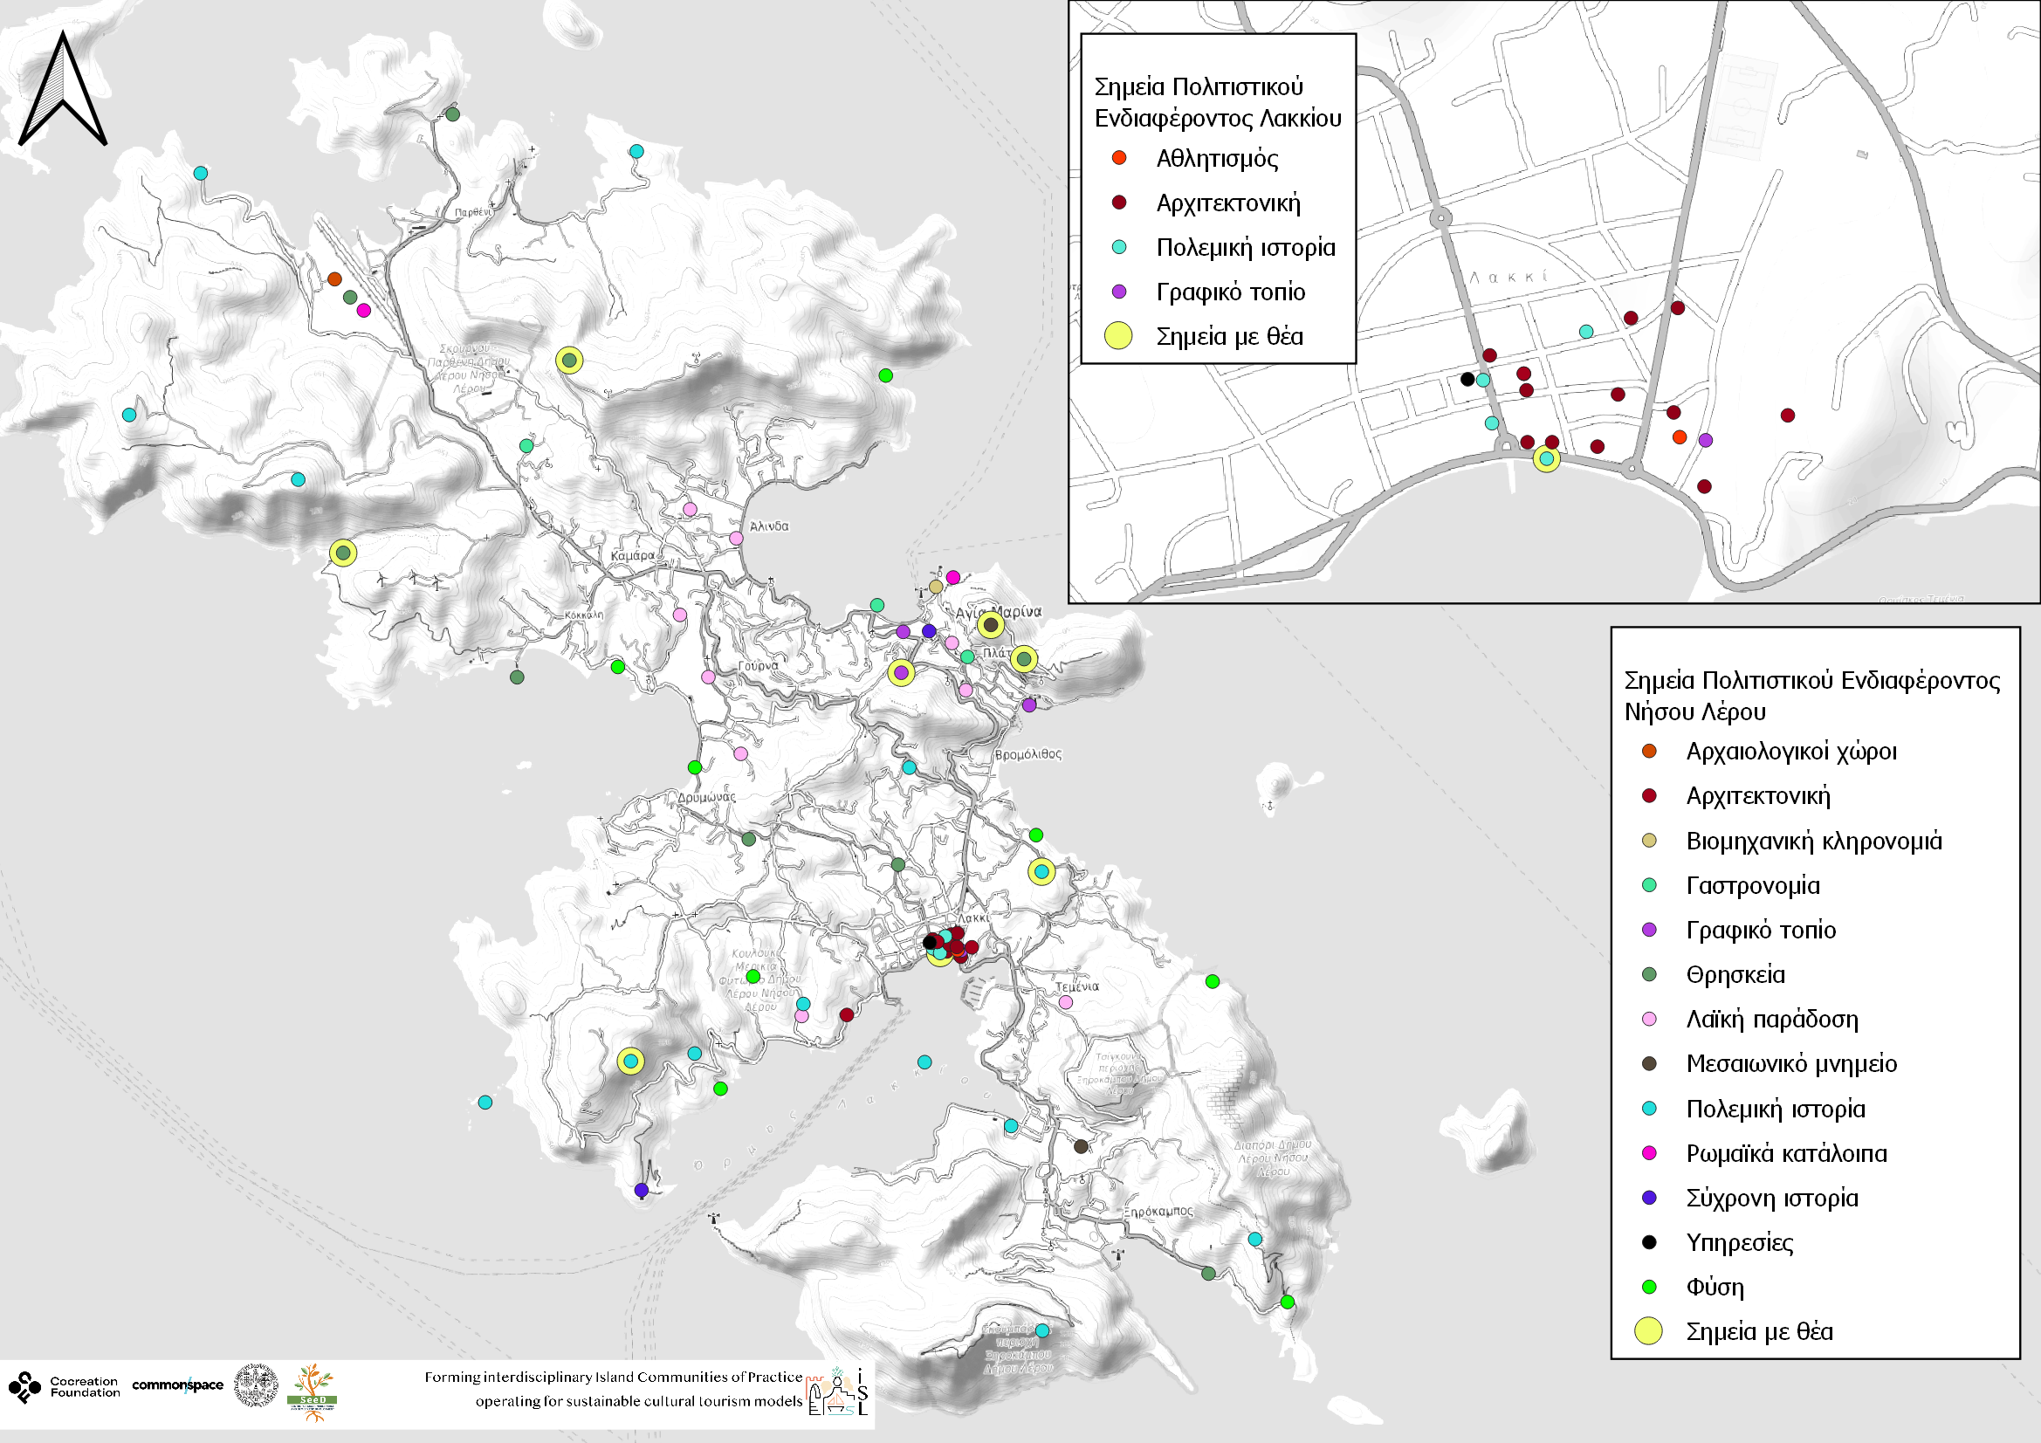
Leros’ island workshop
Mapping results

Slide 8
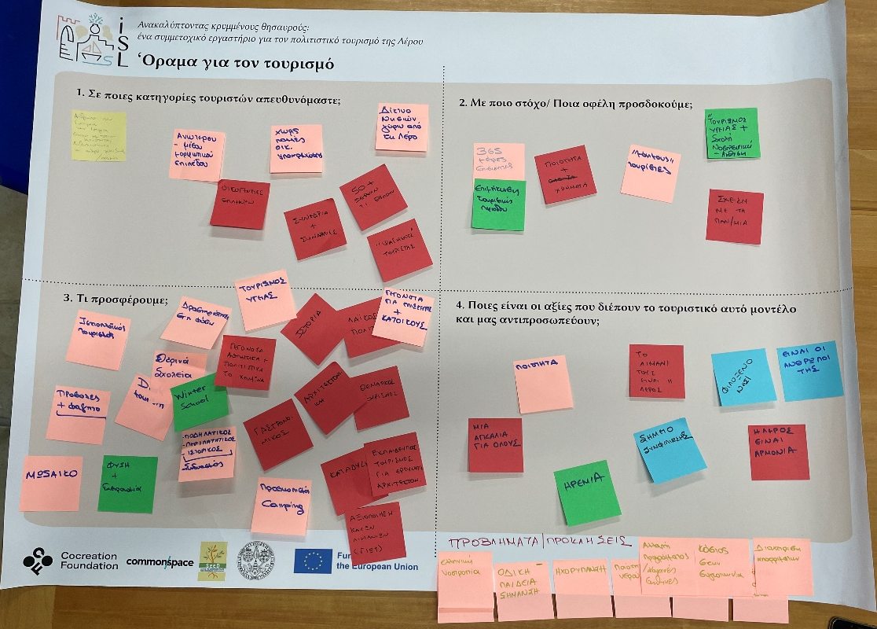
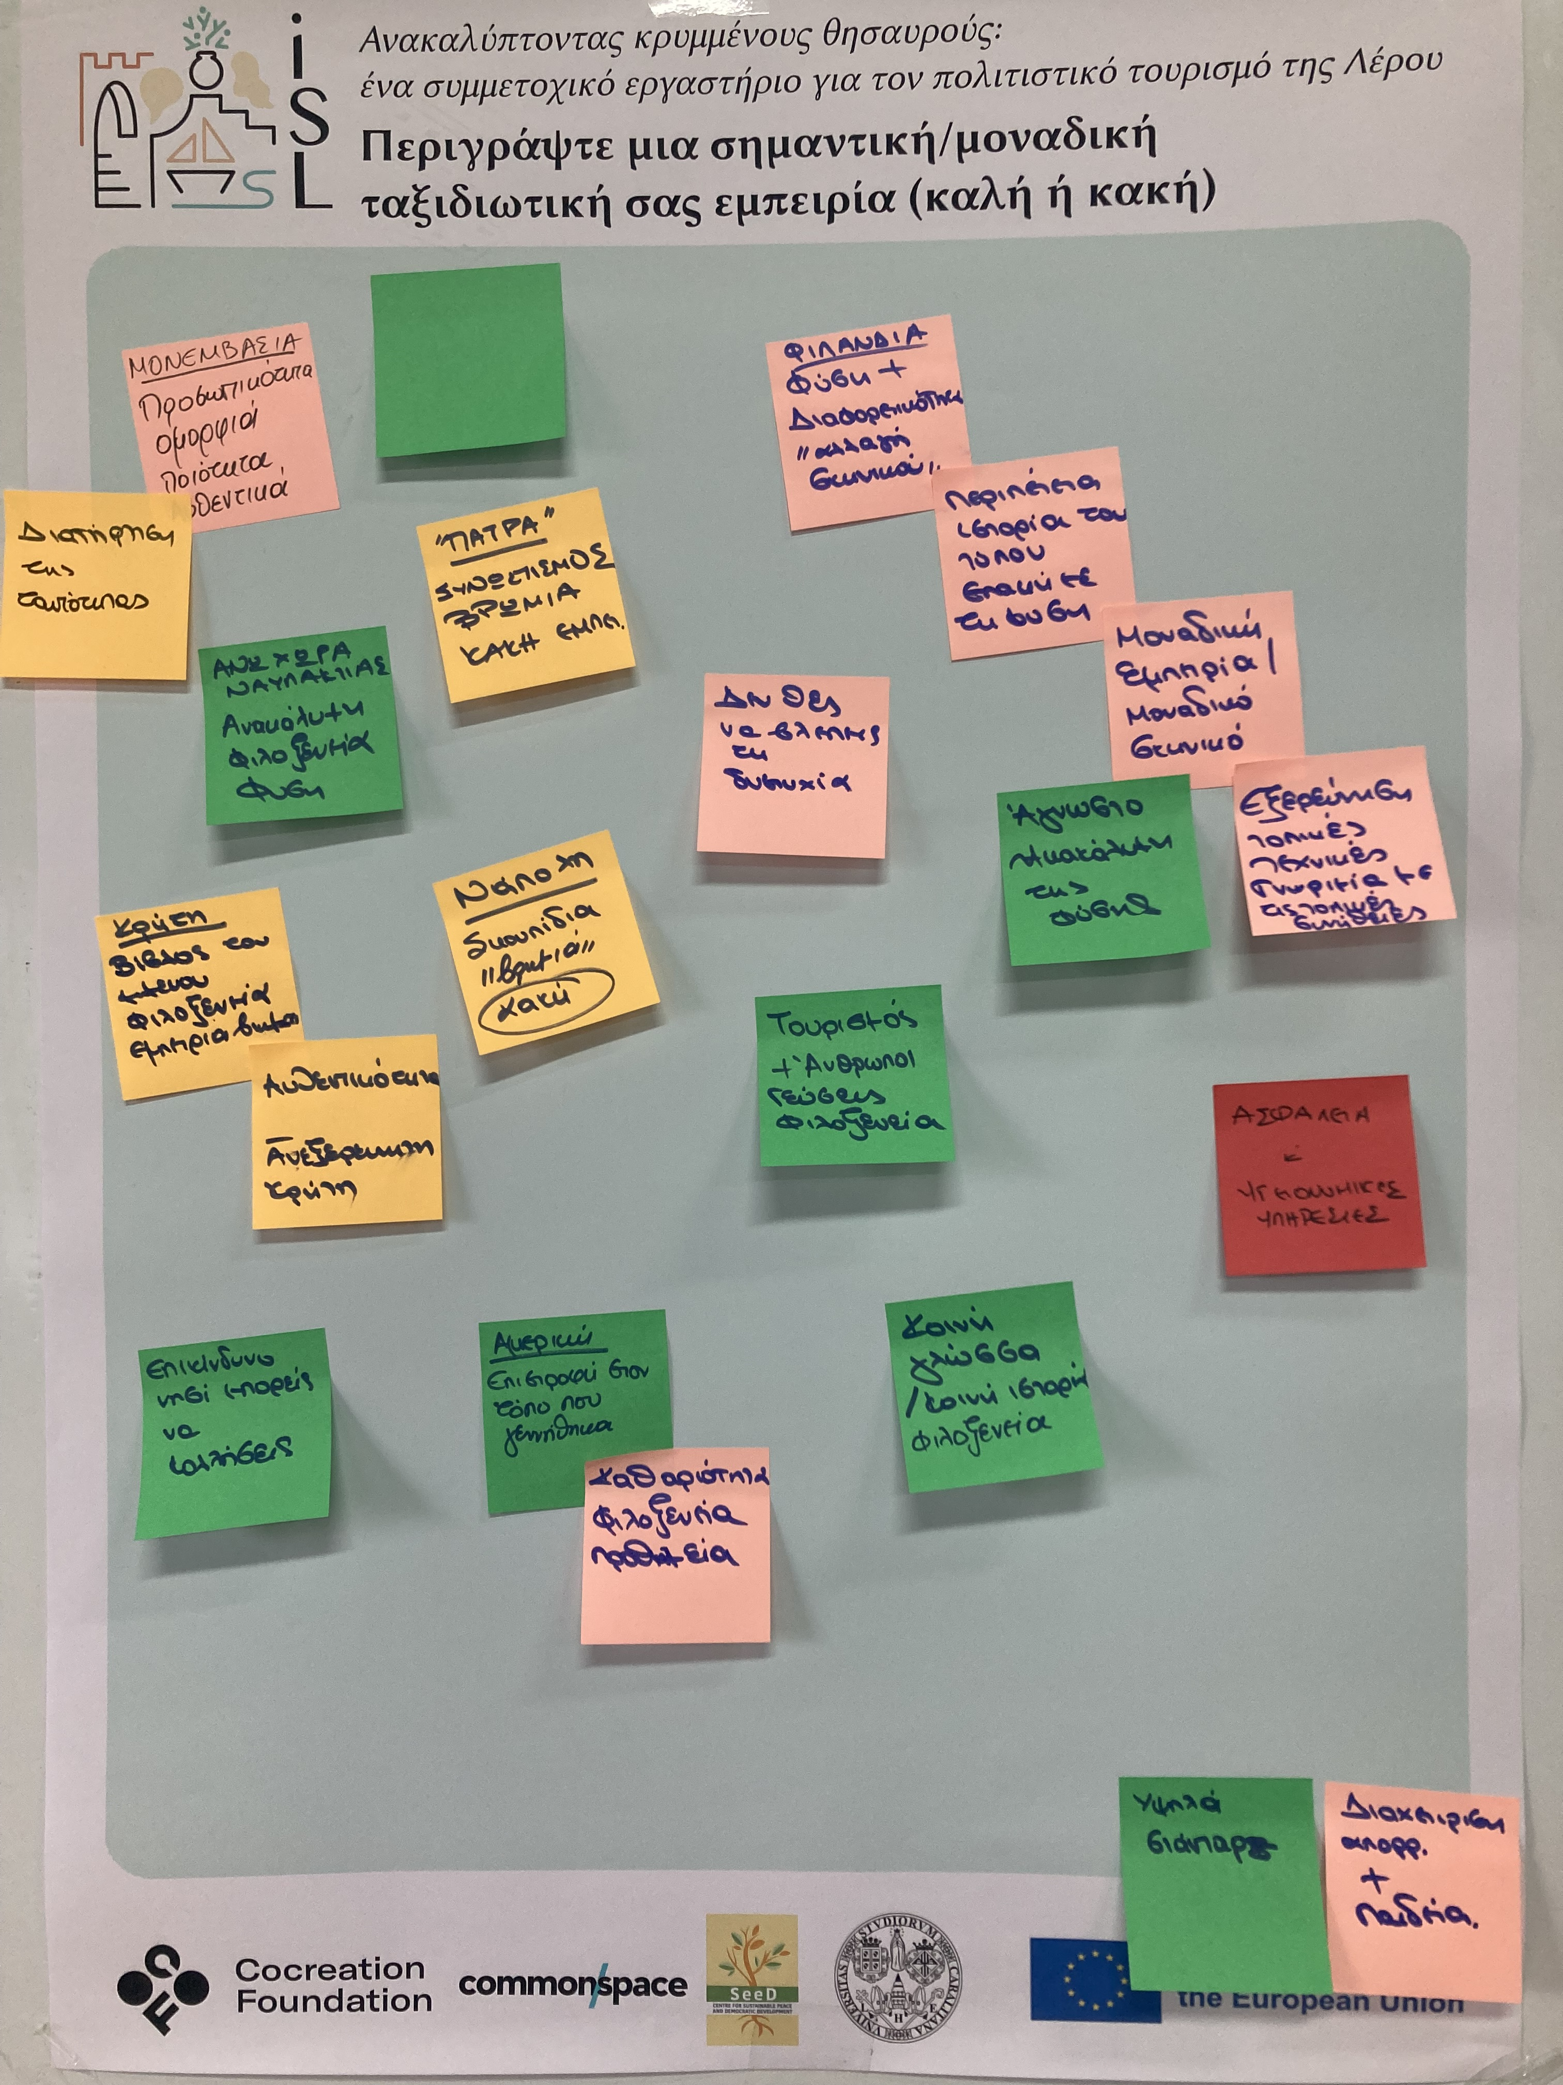
Part 2: Visioning
"Leros as a destination that attracts high quality visitors, who create strong relationships with the island and visit it on a regular basis, with the aim of extending the tourist season, preserving its identity and promoting a model that focuses on people and values such as reconciliation, tranquility, harmony"

Slide 9

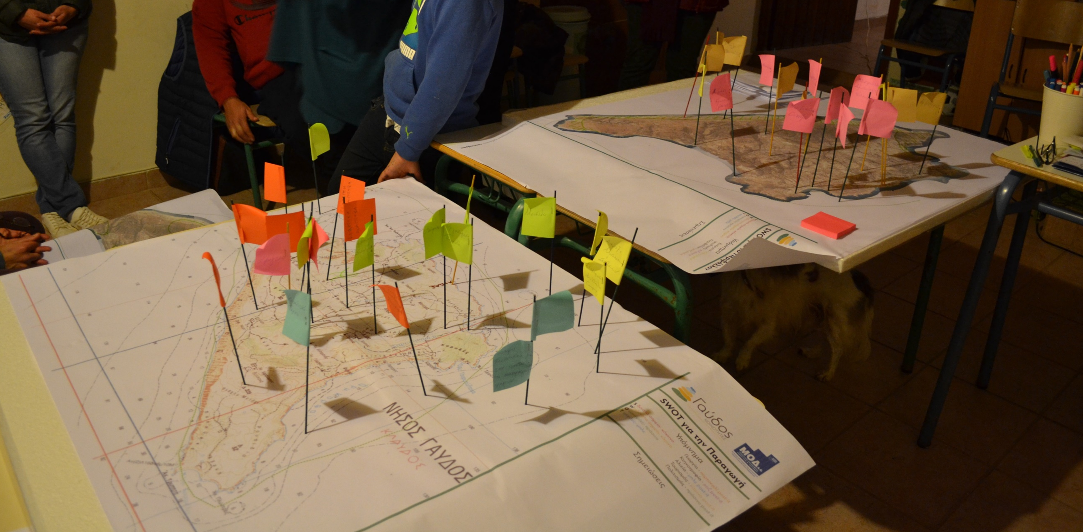
Basic Facilitation Materials
Sticky notes / Post-its
Index cards
Flipcharts / large sheets of paper
Markers and pens (various colors)
Whiteboards and dry-erase markers
Dot stickers for voting or prioritization
Clipboards and writing pads
Physical tools
Visual and Mapping Tools
Large printed maps or plans
Templates for diagrams and mind maps
Model-making materials (foam board, cardboard, clay, LEGO)
Magnetic boards with pieces (for moveable elements)

Slide 10


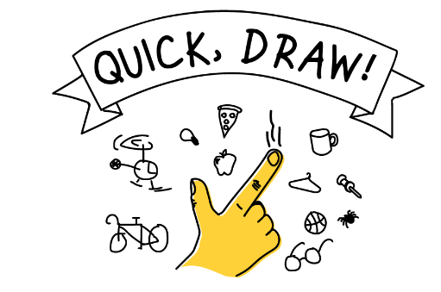
Digital tools
Following the digital era and transformation, digital tools have also dynamically entered how participatory processes are being implemented. Especially during restriction measures forced during the pandemic crisis, digital tools and online participatory processes have increased changing the way physical and online processes are realized.
Examples:
Collaborative Platforms (Miro, Trello, Google Docs)
Mapping Tools (Google Maps, ArcGIS, Maptionnaire, connect2aspire)
Polling/Survey Tools (Mentimeter, SurveyMonkey)
Virtual meeting spaces (Zoom, Gather, Slack)
Sketching tools (Quickdraw)

Slide 11

Digital tools
Data collection and Mobile data collection tools
Data collection is essential for defining project outcomes.
Methods include: surveys, interviews, observations, experiments, focus groups, questionnaires, and secondary data analysis.
Mobile Data Collection (MDC): uses mobile devices (phones, tablets) for easy, real-time data gathering.
MDC can gather quantitative and qualitative data (photos, GPS, voice recordings, list selections).
Many mobile applications exist, varying by cost, features, and usability.

Slide 12
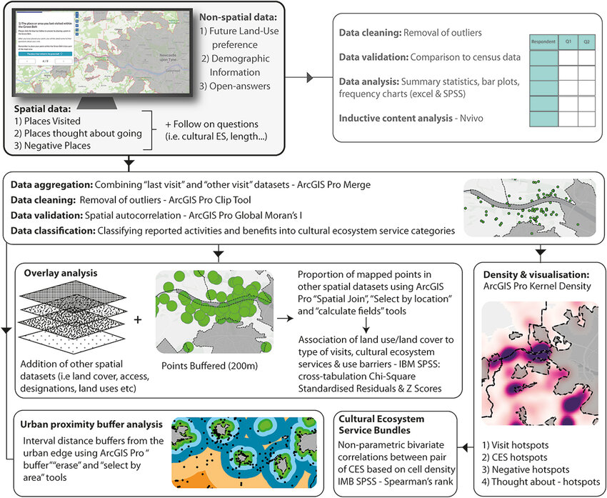
Participatory Planning GIS (ppGIS)
How it works:
A method of using GIS technology to involve communities and stakeholders in spatial decision-making.
Maps created with the community, not for the community.
Key Benefits:
Empowers participants to contribute to spatial data.
Visualizes complex issues (e.g., land use, environmental concerns).
Supports more inclusive and informed planning.
Common Tools:
Open-source GIS (e.g., QGIS)
Web-based mapping platforms (e.g., Maptionnaire, ArcGIS Online)
Mobile mapping apps (e.g., Kobo Toolbox, Collector for ArcGIS)
Source: Kirby et al., (2023)

Slide 13

Blended and Inclusive Approaches
Key Benefits:
Integrated Engagement: Combining digital platforms (e.g., online surveys, virtual meetings) with physical tools (e.g., maps, workshops) enhances participant involvement.
Flexibility: Blended approaches accommodate diverse participant needs and preferences.
Enhanced Data Collection: Utilizing both digital and physical methods enriches the quality and depth of collected data.
Tools:
Digital/physical boards (interactive screens, whiteboards)
QR codes & AR overlays for in-situ engagement
Inclusive toolkits (multi-lingual materials, accessible formats)
Blended sessions for maximum reach

Slide 14
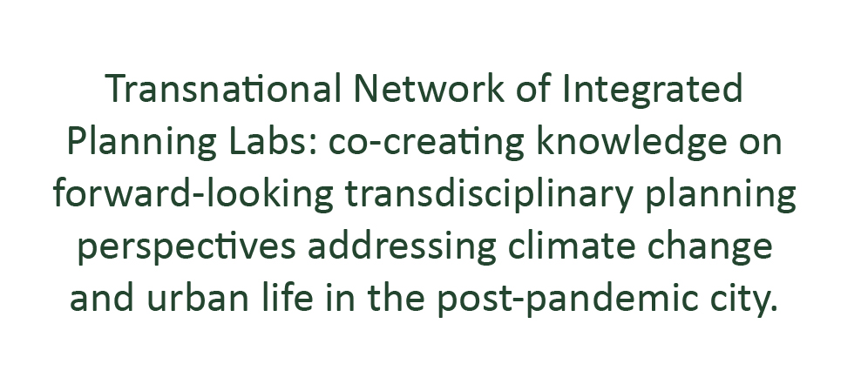


Thank you!

