Slide 1









Project: Erasmus+ 2023-1-EL01-KA220-HED-000160477
Co-funded by the European Union. Views and opinions expressed are however those of the author(s) only and do not necessarily reflect those of the European Union.
Neither the European Union nor the granting authority can be held responsible for them.

Slide 2

Transnational Network of Integrated Planning Labs:
Co-creating knowledge on forward-looking transdisciplinary planning perspectives addressing climate change and urban life in the post-pandemic city
Project number: 2023-1-EL01-KA220-HED-000160477 Erasmus+
InPlaLabs Technical Toolkit
Knowledge Sharing Workshop, 5th June 2025
GIS-based tools and data sources towards climate-resilient integrated planning
Yannis Paraskevopoulos
Department of Geography and Regional Planning, NTUA
Project: Erasmus+ 2023-1-EL01-KA220-HED-000160477
Co-funded by the European Union. Views and opinions expressed are however those of the author(s) only and do not necessarily reflect those of the European Union.
Neither the European Union nor the granting authority can be held responsible for them.

Slide 3

GIS-based tools and data sources towards climate-resilient integrated planning
Attribute-based and Location-based GIS Functions

Slide 4
GIS Functions
Attribute - based
Geospatial Data as Table
Attribute-based Functions
Select by Attributes
Join based on matching attributes
Calculate fields
Notes:
One of the most crucial aspect of gis data are that contain information both as geometries with topology and location and as tables with attributes.
Focusing on its attribute-based Fuctions a geospatial dataset can be understood as a table having more or less all the capabilities of of an excel
Therefore one can perform querries and select specific features based on its attributes and calculate fields between fields.
Also we can connct different gis datasets by joining them based on their matching attributes. For example if we have a GIS dataset with the settlements of Cyprus and an excel table with the population of Cyprus Settlements we can joining them based on their shared name, and create a new GIS dataset of the Cyprus settlmement that contains their population

Slide 5
GIS Functions
Location - based
Geospatial Data as Spatial Features
Location - based Functions
Select by Location
Spatial Join
Calculate geometry attributes
Notes:
Geospatial data are spatial layers/feature classes with specific geometry, location and topology
To this we can perform spatial queries by comparing the spatial relations between GIS layers, as well as join different layers based on their spatial relation. For example we can join Cyprus settelements with their corresponding regions based on which of them are inside the corresponiding regions and therefore have information on the region that corresponds with each settelment
Also, one can the geometry attributes of the layers and for example calculate the area of each settlement. And by combining its table-like capabilities then calculate the population desity of each settlement by dividing the settlement population with its area

Slide 6
GIS-based tools and data sources towards climate-resilient integrated planning
Geoprocessing Tools

Slide 7
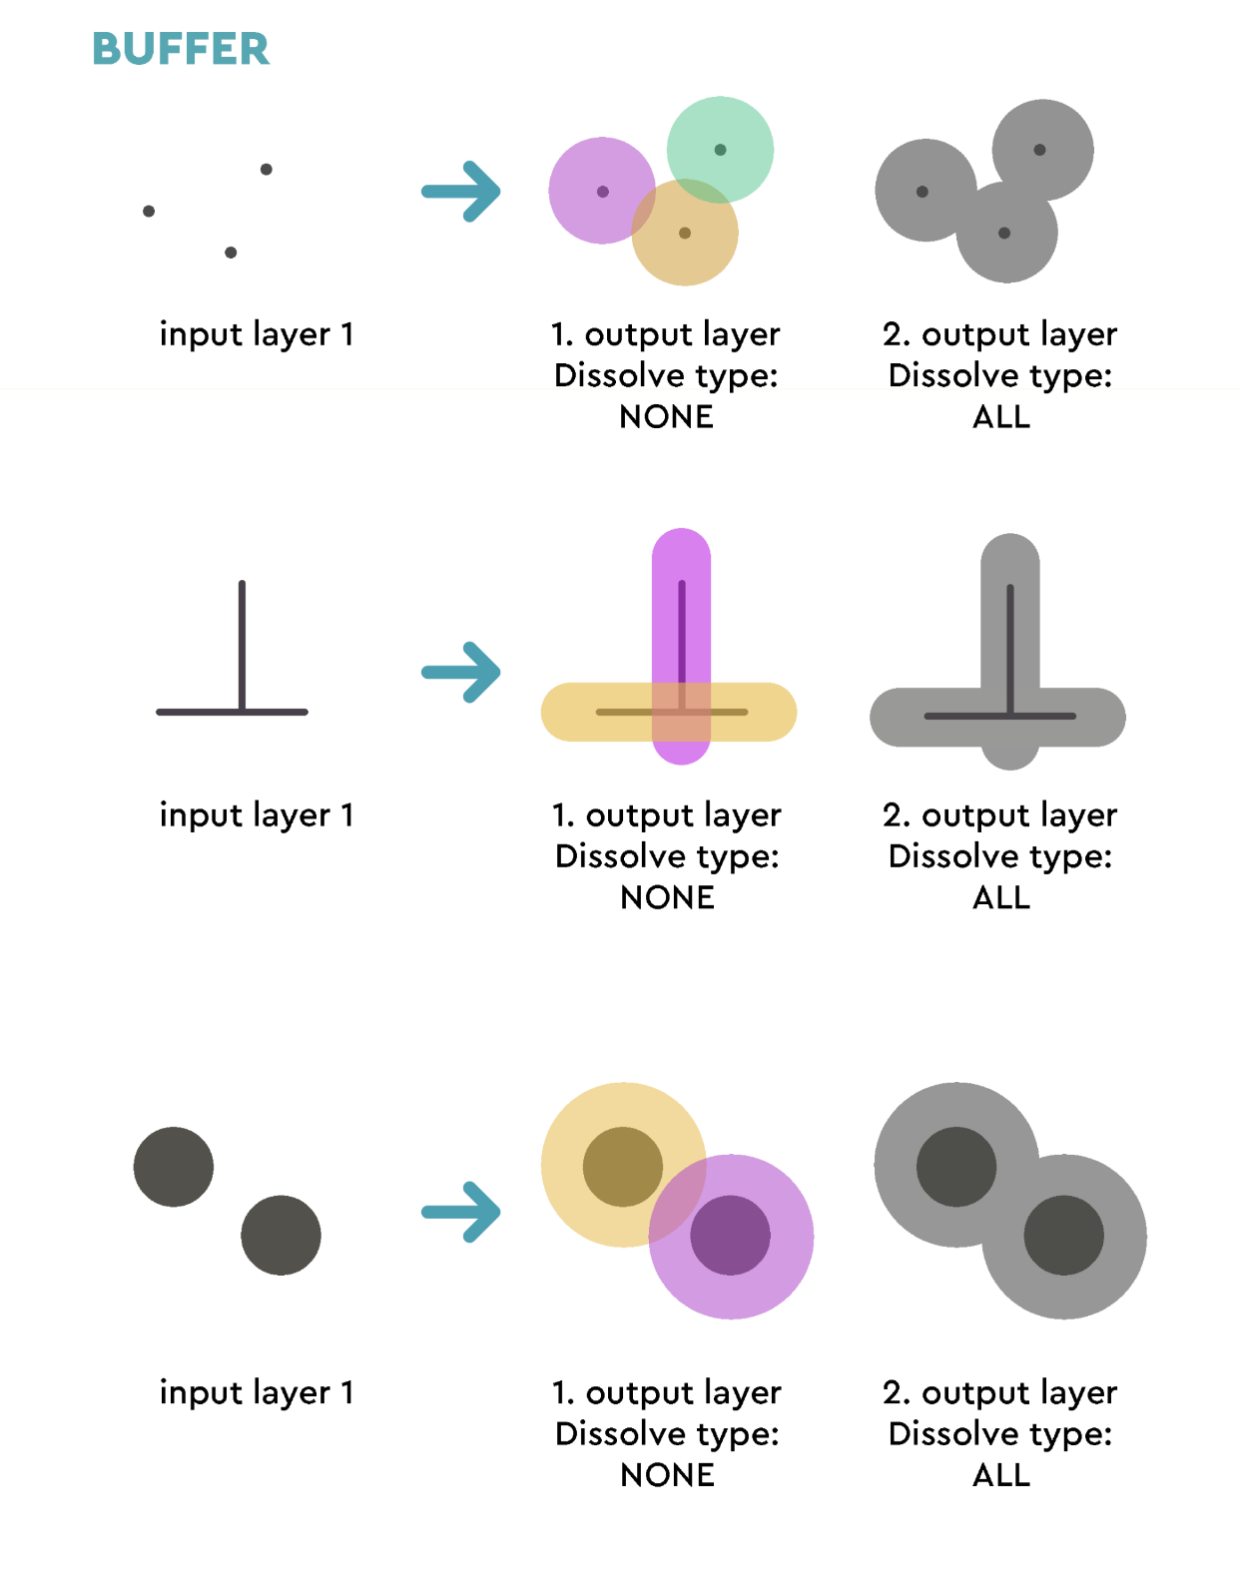
Basic Geoprocessing Tools
Overlay, Extraction and Proximity
Notes:
Computes a buffer area for all the features in an input layer, using a fixed or data defined distance.
It is possible to use a negative distance for polygon input layers. In this case the buffer will result in a smaller polygon (setback).

Slide 8
Basic Geoprocessing Tools
Overlay, Extraction and Proximity

Slide 9
Basic Geoprocessing Tools
Overlay, Extraction and Proximity

Slide 10
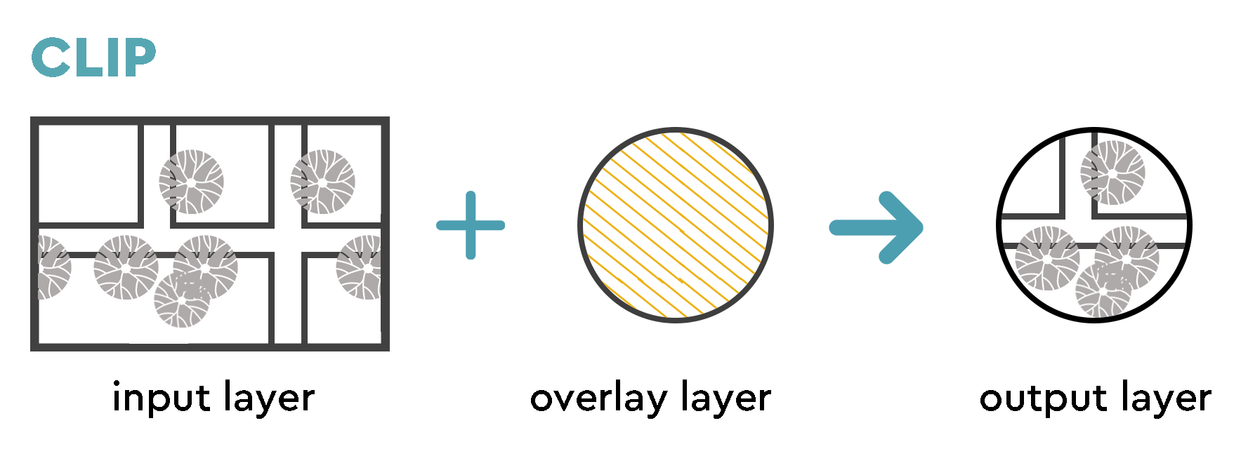
Basic Geoprocessing Tools
Overlay, Extraction and Proximity
Notes:
Clips a vector layer using the features of an additional polygon layer.
Only the parts of the features in the input layer that fall within the polygons of the overlay layer will be added to the resulting layer.
This algorithm uses spatial indexes on the providers, prepared geometries and apply a clipping operation if the geometry isn’t wholly contained by the mask geometry.

Slide 11
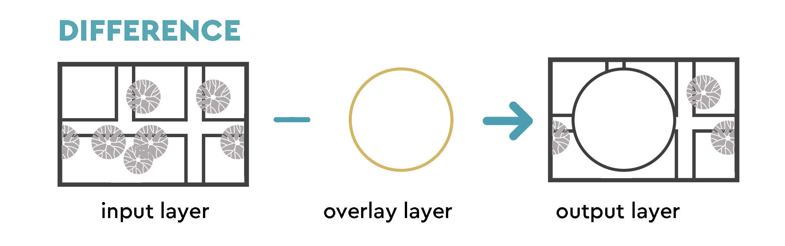
Basic Geoprocessing Tools
Overlay, Extraction and Proximity
Notes:
Extracts features from the input layer that don’t fall within the boundaries of the overlay layer.
Input layer features that partially overlap the overlay layer feature(s) are split along the boundary of those feature(s) and only the portions outside the overlay layer features are retained.

Slide 12
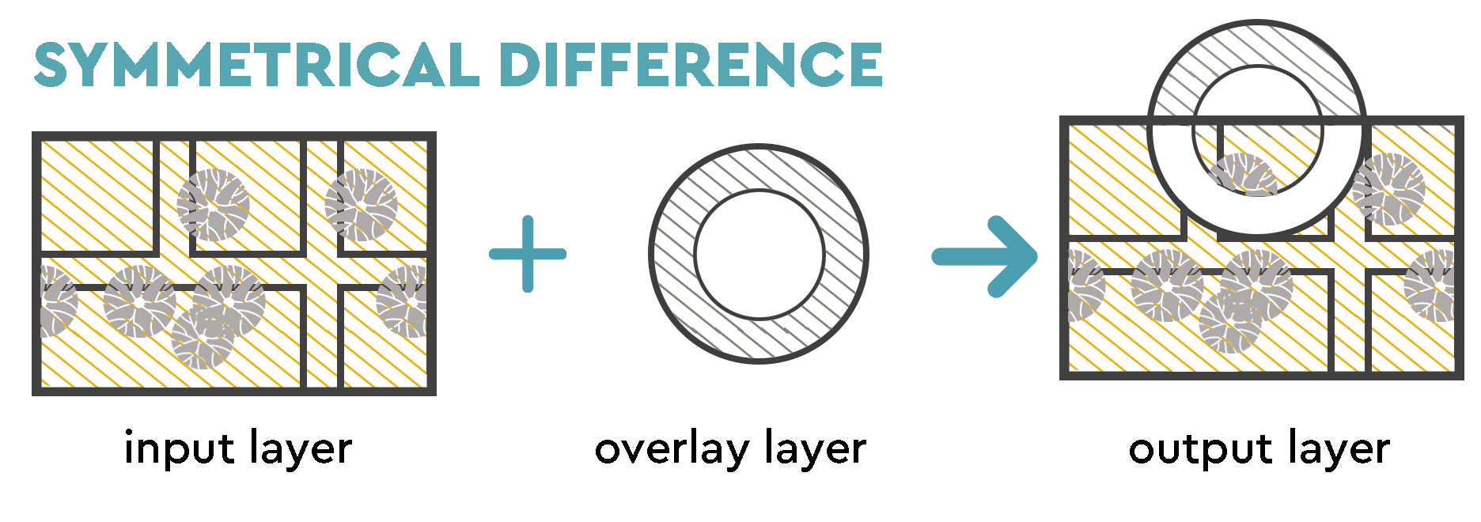
Basic Geoprocessing Tools
Overlay, Extraction and Proximity
Notes:
Creates a layer containing features from both the input and overlay layers but with the overlapping areas between the two layers removed.
The attribute table of the symmetrical difference layer contains attributes and fields from both the input and overlay layers.

Slide 13
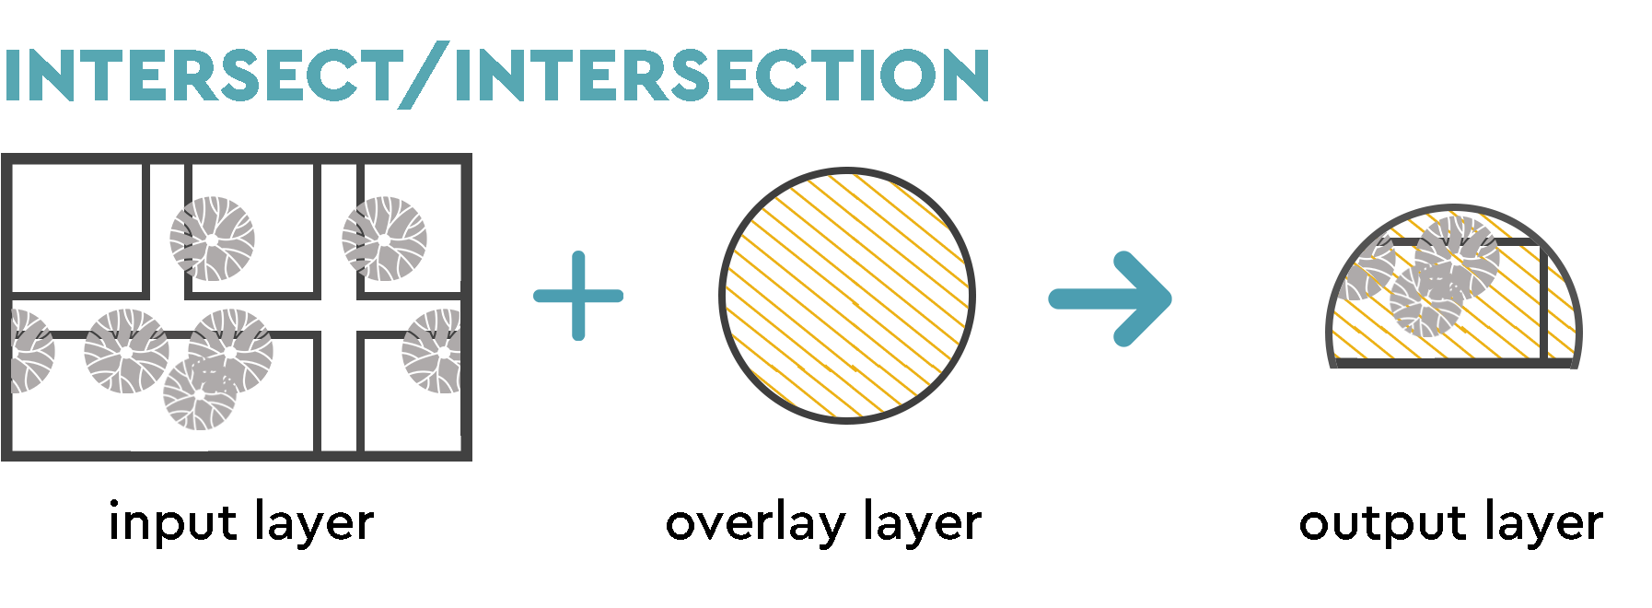
Basic Geoprocessing Tools
Overlay, Extraction and Proximity
Notes:
Extracts the portions of features from the input layer that overlap features in the overlay layer.
Features in the intersection layer are assigned the attributes of the overlapping features from both the input and overlay layers.

Slide 14
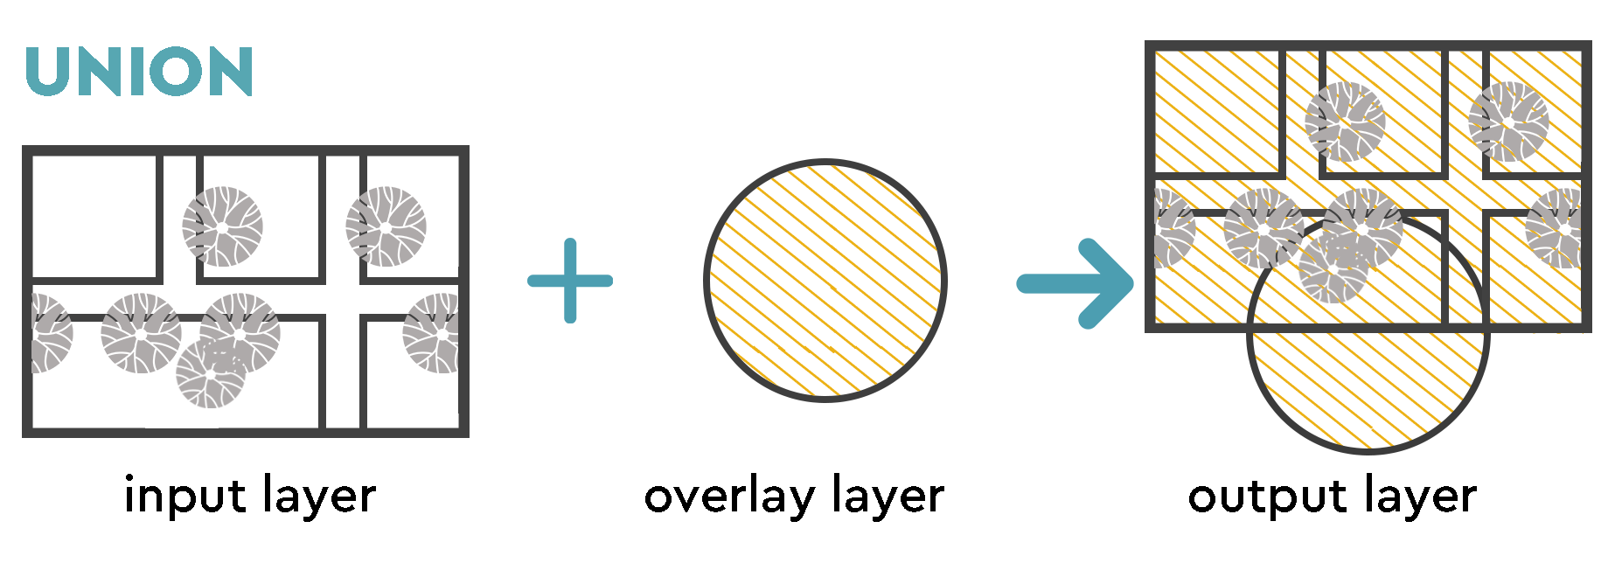
Basic Geoprocessing Tools
Overlay, Extraction and Proximity
Notes:
Checks overlaps between features within the input layer and creates separate features for overlapping and non-overlapping parts. The area of overlap will create as many identical overlapping features as there are features that participate in that overlap.
An overlay layer can also be used, in which case features from each layer are split at their overlap with features from the other one, creating a layer containing all the portions from both input and overlay layers. Features on the same layer will not split each other. The attribute table of the union layer is filled with attribute values from the respective original layer for non-overlapping features, and attribute values from both layers for overlapping features.

Slide 15
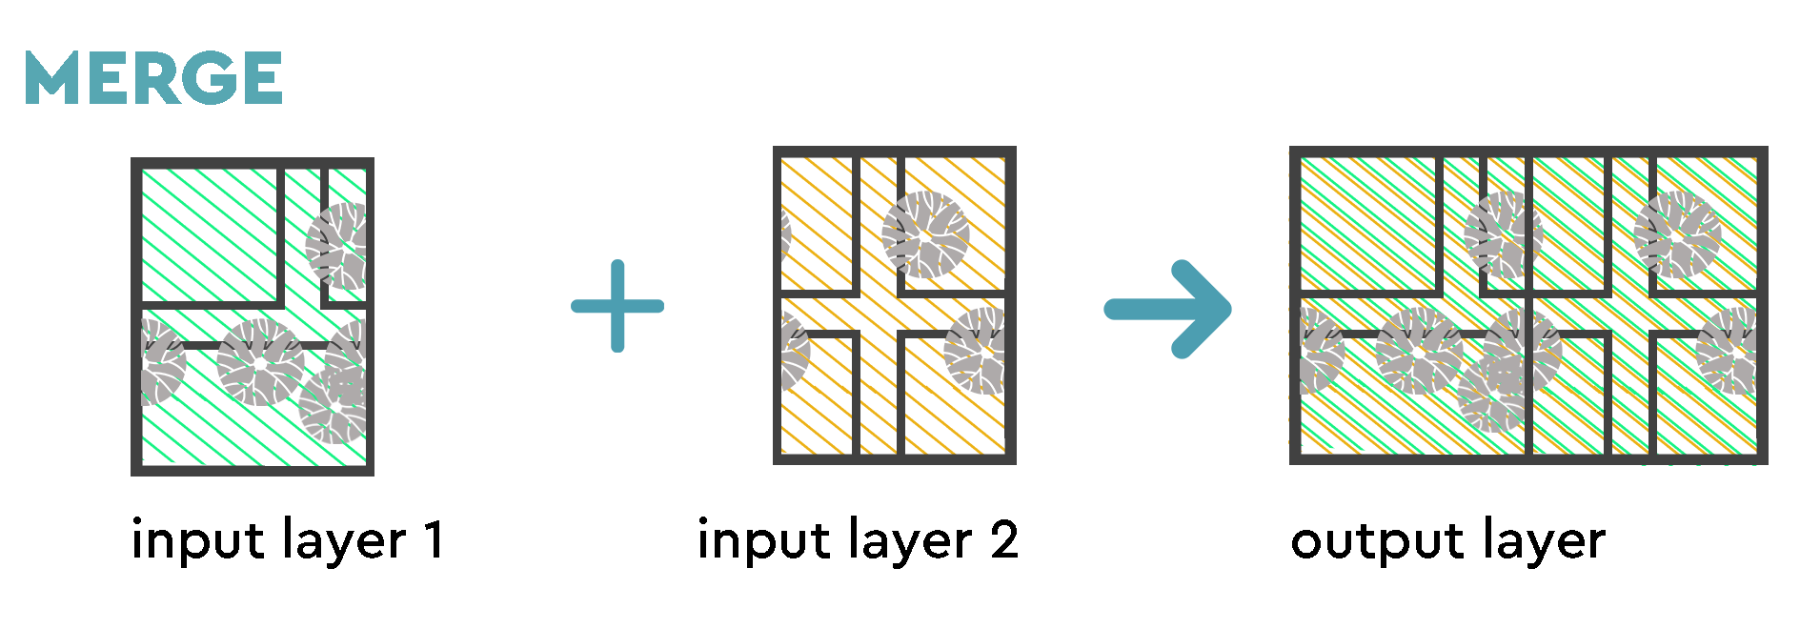
Basic Geoprocessing Tools
Overlay, Extraction and Proximity
Notes:
Combines multiple vector layers of the same geometry type into a single one.
The attribute table of the resulting layer will contain the fields from all input layers. If fields with the same name but different types are found then the exported field will be automatically converted into a string type field. New fields storing the original layer name and source are also added.

Slide 16
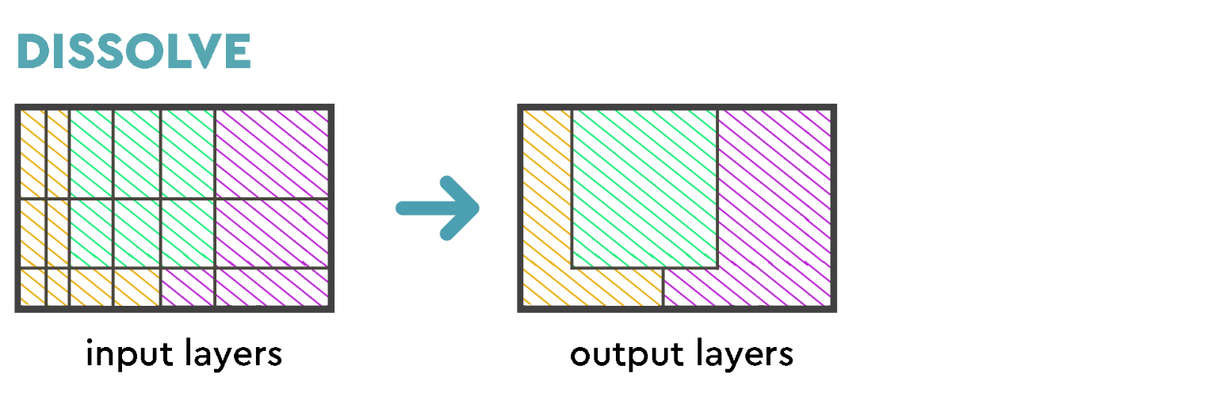
Basic Geoprocessing Tools
Overlay, Extraction and Proximity
Notes:
Takes a vector layer and combines its features into new features. One or more attributes can be specified to dissolve features belonging to the same class (having the same value for the specified attributes), alternatively all features can be dissolved to a single feature.
All output geometries will be converted to multi geometries. In case the input is a polygon layer, common boundaries of adjacent polygons being dissolved will get erased. If enabled, the optional “Keep disjoint features separate” setting will cause features and parts that do not overlap or touch to be exported as separate features (instead of parts of a single multipart feature).

Slide 17
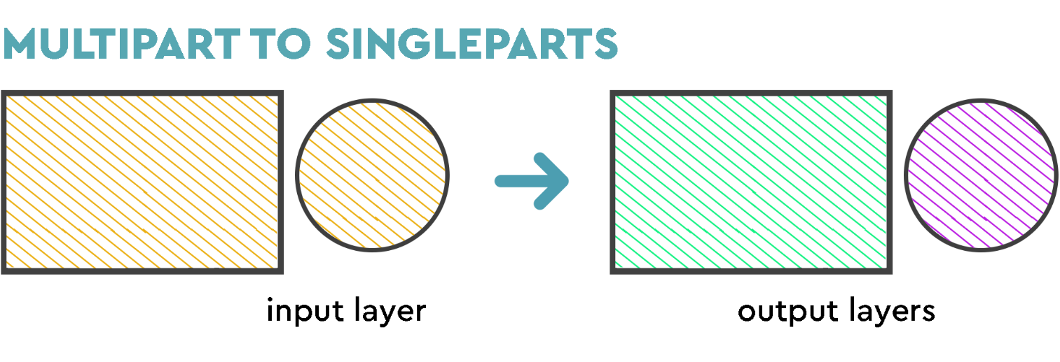
Basic Geoprocessing Tools
Overlay, Extraction and Proximity
Notes:
Splits multipart features in the input layer into singlepart features.
The attributes of the output layer are the same as the original ones but divided into single features.

Slide 18
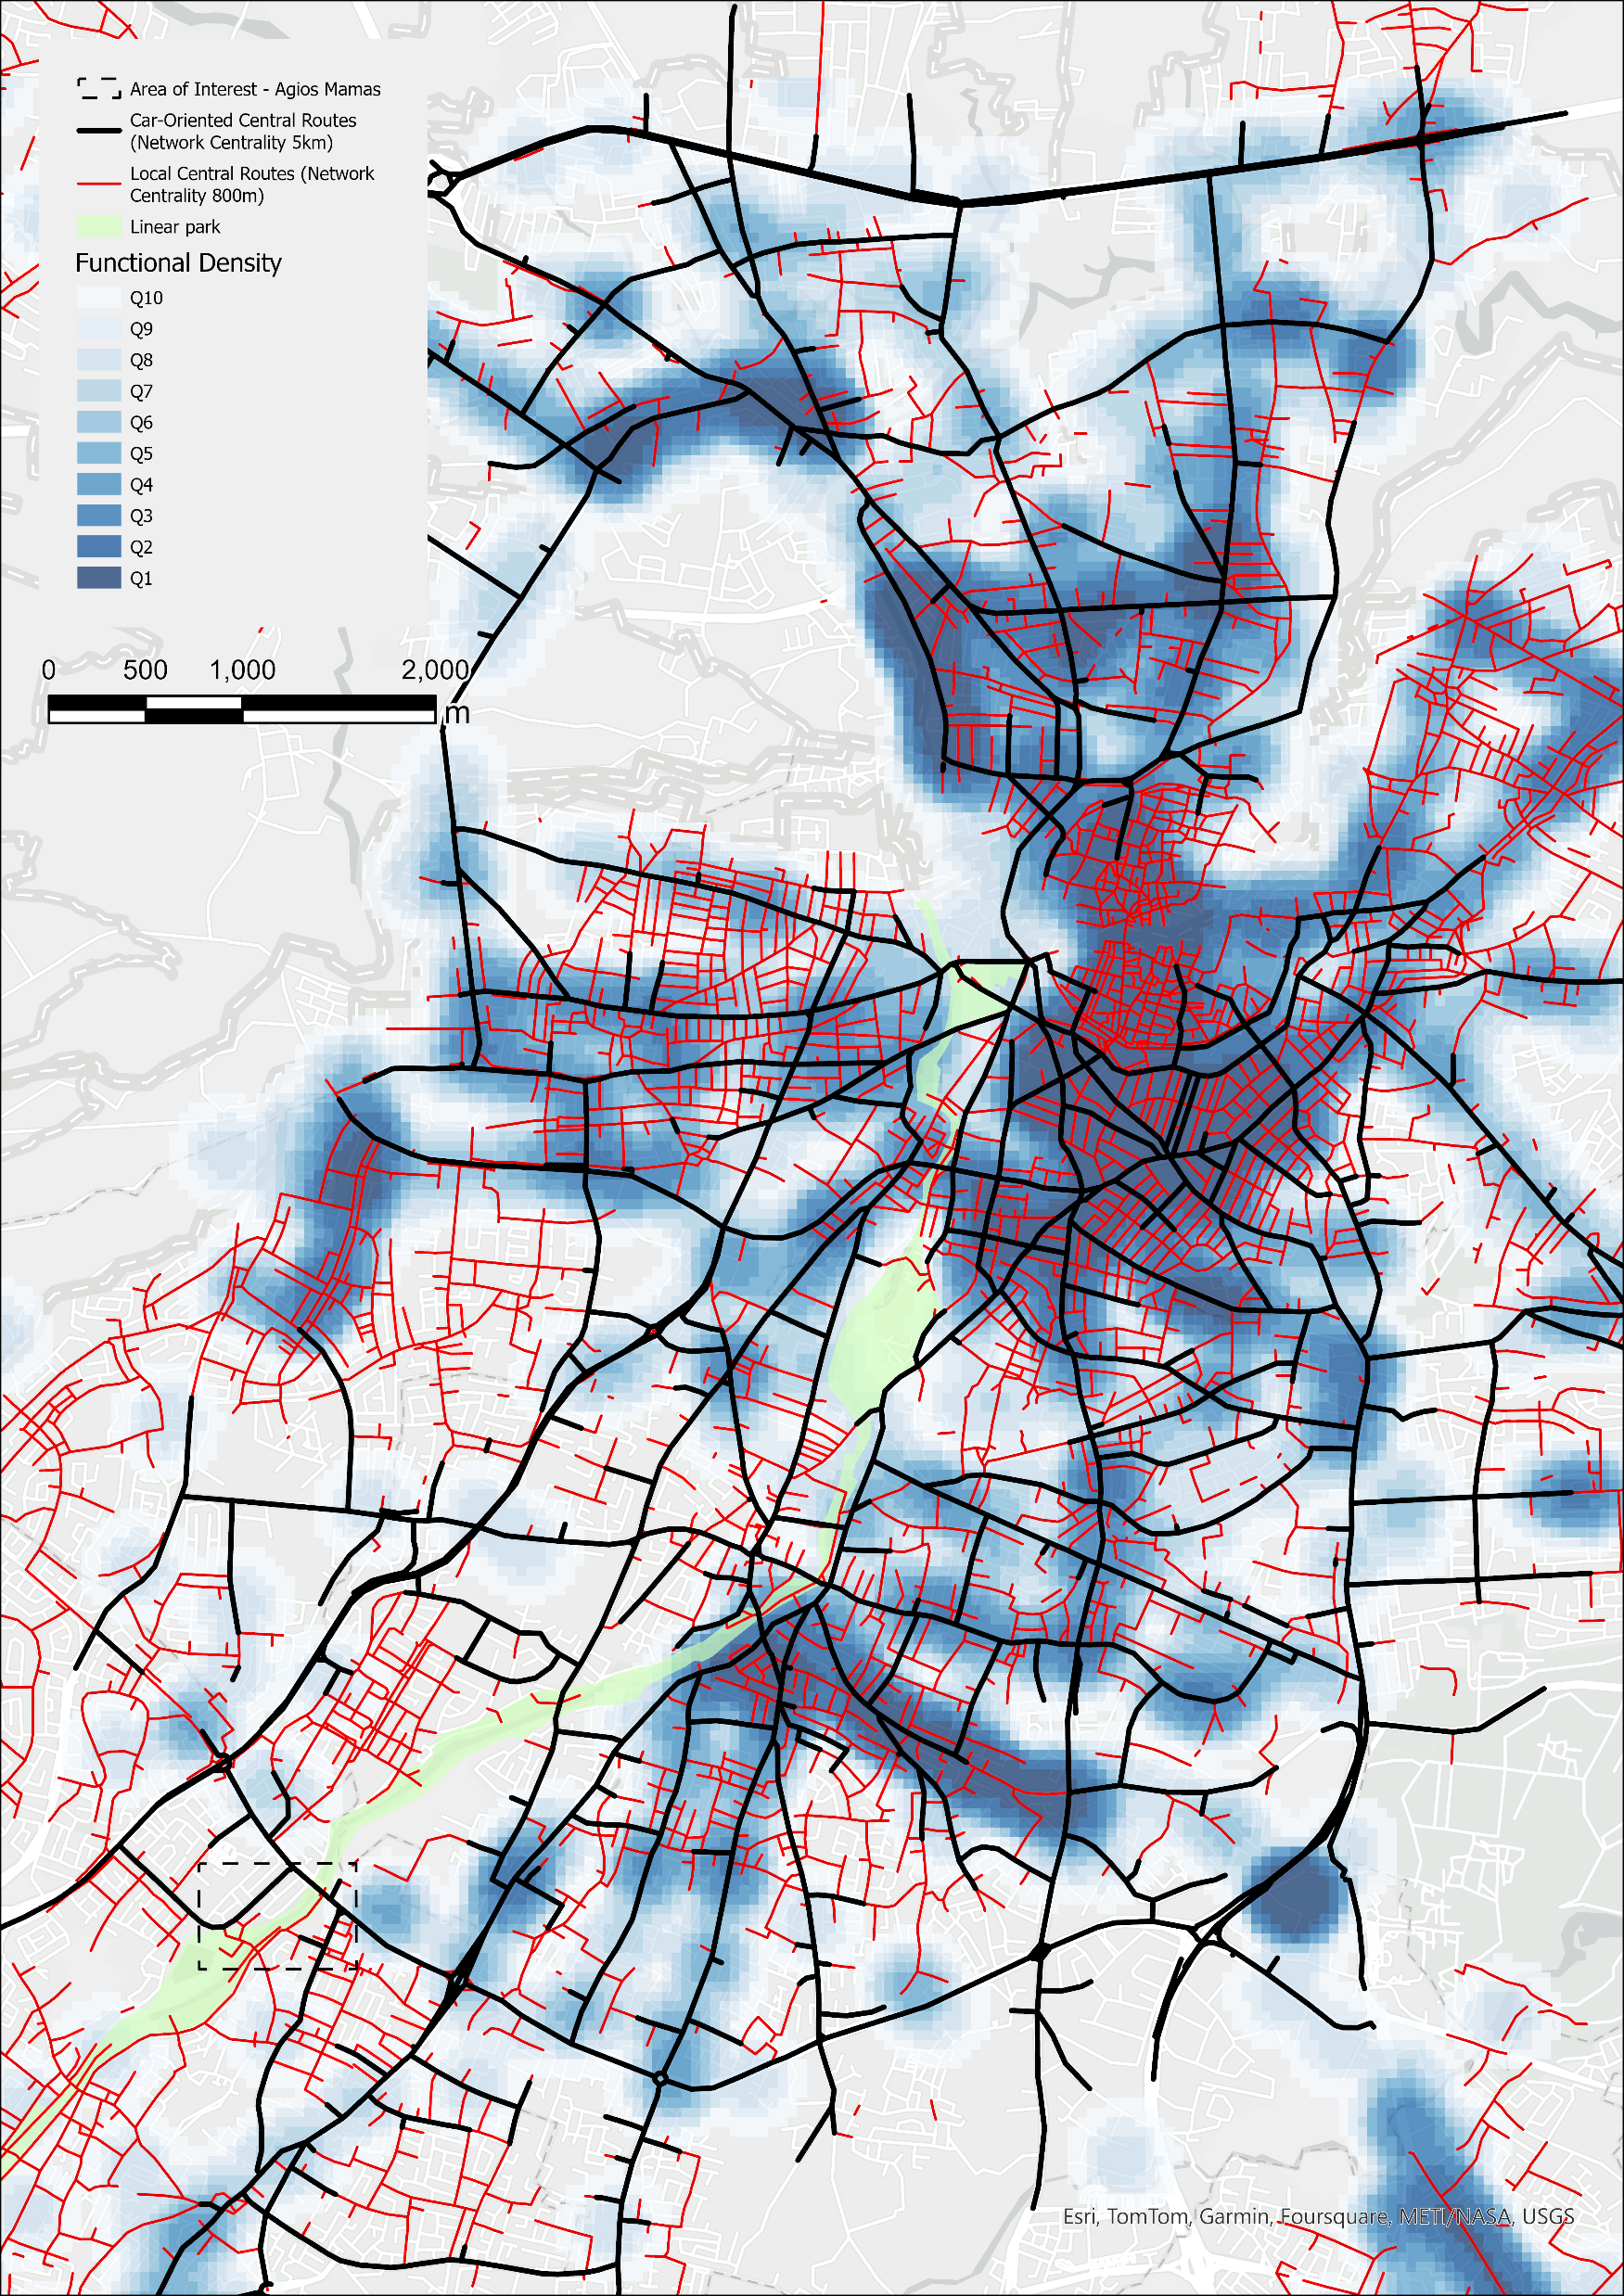
Advanced Geoprocessing Tools
Heatmap - Kernel Density Estimation (KDE)
Creates a density (heatmap) raster of an input vector layer using kernel density estimation.
The density is calculated based on the number of points in a location, with larger numbers of clustered points resulting in larger values.
KDE uses the density within a range (window) of each observation to represent the value at the centre of the window.
Larger values of the Search radius produce a smoother, more generalized density raster. Smaller values produce a more detailed raster
Heatmaps allow easy identification of hotspots and clustering of points.

Slide 19
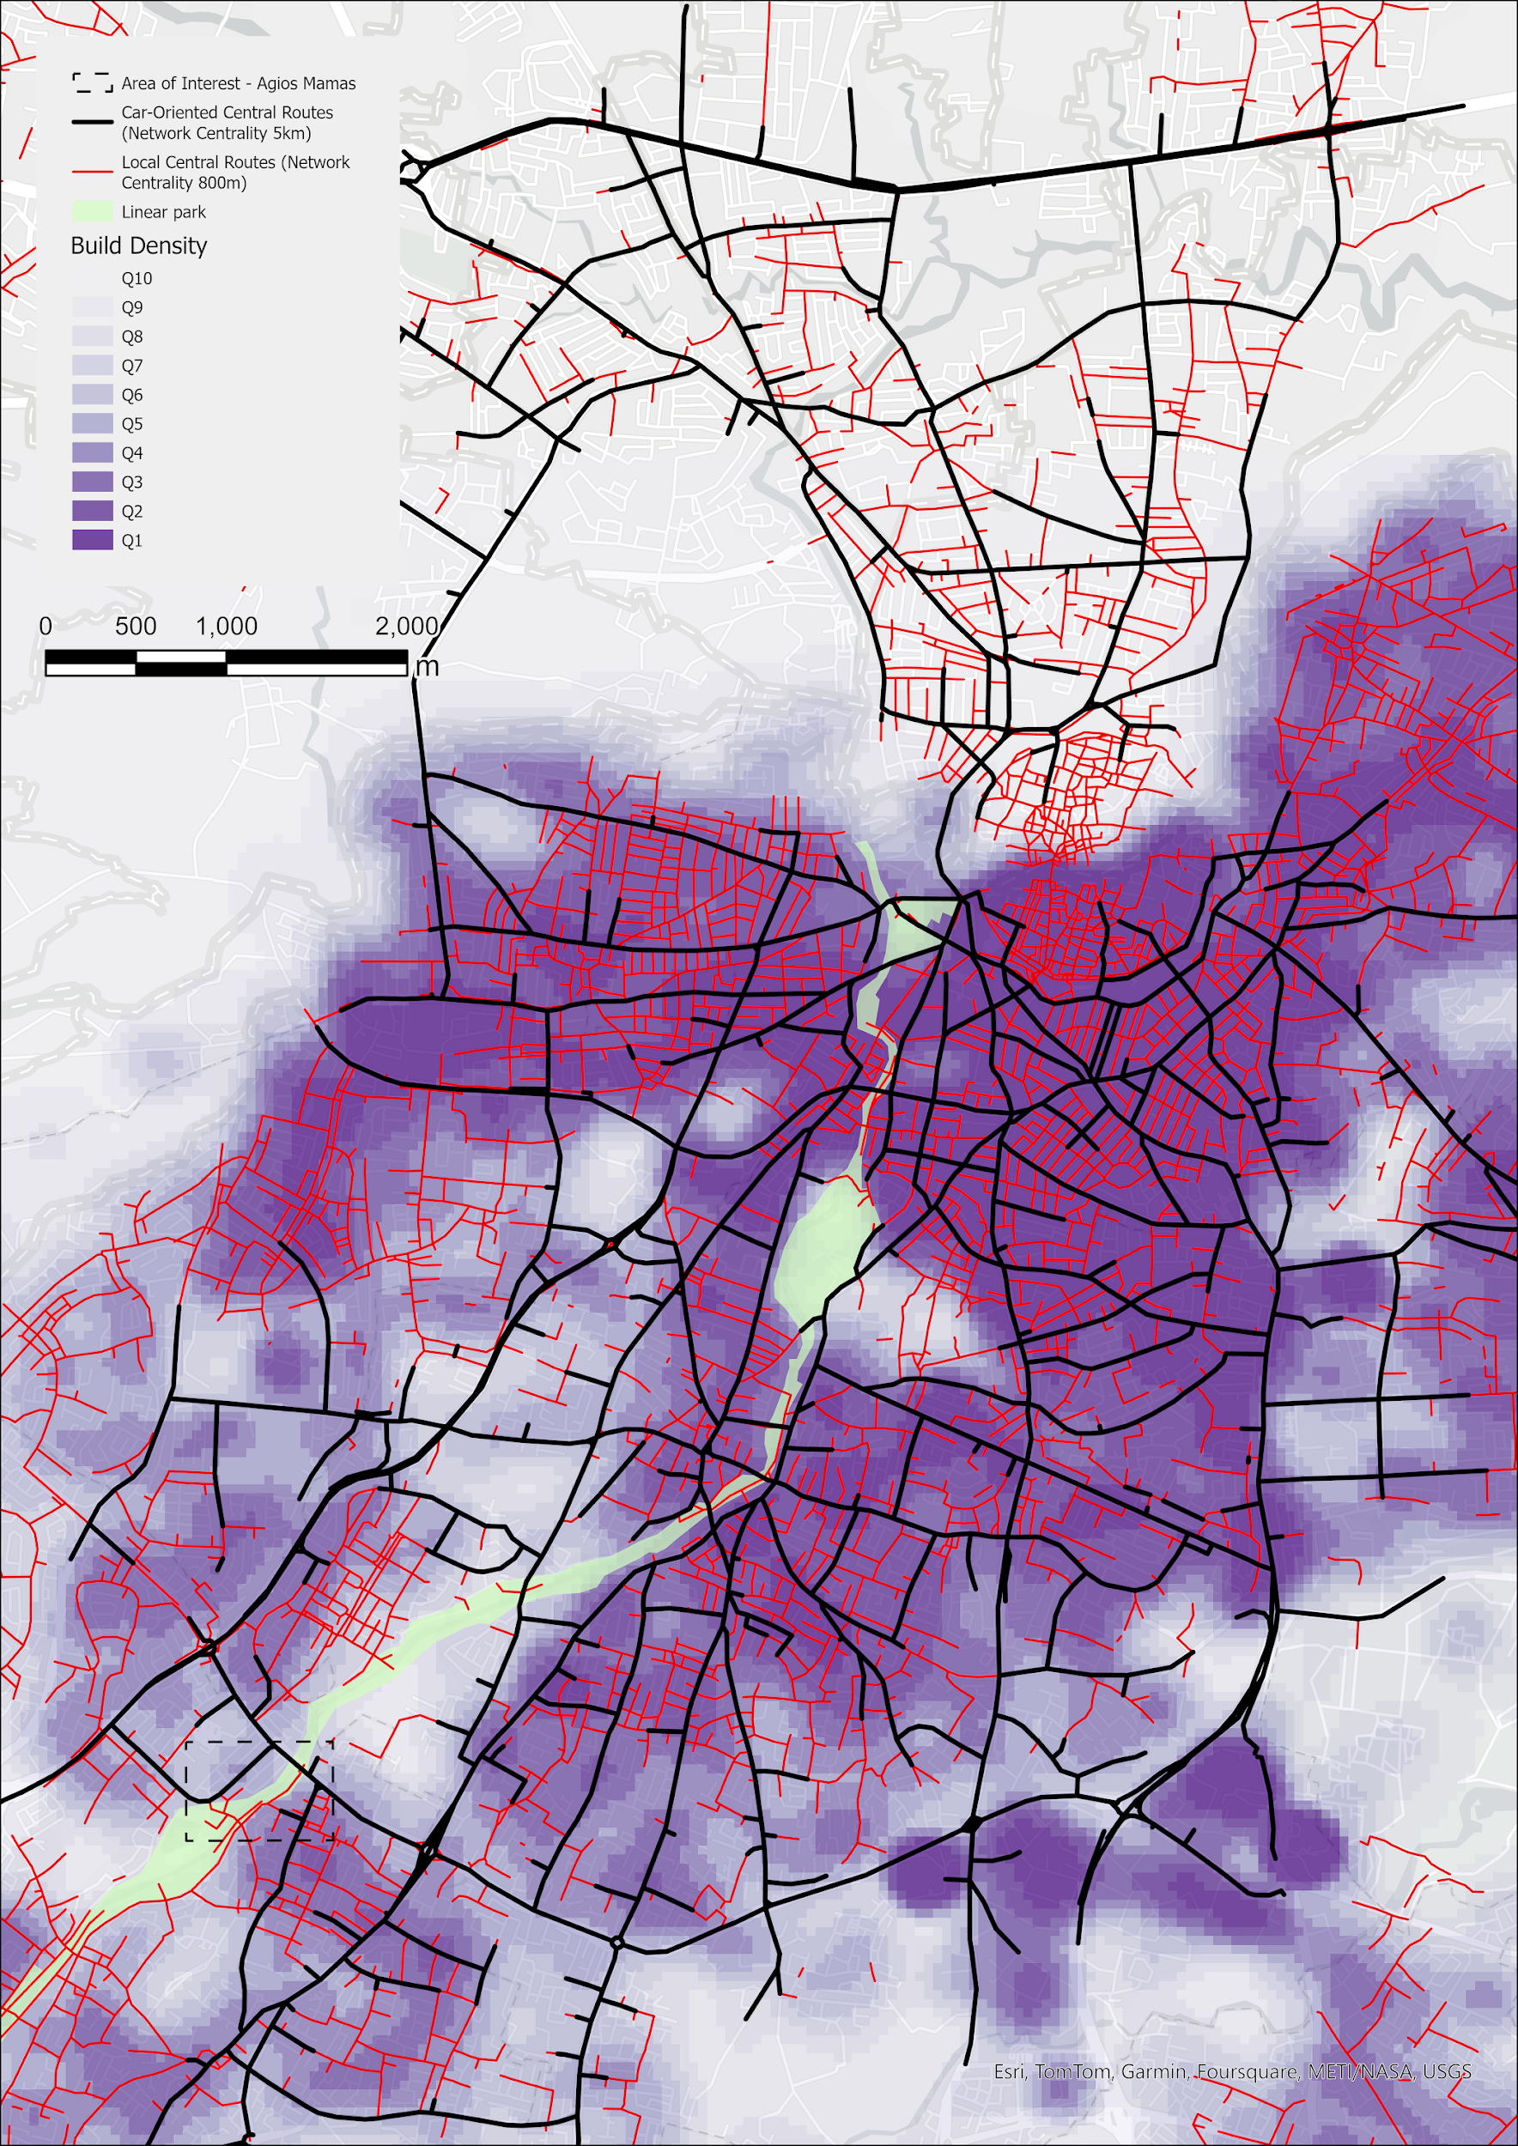
Advanced Geoprocessing Tools
Heatmap - Kernel Density Estimation (KDE)
KDE with Barriers
Creates a density (heatmap) raster of an input vector layer using kernel density estimation.
The density is calculated based on the number of points in a location, with larger numbers of clustered points resulting in larger values.
KDE uses the density within a range (window) of each observation to represent the value at the centre of the window.
Larger values of the Search radius produce a smoother, more generalized density raster. Smaller values produce a more detailed raster
Heatmaps allow easy identification of hotspots and clustering of points.

Slide 20
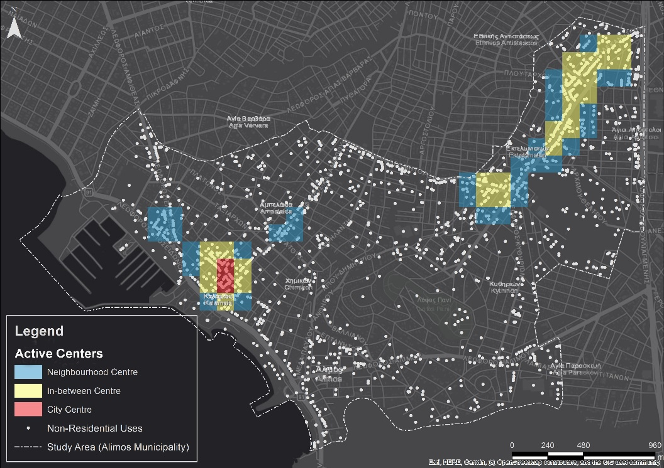
Advanced Geoprocessing Tools
Heatmap - Kernel Density Estimation (KDE) w/ Thresholds
Centrality Magnitude | Active Centrality Threshold (Non-residential KDE >)
Neighborhood Centre | MEAN+1×SD
In-between Centre | MEAN+2×SD
City Centre | MEAN+4×SD

Slide 21
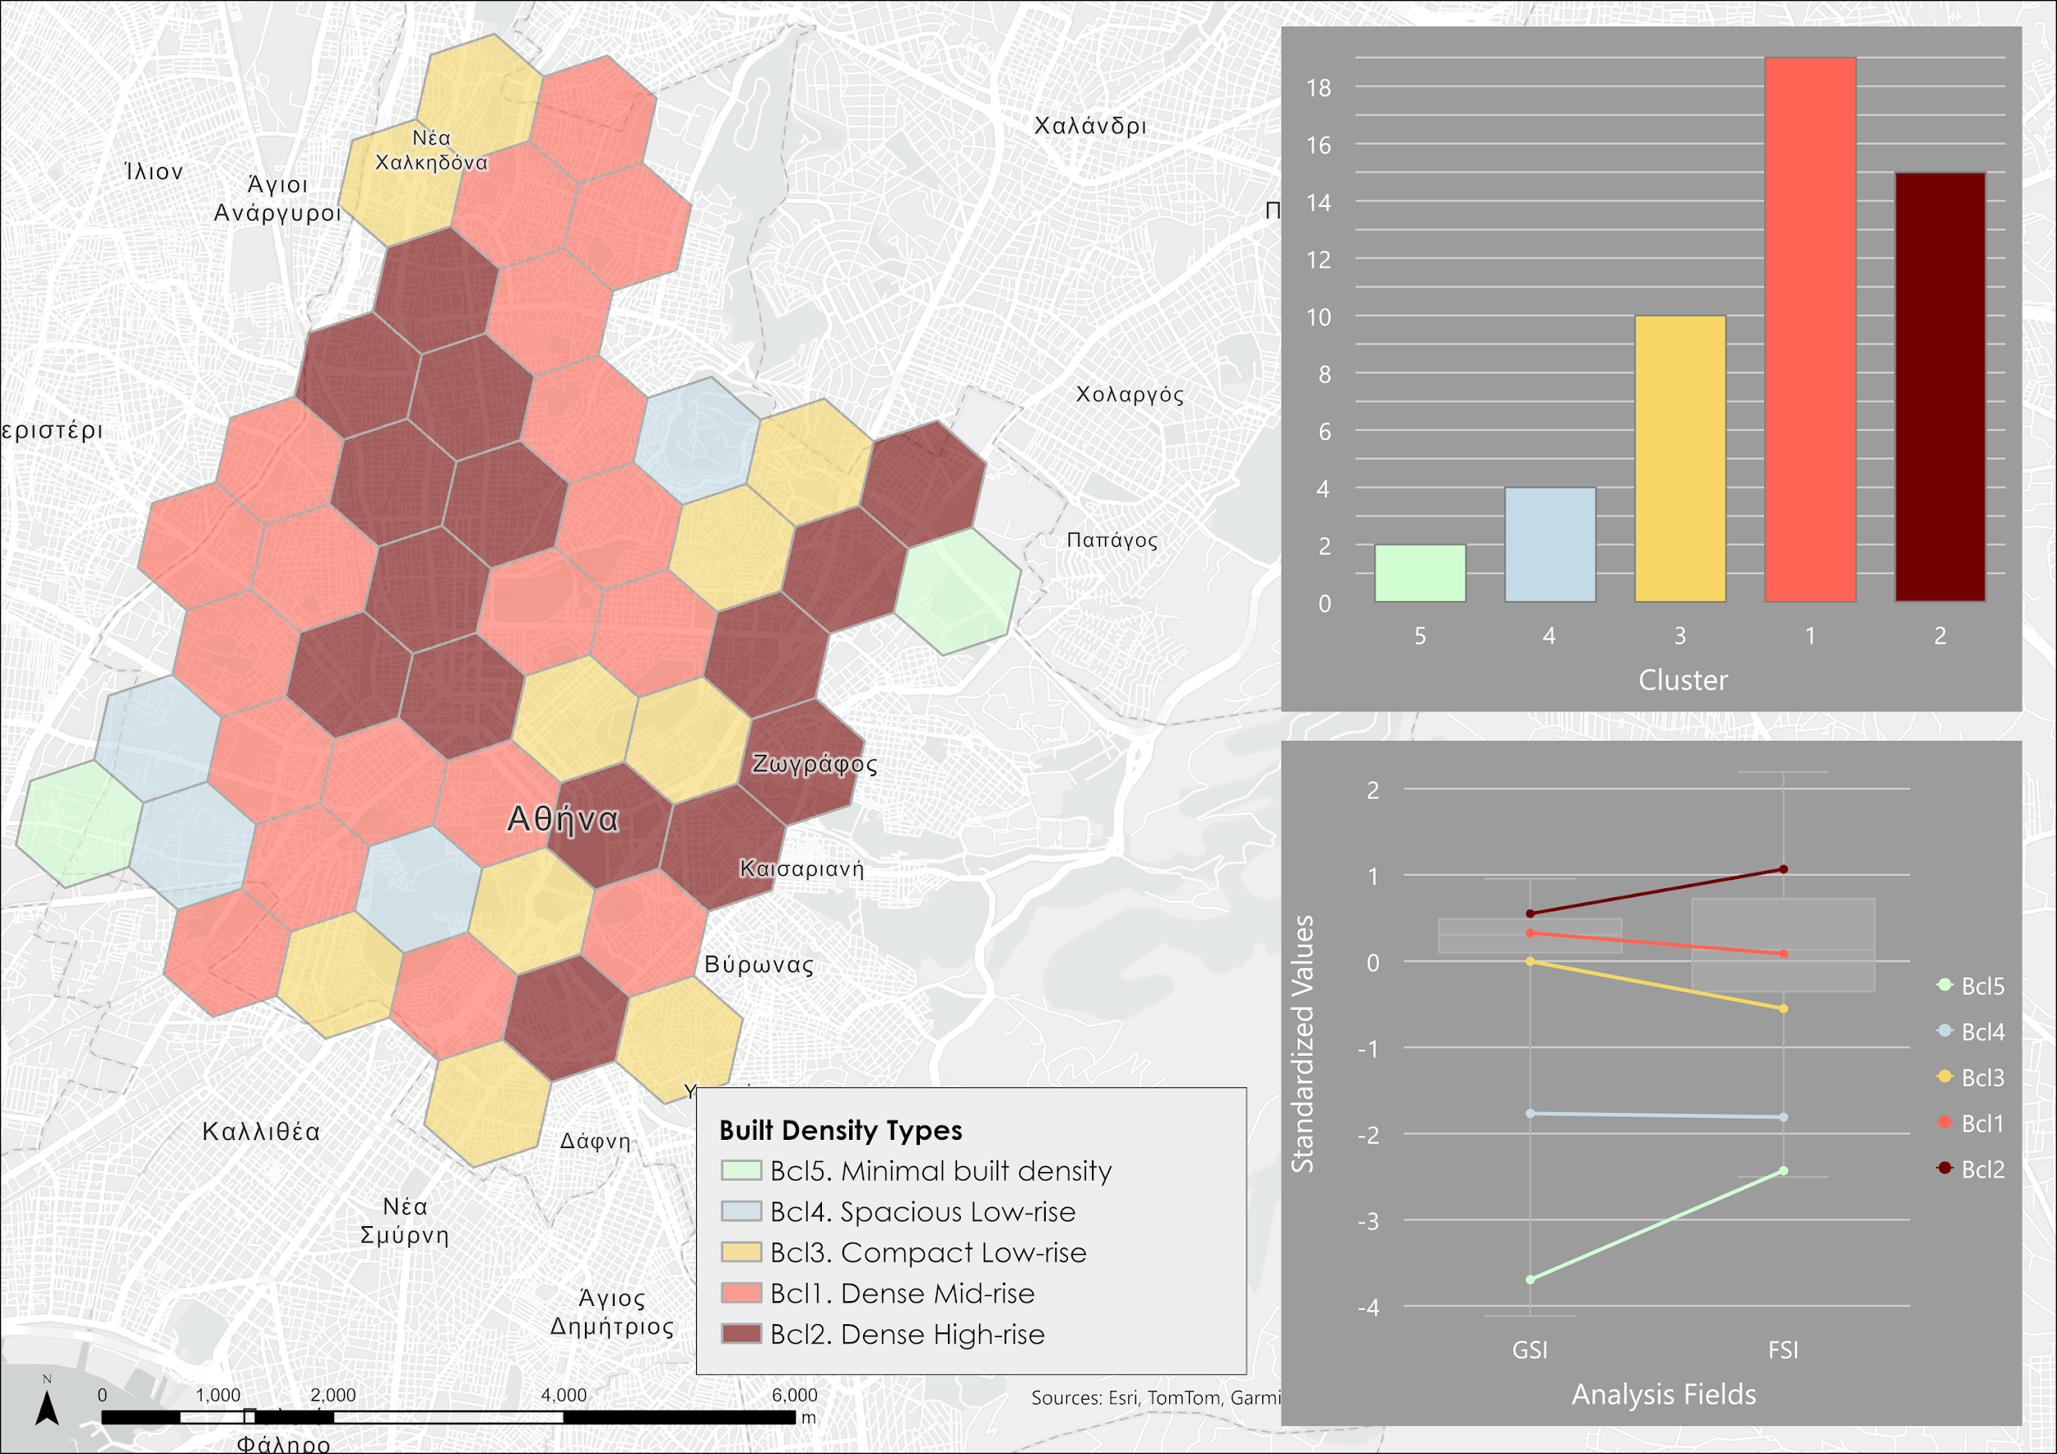
Advanced Geoprocessing Tools
Attribute based Clustering
Clustering, grouping, and classification techniques are some of the most widely used methods in machine learning
Attribute-based clustering utilizes unsupervised machine learning methods to determine natural clusters in your data
These classification methods are considered unsupervised as they do not require a set of preclassified features to guide or train the method to find the clusters in your data.
Notes:
\

Slide 22
GIS-based tools and data sources towards climate-resilient integrated planning
Data Sources

Slide 23
Data Sources for climate-resilient integrated planning
Pan-European coverage
Urban Atlas: Urban Atlas is composed of a suite of products for the Functional Urban Areas (FUA) with more than 50,000 inhabitants in EEA38 countries and UK, that encompasses:1/ Land Cover Land Use products, 2/ Street Tree Layer, showing contiguous rows or patches of trees covering 500 m² or more over "Artificial surfaces", 3/ Population estimates per Urban Atlas polygons, 4/ Building Height layer in a 10 x 10 m grid.
Imperviousness Density: Copernicus Land monitoring services High Resolution land cover characteristics that describe the imperviousness degree showing the sealing density in the range from 0-100% for the EEA-38 countries and UK.
Corine Land Cover: It is a pan-European dataset consisting of an inventory of land cover in 44 classes. The dataset has a Minimum Mapping Unit (MMU) of 25 hectares (ha) for areal phenomena and a Minimum Mapping Width (MMW) of 100 m for linear phenomena and is available as vector and as 100 m raster data
Tree Cover Density: The High Resolution Layer Tree Cover Density product offers information on the percentage of tree cover in a given area. Provides at pan-European level in the spatial resolution of 10 m and 100 m the level of tree cover density in a range from 0% to100% for the 2018 reference year.

Slide 24
Data Sources for climate-resilient integrated planning
Pan-European coverage
Open Street Map (OSM) is a global, free, and open geographic database updated and maintained by a community of volunteers via open collaboration and it includes a multitude of attribute-rich spatial datasets, Its main limitation is that since it relies exclusively on crowd-sourcing its degree of completeness and accuracy is always an issue, especially for some geographic areas and for specific features and categories. In the context of integrated planning, the most relevant datasets of Open Street Map, are the following:
  street network,
  points of interests,
  transport infrastructure,
  Building outlines, and
  Land-uses
City-specific data: Important geospatial data sources are always the city and national authorities (e.g. city geoportal, national statistical authority, national data portal). These sources may vary on the terms that they provide the data (open-access, restricted–access, or paid-access), however it is an invaluable source of reliable detailed data.

Slide 25
Data Sources for climate-resilient integrated planning
Athens, Greece
Hellenic Statistical Authority also known as ELSTAT, supplies comprehensive data on socioeconomic and demographic aspects essential for city planning and resource allocation.
GIS portal for the city of Athens is a catalogue of geospatial data and thematic maps and related to the area of the Municipality of Athens.
Athens Social Atlas provides a nuanced understanding of the city’s social landscape, offering data and analysis on a variety of social issues relevant to the region.
Attikipedia serves as a valuable resource for exploring the historical and geographical dimensions of the Attica region, giving urban planners context to guide their strategies.
participatory LAB provides extensive relevant resources since it is an active interdisciplinary community that studies, documents, learns, disseminates, and applies participatory design processes for public space, with the aim of adapting cities to climate change

Slide 26
Data Sources for climate-resilient integrated planning
Nicosia, Cyprus
Cyprus Statistical Service (CYSTAT) offers comprehensive socioeconomic and demographic data, including population trends, employment statistics, and housing data, which are essential for resource allocation and planning
Department of Lands and Surveys complements this with cadastral data on property ownership, zoning, and land use, which is vital for spatial management.
CADASTRAL CYPRUS includes administrative regions, parcels, plots, building footprints with h value and various other open access data (street network, zones etc.)
data.gov.cy is the National Open Data Portal, where data of most of the Cypriot public sector institutions are available for further use. The main objective of data.gov.cy is to offer the user the possibility to easily and quickly find and access processed or unprocessed public sector data, in order to reuse and exploit them beyond their original destination, for the development of innovative services / products with added value

Slide 27
Data Sources for climate-resilient integrated planning
Gothenburg, Sweeden
Lantmateriet supplies open geographical data and data on land properties for all Sweden.
National roads database provides geodata on roads and streets, including detailed transportation data.
Population statistics for the whole Sweden can be acquired from Statistics Sweden.
With respect to contemporary planning developments in Gothenburg, this information is available on the website of Gothenburg City Planning office, including digital comprehensive plan of Gothenburg and information about current detail plans.
Gothenburg City Planning Office where one can download all building permits, including all floor plans and situation plans).
The Swedish National Database hosts different datasets created within academic and research institutions, that can be accessed directly or on demand.

Slide 28
Data Sources for climate-resilient integrated planning
Palermo, Italy
Istat, the Italian National Institute of Statistics, serves as a primary resource, offering comprehensive data on demographics and socioeconomic indicators essential for urban planning.
The Municipality of Palermo shares open data held by the administration through the OpenData project, here one can find data and information regarding different aspects of the administration (green, culture and tourism, education, mobility, etc.).
The City of Palermo also makes available technical documentation regarding on city planning.
OpenData Sicilia and PalermoHub provide maps with advanced search and filtering capabilities that makes it easy and intuitive to search the maps on the Palermo area
About data concerning the environment, ISPRA, Istituto Superiore per la Protezione e la Ricerca Ambientale, makes available various data at the national and regional level.

Slide 29

thank you!

Slide 30


