Slide 1









Project: Erasmus+ 2023-1-EL01-KA220-HED-000160477
Co-funded by the European Union. Views and opinions expressed are however those of the author(s) only and do not necessarily reflect those of the European Union.
Neither the European Union nor the granting authority can be held responsible for them.

Slide 2

Transnational Network of Integrated Planning Labs:
Co-creating knowledge on forward-looking transdisciplinary planning perspectives addressing climate change and urban life in the post-pandemic city
Project number: 2023-1-EL01-KA220-HED-000160477 Erasmus+
InPlaLabs Methodological Resources
Knowledge Sharing Workshop, 5th June 2025
Quantitative methods for integrated spatial planning I (Connectivity and Proximity Planning)
Stefanos Tsigdinos
Department of Geography and Regional Planning, NTUA
Project: Erasmus+ 2023-1-EL01-KA220-HED-000160477
Co-funded by the European Union. Views and opinions expressed are however those of the author(s) only and do not necessarily reflect those of the European Union.
Neither the European Union nor the granting authority can be held responsible for them.

Slide 3
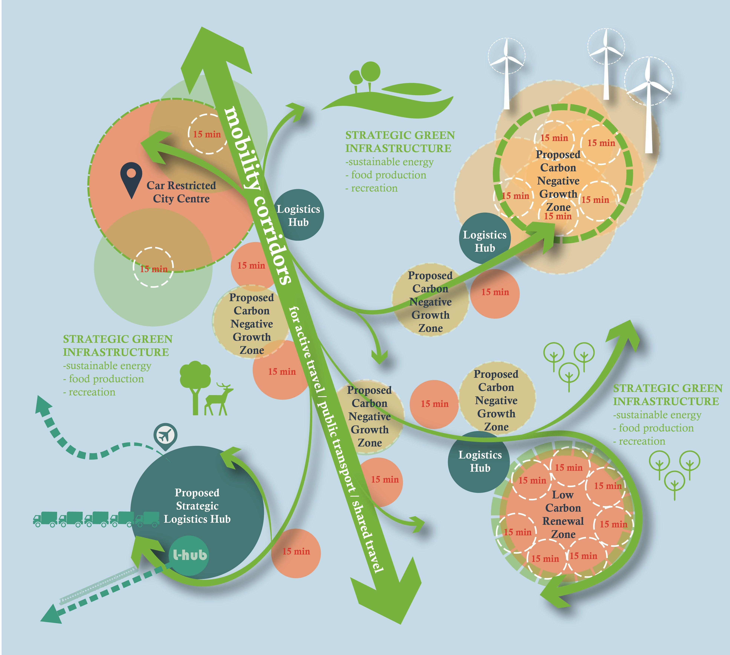
Integrated planning for accessible cities
Conventional planning approaches do not consider both transport and urban dimensions
However, spatial planning is an interdisciplinary concept
Urban and transport dimensions play a pivotal role in shifting from conventional to sustainable approaches
How could these be linked?
  Through combined urban and transport policies and interventions under the main concept of integrated planning
Source: https://www.rtpi.org.uk/research-rtpi/2020/june/net-zero-transport-the-role-of-spatial-planning-and-place-based-solutions/

Slide 4


Connexus or proximus? A fundamental dilemma
OR
Notes:
Here is an example of th Difference between conceptual scenarios and actual scenarios

Slide 5
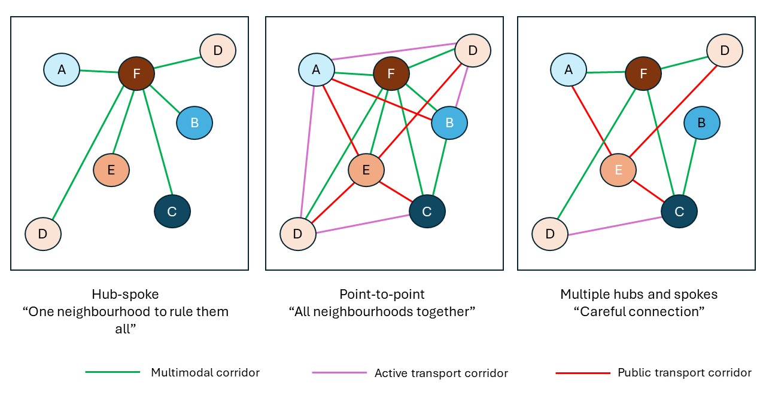
Connectivity or proximity (accessibility) planning
Connectivity planning: When we connect land uses with each other
Source: Paraskevopoulos et al., 2024
Notes:
Here is an example of th Difference between conceptual scenarios and actual scenarios

Slide 6
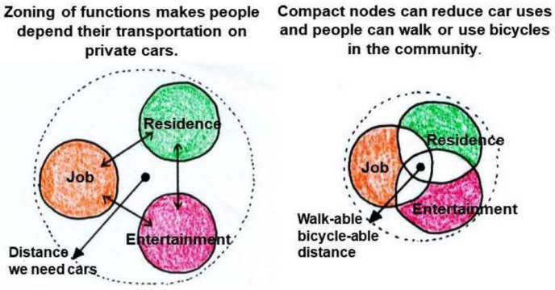
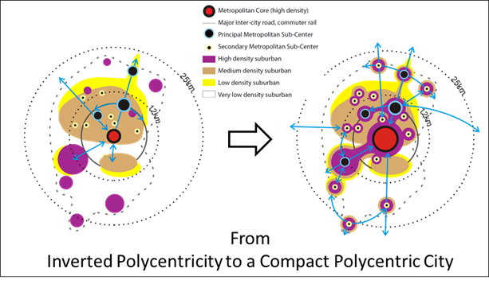
Connectivity or proximity (accessibility) planning
Proximity planning: When we plan new land uses or re-distribute existing ones
Source: Shrivastava and Singh, 2020 & https://www.joburg.org.za/
Notes:
Here is an example of th Difference between conceptual scenarios and actual scenarios

Slide 7
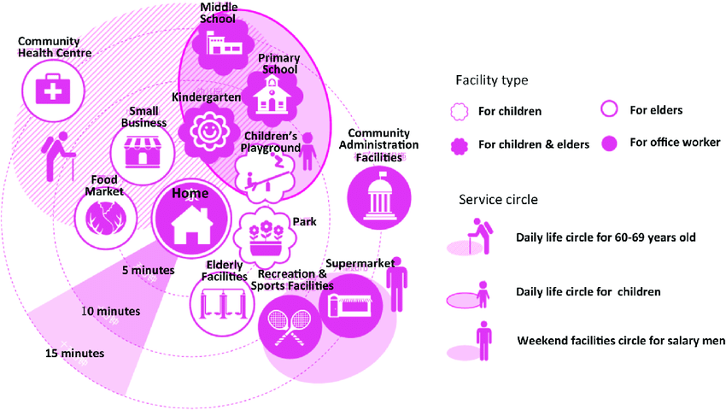
Connectivity or proximity (accessibility) planning
X minutes framework
Source: Hou and Liu, 2017
Notes:
Here is an example of th Difference between conceptual scenarios and actual scenarios

Slide 8
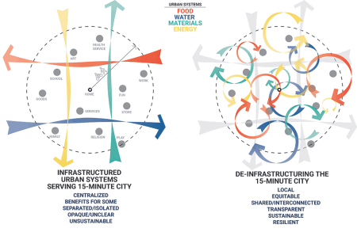
Connectivity or proximity (accessibility) planning
De-centralising
Source: https://urbanland.uli.org/planning-design/de-infrastructuring-in-the-era-of-the-15-minute-city
Notes:
Here is an example of th Difference between conceptual scenarios and actual scenarios

Slide 9
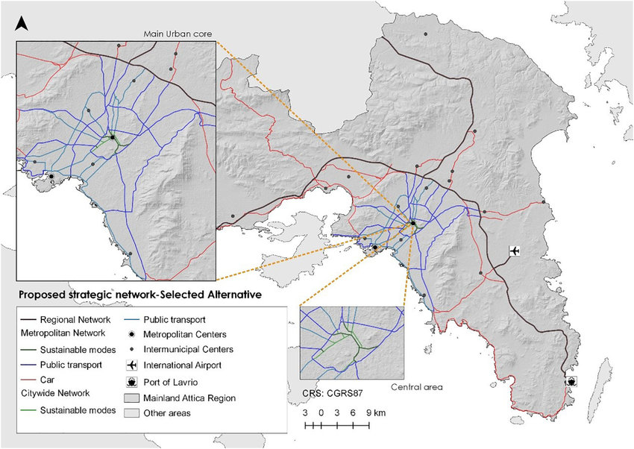
Connectivity or proximity (accessibility) planning
Street classification
Source: Tsigdinos and Vlastos, 2021
Notes:
Here is an example of th Difference between conceptual scenarios and actual scenarios

Slide 10
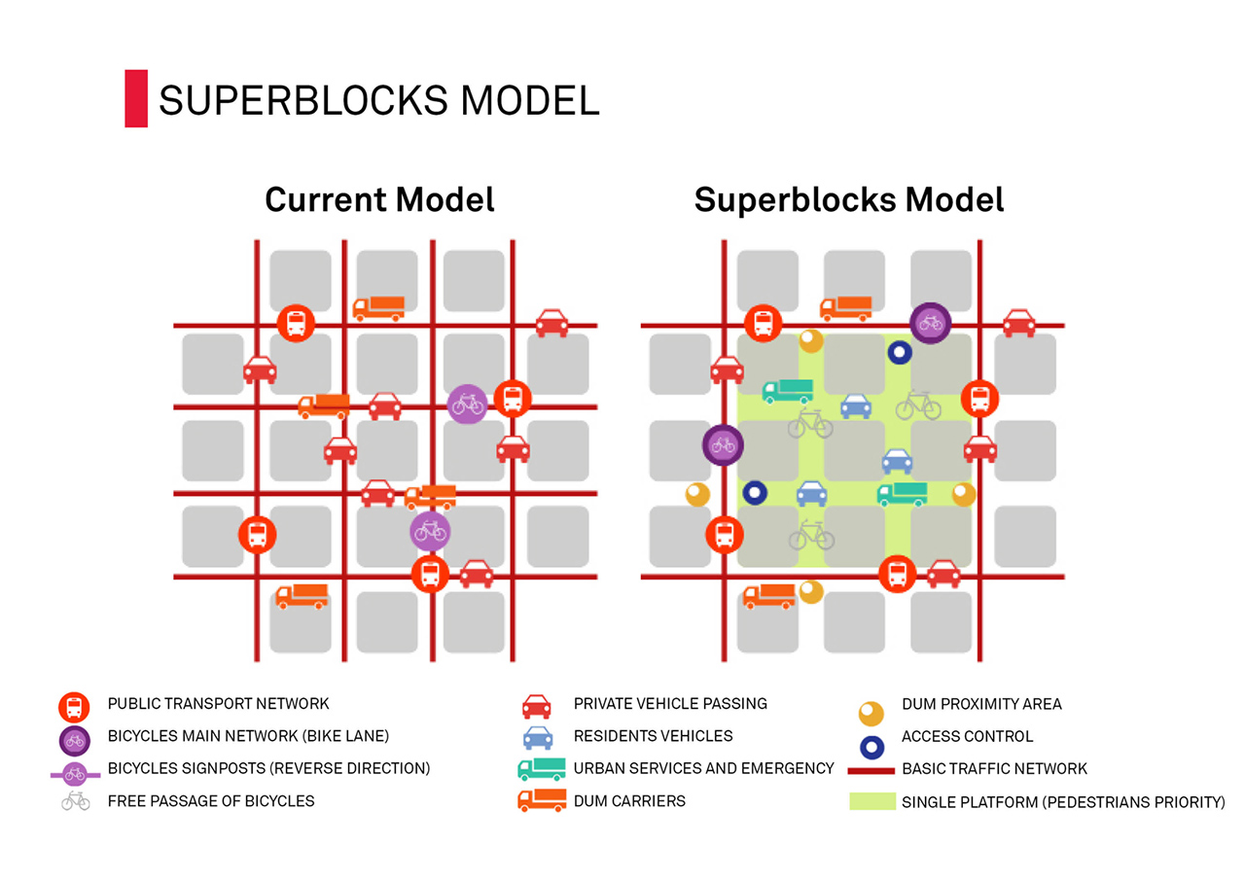
Connectivity or proximity (accessibility) planning
Superblock
Source: https://barcelonarchitecturewalks.com/superblocks/
Notes:
Here is an example of th Difference between conceptual scenarios and actual scenarios

Slide 11
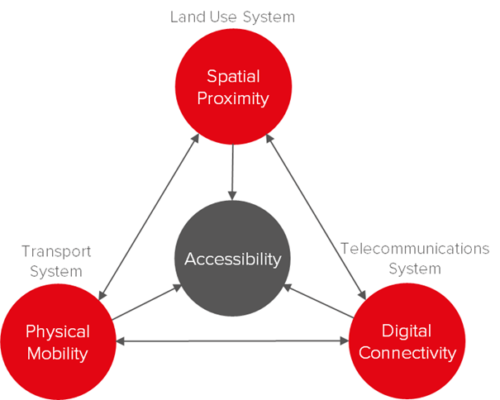

Connectivity or proximity (accessibility) planning
Tripple access framework
Source: https://www.tapforuncertainty.eu/
Notes:
Here is an example of th Difference between conceptual scenarios and actual scenarios

Slide 12
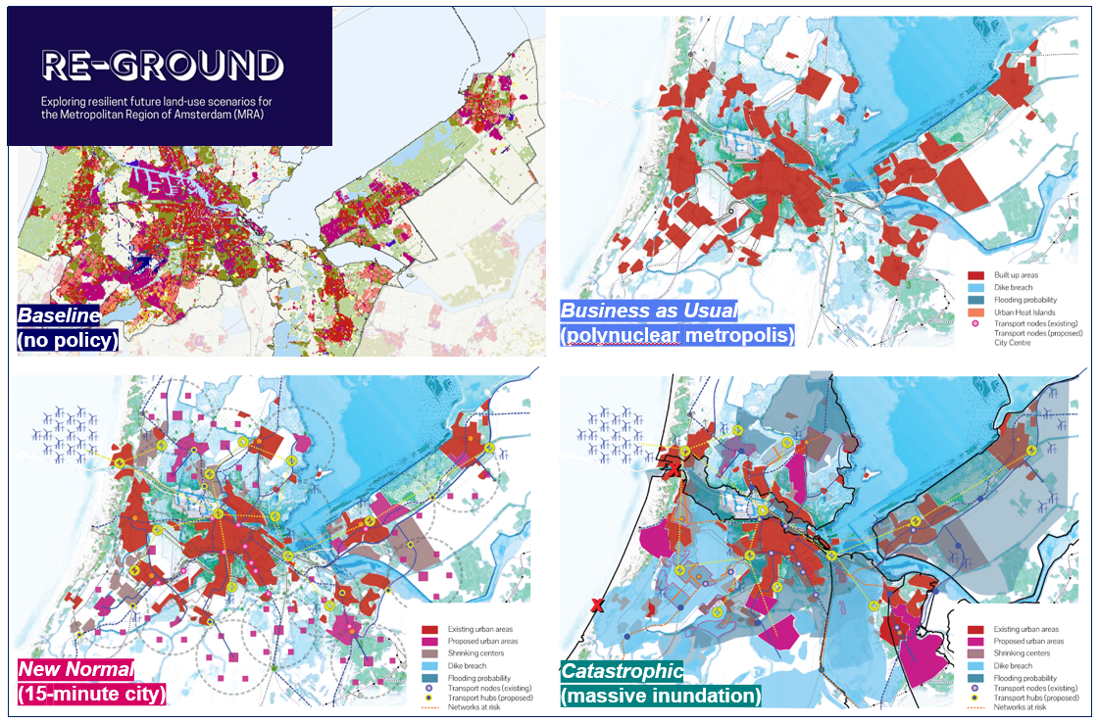
Accessibility planning for the future
Source: https://www.tudelft.nl/en/stories/articles/the-future-ground-planning-cities-for-an-uncertain-future
Notes:
Here is an example of th Difference between conceptual scenarios and actual scenarios

Slide 13

thank you!

