Slide 1

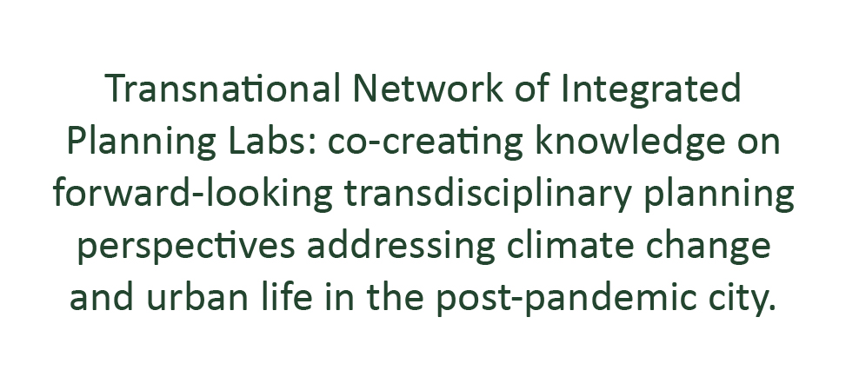







Project: Erasmus+ 2023-1-EL01-KA220-HED-000160477
Co-funded by the European Union. Views and opinions expressed are however those of the author(s) only and do not necessarily reflect those of the European Union.
Neither the European Union nor the granting authority can be held responsible for them.

Slide 2

Transnational Network of Integrated Planning Labs:
Co-creating knowledge on forward-looking transdisciplinary planning perspectives addressing climate change and urban life in the post-pandemic city
Project number: 2023-1-EL01-KA220-HED-000160477 Erasmus+
Qualitative Methods
For Integrated Spatial Planning
5/6/2025
Project: Erasmus+ 2023-1-EL01-KA220-HED-000160477
Co-funded by the European Union. Views and opinions expressed are however those of the author(s) only and do not necessarily reflect those of the European Union.
Neither the European Union nor the granting authority can be held responsible for them.
Notes:
Hello everyone. My presentation today is on Qualitative Methods for Integrated Spatial Planning. We will explore how methods like interviews, observations, and participatory techniques can help us understand urban life and inform inclusive, responsive planning strategies. There will be connections with the next lecture given by CS on participatory methods as well.

Slide 3
Qualitative Methods for Integrated Spatial Planning
Introduction
Integrated Spatial Planning
What are qualitative methods and why are they essential?
How do they complement quantitative methods?
Quantitative Methods
Measurable patterns
Qualitative Methods
Human experience
Notes:
Integrated spatial planning is a strategic and holistic approach to managing land use and development that considers social, economic, environmental, and governance factors across different sectors and geographic scales.
Quantitative methods provide measurable, data-driven insights to inform design decisions, validate hypotheses, and predict outcomes. They can miss contextual nuances and users’ perspectives. This is where qualitative methods come in. Qualitative methods allow us to capture human experience—things like perception, culture, social practices—that can’t be fully represented by numbers. In integrated planning, these methods are essential because they highlight lived realities, making planning more context-sensitive and inclusive. They don’t replace quantitative methods—they complement them.

Slide 4
Qualitative Methods for Integrated Spatial Planning
Introduction
Qualitative Methods
Interviews
Focus Groups
Ethnographic Observations
Participatory Design
Post-Occupancy Evaluations
Qualitative methods uncover human experiences, cultural contexts, and intangible factors that shape design decisions. Micro & meso scales.
Strengths: reveals hidden needs, fosters inclusivity, contextual richness
Limitations: time/labour intensive, subject to biases
Notes:
Qualitative methods insight into the human factor and user needs to inform design decisions or adjustments made after a project’s completion. Best used at the micro and meso scales as it would be hard to process the data for the macro scale.
Here’s a quick overview of key qualitative methods
Interviews & Focus Groups | Purpose: Capture stakeholder needs, preferences. Example use: assessing occupant needs in project stage design
Ethnographic Observations | Purpose: Study people’s behaviour in the built environment. Jan Gehl’s "soft data" approach observing Copenhagen’s public life to inform pedestrian zones
Participatory Design | Purpose: Engage users directly in the design process. Example use: Optimising shading systems or A/C usage
Post-Occupancy Evaluations | Evaluate lived experiences post-construction. Example use: Adjusting layouts according to user preferences

Slide 5
Qualitative Methods for Integrated Spatial Planning
Ethnogaphic observations
Ethnographic observations
Behavioural mapping (Track movements/activities in space over time). Outputs: annotated maps, time-lapse photography
Shadowing (Follow users to document experience). Outputs: notes, photographs
Diary Studies (Users self-report experiences) Outputs can use different media as appropriate such as text/audio/photo or combination
Technically easy to perform with use of simple tools and software but sometimes labour/time intensive.
Complement quantitative data with contextual richness, capture social interactions, real-world behaviours and users’ needs.
Notes:
Ethnographic methods like help us observe real-world behavior in context. They are powerful because they reveal habits, conflicts, or needs that wouldn’t emerge from surveys or models alone. Technically easy to perform with use of simple tools and software but sometimes labour/time intensive.
Examples include:

Slide 6
Qualitative Methods for Integrated Spatial Planning
Interviews
Structured & Semi-structured Interviews
Structured interviews: closed-ended questions (e.g. Likert scale), follow a script (or questionnaire), statistical data analysis easy to carry out.
Semi-structured interviews: guided by core questions with follow ups, balances standardisation and depth, adapts based on responses, identifies themes/patterns.
Un-structured interviews are more open-ended and conversational, commonly used to record oral histories.
Commonly a combination of structured/semi-structured questions are employed together. Gives a ‘why’ to standardised responses, combines experience with quantitative metrics.

Slide 7
Qualitative Methods for Integrated Spatial Planning
Focus Groups & Workshops
Focus Groups & Workshops
Focus Groups (Gather insights, opinions, experiences from stakeholders. Understand perceptions rather than offer solutions)
Workshops (Co-create, develop ideas, make collaborative decisions. Focus on producing outputs or actionable design insights)
Combination of methods e.g. city walks with guided conversations
These methods offers both deep insights and practical outcomes, grounding design in both lived experience and collaborative agency.
Notes:
Focus groups are useful for exploring attitudes and perceptions—they help planners identify issues. Workshops are more action-oriented; they co-create ideas or solve problems. Often, they’re combined—for example, a city walk that ends in a design workshop. Together, they offer both insight and shared ownership.

Slide 8
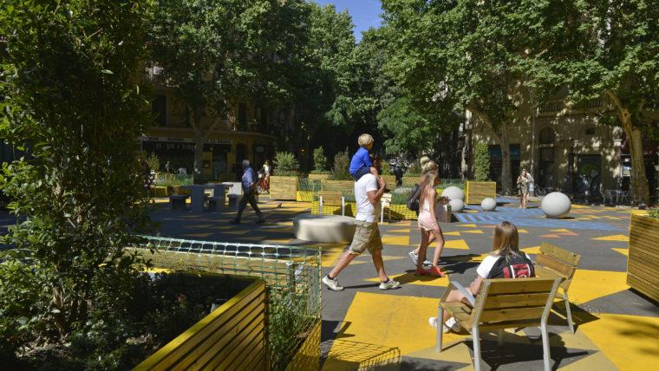

Qualitative Methods for Integrated Spatial Planning
Applications in Spatial Planning: Barcelona’s Superblocks
Observational & Qualitative studies
Focus Groups with elderly residents, people with mobility challenges, and caregivers.
Transect Walks with diverse community members—children, parents, disabled individuals—along planned routes within proposed Superblock areas.
Participatory Mapping: Residents annotated maps with areas of interest and brought photos to discuss positive/negative experiences in the space.
Notes:
In Barcelona, qualitative methods were used to in the project of newly pedestrianized 'Superblocks.' Focus groups with elderly residents and transect walks with families revealed concerns about comfort, shade, and safety. Participatory mapping allowed people to mark areas of importance. These insights shaped more inclusive redesigns. Qualitative methods were deployed both before/during the design process, as well as afterwards to assess the impact and success of the project.

Slide 9
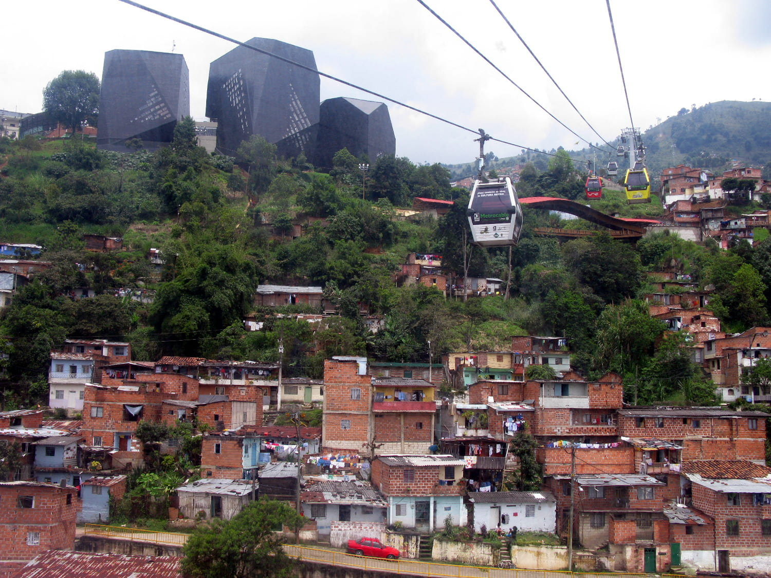
Qualitative Methods for Integrated Spatial Planning
Applications in Spatial Planning: Medellin’s Metrocable System
Co-Designing Mobility in Informal Settlements
Interviews with hillside residents revealed mobility barriers: time, danger, cost.
Workshops and visioning sessions identified mobility as both a social right and safety issue.
Local knowledge guided station placement and access paths.
Result: integration of cable cars into urban transit + improved stairs, lighting, and parks.
Notes:
Medellín’s hillside neighborhoods were once disconnected from the city core due to steep terrain and informal street networks. Through interviews and workshops, residents explained how their daily commutes involved hours of walking and high risk.
Planners used this input to co-design the Metrocable—a cable car system integrated into the public transport network. Stations were placed near key desire lines, and interventions extended beyond the stations—stairs were rebuilt, lighting added, and adjacent public spaces improved. This project shows how qualitative methods can lead to infrastructural and social transformation, especially when addressing spatial inequality.

Slide 10
Qualitative Methods for Integrated Spatial Planning
Resources & references
Resources
Gehl, J. (2011). Life Between Buildings
Public Life Tools – Gehl Institute; https://thinkcityinstitute.org/wp-content/uploads/2021/09/Public-Life_Complete_Guide.pdf
Pink, S. (2013). Doing Visual Ethnography
UN-Habitat. (2024). An Incremental and Participatory Toolbox for Urban Planning
Sheydayi, A. & Dadashpoor, H. (2023). Conducting qualitative content analysis in urban planning research and urban studies
Jacobs, J. (1993). The City Unbound: Qualitative Approaches to the City
Notes:
Here are a few resources to help you explore qualitative methods further. The books and articles provide both theory and practical case studies. The toolkits, like UN-Habitat’s, offer participatory templates. These tools are valuable if you’re looking to bring qualitative depth into your future spatial planning work.

Slide 11

thank you!

Slide 12


