Slide 1
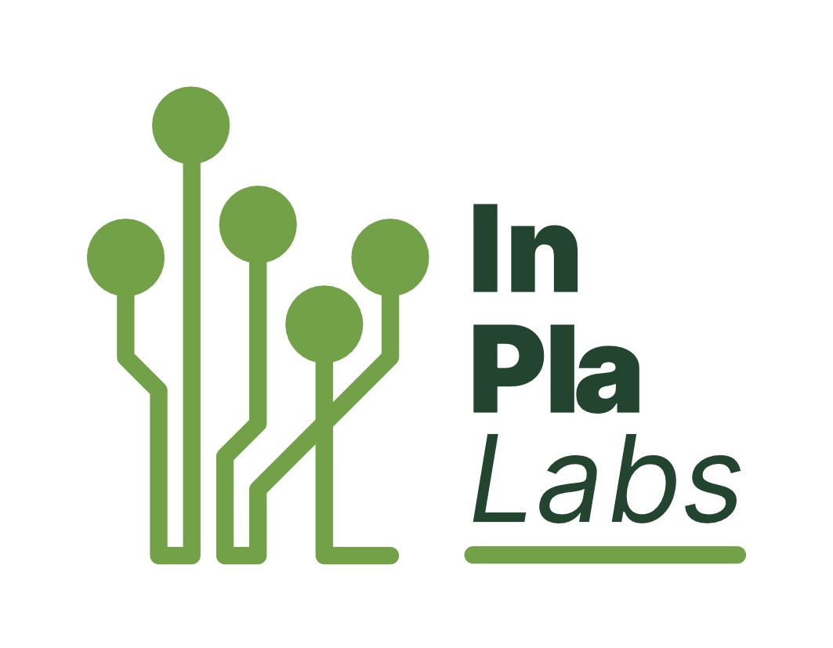







Transnational Network of Integrated Planning Labs:
Co-creating knowledge on forward-looking transdisciplinary planning perspectives addressing climate change and urban life in the post-pandemic city
Project number: 2023-1-EL01-KA220-HED-000160477 Erasmus+
Qualitative and Participatory methods for integrated spatial planning II
June 5th, 2025
Project: Erasmus+ 2023-1-EL01-KA220-HED-000160477
Co-funded by the European Union. Views and opinions expressed are however those of the author(s) only and do not necessarily reflect those of the European Union.
Neither the European Union nor the granting authority can be held responsible for them.

Slide 2
Designing and Implementing Participatory Exercises | Concrete Steps
[B. Implementation of the participatory design activity]
Ask for feedback
Document and Share
Define Next Steps
[C. Evaluation of the process]
Concept Synthesis
Foster Idea and Dialogue Generation
Choose Facilitation Techniques and tools.
[A. Preliminary stage]
Set the Agenda and find the right space
Inform the group of participants
Elaborate a stakeholders’ analysis
Define action’s objectives

Slide 3
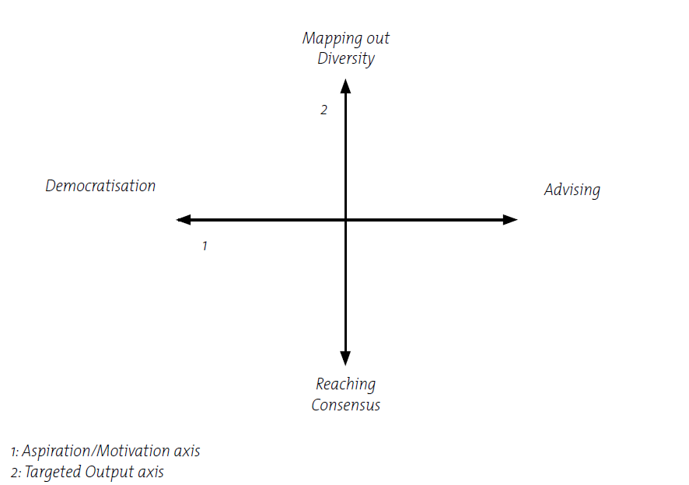

Which method should we use?
Objectives: Reasons for involvement and expected outcomes
Topic: The nature and scope of the issue
Participants: Who is affected, interested or can contribute to solutions
Time: Amount of time available
Budget: Availability of resources

Slide 4


Participatory Methods
These are overarching approaches or strategies used to engage stakeholders (such as community members) in decision-making, planning, or data collection.
They guide how participation happens.
vs
Participatory Tools
These are specific instruments or techniques used within participatory methods to facilitate engagement or gather data.

Slide 5
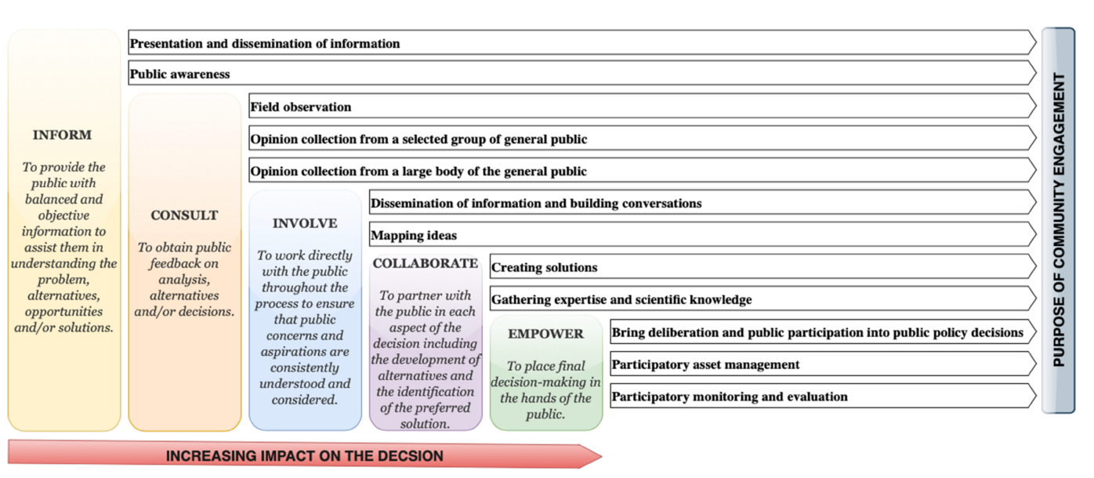
Purpose(s) of community engagement in each level of public participation
Source: Geekiyanage et al. (2021)

Slide 6
Participatory Methods and Tools
Public awareness
Strengths
Relatively easy to convene, familiar procedures can involve a wide range of stakeholders
Provides an opportunity to relay information, explain processes and gather feedback with a large group of people
Participatory Method
Public meetings
Tools
Presentation followed by questions and answers
Town-hall meeting
Panel/roundtable
Large group/small group
Limitations
Discourages those not used to speaking in larger groups
Can be difficult to control
The audience is not likely to be representative
Attendance levels can be low unless people feel deeply connected to the issue and/or make the time to attend
Ensure the meeting place is accessible

Slide 7

Participatory Methods and Tools
Opinion collection from a large body of the general public
Participatory Method
Focus groups
Tools
Face to face
Virtual tools: Microsoft Teams, Zoom, Skype, Mural
Strengths-Limitations
Can explore different perspectives of a small group of people of a common issue/goal
Not effective for providing information to the public

Slide 8
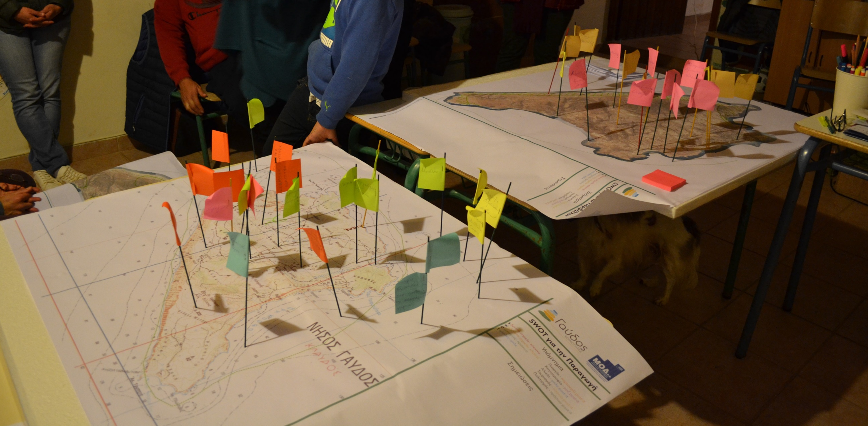
Participatory Methods and Tools
Mapping ideas
Participatory Method
Community
mapping/Mind mapping
Tools
Round tables
Public participatory geographic information system (PPGIS)
Virtual mapping tools
Strengths-Limitations
Enable citizens to map the social, ecological and economic assets, along with historical events of their community
A useful way for initiating dialogue and planning in a community
The method can be used to document certain aspects, strengths or weaknesses, or locations of services within a community, neighborhood, or municipality
Time-consuming
Expensive in process

Slide 9
Participatory Methods and Tools
Opinion collection from a large body of the general public
Bring deliberation and public participation into public policy decisions
Participatory Method
Visioning
Tools
Facilitated idea-sharing and recording
Notecard/flip chart brainstorming
Graphic facilitation (e.g., PATHTM)
Strengths-Limitations
Brings citizens and stakeholders together to assist a group of stakeholders in developing a shared vision of the future
Require long-term commitment
It may be challenging to give a healthy balance of attention to each of the areas determined to be important in the community

Slide 10
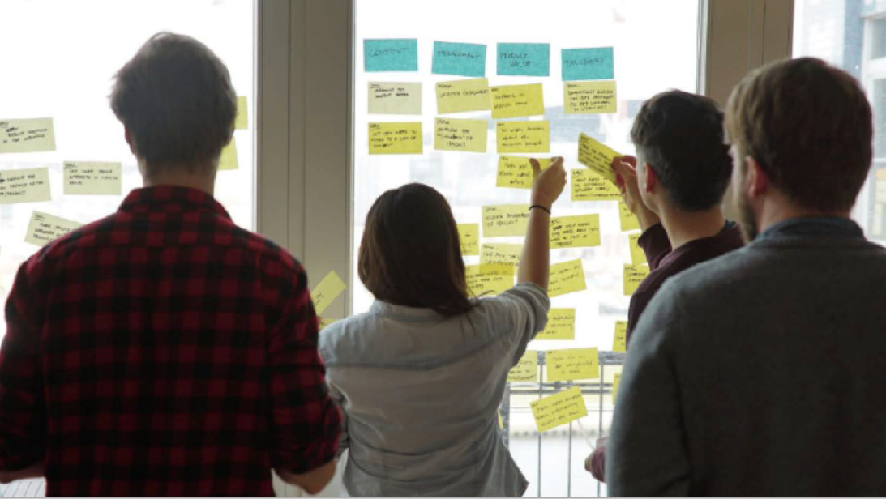
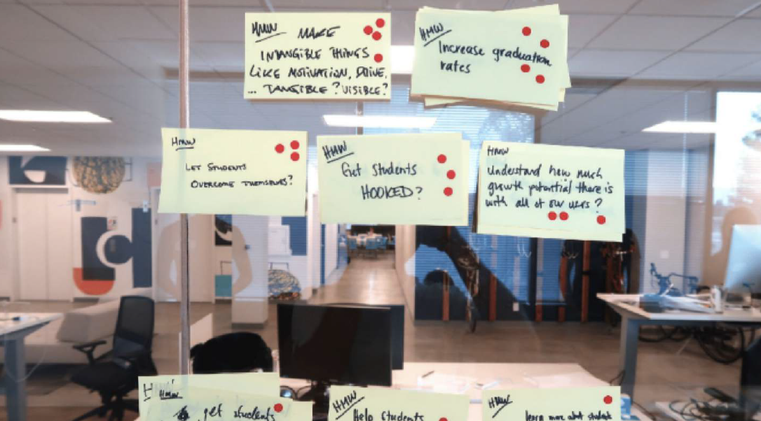
Participatory Methods and Tools
Creating Solutions
Participatory Method
Workshop,
Open space
events
Tools
Physical workshops
Remote workshops using Mentimeter, Slido, Go Create)
Strengths-Limitations
Help to translate detailed discussions into action plans
Provide an opportunity to bring together the knowledge of all participants and is attractive because they set the workshop agendas
Participants attending may have very disparate skills and knowledge
Logistics-It can be difficult to arrange meetings and workshops for different geographical locations and time zones
Ideas Workshops

Slide 11
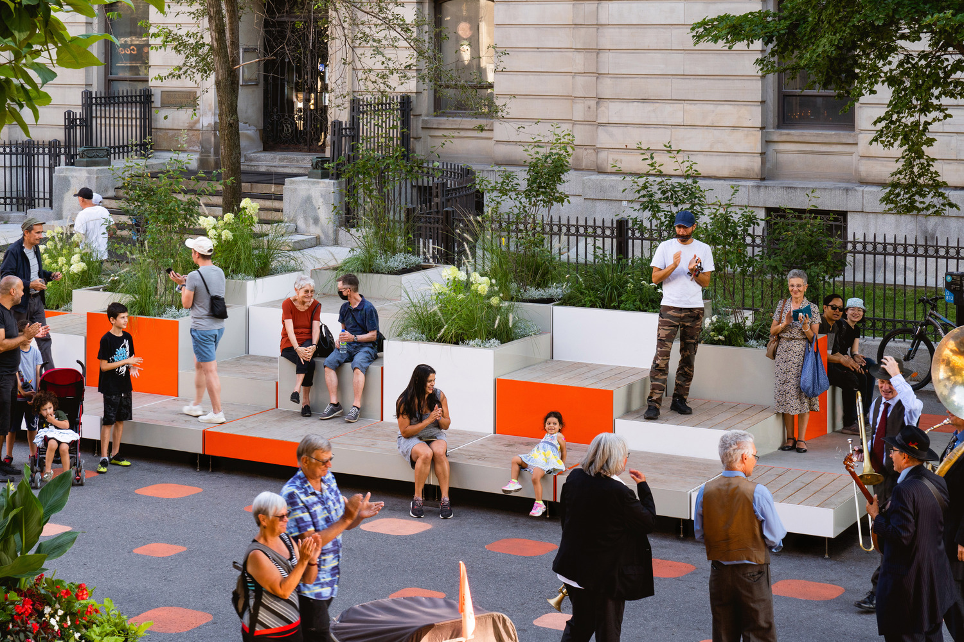
Participatory Methods and Tools
Creating Solutions
Participatory Method
Design charrette,
Tactic-urbanism
(Placemaking, Pop-ups)
Tools
Physical gathering
Digital tools such as SketchUp, Dynamo, Grasshopper
Strengths-Limitations
Provide a forum for ideas and offers the unique advantage of giving immediate feedback to the designers
With multiple perspectives represented in the charrette, it is challenging and time-consuming for all involved to agree on the final design solution
Experts may dominate it
Public Space, Montreal, Canada
Architects: LAAB Collective

Slide 12
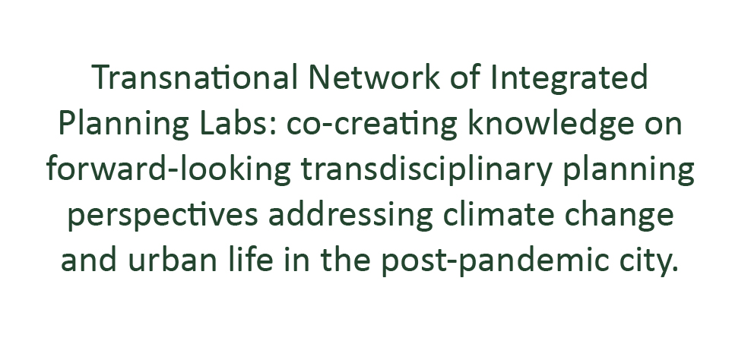


Thank you!

