Slide 1
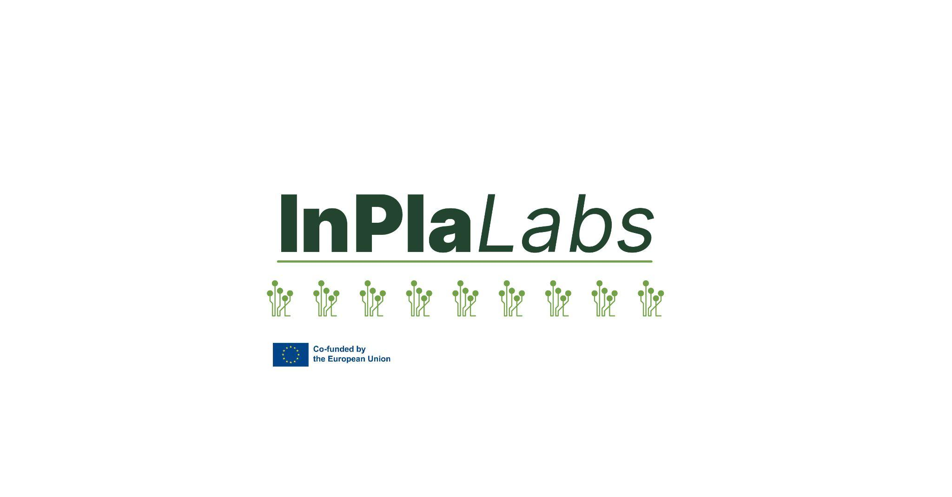
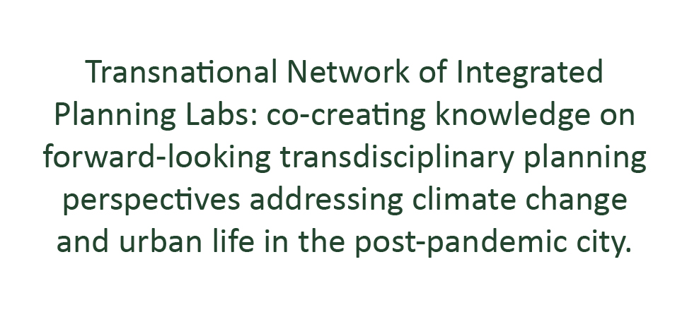

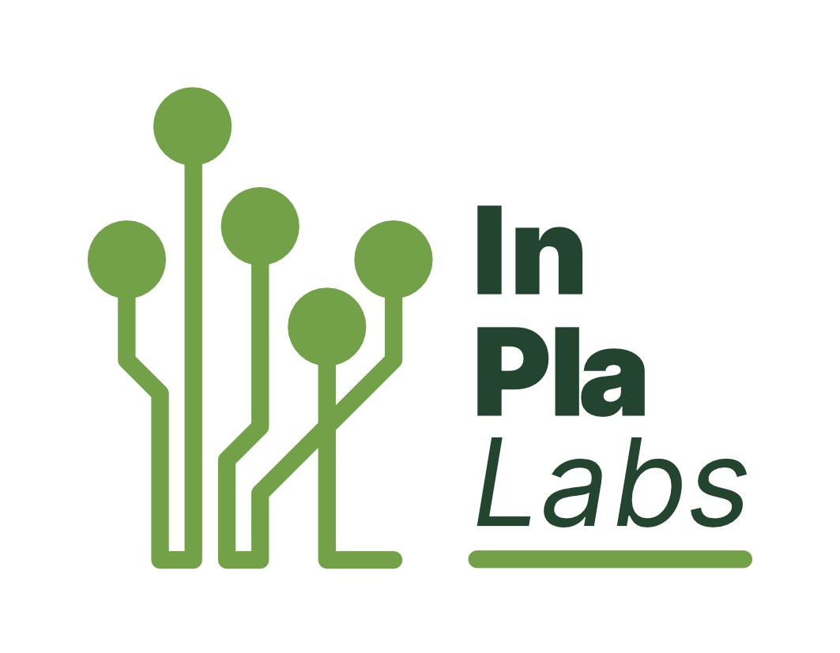





Project: Erasmus+ 2023-1-EL01-KA220-HED-000160477
Co-funded by the European Union. Views and opinions expressed are however those of the author(s) only and do not necessarily reflect those of the European Union.
Neither the European Union nor the granting authority can be held responsible for them.

Slide 2

Transnational Network of Integrated Planning Labs:
Co-creating knowledge on forward-looking transdisciplinary planning perspectives addressing climate change and urban life in the post-pandemic city
Project number: 2023-1-EL01-KA220-HED-000160477 Erasmus+
InPlaLabs Methodological Resources
Knowledge Sharing Workshop, 5th June 2025
The crucial mixed-methods approaches for climate-resilient integrated planning of the contemporary European city
Stefanos Tsigdinos, Yannis Paraskevopoulos
Department of Geography and Regional Planning, NTUA
Project: Erasmus+ 2023-1-EL01-KA220-HED-000160477
Co-funded by the European Union. Views and opinions expressed are however those of the author(s) only and do not necessarily reflect those of the European Union.
Neither the European Union nor the granting authority can be held responsible for them.

Slide 3
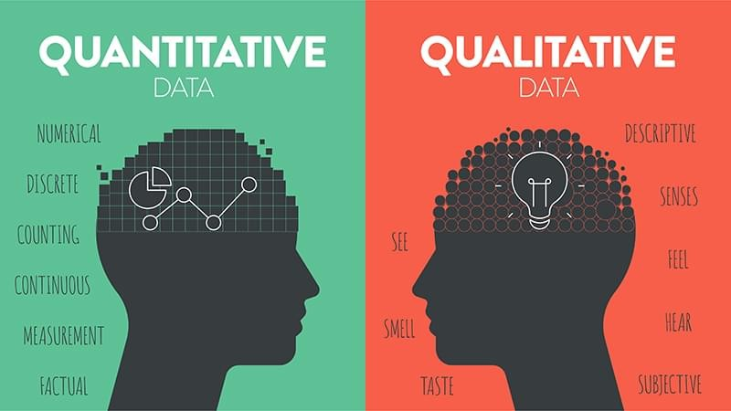
What methods we need for integrated planning?
Qualitative
OR
Quantitative
Source: https://www.linkedin.com/pulse/unveiling-philosophical-layers-quantitative-vs-prabath-mudalige-wmjvc/

Slide 4
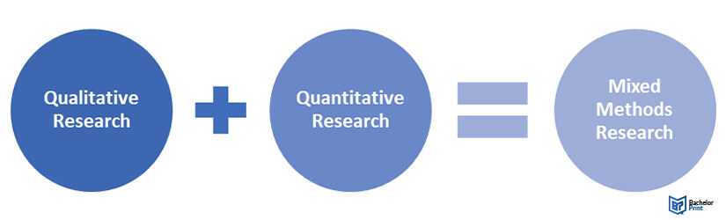

Going beyond the traditional “dipole”
Source: https://urbanland.uli.org/planning-design/de-infrastructuring-in-the-era-of-the-15-minute-city
Integrated planning needs integrated methods!

Slide 5
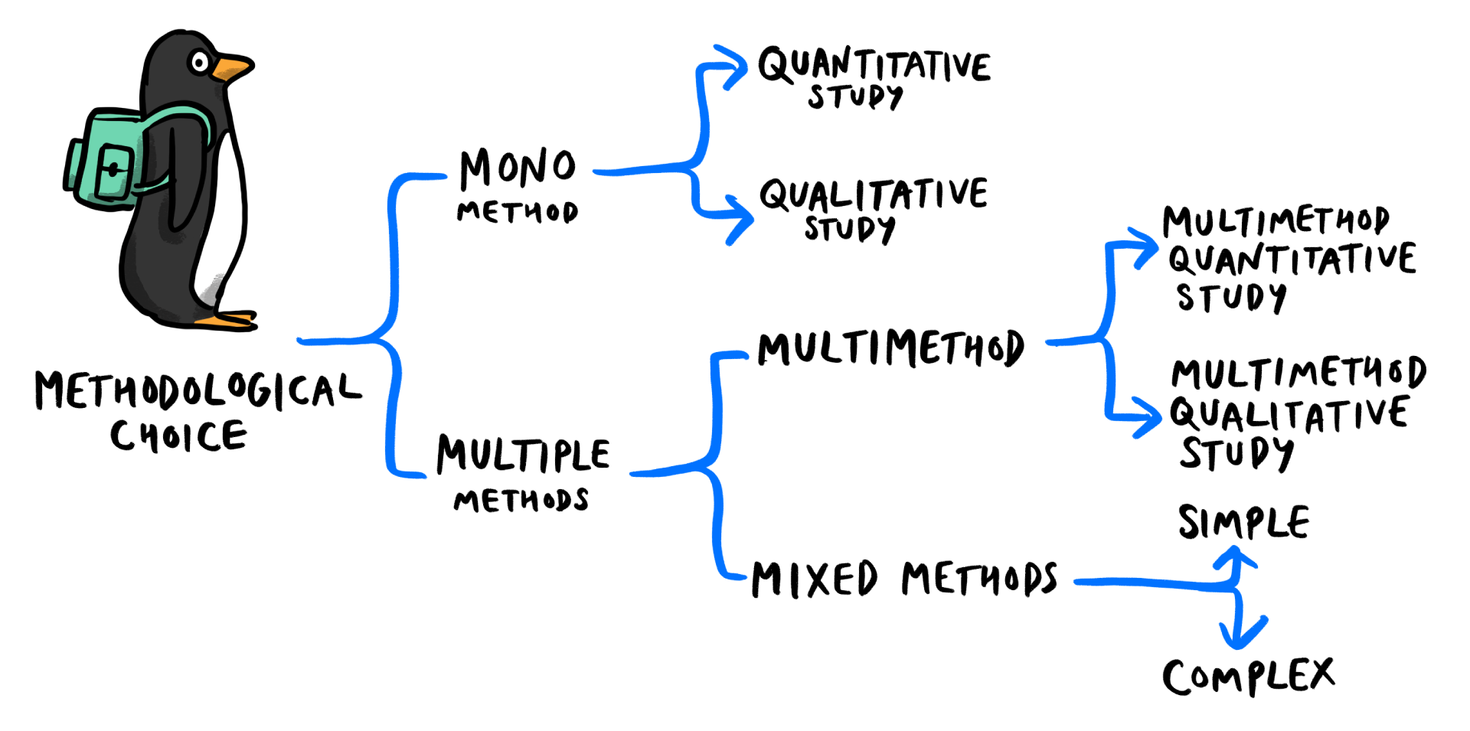
Integrated planning needs integrated methods!
Source: https://open.library.okstate.edu/gognresearchmethods/chapter/mixed-methods-triangulation-2/

Slide 6
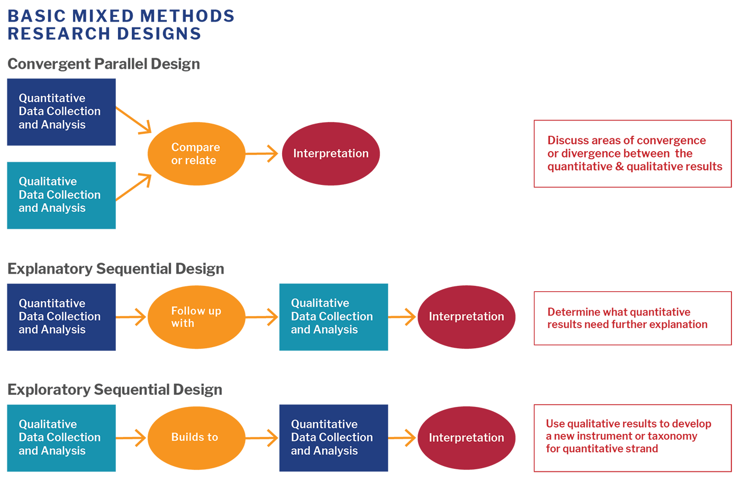
Integrated planning needs integrated methods!
Source: https://catalyst.harvard.edu/

Slide 7








Integrated planning needs integrated methods!
Delineating ways of thinking: Strand 1
Strategic vision || scenarios
Implementation
Participation + In-depth qualitative techniques
Connectivity vs Proximity + GIS/Spatial analysis

Slide 8
Integrated planning needs integrated methods!
Delineating ways of thinking: Strand 2
Planning alternatives
Evaluation of planning process
Connectivity vs Proximity + GIS/Spatial analysis
Participation + In-depth qualitative techniques

Slide 9

Integrated planning needs integrated methods!
Delineating ways of thinking: Strand 3
Strategic vision || scenarios
Implementation
Evaluation
Accessibility+ GIS/Spatial analysis
Participation + In-depth qualitative techniques
Participation + qualitative techniques

Slide 10
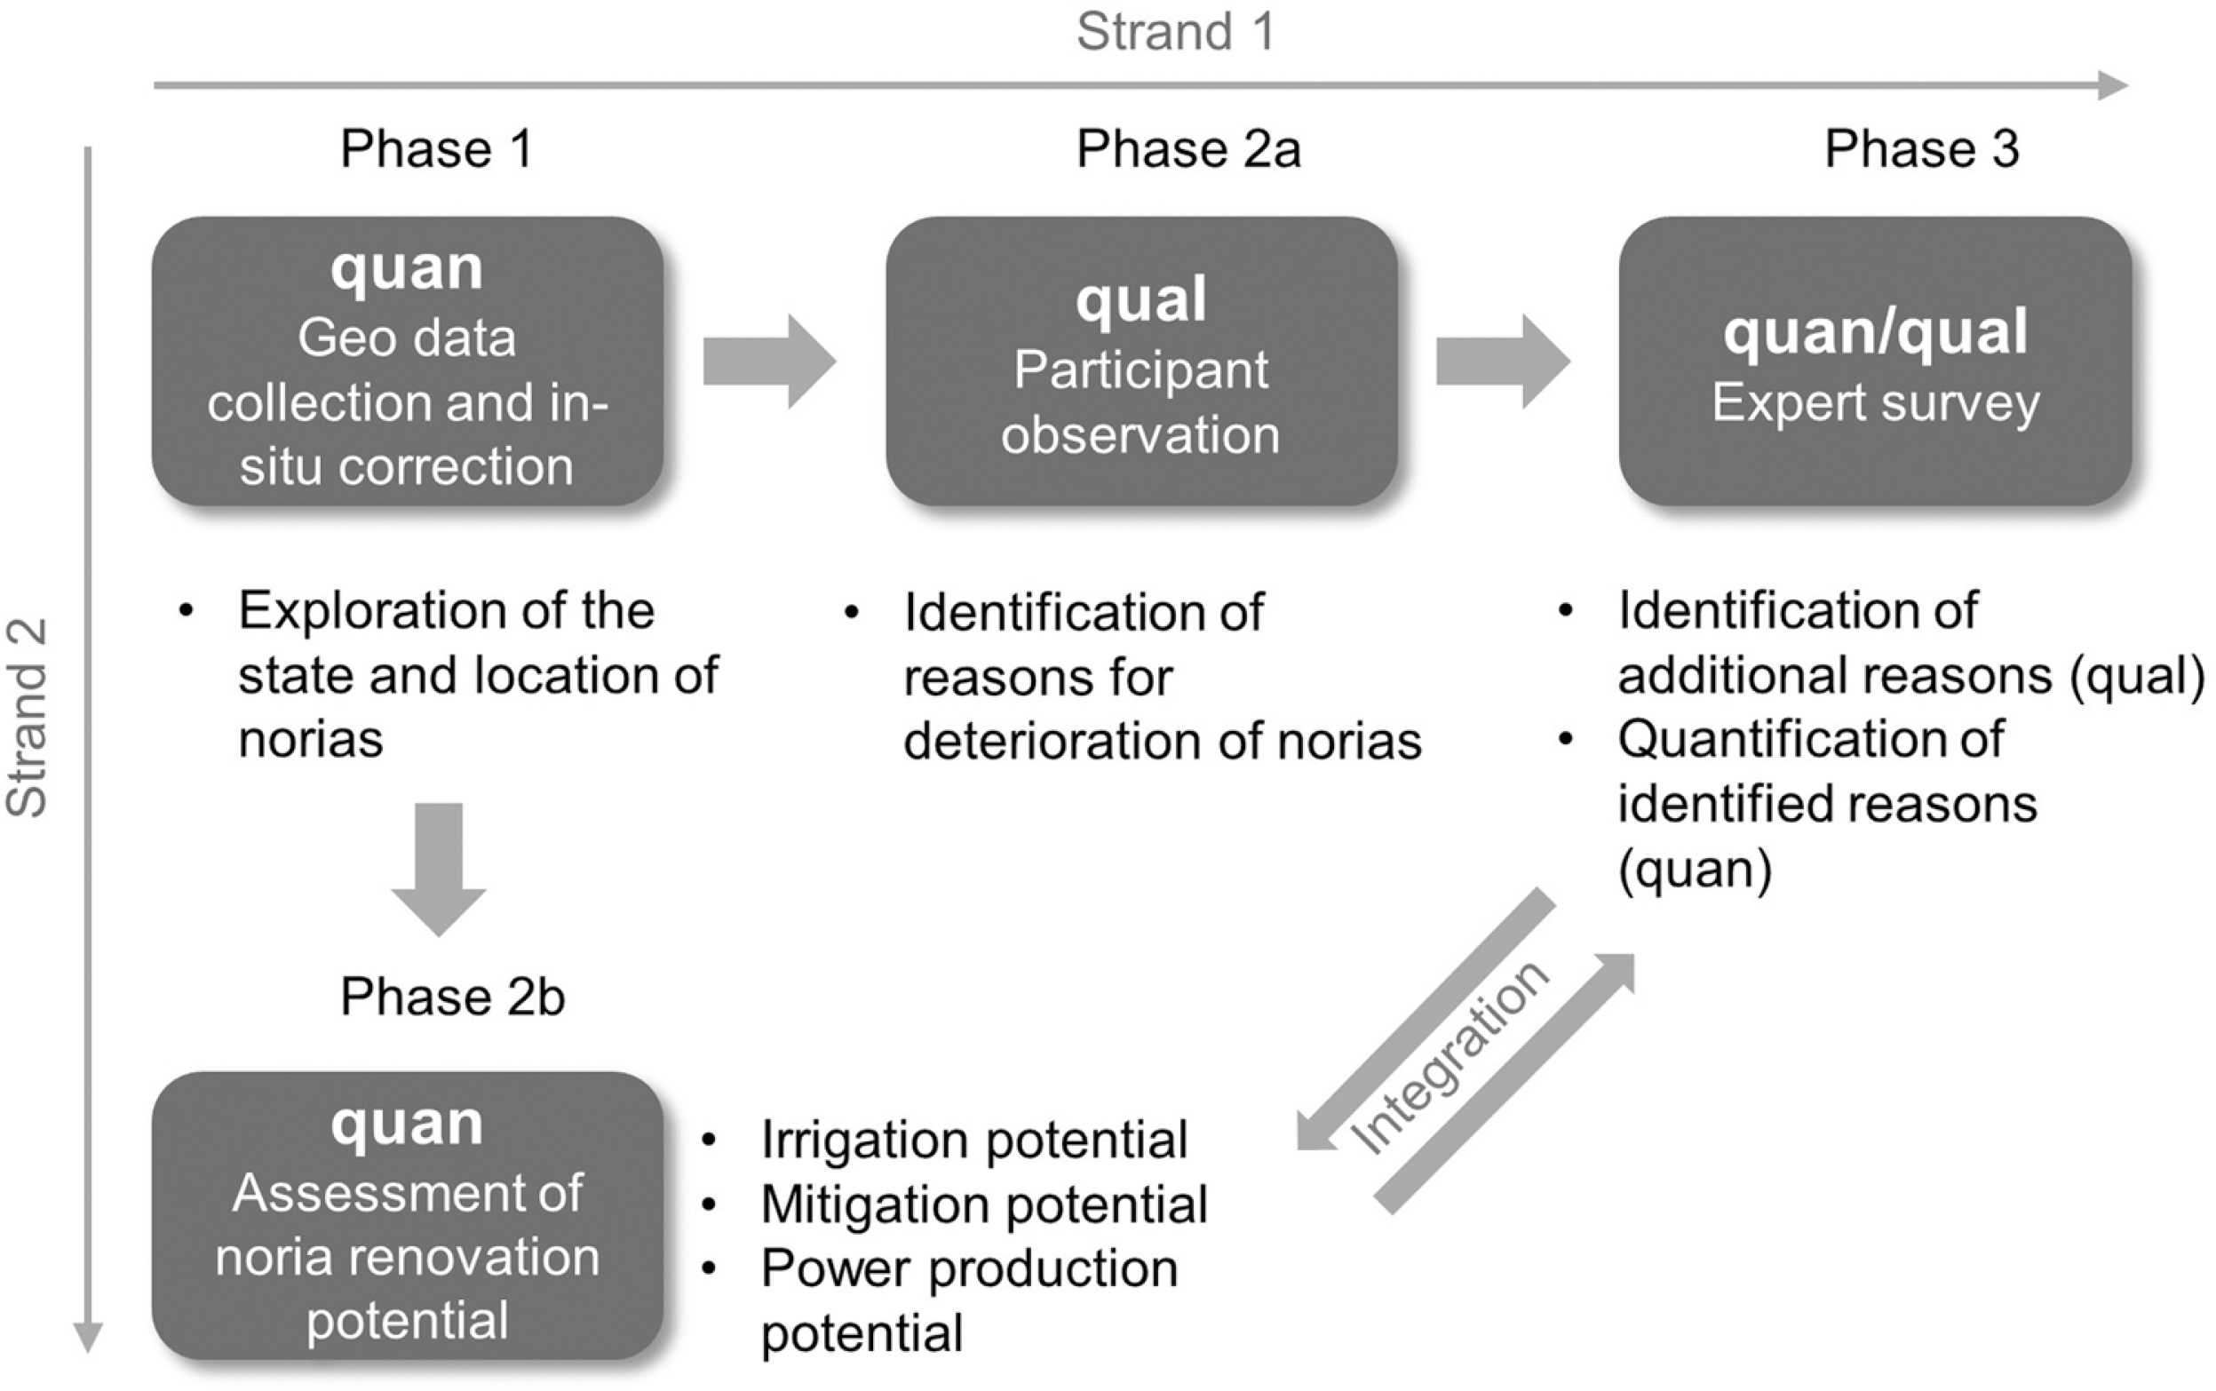
Integrated planning needs integrated methods!
Source: Heider et al., 2022

Slide 11
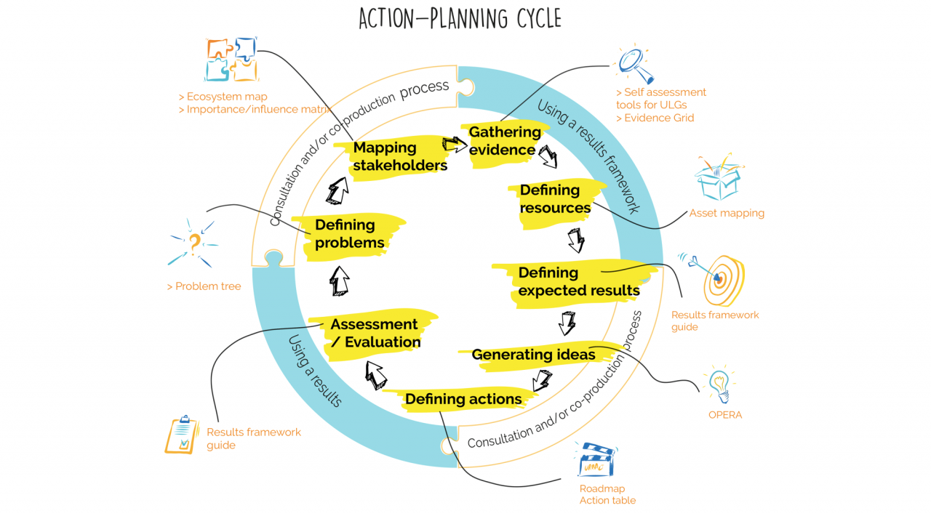
Integrated planning needs integrated methods!
Source: https://urbact.eu/articles/urbact-another-paradigm-european-cities

Slide 12






Integrated planning needs integrated methods!
Planning a city taking the integrated (methods) path!
City Y: Strategic vision for 2025
Planning the measures
Evaluating the measures
Focus group for building the scenarios
Participatory workshop for choosing the best scenario
Connectivity planning for neighbourhoods
GIS planning for actual connections
Focus group for identifying the impacts
Spatial indicators for measuring the impacts

Slide 13

Integrated planning needs integrated methods!
Available tools and methods
Selected tools and methods
Objective
Objective
Choose your methods and tools wisely!
Objective
Objective

Slide 14

thank you!

