Slide 1

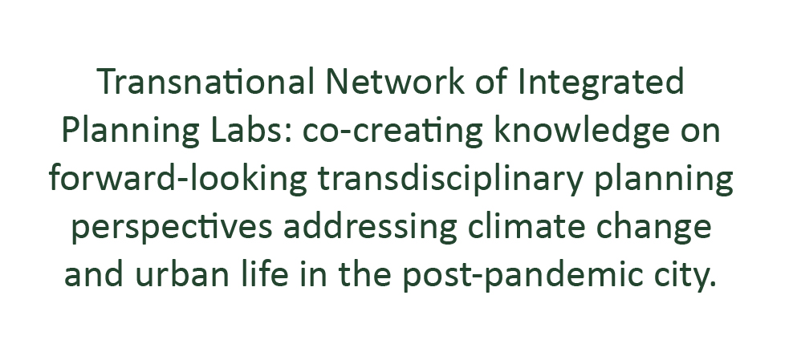







Project: Erasmus+ 2023-1-EL01-KA220-HED-000160477
Co-funded by the European Union. Views and opinions expressed are however those of the author(s) only and do not necessarily reflect those of the European Union.
Neither the European Union nor the granting authority can be held responsible for them.

Slide 2

Transnational Network of Integrated Planning Labs:
Co-creating knowledge on forward-looking transdisciplinary planning perspectives addressing climate change and urban life in the post-pandemic city
Project number: 2023-1-EL01-KA220-HED-000160477 Erasmus+
The crucial green and digital skills for climate-resilient integrated planning of the contemporary European city
05/06/2025
Project: Erasmus+ 2023-1-EL01-KA220-HED-000160477
Co-funded by the European Union. Views and opinions expressed are however those of the author(s) only and do not necessarily reflect those of the European Union.
Neither the European Union nor the granting authority can be held responsible for them.

Slide 3

Green and Digital skills
Green technology is a key factor to foster more sustainable urban development. It includes all aspects of city planning, including transportation, infrastructure, telecommunications and energy.
Green tech also supports green living practices, including recycling and use of energy and renewable resources.
Notes:
What is EBDP and how it distinguishes from RID (Research Informed Design) and DDD (Data Driven Design).

Slide 4
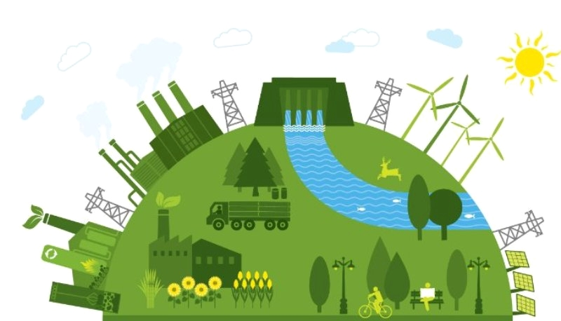
What are Green skills?
Green skills are skills that promote economic growth while protecting the environment. The United Nations define green skills as:
“Green skills are the knowledge, abilities, values, and attitudes needed to live in, develop and support a sustainable and resource-efficient society.”
Green technology is the key to a sustainable future. To adopt greener practices and build healthier cities, we need digital skills, smart connectivity, technology-driven efficiency, and data insights.

Slide 5

Green Digital Transformation
What is it important?
Green digital transformation is important to help cities and regions use digital technologies to advance climate goals while ensuring equity, privacy, and resilience. This aligns with the EU Green Deal’s aim to leverage digital tools for a carbon-neutral, sustainable future.

Slide 6
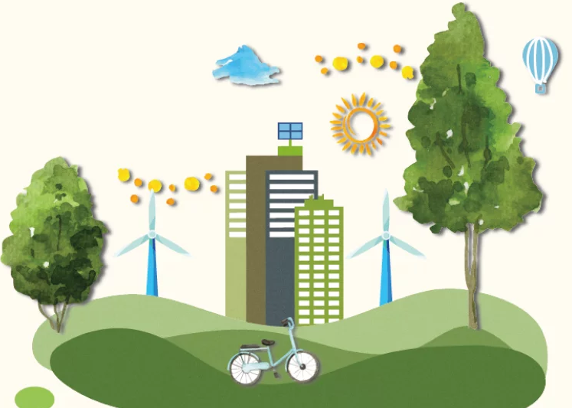
Why do we need green and digital skills
As we combat climate change and aim for carbon neutrality, innovation in science and technology is essential.
Addressing Environmental Crises
Fostering Economic Growth
Green skills will help to effectively combat the challenges confronting modern society, such as climate change, pollution, and resource depletion.
Green technology industries, such as renewable energy and sustainable product development, offer avenues for generating new jobs and driving economic growth.

Slide 7

SDG 9
Industry, innovation and infrastructure
SDG 9 includes the target of upgrading infrastructure and retrofitting industries to make them sustainable, with increased resource-use efficiency and greater adoption of clean and environmentally sound technologies and industrial processes by 2030.
Notes:
green skills are also emphasized in the UN’s Sustainable Development Goals.
It has become essential for both developed and developing countries to shift towards more environmentally sustainable ways of producing and consuming, as mentioned in the 17 Sustainable Development Goals (SDGs).

Slide 8
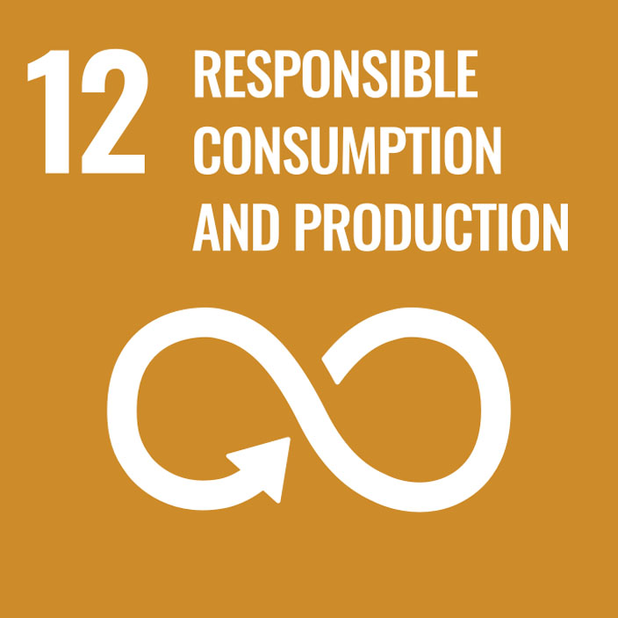
SDG 12
Industry, innovation and infrastructure
SDG 12 includes the target of achieving the sustainable management and efficient use of natural resources by 2030.
Notes:
We can find the reasons for why we need green skills in the UN’s Sustainable Development Goals.

Slide 9
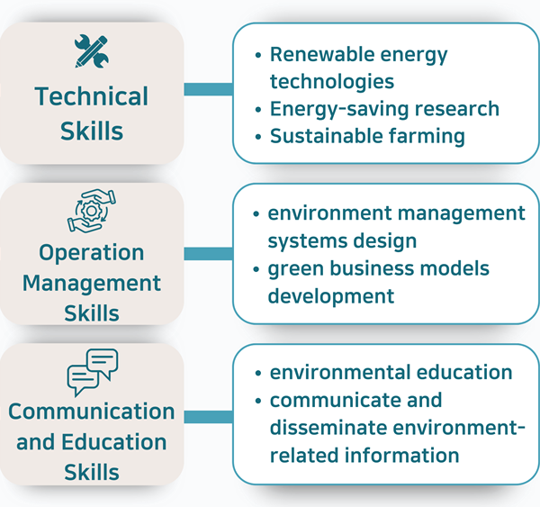
Types of green skills
They can be divided into three main categories.
Technical Skills, Operation Management Skills and Communication and Education Skills.
Different countries and regions focus on different green skills, and the scope and content of green technologies are constantly changing as technology advances in environmental and sustainability.

Slide 10
Summary
Green Skills
Digital Skills
Competences enabling low‑carbon, circular & nature‑positive solutions
Covering: climate‑risk analysis, nature‑based solutions (NBS), renewable‑energy planning, circular materials, stakeholder co‑creation
Competences to collect, model & exploit spatio‑temporal data
GIS, remote sensing, BIM/3D city models, IoT, AI/ML analytics, Urban Digital Twins

Slide 11
Summary
Key Green Skills
Key Digital Skills
Cluster | Typical competences
Climate‑Risk | downscaled hazard mapping, vulnerability indexing
Nature‑Based Solutions | ecosystem‑service valuation, green‑infrastructure design
Energy & Mobility | district energy modelling, SUMP & multimodal planning
Circularity | material‑flow analysis, LCA
Social & Equity | participatory facilitation, just‑transition finance
Cluster | Typical competences
Geospatial | advanced GIS, EO/Copernicus data exploitation
Modelling | Digital‑twin building, scenario testing, CFD/heat‑island sims
Information Models | BIM ↔ GIS integration, open standards
Data & AI | Python/R, machine learning, dashboarding
Governance | open‑data policy, GDPR, cyber‑security
Notes:
In conclusion, green skills are indispensable tools in the battle against climate change and building of a sustainable future.

Slide 12

thank you!

