Slide 1







Transnational Network of Integrated Planning Labs:
Co-creating knowledge on forward-looking transdisciplinary planning perspectives addressing climate change and urban life in the post-pandemic city
Project number: 2023-1-EL01-KA220-HED-000160477 Erasmus+
Evidence-based design and planning
for addressing climate change and contemporary urban life
Ioanna Stavroulaki,
Co-founder, Urban Calculator /
Associate professor, Spatial Morphology Group_SMoG,
Chalmers university of Technology
05/6/2025
Project: Erasmus+ 2023-1-EL01-KA220-HED-000160477
Co-funded by the European Union. Views and opinions expressed are however those of the author(s) only and do not necessarily reflect those of the European Union.
Neither the European Union nor the granting authority can be held responsible for them.

Slide 2

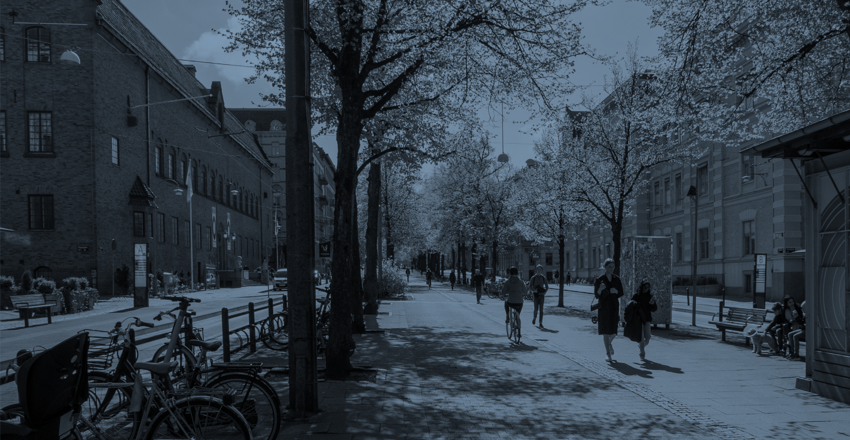
Evidence-Based Design and Planning (EBDP)
is an approach that uses evidence from research and urban analysis to inform and improve design decisions.
We focus on evidence and analysis that link the spatial forms and structures to urban processes of socio-economic and social-ecologic nature (e.g. movement patterns, segregation, development of local markets, microclimate, biodiversity, ecosystem services).

Slide 3
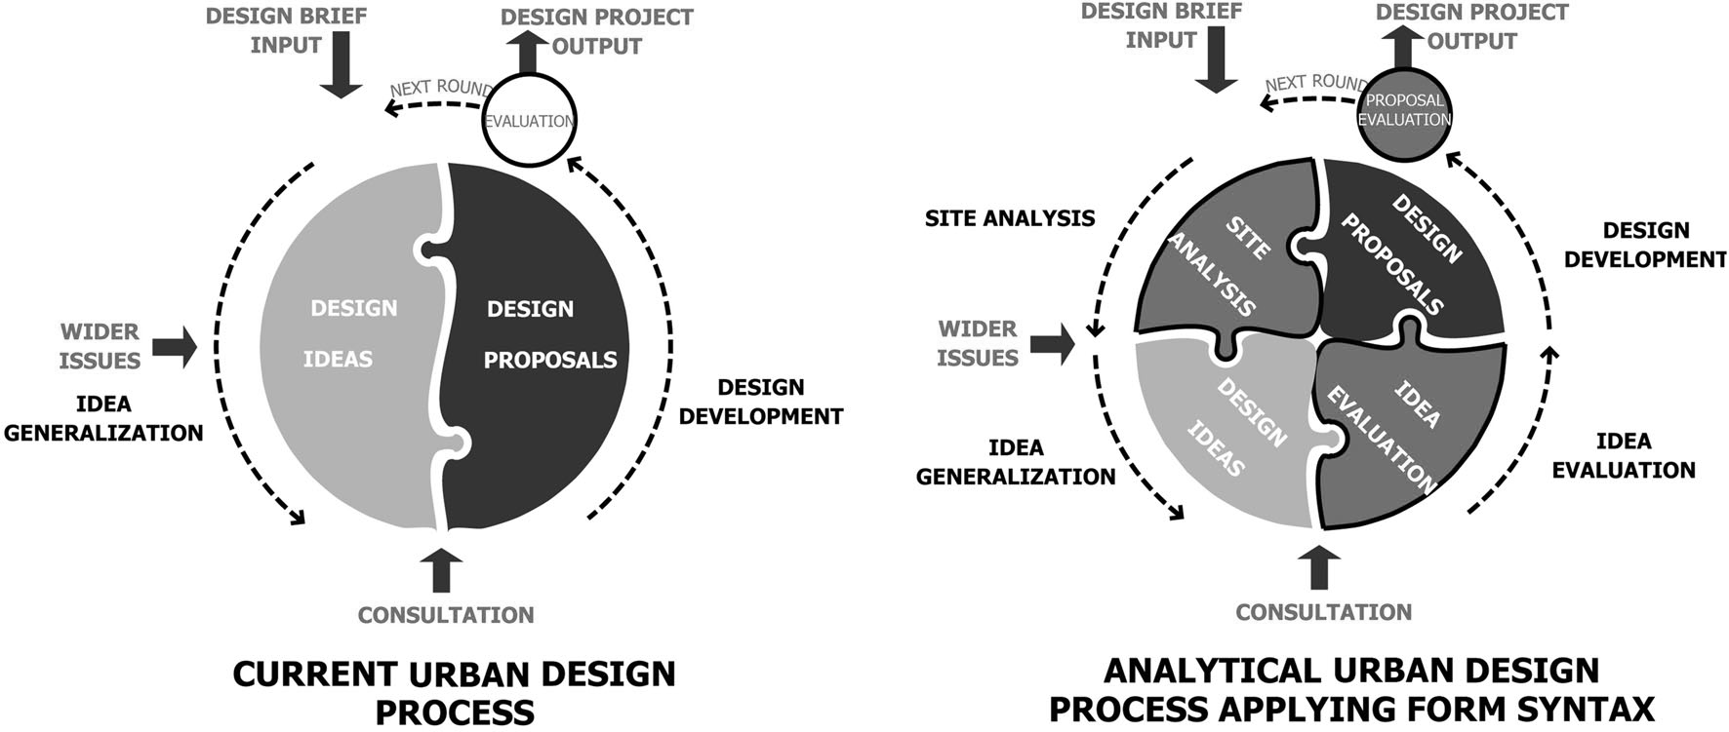
Evidence-based design practice
The role of theory, evidence and spatial analysis
Evidence-based design, which draws from the principles of evidence-based medicine (EBM), requires that design decisions are informed by the best available research.
In contrast to the conventional design process that often relies on intuition, artistic inspiration, or precedent (best-practices), EBD emphasizes the use of rigorous scientific evidence to guide decision-making.
Because design is considered a wicked or ill-defined problem, creative solutions are required, and this is what dominates many of the teaching curricula in architectural and urban design schools (Karimi 2020).
This is not a problem per se, but the huge weight of
generating creative ideas has put other stages of the design process, such as knowledge accumulation, design evaluation and design impact assessments to the background.
Berghauser Pont, M., 2024
Yu Ye et al. 2017

Slide 4
Evidence-based design practice
The role of theory, evidence and spatial analysis
It is not an either-or process. We need both!
Design 'includes an iterative, interconnected series of explorations which sometimes is led by logical thinking and sometimes by intuitive creations’ (Karimi 2020)
In the light of great societal and environmental challenges many academics and professionals are calling for a paradigm shift in the architectural profession to be able to contribute to the solution of these challenges.
Yu Ye et al. 2017

Slide 5
Evidence-based design practice
The role of theory, evidence and spatial analysis
Evidence-based design (EBD) is a design method that addresses this challenge by intentionally basing design decisions on the most reliable research evidence. It involves the collaboration between an evidence-based designer and an informed client to make decisions informed by research and project evaluations. The goal of EBD is to achieve the best possible outcomes by incorporating credible research in the decision-making process.
Yu Ye et al. 2017

Slide 6
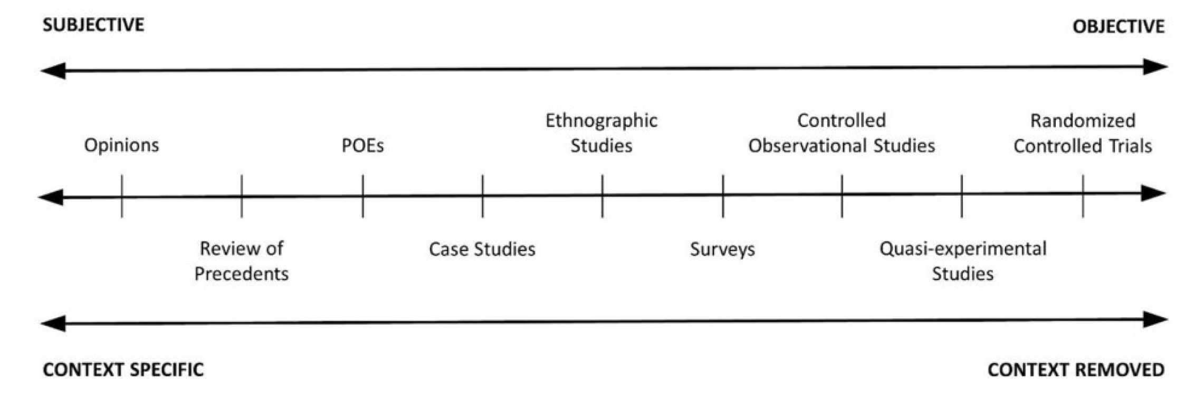
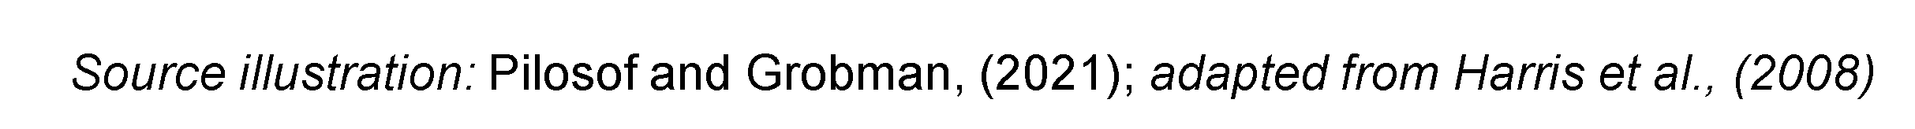
Evidence is the cornerstone of EBD
Types of evidence
Evidence is often confused with experience or precedents, commonly referred to as ‘best practice’
Best practice provides spatial ideas and solutions, but lacks supporting theory to understand the mechanism why something works (Pilosof and Grobman, 2021).
Evidence is often confused with proof
Evidence should instead be understood as it is defined in science, where it is divided into gradients and only the highest levels consider causation.
/ High uncertainty
High certainty /
One could say that the review of precedents or ‘best practice’ covers the lowest level of evidence (is more subjective and context specific), while proven causation based on large samples covers the highest level of evidence.

Slide 7
Evidence is the cornerstone of EBD
Types of evidence
Quantitative spatial analysis, empirical studies, big data and urban analytics, field and observation studies, qualitative analysis, interviews and surveys, scientific reviews and state-of-the-art surveys, are evidence resources for EBD.
They fall in the middle between subjective opinions and scientific proof. They should have an adequate level of accuracy and precision that can guide decision making in a responsible manner.
/ High uncertainty
High certainty /

Slide 8
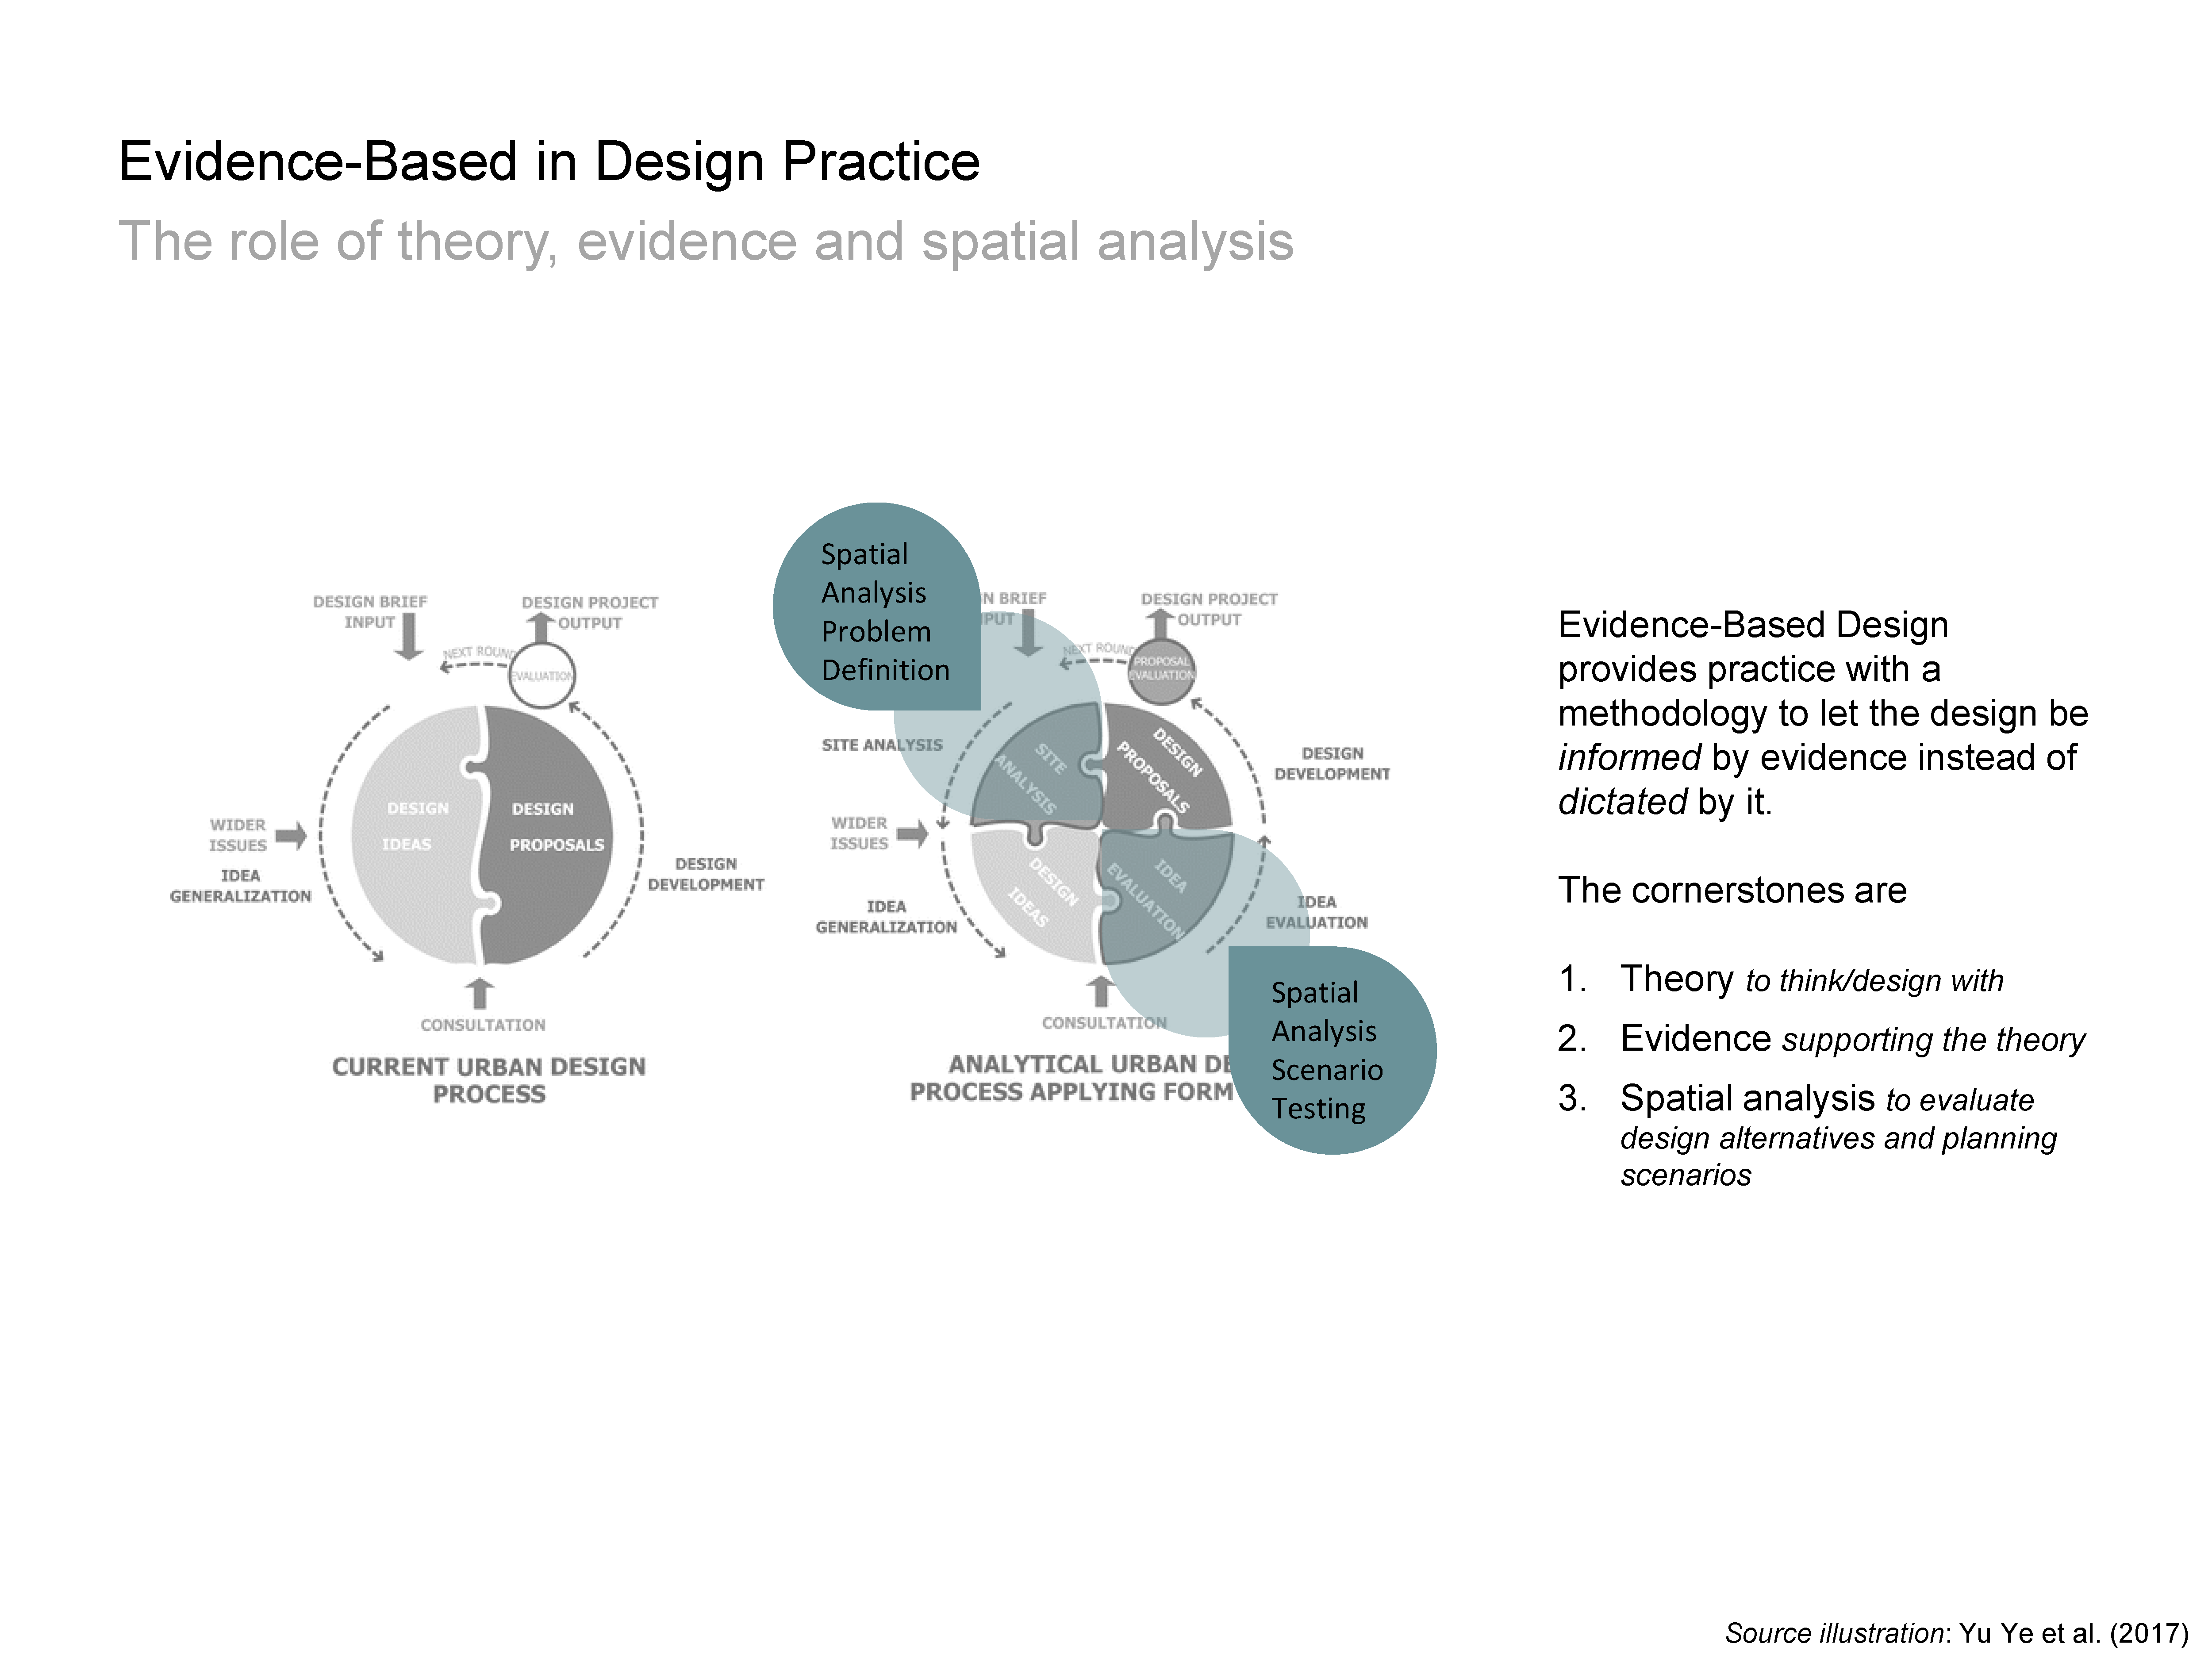
Evidence-based design practice
The role of spatial analysis
The role of spatial analysis is key in this process, both in the initial phases to help identify and locate problems and resources, and during the design iterations to help evaluate different scenarios and design alternatives, in order to reach the best possible final design proposal that answers the project aims and objectives.
Yu Ye et al. 2017

Slide 9
Evidence-based design practice
The demand for early stage design scenario-assesment
Assisting planning and design with analytical methods helps achieve desired outcomes and reduces the risk of failure, which, in the built environment, has long-lasting social and environmental consequences; once something is built, it is difficult and costly to fix.
EBDP enables the evaluation of design and planning ideas, often led by intuition, to determine empirically whether they are the right solution.
Twin2Expand. Twinning towards Research Excellence in Evidence-Based Planning and Urban Design
COST - DESIGN CYCLE (the Mac Leamy curve)

Slide 10
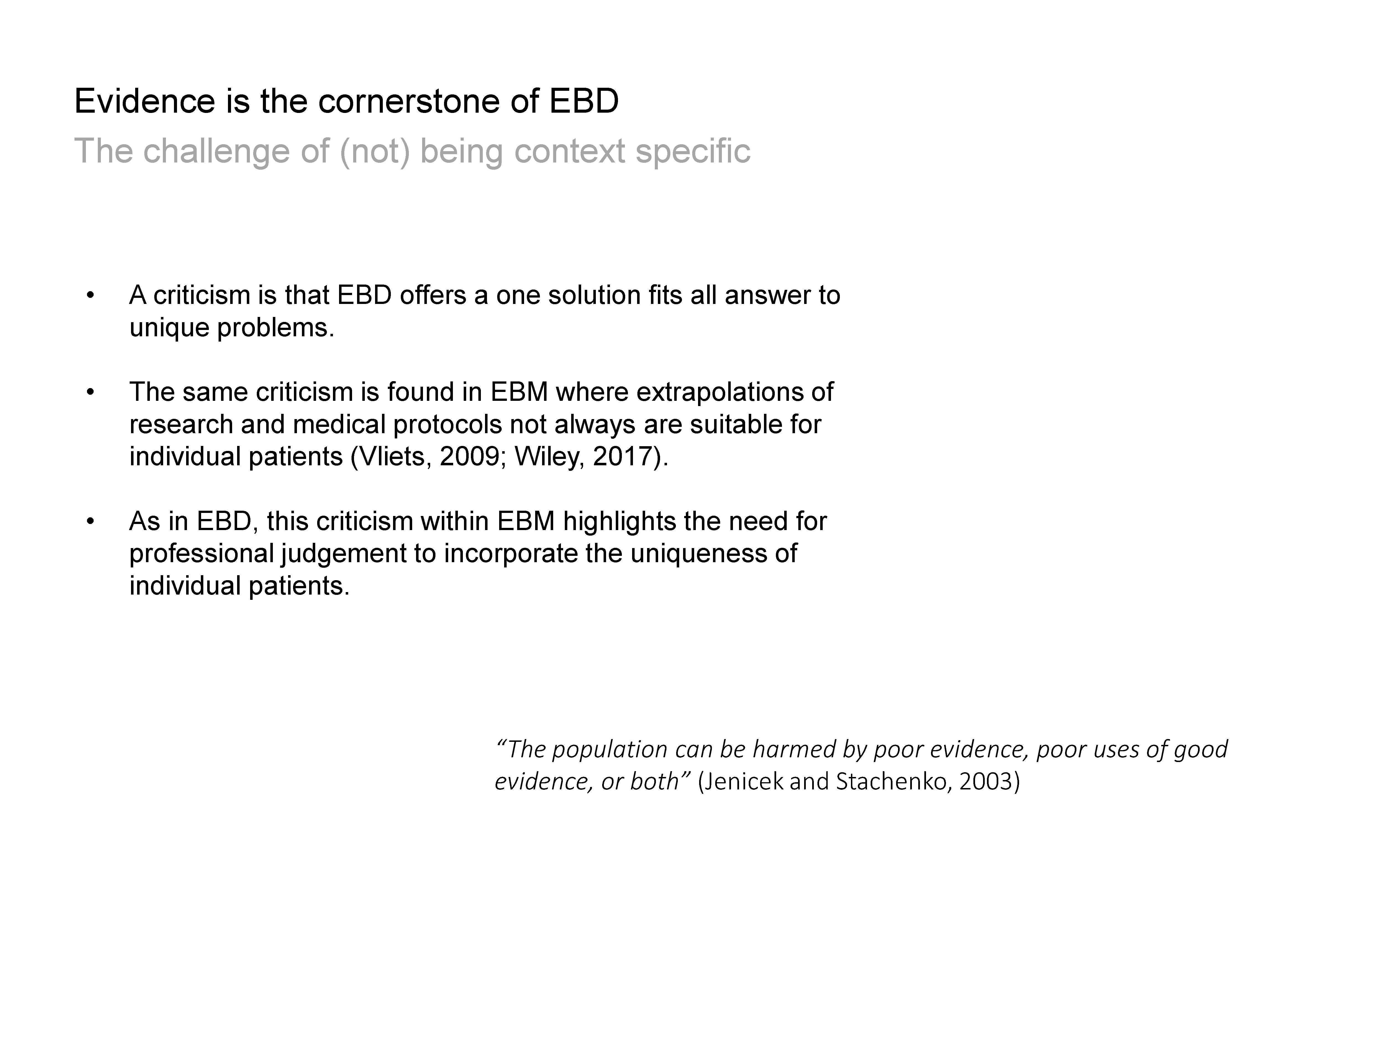
Evidence is the cornerstone of EBD
Use of evidence for context-specific designs

Slide 11
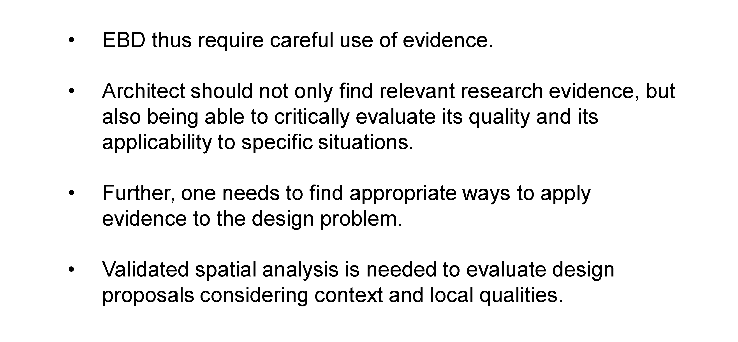
Evidence is the cornerstone of EBD
Use of evidence for context-specific designs

Slide 12
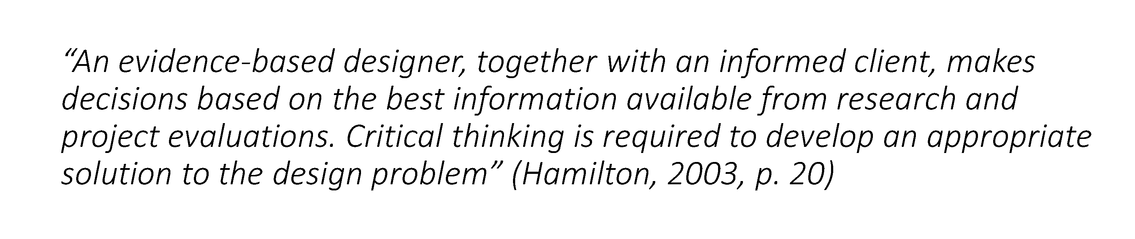
Evidence is the cornerstone of EBD
Use of evidence for context-specific designs

Slide 13

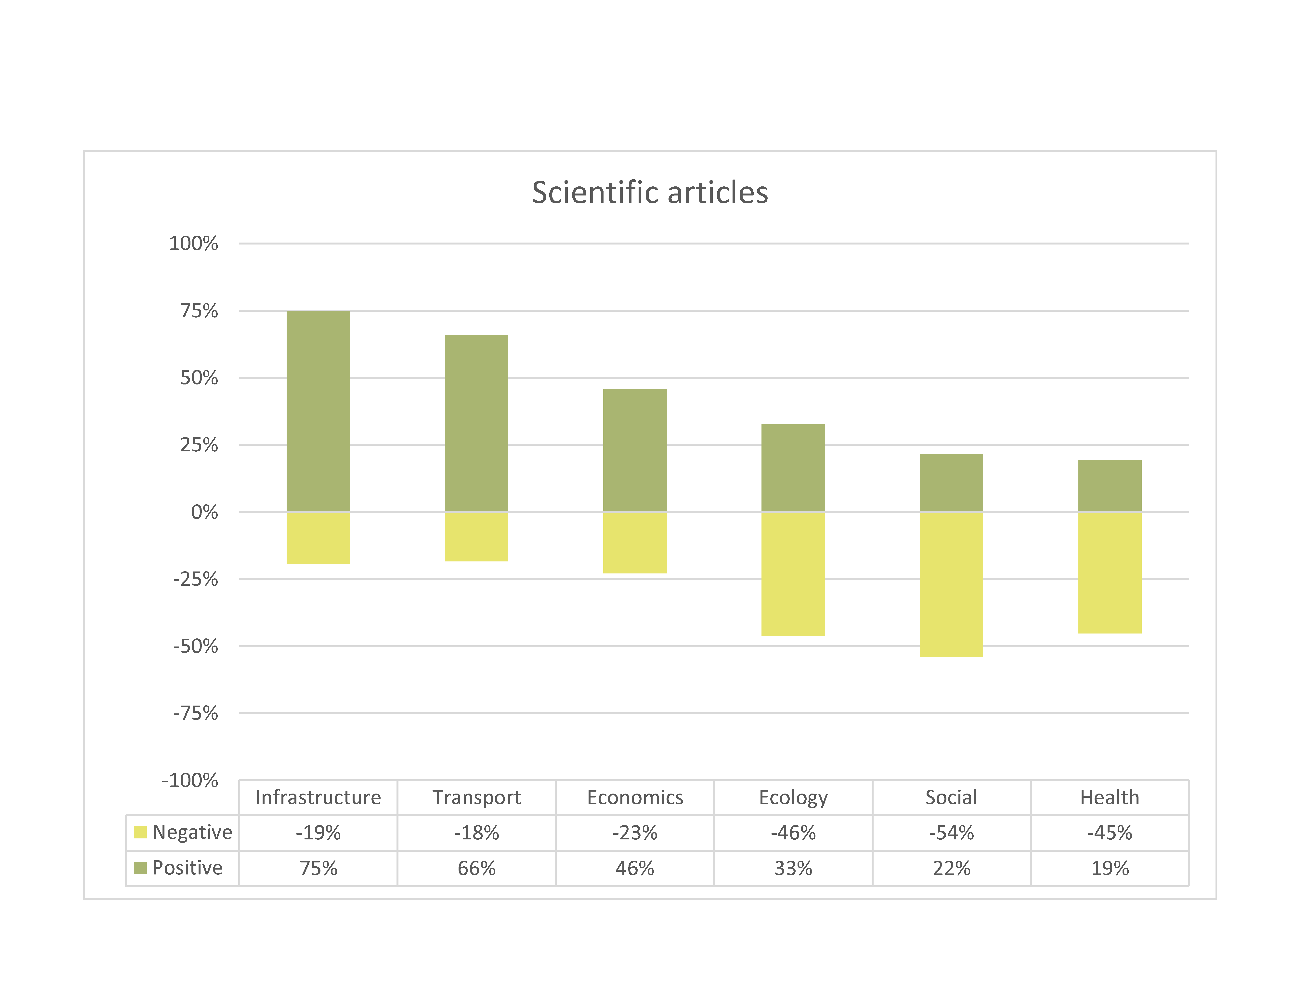
Evidence is the cornerstone of EBD
Use of evidence for context-specific designs
Oftentimes the evidence is conflicting
Oftentimes the evidence is conflicting
Need for,
interdisciplinary teams and expertises,
multiple evidence-sources and
integrated assesments of design solutions
to
address the complex socio-economic and environmental challenges of contemporary cities,
create synergetic impacts and benefits,
address conflicts and prioritise actions.
Summary of 229 papers
Berghauser Pont, M., Haupt, P., Berg, P., Alstäde, V., & Heyman, A. (2021). Systematic review and comparison of
densification effects and planning motivations. Buildings and Cities, 2(1), 378–401. DOI: http://doi.org/10.5334/bc.125

Slide 14
Evidence is the cornerstone of EBD
Use of evidence for context-specific designs
Oftentimes the evidence is conflicting
Need for,
interdisciplinary teams and expertises,
multiple evidence-sources and
integrated assesments of design solutions
to
address the complex socio-economic and environmental challenges of contemporary cities,
create synergetic impacts and benefits,
address conflicts and prioritise actions.
Summary of 229 papers
For example, there is strong dichotomy between predominantly positive impacts of urban density linked to public infrastructure, economy and transport and predominantly negative impacts linked to ecology, climate, social issues and health.
Berghauser Pont, M., Haupt, P., Berg, P., Alstäde, V., & Heyman, A. (2021). Systematic review and comparison of
densification effects and planning motivations. Buildings and Cities, 2(1), 378–401. DOI: http://doi.org/10.5334/bc.125

Slide 15
Evidence is the cornerstone of EBD
Use of evidence for context-specific designs
Oftentimes the evidence is conflicting
Need for,
interdisciplinary teams and expertises,
multiple evidence-sources and
integrated assesments of design solutions
to
address the complex socio-economic and environmental challenges of contemporary cities,
create synergetic impacts and benefits,
address conflicts and prioritise actions.
Summary of 229 papers
But recent studies (Eldesoky et al., forthcoming) find that biodiversity can still be high within dense urban environments depending on the building typologies neighboring green areas.
Berghauser Pont, M., Haupt, P., Berg, P., Alstäde, V., & Heyman, A. (2021). Systematic review and comparison of
densification effects and planning motivations. Buildings and Cities, 2(1), 378–401. DOI: http://doi.org/10.5334/bc.125

Slide 16
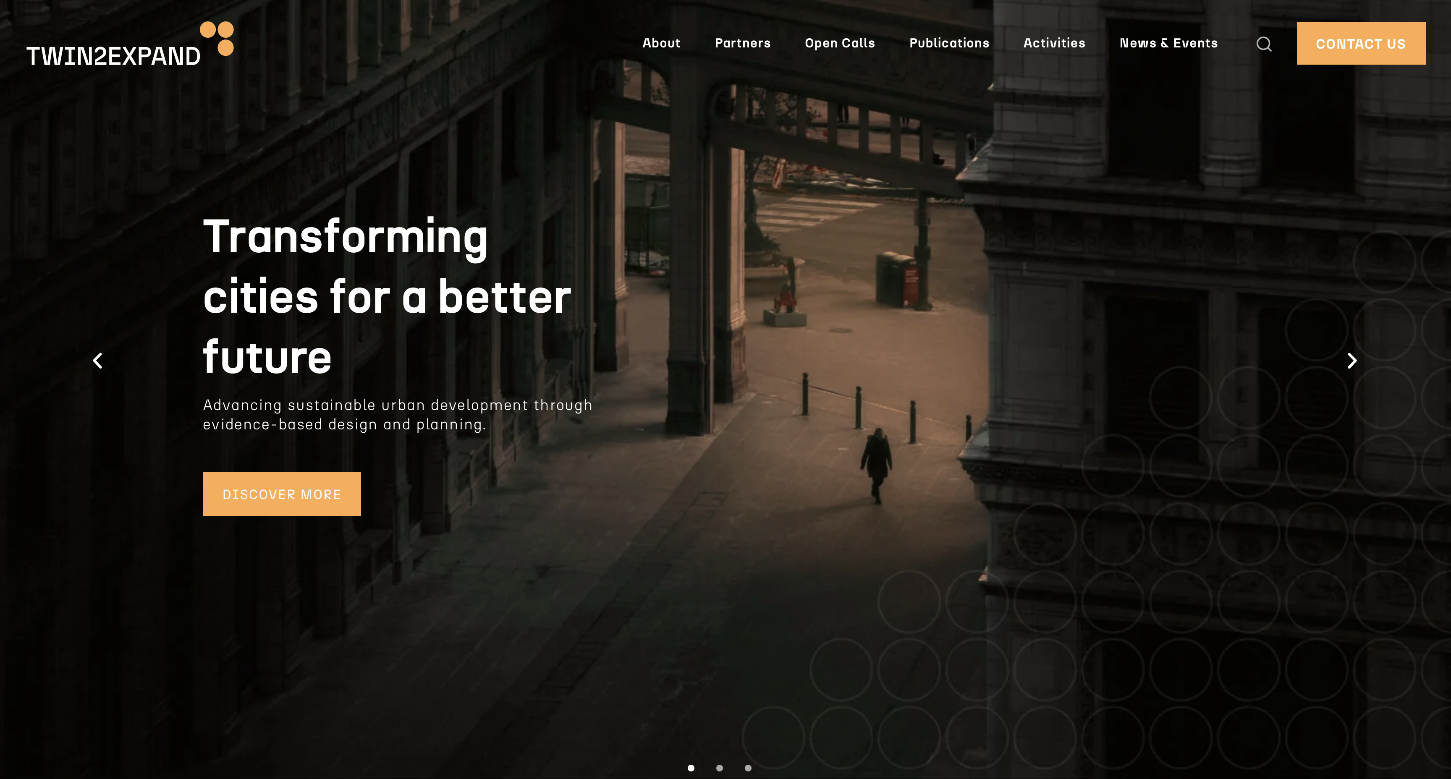
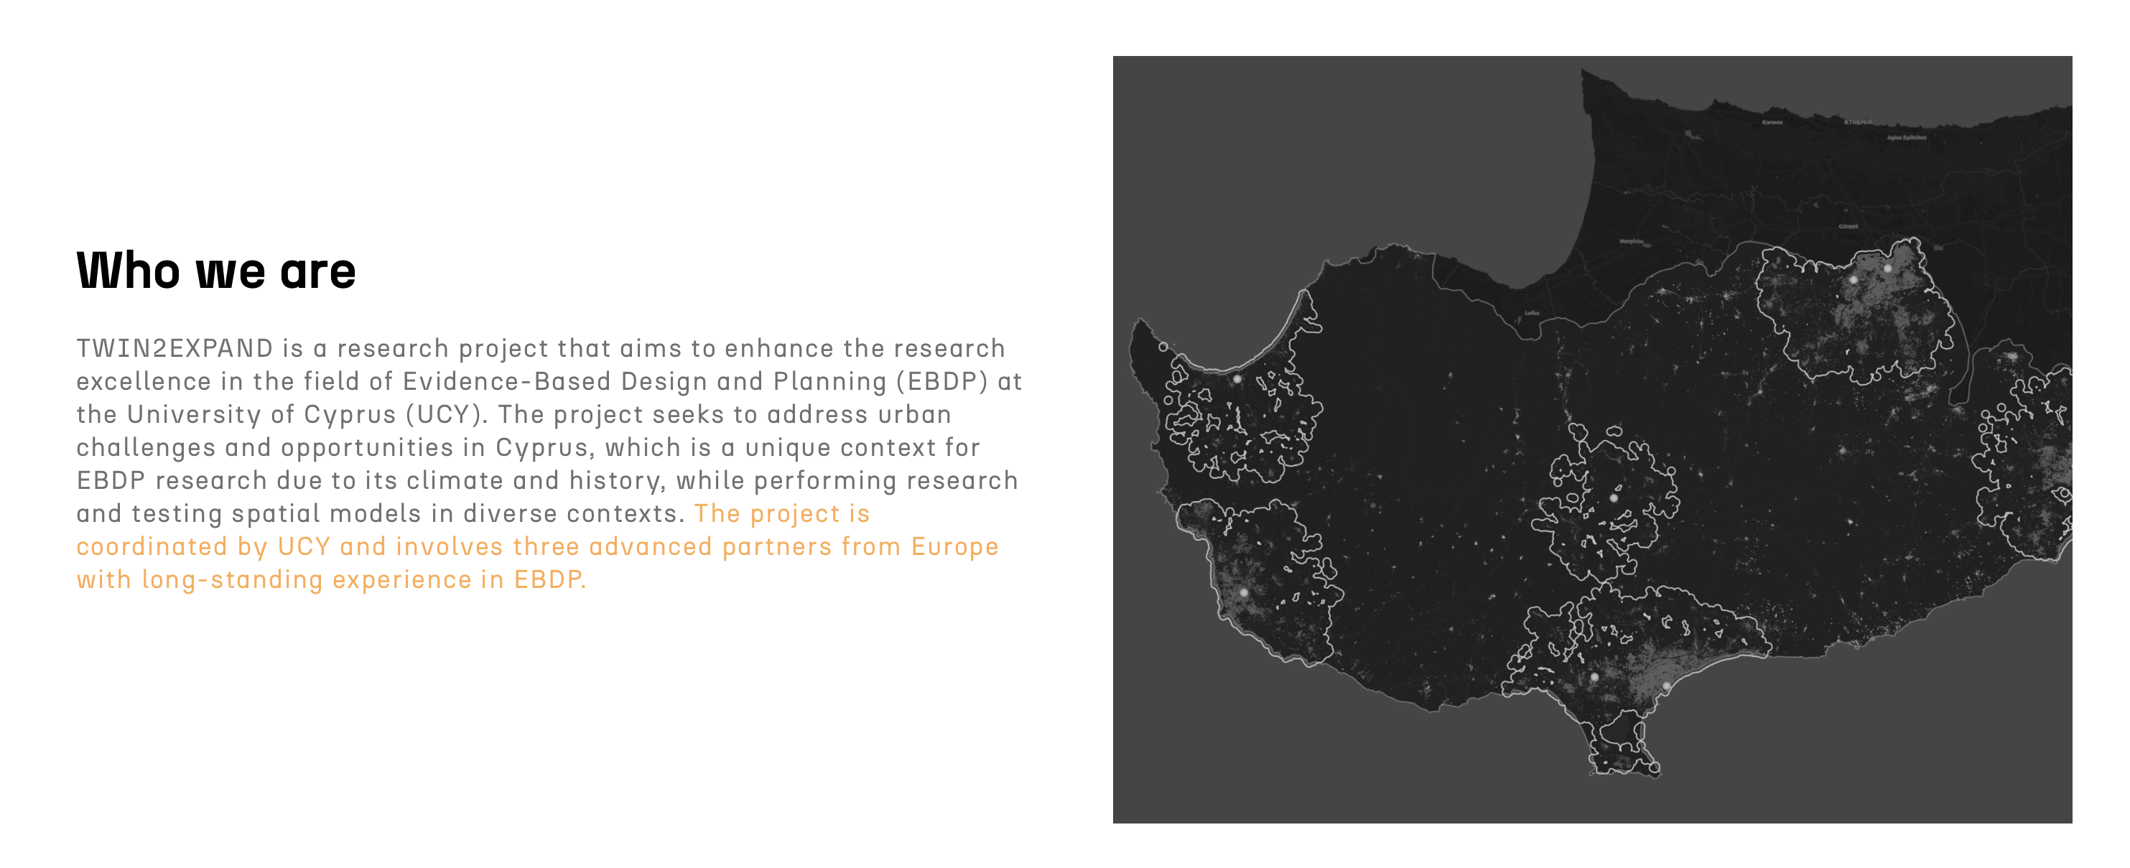
https://twin2expand.surf.com.cy

Slide 17
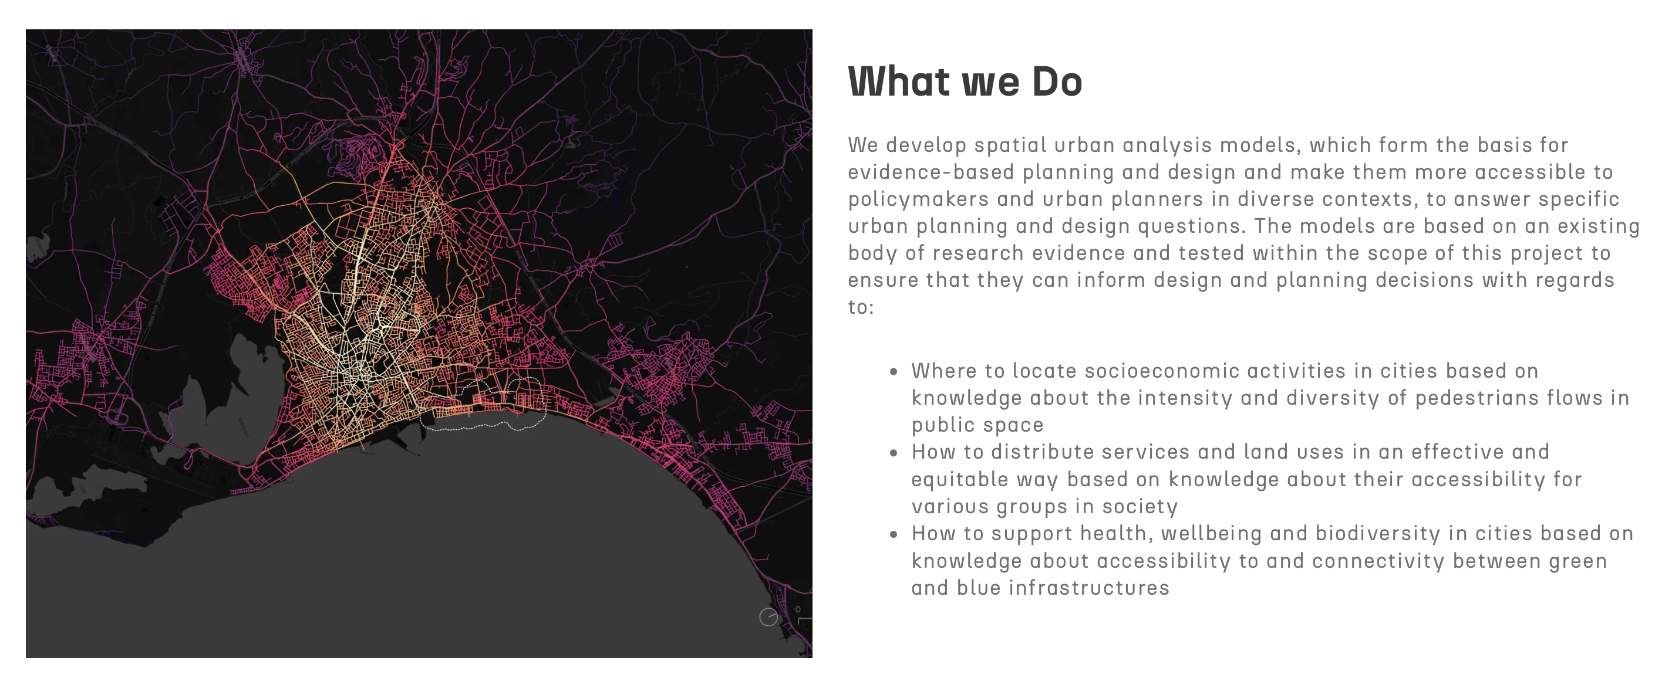
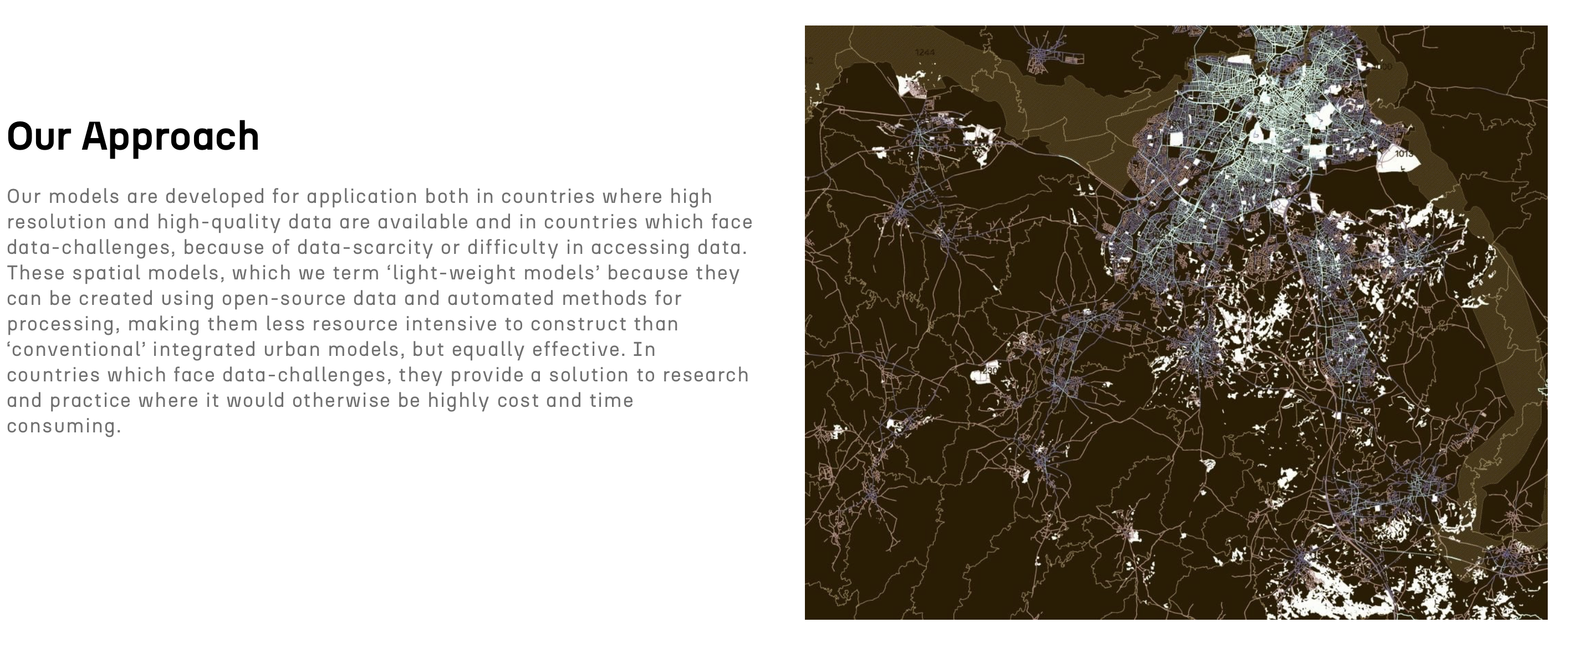
https://twin2expand.surf.com.cy

Slide 18
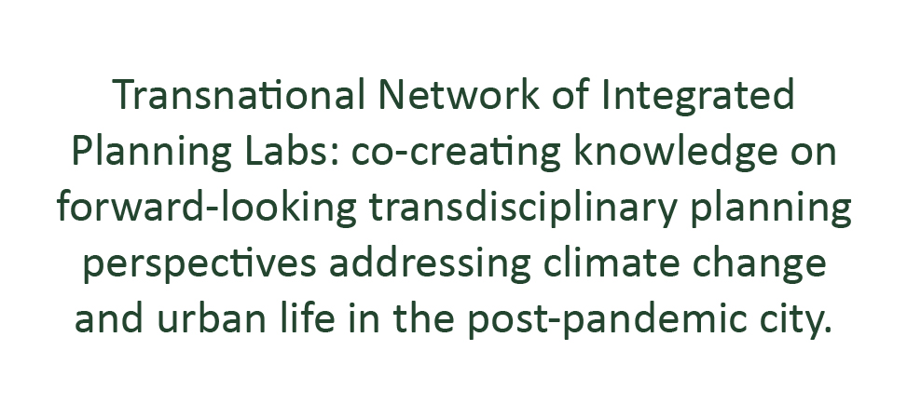


thank you!

