Slide 1
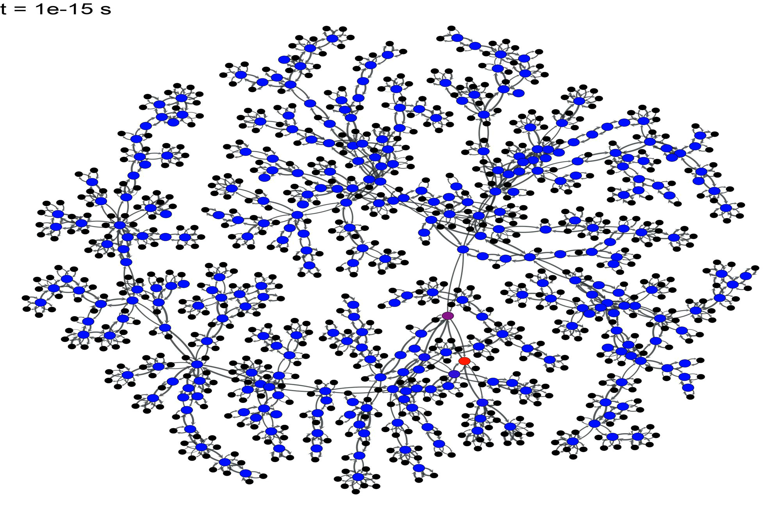
Evaluating time-dependent probabilities
Solution of Master Equation for probabilities of ccupancy in the network of explored states, which is progressively augmented “on the fly”
Notes:
Master equation

Slide 2
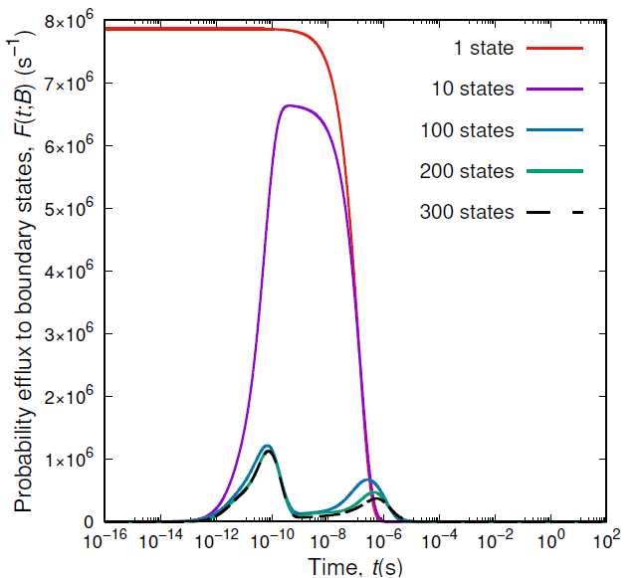
Probability efflux from the current set of explored states

Slide 3
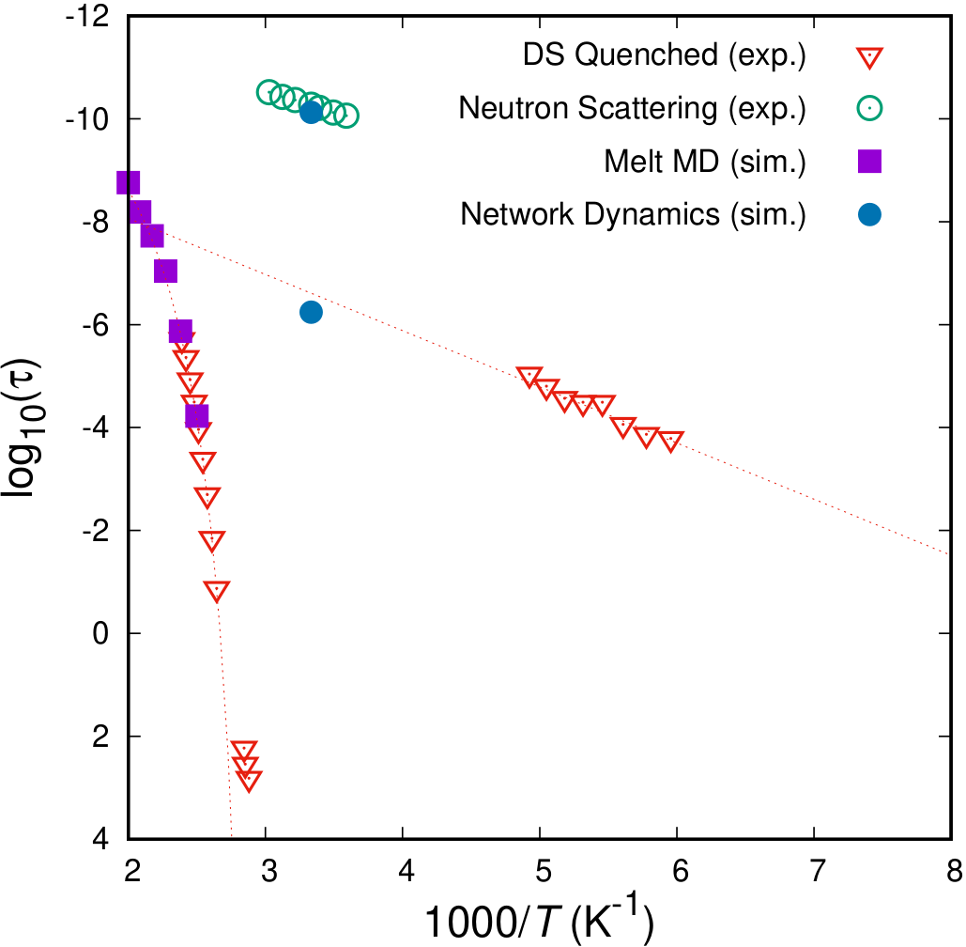
Revealing the molecular relaxations of atactic PS
Simulations:
Network Dynamics: Peaks of the probability efflux from the set of explored states.
MD: Characteristic times from orientational autocorrelation function of pendant bonds.
δ-relaxation
γ-relaxation
α-relaxation
Experimental measurements:
DS: Grigoriadi, K.; Putzeys, T.; Wubbenhorst, M.; van Breemen, L.C.A.; Anderson, P.D; Hütter M. J.Polym.Sci. B Polym. Phys. 2019, 57, 1394.
Neutron Scattering: Arrese-Igor, S.; Arbe, A.; Frick, B.; Colmenero, J. Macromolecules 2011, 44, 3161.
β*-relaxation
T_{g}
Vogiatzis, G.G.; van Breemen, L.C.A.; DNT; Hütter, M. Comp. Phys. Comm. 2020, 248, 107008.

Slide 4
THE LUMPING PROBLEM
In many systems evolving through infrequent transitions in a network of states (e.g., reacting systems) the number of states (e.g., molecular species) is enormous
Because of this large number, one is unable to deal with each state separately
It is often expedient to lump all the states into a few clusters or “equivalence classes" or “lumped classes”, and then consider each class as an independent entity
J. Wei, J.C.W. Kuo I&EC Fundamentals 8(1), 114 (1969)

Slide 5
LUMPING ANALYSIS
Lumping = linear transformation of an -tuple state probability vector, , into an -tuple vector , of smaller dimension with help of a matrix of rank , where :
=
Properties of lumping matrix M:
Elements are either 0 or 1
Each column contains exactly one 1
J. Wei, J.C.W. Kuo I&EC Fundamentals 8(1), 114 (1969)

Slide 6
LUMPING ERROR
System whose dynamics follows the master equation
is exactly lumpable by a matrix M if there
exists a matrix such that the dynamics of the
lumped system is described by . Then,
=
Lumping error:

Slide 7
THE PROBLEM OF OPTIMAL LUMPING
For a system with n states whose dynamics is described by the n×n matrix K, determine a number of lumped states and a × lumping matrix M such that the objective function
with z₁, z₂, z₃ pre-defined constants, is minimized.
E = lumping error
W = long-time parameter
A = diag( P₁(∞), P₂(∞), …, P_{n}(∞))
N. Lempesis, D.G. Tsalikis, G.C. Boulougouris, DNT J. Chem. Phys. 135, 204507 (2011).

Slide 8
THE PROBLEM OF OPTIMAL LUMPING
Problem solved stochastically, using MC moves which change the dimensionality and the form of the lumping matrix M, while respecting the constraints it must satisfy.
Wang-Landau scheme invoked to determine density of matrix M-“states” in the space of variables (E, W, ). This avoids getting trapped in local minima of the objective function z( , M).
Pick that M which minimizes the objective function.
N. Lempesis, D.G. Tsalikis, G.C. Boulougouris, DNT J. Chem. Phys. 135, 204507 (2011).

Slide 9
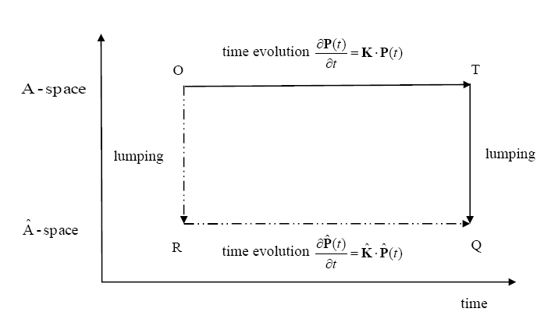
TEST OF LUMPING ALGORITHM
System: 641 particle Lennard-Jones mixture (80%A, 20%B) at 37 K, just below T_{g}=38.4 K. Original network of n=1503 states (basins), with transition rate constants between them determined through parallel TAD. Final =600.

Slide 10
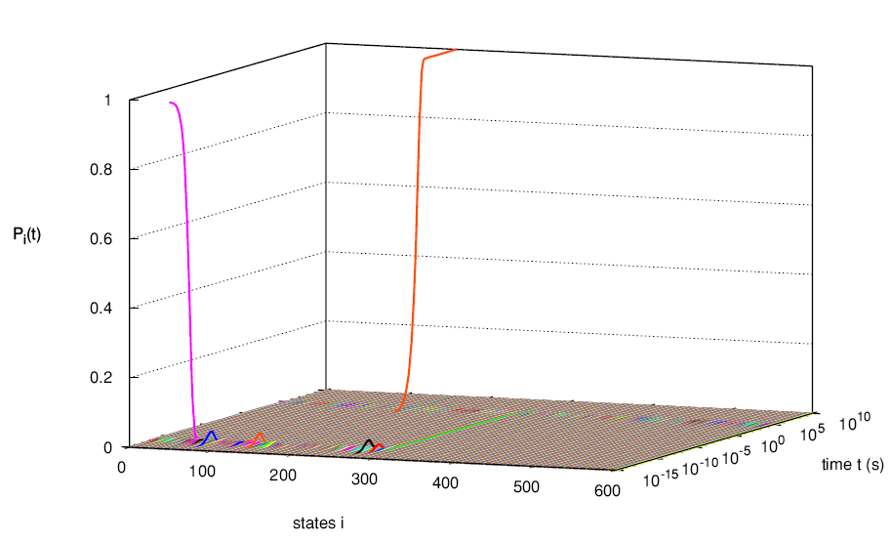
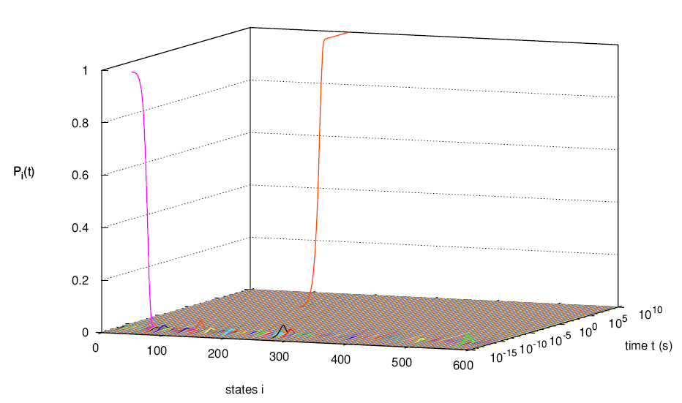
TEST OF LUMPING ALGORITHM
N. Lempesis, D.G. Tsalikis, G.C. Boulougouris, DNT J. Chem. Phys. 135, 204507 (2011).

Slide 11
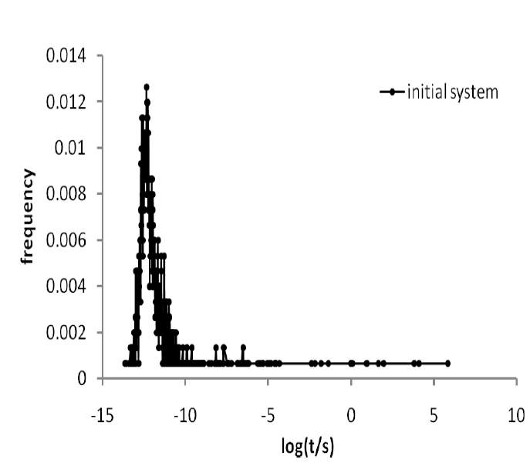
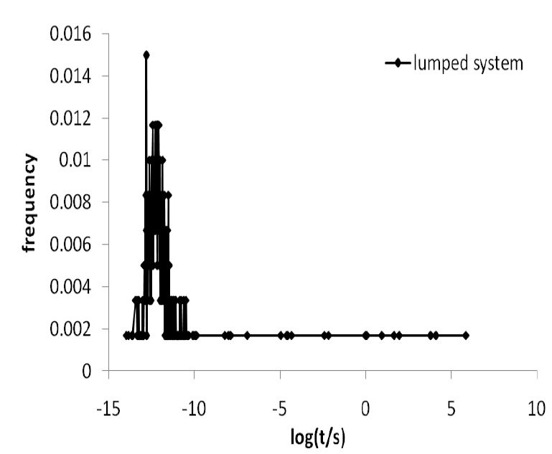
TEST OF LUMPING ALGORITHM
Histograms of inverse opposite eigenvalues of rate constant matrix in original (1503 states) and lumped (600 clusters of states) systems

Slide 12
SUMMARY
• Addressing long-time dynamics is greatly facilitated if system evolution in configuration (or order parameter) space can be reduced to a succession of uncorrelated infrequent events. Rate constants for individual events can be estimated from the (free) energy landscape and the particle masses.
• Kinetic Monte Carlo (KMC) simulation generates stochastic trajectories in a network of discrete states connected by transition paths of known rate constants. It can become inefficient when the spectrum of eigenvalues of the rate constant matrix is very broad.
• Analytical solution of the Master Equation starting from a given probability distribution among states can be much more efficient than KMC. Special techniques for spatially periodic systems (MESoRReD) afford tremendous acceleration of the computations. Correlation functions for state-dependent observables are readily obtained from the analytical solution (EROPHILE).
• In a glassy system, the Dynamic Integration of a Markovian Web (DIMW) method can track structural relaxation by solving the master equation in a network of states which is progressively augmented “on the fly”.
• A systematic “lumping” technique has been designed which reduces the number of states that need to be tracked, while preserving the long-time dynamical characteristics of the system.

Slide 13
ACKNOWLEDGMENTS
Dr. R. Larry June (Shell Chemical Company)
Prof. Randall Q. Snurr (Northwestern University)
Prof. Michael L. Greenfield (U. of Rhode Island)
Dr. Nikolaos P. Kopsias (Intracom Hellas)
Dr. Niki Vergadou (NCSR “Demokritos”)
Dr. George C. Boulougouris (Univ. of Thrace)
Dr. Dimitrios Tsalikis (Univ. of Patras)
Dr. Nikolaos Lempesis (Univ. Fribourg, CH)
Dr. Panagiotis D. Kolokathis
Dr. Georgios G. Vogiatzis

