Slide 1
TRACKING THE DYNAMICS OF SYSTEMS EVOLVING THROUGH INFREQUENT TRANSITIONS IN A NETWORK OF DISCRETE STATES
Doros N. Theodorou
School of Chemical Engineering, Department of Materials Science and Engineering, National Technical University of Athens, Zografou Campus, 157 80 Athens, GREECE
doros@central.ntua.gr

Slide 2
MOTIVATION
Atomistic molecular dynamics simulation: μs time scales. [see, however, ms-long simulations of K.Lindorff-Larsen, S. Piana, R.O. Dror, D.E. Shaw, Science 334, 517-520 (2011)].
Dynamics of most physical, chemical, materials, biological systems: s to years.
In many cases, dynamics is slow because the system spends most of its time trapped within relatively narrow regions of configuration space and only infrequently jumps from region to region.

Slide 3
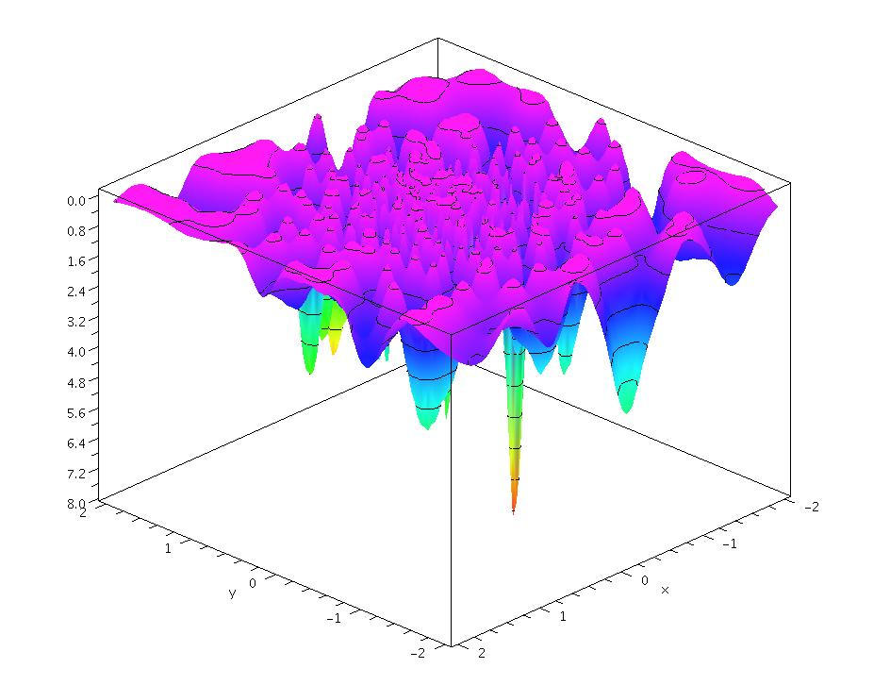
RUGGED ENERGY LANDSCAPES
Potential energy V (x), or
potential of mean force U(x)
atomic coordinate or collective variable (“order parameter”)
x₂
x₁
Minima: “inherent structures” F. H. Stillinger, Science 267, 1935 (1995).
(Collections of) basins of attraction around minima: “states”.
The entire x-space can be tessellated into states.

Slide 4
EXAMPLES OF PHENOMENA INVOLVING EVOLUTION ON RUGGED ENERGY LANDSCAPES
Diffusion of defects and impurities in metals and semiconductors
Permeation of gas molecules through amorphous polymers
Diffusion of bulky hydrocarbons in zeolites
Structural relaxation and plastic deformation of glassy materials
Protein folding
Phase transitions in molecular and atomic clusters
Kinetics of networks of chemical reactions

Slide 5
OUTLINE
Infrequent events, calculation of transition rate constants
Kinetic Monte Carlo simulation
Master Equation: its analytical solution and calculation of time correlation functions
Low-temperature diffusion of Xe in Silicalite-1: Comparative application of various methods
The energy landscape picture for glasses
A method for tracking structural relaxation in glasses: Application to atactic polystyrene
The lumping problem

Slide 6
TRANSITION RATE CONSTANT
Time scale separation: Mean waiting time for transition out of a state is long in comparison with the time required for system to establish a restricted equilibrium among configurations in the state.
t_{cor} << t_{rxn}
By the time it exits a state, the system has lost all memory of how it entered there (Markovian character of a sequence of infrequent events).
Rate constant k_{i→j}: Probability per unit time that a transition to state j will occur, provided the system is in state i.

Slide 7
COMPUTATION OF RATE CONSTANTS
Input: Energy hypersurface and masses associated with degrees of freedom.
Molecular dynamics (MD), reduction to an inherent structure trajectory and hazard plot analysis [E. Helfand, J. Chem. Phys. 69, 1010 (1978)]
Temperature-accelerated dynamics [M. R. Sørensen, A.F. Voter, J. Chem. Phys. 112, 9599 (2000)]
Transition-State Theory estimate from free energy difference between the system confined to the boundary hypersurface of state i and the system allowed to sample the entire state i. Calculation of dynamical correction factor through short MD trajectories initiated on the boundary hypersurface [C.H. Bennett, 1975; D. Chandler, J. Chem. Phys. 68, 2959 (1978), A.F. Voter and J.D. Doll, J. Chem. Phys. 82, 80 (1985)].

Slide 8
COMPUTATION OF RATE CONSTANTS
Determination of reaction path (e.g., by Fukui’s intrinsic reaction coordinate approach) and computation of free energy profile along the path by umbrella sampling or “blue moon ensemble” simulations [T.R. Forester, W. Smith J. Chem. Soc. Faraday Trans. 93, 3249 (1997)]
Flux-tempered metadynamics [S. Singh, C.C. Chiu, J. de Pablo J. Stat. Phys. 144, 1 (2011); A. Laio, M. Parrinello, Proc. Natl. Acad. USA 99, 12562 (2002)]
Transition path sampling [P.G. Bolhuis, D. Chandler, C. Dellago, P.L. Geissler Annu. Rev. Phys. Chem. 53, 291 (2002); C. Dellago, P.G. Bolhuis, P. Geissler Adv. Chem. Phys. 123, 1 (2002)]

Slide 9
CALCULATING RATE CONSTANTS FOR TRANSITIONS BETWEEN BASINS
Definitions:
Hazard rate h(t): Conditional probability that a system, which has survived a time t since its last transition, will undergo a transition between t and t+dt is h(t) dt.
Cumulative hazard H(t):
Probability that a transition occurs in time less than t since the last transition:
Poisson process: h(t) = λ, a constant. H(t)= λt, P(t)=1−exp(− λt)
Notes:
P(t) = cumulative probability density function for residence times.
One has: 1-P(t+Δt) = [1-P(t)] [1-h(t)Δt]

Slide 10
CALCULATING RATE CONSTANTS FOR TRANSITIONS BETWEEN BASINS
Hazard Plot Analysis Helfand, E. J. Chem. Phys. 69, 1010 (1978)
In the course of MD simulation, for any visited basin, β, record residence times between entry to and exit from the basin. Also record the basins γ to which exits from β occur.
Order residence times in β:
Estimate cumulative hazard corresponding to residence time t_{k}:
Linear plot going through the origin indicates a Poisson process.
Residence time t_{k} (ps)
Slope of plot, λ_{β} = total rate constant for exiting basin β.
Rate constant
Notes:
By definition, H(t) = -ln[1-P(t)]
with P(t) = probability for a transition out of the state to have occurred in time less than t.
Estimate of P(t) based on recorded transitions: P(t) = k/n
The sum on the right hand side of H^hat(t_k) can be viewed as an approximation of integral, from 0 to k/n , of 1/(1-x) dx.= -ln(1-k/n)

Slide 11
SEQUENCE OF INFREQUENT EVENTS IS A HOMOGENEOUS POISSON PROCESS
Numbers of occurrences counted in disjoint time intervals are independent of each other.
Probability distribution of occurrences counted within any time interval only depends on the length of the interval.
No counted occurrences are simultaneous.
Number of observed occurrences within a given time interval follows a Poisson distribution:
Waiting time until the next occurrence follows an exponential distribution:
Several Poisson processes i occurring in parallel constitute a Poisson process with rate constant .

Slide 12
KINETIC MONTE CARLO (KMC) SIMULATION
Generation of stochastic trajectories as sequences of transitions between states in a network of n states
Deploy N >> n independent walkers among the states according to a prescribed initial probability distribution: N_{i} (t) ≈ N P_{i}(0), i=1, 2, …, n
For each state i that is occupied at time t, calculate expected fluxes R_{i→j}(t) = N_{i} (t) k_{i→j} , overall flux R(t) = Σ_{i}Σ_{j}R_{i→j}(t) and conditional probabilities q_{i→j}(t) = R_{i→j}(t)/ R(t).
(ii) Pick time until next transition Δt=−ln(1−ξ)/R(t), where ξ [0,1) is a uniformly distributed pseudorandom number. Pick type i→j of next transition according to q_{i→j}(t).
(iii) Of the N_{i} (t) walkers present in state i pick one with probability 1/ N_{i} (t) and move it to state j.
(iv) Advance simulation time by Δt. Update array keeping track of current positions of all walkers. Set N_{i} (t+ Δt) = N_{i} (t) − 1, N_{j} (t+ Δt) = N_{j} (t) + 1.
(v) Return to step (i).

Slide 13
MASTER EQUATION
P_{i}(t): Probability of being in state i at time t.
Transition rate constant matrix
i
k_{i→j}
vector of state probabilities
k_{j→i}
or
j
t→∞ : dP/dt=0, k_{i→j} P_{i}(∞)= k_{j→i} P_{j}(∞)
equilibrium state probabilities
(microscopic reversibility)
Need to solve the master equation starting from an initial probability distribution among states P(0).

Slide 14
MASTER EQUATION: ANALYTICAL SOLUTION
P(0) given
Define reduced state probabilities:
given
Matrix is symmetric (microscopic reversibility)
Matrix is negative semidefinite
Real eigenvalues λ₀=0 ≥ λ₁ ≥ λ₂ ≥ … ≥ λ_{n-1}
Eigenvector corresponding to λ₀=0 is
K.E. Shuler, Phys. Fluids 2, 442 (1959).
J. Wei, C.D. Prater, Advan. Catal. 13, 204 (1962).
N. V. Buchete, G. Hummer, J. Phys. Chem. B 112, 6057 (2008).
G. Boulougouris, DNT, J. Chem. Phys. 130, 044905 (2009).

Slide 15
MASTER EQUATION: ANALYTICAL SOLUTION
Diagonalization of permits writing down an analytical solution to the master equation.
Eigenvalues λ₀=0 ≥ λ₁ ≥ λ₂ ≥ … ≥ λ_{n-1}
Eigenvectors
Orthonormality:
,
Solution of the master equation:
K.E. Shuler, Phys. Fluids 2, 442 (1959).
J. Wei, C.D. Prater, Advan. Catal. 13, 204 (1962).
N. V. Buchete, G. Hummer, J. Phys. Chem. B 112, 6057 (2008).
G. Boulougouris, DNT, J. Chem. Phys. 130, 044905 (2009).

Slide 16
EROPHILE: Eigenvalue Representation of Observables and Probabilities in a HIgh-dimensionaL Euclidean space
For any observable A, which has well-defined values A_{i} within each state i, nonequilibrium ensemble average value at time t is:
Time autocorrelation function is:
where
Eigenvalues and eigenvectors of symmetrized n×n rate constant matrix describing transitions among n explored states (relaxation modes)
∞: equilibrium among the n explored states.
G. Boulougouris and DNT, J. Chem. Phys. 130, 044905 (2009)

Slide 17
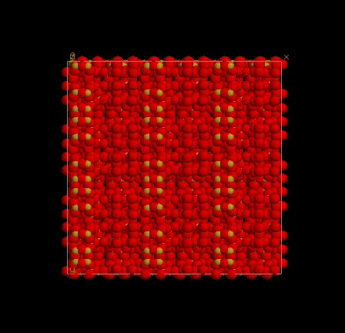
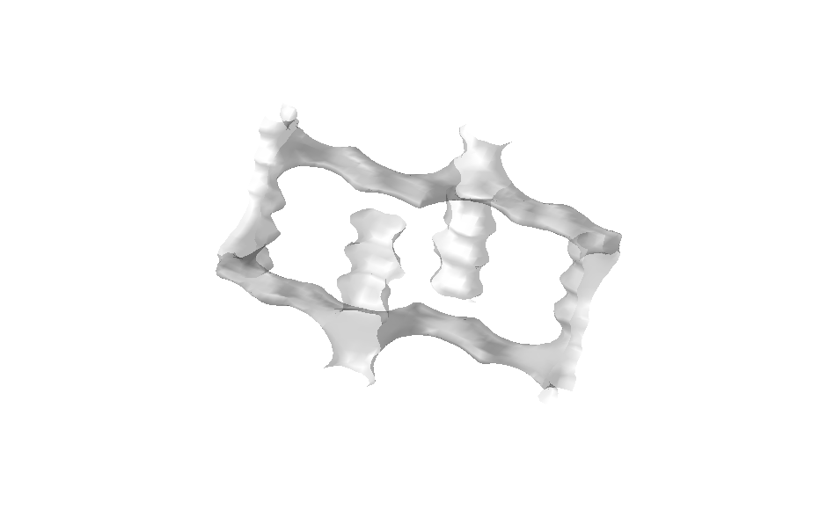
EXAMPLE APPLICATION: LOW TEMPERATURE, LOW OCCUPANCY DIFFUSION OF XENON IN SILICALITE-1
Silicalite-1 (MFI)
Si₉₆O₁₉₂
Pnma
a = 20.07 Å
b = 19.91 Å
c = 13.42 Å
(3 × 3 × 3
unit cells shown)
y
x
z
Made up of SiO₄ tetrahedra sharing vertices.
Straight and sinusoidal (zigzag) channels of diameter ≈ 5.5 Å

Slide 18
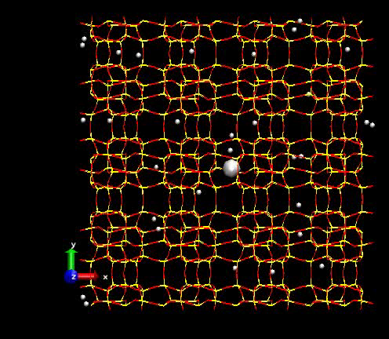
Xe/SILICALITE-1, 300 Κ
MD simulation
E. Pantatosaki and G.K. Papadopoulos
Notes:
8 unit cells shown. Concentration 4 molecules per unit cell. 300Κ.

Slide 19
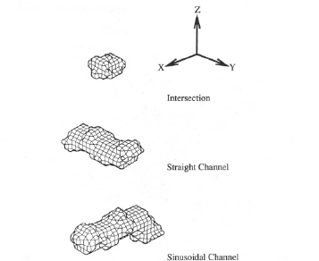
TRANSITION STATE THEORY ANALYSIS OF Xe/Silicalite-1, 150 K
I
S
Z
-a/4, b/2
a/4, b/2
y
1
2
3
4
6
5
x
1
3
y
2
z
-a/4, 0
a/4, 0
x
R.L June, A.T. Bell, and DNT J. Phys. Chem. 95, 8866 (1991)
Notes:
8 unit cells shown. Concentration 4 molecules per unit cell. 300Κ.

Slide 20
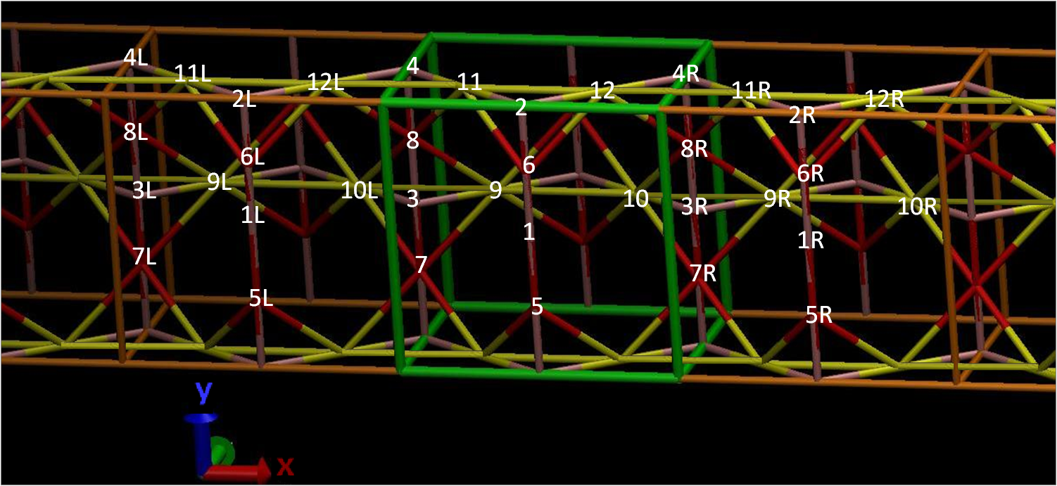
P_{I}(∞) | 0.014
P_{S}(∞) | 0.412
P_{Z}(∞) | 0.574

Slide 21
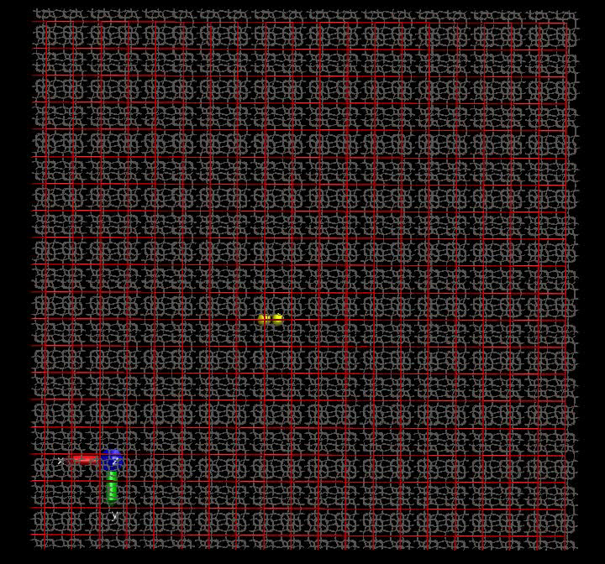
KINETIC MONTE CARLO

Slide 22
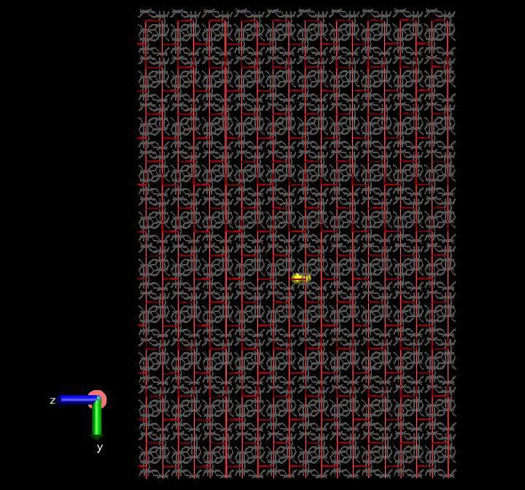
KINETIC MONTE CARLO
Einstein, 1905

Slide 23
SOLUTION OF THE MASTER EQUATION
Cell 1
Cell 2
. . . . . .
Cell 2^{ν} -1
Cell 2^{ν}
2^{ν} unit cells n states/unit cell PBCs at the ends n=12, ν=7
Cell 2^{ν-1}
Cell 2^{ν-1} +1
L_{d}
2L_{p}
Initially only two central cells 2^{ν-1} and 2^{ν-1}+1 filled, all others empty
Approaches:
• Direct diagonalization of 2^{ν}n× 2^{ν}n matrix .
• Recursive reduction of dimensionality (MESoRReD), ultimately expressing the eigenvalues and eigenvectors of in terms of those of 2^{ν} matrices of dimension n×n, pertaining to the unit cell.
• Numerical solution of the Master Equation by Euler method.
Panagiotis D. Kolokathis

Slide 24
SOLUTION OF THE MASTER EQUATION
Cell 1
Cell 2
. . . . . .
Cell 2^{ν}-1
Cell 2^{ν}
2^{ν} unit cells n states/unit cell PBCs at the ends n=12, ν=7
Cell 2^{ν-1}
Cell 2^{ν-1}+1
L_{d}
2L_{p}
♦ 1×10⁻⁸ s
* 2×10⁻⁸ s
• 4×10⁻⁸ s
Points: MESoRReD
Line fits: continuum diffusion problem
Histograms: Euler method 1×10⁻⁸ s
P.D. Kolokathis

Slide 25
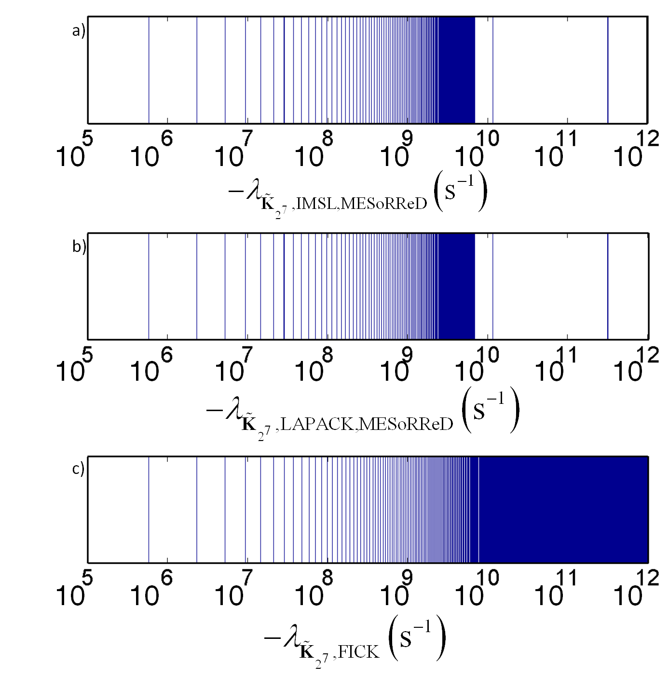
Solution to Master Equation:
Solution to Continuum Diffusion Equation:
D_{αα} obtainable from nonzero eigenvalue of symmetrized rate constant matrix with smallest absolute magnitude.
−λ_{m} (s⁻¹)
D_{xx} ( fπ/L_{p})² (s⁻¹)
Notes:
Found a way to calculate lim_{L_p \rightarrow \infty} (- \lambda_1) by diagonalization of a matrix pertaining to a single unit cell. The matrix is an explicit function of \nu.

Slide 26
Xe/Silicalite-1 at 150 K TST DIFFUSIVITIES FROM VARIOUS METHODS
Method | D_{xx} (10⁻¹⁰ m² s⁻¹) | D_{yy} (10⁻¹⁰ m² s⁻¹) | D_{zz} (10⁻¹⁰ m² s⁻¹) | D (10⁻¹⁰ m² s⁻¹)
KMC-TST^{1,2} | 9.67±0.14 | 11.62±0.25 | 1.71±0.05 | 7.66±0.14
Direct Diagonali-zation-TST, fit continuum soln.¹ | 9.7088±0.0029 | 11.676±0.002 | 1.7627±0.0093 | 7.7157±0.0044
MESoRReD¹-TST fit continuum soln. | 9.7088±0.0029 | 11.676±0.002 | 1.7627±0.0093 | 7.7157±0.0044
MESoRReD¹-TST from λ₁ | 9.7132 | 11.684 | 1.7531 | 7.7171
Euler Method¹-TST | 9.70 | 12.5 | 1.83 | 8.01
KMC-DC TST² | 5.1 | 7.3 | 0.83 | 4.41
MD² | 4.3 | 10.0 | 0.99 | 5.1
PFG NMR³ | − | − | − | 1.6
¹P.D. Kolokathis and DNT, J. Chem. Phys. 137, 034112 (2012).
²R.L. June, A.T. Bell, DNT J. Phys. Chem. 95, 8866 (1991)
³J Kärger, H. Pfeifer, F. Stallmach, N.N. Feoktistova, S.P. Zhdanov Zeolites 13, 50 (1993).

Slide 27
Xe/Silicalite-1 at 150 K COMPUTATIONAL REQUIREMENTS
Method | CPU time (s) | Memory (MB)
KMC-TST^{1,2} | 6183.46 | 6
Direct Diagonalization-TST, fit continuum soln.¹ | 37.81 | 38
MESoRReD¹-TST, fit continuum soln. | 2.83 | 44
MESoRReD¹-TST from λ₁ | 0.0059 | 2
Euler Method¹-TST | 23760 | 401
MD² | 309173
¹P.D. Kolokathis and DNT, J. Chem. Phys. 137, 034112 (2012).
²R.L. June, A.T. Bell, DNT J. Phys. Chem. 95, 8866 (1991), normalized

Slide 28
Xe/Silicalite-1 at 150 K COMPUTATIONAL REQUIREMENTS
Method | CPU time (s) | Memory (MB)
KMC-TST^{1,2} | 6183.46 | 6
Direct Diagonalization-TST, fit continuum soln.¹ | 37.81 | 38
MESoRReD¹-TST, fit continuum soln. | 2.83 | 44
MESoRReD¹-TST from λ₁ | 0.0059 | 2
Euler Method¹-TST | 23760 | 401
MD² | 309173
¹P.D. Kolokathis and DNT, J. Chem. Phys. 137, 034112 (2012).
²R.L. June, A.T. Bell, DNT J. Phys. Chem. 95, 8866 (1991), normalized

Slide 29
Xe/Silicalite-1 at 150 K COMPUTATIONAL REQUIREMENTS
Method | CPU time (s) | Memory (MB)
KMC-TST^{1,2} | 6183.46 | 6
Direct Diagonalization-TST, fit continuum soln.¹ | 37.81 | 38
MESoRReD¹-TST, fit continuum soln. | 2.83 | 44
MESoRReD¹-TST from λ₁ | 0.0059 | 2
Euler Method¹-TST | 23760 | 401
MD² | 309173
¹P.D. Kolokathis and DNT, J. Chem. Phys. 137, 034112 (2012).
²R.L. June, A.T. Bell, DNT J. Phys. Chem. 95, 8866 (1991), normalized

Slide 30
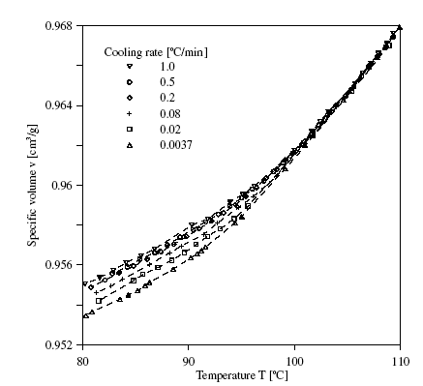
GLASSES ARE NON-EQUILIBRIUM MATERIALS
atactic Polystyrene (aPS)
M_{w}=145 kg/mol
M_{w}/M_{n}=1.03
LIQUID
Glass structure and properties depend on the rate of cooling from the melt.
GLASS
J. Hadač, P. Slobodian, P. Říha, P. Sáha, R.W. Rychwalski, I. Emri, J. Kubát, J. Non-Cryst. Solids, 353, 2681-2691 (2007)

Slide 31
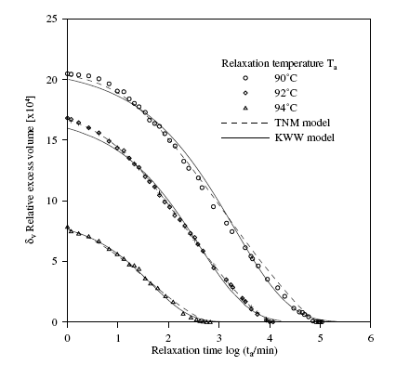
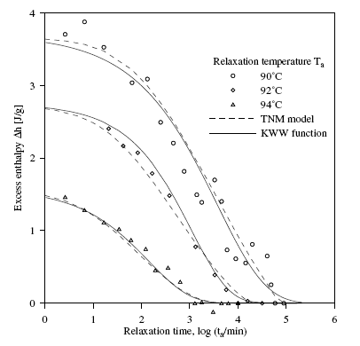
GLASSES ARE NON-EQUILIBRIUM MATERIALS
Glass properties change with time (physical ageing)
aPS, M_{w}=145 kg/mol, M_{w}/M_{w}=1.03, T_{g}(1ºC/min)=97.8±0.2ºC
J. Hadač, P. Slobodian, P. Říha, P. Sáha, R.W. Rychwalski, I. Emri, J. Kubát, J. Non-Cryst. Solids, 353, 2681-2691 (2007)

Slide 32
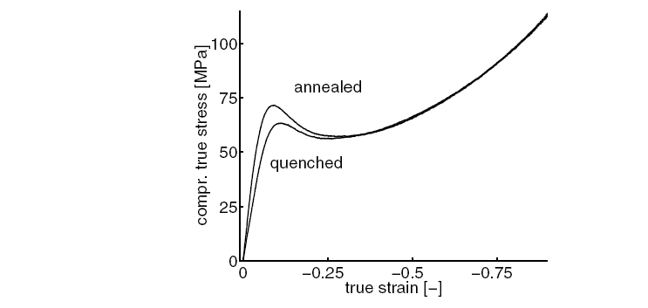
GLASSES ARE NON-EQUILIBRIUM MATERIALS WITH COMPLEX MECHANICAL BEHAVIOUR
PC in compression: Effect of ageing
H. Van Melick, Ph.D. Thesis, Technical University of Eindhoven, 2002

Slide 33
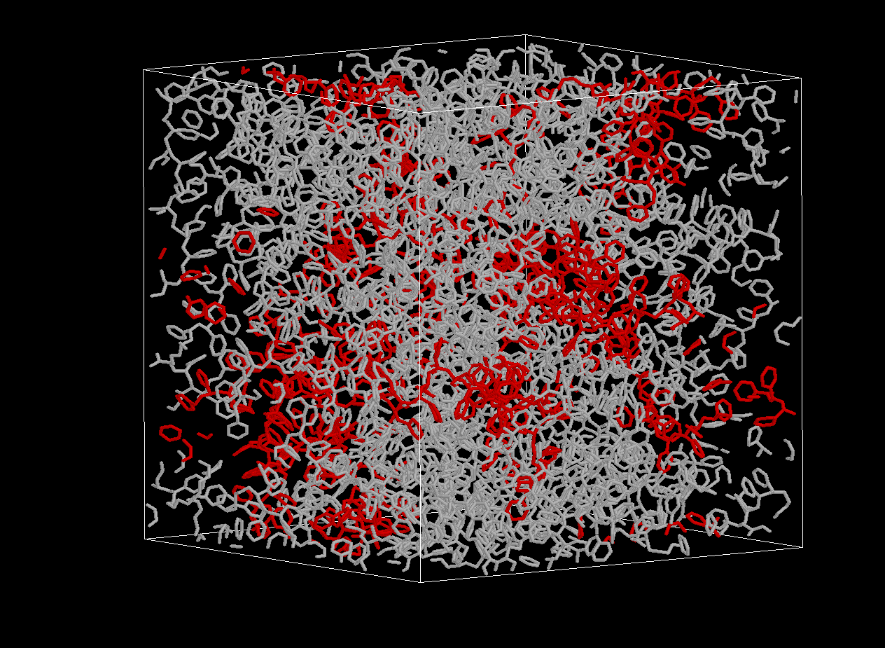
ENERGY LANDSCAPE-BASED MODELING OF GLASSY ATACTIC POLYSTYRENE
Starting point: Well-equilibrated melt configurations
T. Spyriouni, C. Tzoumanekas, DNT, G. Milano, F. Müller-Plathe, Macromolecules, 40, 3876-3885 (2007).

Slide 34
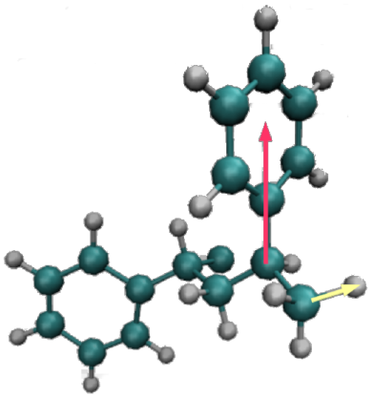
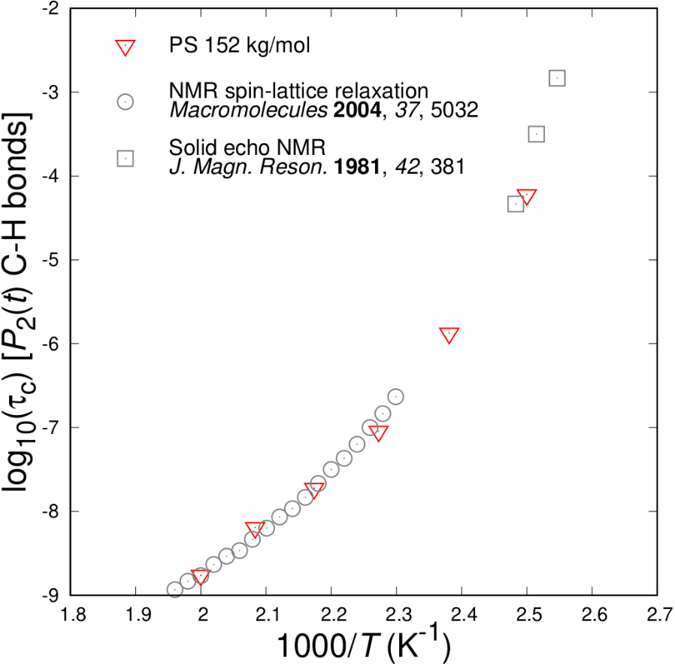

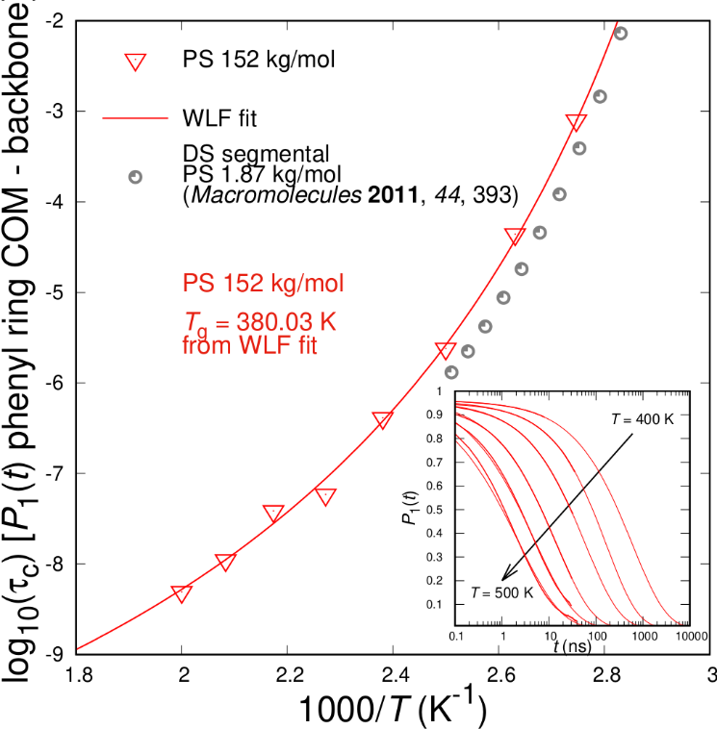
Segmental Dynamics and Glass Transition: atactic Polystyrene
Atomistic Molecular Dynamics
Fit to empirical Williams–Landel–Ferry relation ^{[1]:}
Experimental T_{g} ^{[2]} : 373 K
Ferry, J. D. “Viscoelastic Properties of Polymers”, 3rd ed. Wiley, New York, 1980.
Hintermeyer, J. et al. Macromolecules 2008, 41, 9335.
Vogiatzis G.G.; DNT Macromolecules 2014, 47, 387.

Slide 35
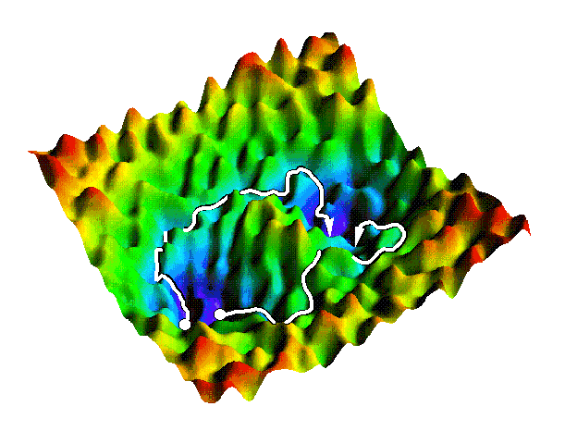
Energy Landscape Picture of a Glass
V
Inherent structure
x
Basin
Metabasin
(C. Dellago)
Configuration fluctuating in the neighborhood of local energy minima: “Inherent structures” : Stillinger, F.H. Science 1995, 267, 1935. See also work by P.G. Debenedetti, D.J. Lacks, A. Heuer, G. Parisi, F. Sciortino, D. Wales, T. Keyes, T.M. Truskett, DNT and U.W. Suter.
Transitions between minima inhibited by high energy barriers.
Glass properties: arithmetic averages of properties of individual “basins of attraction”. Restricted equilibrium established within each basin.
Glassy computer specimens generated by rapid cooling of the melt.
Notes:
Quasi-harmonic approximation within basins

Slide 36
In-basin motion: Quasi-Harmonic Approximation (QHA)
Mass-weighted coordinates
Second derivatives of the potential energy
Eigenvalue problem
Normal mode angular frequencies
Helmholtz energy
V (x₀) =V_{inh} and ω_{i} are functions of the spatial extent of the system.

Slide 37
GIBBS ENERGY MINIMIZATION OF A BASIN UNDER GIVEN STRESS STATE
Quench from melt by classical MD
V_{k}= V_{o},…,V_{f}
Inherent structure
Vibrational free energy
G_{k}(T, P, V_{k})
Atactic polystyrene modified A.Lyulin et al. (2003) model isotropic dilation/contraction
N.P. Kopsias and DNT, J. Chem. Phys. 109, 8573 (1998). D. Tsalikis, G.C. Boulougouris, DNT.

Slide 38
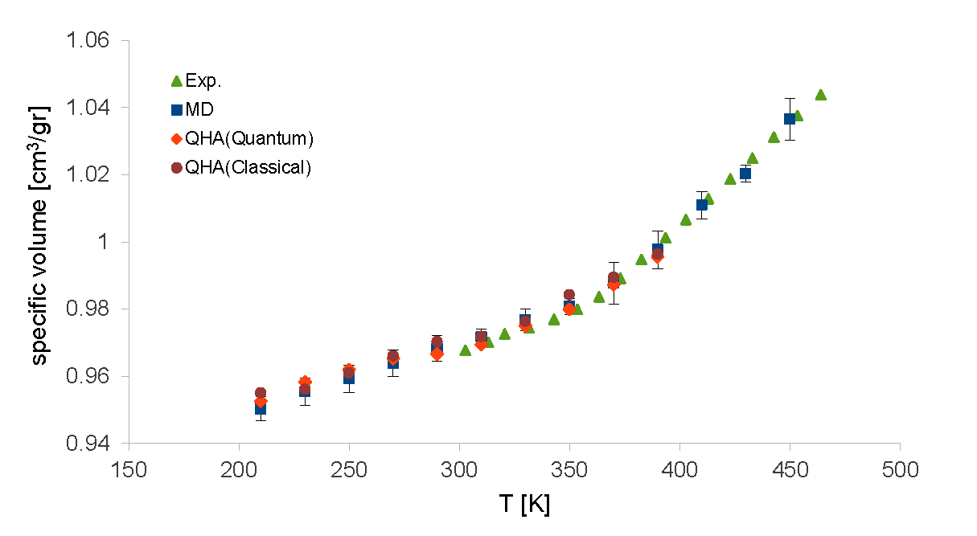
Volumetric Behavior: QHA vs. MD
Atactic polystyrene, modified A.Lyulin* model
Pressure 1 bar
MD cooling rate 0.5 K/ns
641 united atoms
Averages over 5 basins
Lempesis, N.; Vogiatzis, G.G.; Boulougouris, G.C.; van Breemen, L.C.A.; Hütter, M.; DNT, Mol. Phys. 2013, 111, 3430.
Exp: Zoller, P.; Walsh, D.J. Standard Pressure-Volume-Temperature Data for Polymers. Technomic: Lancaster, 1995.
*Lyulin, A.V.; DeGroot, J.; Michels, M. Macromol. Symp. 2003, 191, 167.
Notes:
Debye temperature around 100 K

Slide 39
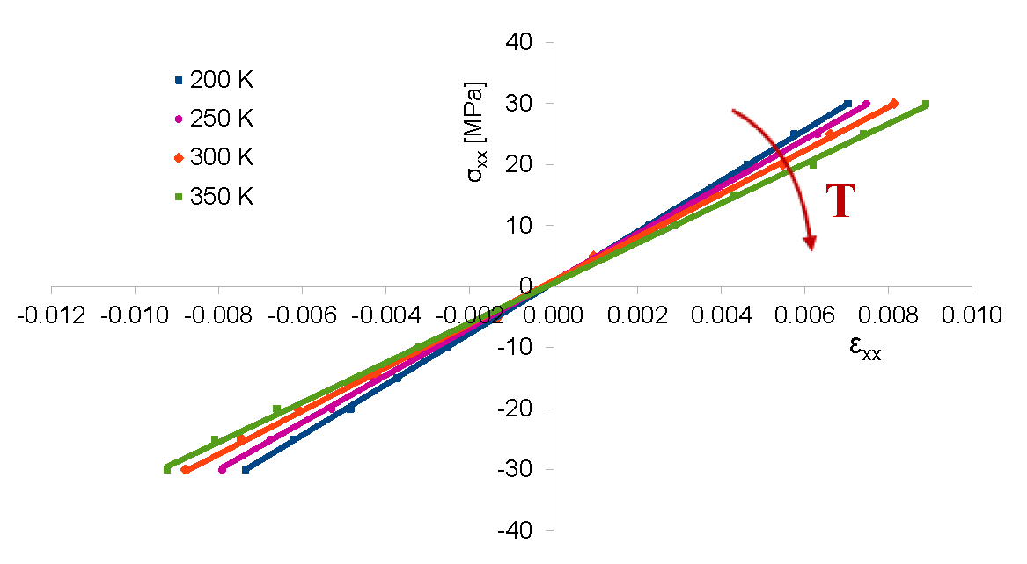
Elasticity of Polymer Glasses: Quasi-harmonic approximation
200 computational “specimens”, p=1 bar
Glassy atactic polystyrene (PS) | Computation | Experiment
Young’s modulus E (GPa), 300 K | 3.55 | 3.2-3.7
dE/dT (MPa/K) | -6.0 | -4.48
Poisson ratio ν | 0.35 | 0.33
dν/dT (K⁻¹) | 0.00022 | 0.00015
Lempesis, N; Vogiatzis, G.G.; Boulougouris, G.C.; van Breemen, L.C.A.; Hütter, M.; DNT, Mol. Phys. 2013, 111, 3430.

Slide 40

Relaxation in glasses: Energy landscape picture
Determine saddle points
out of initial basin A.
Discover new minima
Through each saddle point, determine reaction path
Calculate transition rates
C
B
A
D
network topology
energy landscape
‡
C
B
D
A

Slide 41
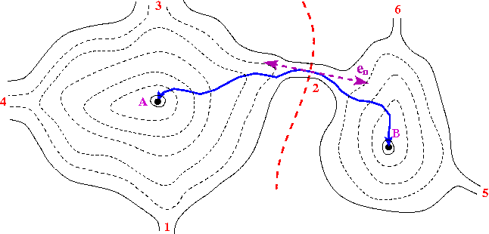
ELEMENTARY TRANSITIONS BETWEEN BASINS
‡
Determine saddle points (1, 2, 3, 4, …) out of current basin A. “Dimer method”, G. Henkelmann and H. Jónsson, J. Chem. Phys. 111, 7010 (1999).
Through each saddle point, determine reaction path “Intrinsic Reaction Coordinate”, K. Fukui Acc.Chem.Res. 14, 363 (1981).
First step on either side in the direction of the eigenvector correspon- ding to the negative eigenvalue of the Hessian:
Subsequent steps in steepest descent direction:
Estimate transition rate constants via Transition State Theory
‡
Quasi-harmonic approximation

Slide 42
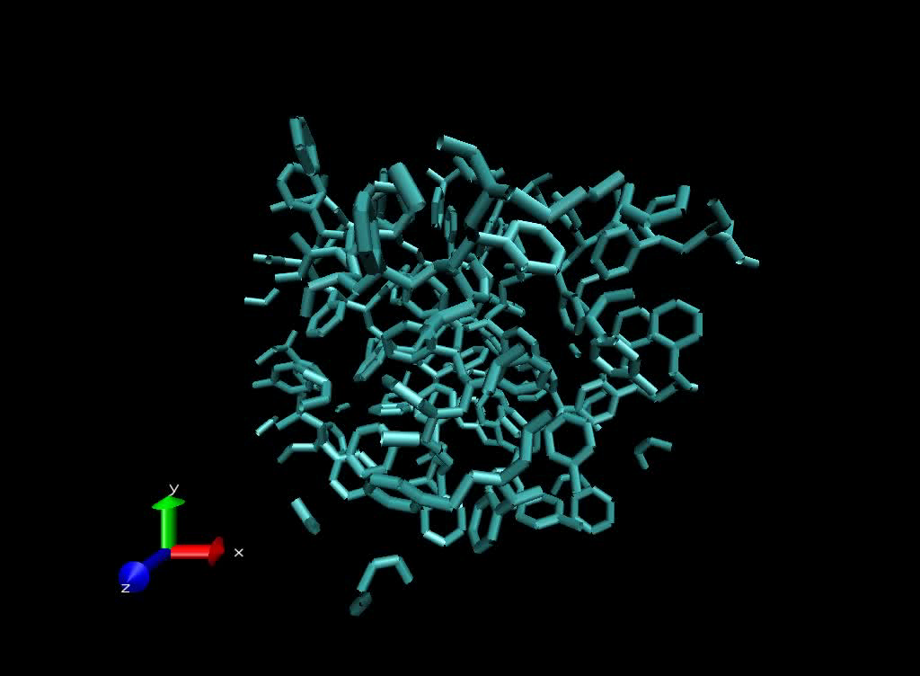

Slide 43
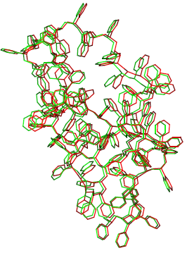
Energy profile along an elementary transition
a-PS, T=250 K ,P = 1 bar, β=1/(k_{B}T)
βV
, Å

Slide 44
TRACKING THE EVOLUTION OF THE PROBABILITY DISTRIBUTION
AMONG STATES BASED ON A FIRST PASSAGE SAMPLING SCHEME
Distinguish between “explored” states (paths leading out of them determined), and “boundary” states (connected to explored states but not yet explored themselves).
Explored
Boundary
Time-dependent probability of occupancy of each explored state determined by analytical solution of master equation:
Set of explored states augmented by appending a boundary state at an appropriately chosen time based on first passage time analysis.
Analytical solution of master equation, with atomistically calculated rate constants, in a network of states that is progressively augmented “on the fly”
Set of boundary states updated by including neighbours of newly added state.
“Dynamical Integration of a Markovian Web” (DIMW): G. Boulougouris and DNT, J. Chem. Phys. 127, 084903 (2007)

Slide 45
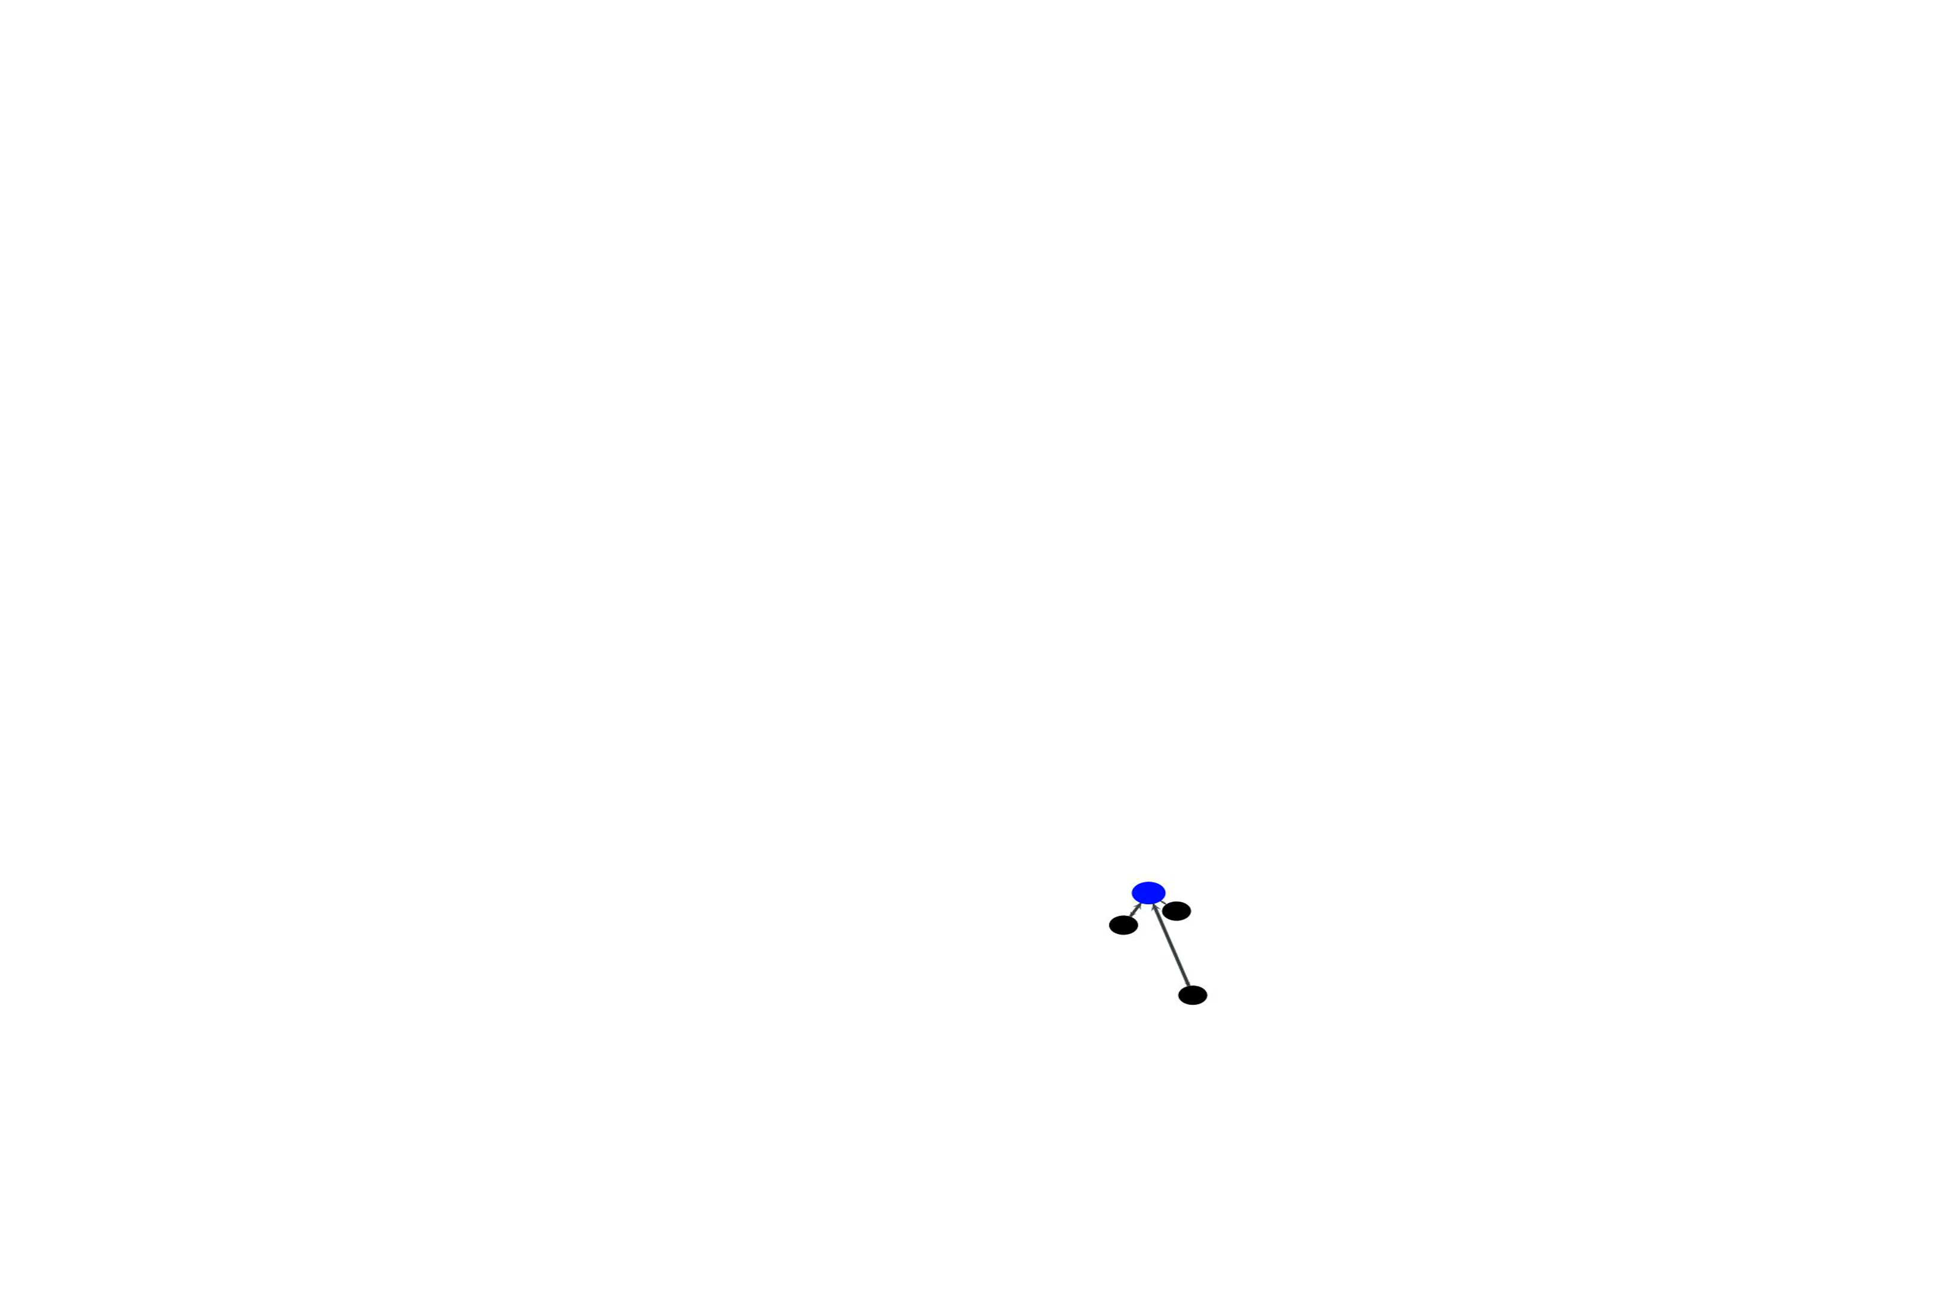
Creating a network of states
Graph representation: Vogiatzis, G.G.; van Breemen L.C.A.; Hütter, M.
Macromol. Theor. Simul. 2019, 190036.

