Slide 1
Ethics and Cyberspace
Byron KALDIS

Slide 2
Ethical Issues in Computer Science and Information Technology
Lecture 1

Slide 3
Information
Knowledge as Information: Very important
New Technology transmits information in vast amounts and very rapidly and (mostly) freely
Information Revolution (4th revolution)
Information Age
Information Societies

Slide 5
Social Issues in Computing and Information Technology
Digital Divide
Access
Geography
Income
Ethnicity
Age
Education

Slide 6
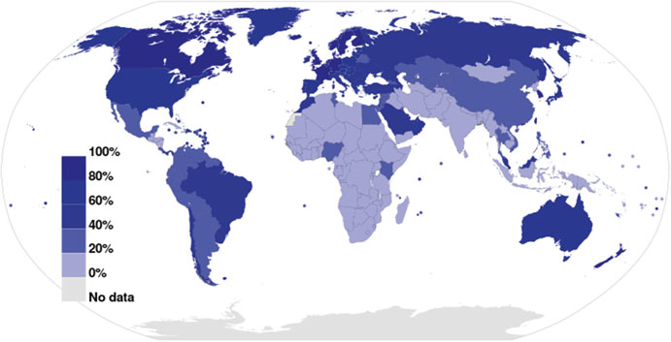

Slide 7
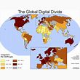

Slide 10
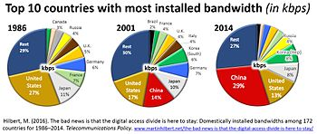

Slide 11
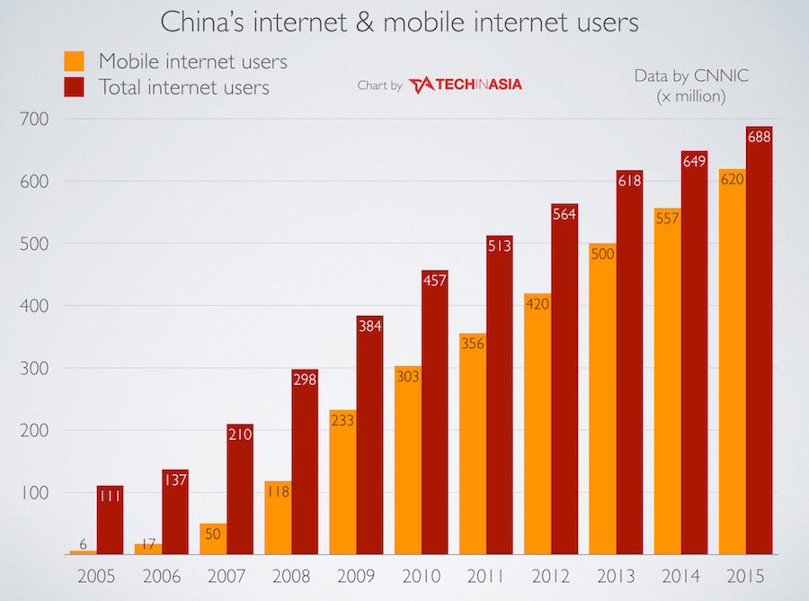

Slide 12
What human input should be:
• Creating awareness of the potential for ICT to meet one’s needs
• Creating, developing, and strengthening capacity to use information and ICT effectively, using local inputs
• Building capacity to produce and package information so that it adds value to local inputs
• Ensuring ongoing technical capacity development and developing a format for sharing knowledge and information
• Preventing the local capacity from being drained to other, usually developed countries

Slide 13
Ethics and Privacy
Important
Dangers
Internet Criminals
Our personal identity
Our country’s security
Security before the internet crime is commited

Slide 14
Challenges
• High digitalization of information and increasing bandwidth
• Declining costs of digital communication
• Increased miniaturization of mobile computing devices and other communications equipment
• Greater public awareness by the news media of the potential abuse of digital communication, especially the Internet

Slide 15
PRIVACY
1. Control of external influences:
• Solitude : The right to be alone without disturbances
• Anonymity : The right to have no public personal id entity
• Intimacy : The right not to be monitored
2. Control of personal information:
Reserve : The right to control one’s personal information including the methods of dissemination of that information.

Slide 16
Types of Privacy
PERSONAL: privacy of personal attributes and facts
prevention of anyone or anything that would intrude (either physically or by electronic means) or violate the personal space where those attributes are

Slide 17
INFORMATION Privacy: protection of unauthorized access to information itself
Different Types of Information Privacy:
Personal information :
Most personal information of value includes information on personal lifestyles such as religion, sexual orientation, political affiliations, or personal activities.
Financial information :
Financial information is important not only to individuals but also to organizations. Financial information is a very valued asset because it gives the organization the autonomy it needs to compete in the marketplace

Slide 18
Information Privacy
• Medical information : Medical information is very personal and very important to all of us. For personal, employment, and insurance purposes, many people want their medical information to be private.
• Internet : In this new age, the Internet keeps track of all our activities online.

Slide 19
Institutional Privacy
Institutions (e.g. Research Institutes, Universities, Governments, Businesses etc) wish to keep their data (research data or sales or country sensitive data) secret

Slide 20
Value of Privacy Eroded
Personal Identity
Personal Autonomy
Social Relationships

Slide 21
Database Systems Information
Information Gathering
Privacy Violation & the Law
Intrusion
Misuse of Information
Interception of Information
Information Matching

Slide 22
ANONYMITY: enabled by certain computer means
Anonymous servers :
(a) Full anonymity servers:
no identifying information is forwarded in packet headers.
(b) Pseudonymous servers:
put pseudonym in forwarded packet headers, keeping the real identity behind a pseudonym, but being able to receive and forward all packets sent to the pseudonym to the real server
Anonymous users

Slide 23
Anonymity: good and bad
society may not be safe if many criminals use anonymity to hide their criminal activities
Anonymity may be good for some relationships and the security of some people
Anonymity is good when a whistle-blower uses it to check unhealthy activities within a private business.
• Anonymity is good in National Defence:
in cases of national security so that no underground spies can gather information about our country
Etc.

Slide 24
SECURITY
Why needed:
1. Confidentiality : To prevent unauthorized disclosure of information to third parties.
This is important in a number of areas including the disclosure of personal
information such as medical, financial, academic, and criminal records.
2. Integrity : To prevent unauthorized modification of files and maintain the status quo.
It includes system, information, and personnel integrity. The alteration of information may be caused by a desire for personal gain or a need for revenge.
3. Availability : To prevent unauthorized withholding of information from those who need it when they need it.
------------------------------------------------------------------------------------------------------------
Physical Security
the prevention of access to physical facilitates such as computer
Systems
Information security
prevention of access to information by encryption, authentication , and other means.

Slide 25
Security-2
* Physical Security
the prevention of access to physical facilitates such as computer Systems
* Information Security
prevention of access to information by encryption, authentication, and other means.
>>Electronic Access Controls
Advances in technology: more invasive electronic controls that include card access control systems, firewalls, and the most important type:
The Interior of the software may be secured using electronic barriers such as firewalls and passwords
_Cryptography – encryptions
_Authentication: the system collects information about the user checking that the user is genuine

Slide 26
Software and Ethics
Software is a set of computer programs comprising a sequence of short commands called instructions that tell the computer what to do.
Software is either built into the computer’s more permanent memory, called ROM (read-only memory), or loaded on demand in the less permanent but more volatile memory called RAM (random access memory).
Software producer (individual or company etc.) creates or develops a set of programs to meet the specifications of a user, if there is a contract, or of a specific task if it is general software
Software buyers, or customers buy or get the finished software from the developer/producer in order to satisfy a need, basing their decision on what the producer claims about the product. The buyer may be an individual or a company etc..

Slide 27
Software: ethical issues
Standards ( set standards - legal protection of buyers)
Development & Testing (it does not always work!)
Validation & Verification (mathematical methods for tests to show that the software under review is faulty. Tests are random. But as the level of programming gets lower and lower toward machine code, software bugs get harder and harder to detect, and no amount of V&V is able to prevent those bugs from falling appearing.
Reliability: cannot be measured by wear and tear/ measures of reliability
Security: (security attacks on systems through software “holes” rather than through hardware, mainly through piracy, deletion, and alteration of programs and data)
Safety: (depends on the design and environment in which such software is used. But because of the multitude of such environments, and because software is the result of many people’s input and used in different applications, there is no guarantee that it will work in every environment)
Quality
============================
RISKS & HAZARDS: RISK ASSESSEMENT

