Slide 1
Procedural Language (PL/SQL)
Nikolas Mitrou
Professor ECE, NTUA

Slide 2
Procedural Language (PL/SQL)
Introduction
Implementations:
PL/PostgreSQL – PL/pgSQL
Oracle PL/SQL
…
Structure – Declarative statements PL/pgSQL
Executable statements and flow control in PL/pgSQL
Data structures and function parameters PL/pgSQL

Slide 3
PL/SQL
Introduction – what PL/SQL is/do
(SQL) programming language for servers
Enriches SQL with control structures
Defines functions/procedures
Implements complex computations
Accepts user-defined functions and operators
By using it, many time-consuming transactions with the server are avoided

Slide 4
PL/SQL (cont.)
Implementations
ORACLE PL/SQL
Oracle Database 12c, PL/SQL http://www.oracle.com/technetwork/database/features/plsql/index.html
Using Oracle PL/SQL, http://infolab.stanford.edu/~ullman/fcdb/oracle/or-plsql.html
PL/PostgreSQL
PL/pgSQL Documentation http://www.postgresql.org/docs/10/static/plpgsql.html
PL/pgSQL Tutorial, http://www.w3resource.com/PostgreSQL/pl-pgsql-tutorial.php

Slide 5
PL/pgSQL
Structure
Example
Its basic structure is the block (defines the scope of its variables)
A label may be used for reference
We can have nested blocks
messages
CREATE FUNCTION [schema.]somefunc() RETURNS INTEGER AS $$
<< outerblock >>
DECLARE
quantity INTEGER := 30;
BEGIN
RAISE NOTICE 'Quantity here is %', quantity; -- Prints 30
quantity := 50;
-- this is a single-line comment
-- multiline comments are included within /* ….*/
-- Create a subblock
DECLARE
quantity INTEGER := 80;
BEGIN
RAISE NOTICE 'Quantity here is %', quantity; -- Prints 80
RAISE NOTICE 'Outer quantity here is %',
outerblock.quantity; -- Prints 50
END;
RAISE NOTICE 'Quantity here is %', quantity; -- Prints 50
RETURN quantity;
END;
$$ LANGUAGE plpgsql;
[ <<label>> ]
[ DECLARE
declarations ]
BEGIN
statements
END [label] ;
$$: delineate the body of the function

Slide 6
PL/pgSQL (cont.)
Declarations (version 9.5)⁽¹⁾
All variables must be declared (with the exception of INTEGERS in a FOR loop)
Examples:
myint1 INTEGER;
myint2 INTEGER DEFAULT 1;
myint3 CONSTANT INTEGER := 20;
mystring VARCHAR;
myrow tablename%ROWTYPE;
myfield tablename.columnname%TYPE;
The general structure of a declarative statement is:
name [ CONSTANT ] type [ COLLATE⁽²⁾ collation_name ]
[ NOT NULL ] [ { DEFAULT | := } expression ];
⁽¹⁾ You can see the latest version here: http://www.postgresql.org/docs/10/static/plpgsql.html
⁽²⁾ COLLATE: declares the way of setting strings in an order, based e.g. on a character set

Slide 7
PL/pgSQL (cont.)
Functions: input and output parameters
Functions can accept and return as parameters all data types allowed by the server (scalar, array or composite data- %rowtype)
They can also be defined to return a “set” (or array) of any data that can be returned individually
They can simply perform a set of functions and not return anything (RETURNS void)

Slide 8
PL/pgSQL (cont.)
Example of a function with a single input and a single output parameter
schema (if not the public)
DROP FUNCTION IF EXISTS example1.find_student(integer);
CREATE FUNCTION example1.find_student(persID INTEGER) RETURNS text AS $$
-- Instead of the above two statements: CREATE OR REPLACE FUNCTION …
DECLARE
last_name VARCHAR;
first_name VARCHAR;
BEGIN
SELECT name, givenname INTO STRICT last_name, first_name --(*)
FROM example1.student WHERE IDstudent = persID;
RETURN first_name || '=====' || last_name; --(**)
END;
$$ LANGUAGE plpgsql;
SELECT example1.find_student(202429);
(*) STRICT is optional. If present, the query must return exactly one row
(**) String concatenation in postgreSQL: string || string

Slide 9
PL/pgSQL (συνέχεια)
Δομές ελέγχου
IF boolean-expression THEN
statements
[ ELSIF boolean-expression THEN
statements
[ ELSIF boolean-expression THEN
statements
...]]
[ ELSE
statements ]
END IF;
[ <<label>> ]
FOR identifier IN [ REVERSE ] expression1 .. expression2 LOOP
statement;
[...]
END LOOP;
[ <<label>> ]
WHILE condition LOOP
statement;
[...]
END LOOP;
CASE
WHEN boolean-expression THEN
statements
[ WHEN boolean-expression THEN
statements
... ]
[ ELSE
statements ]
END CASE;

Slide 10
PL/pgSQL (συνέχεια)
Example 3:
Enter as many new entries in the room table of the Elementary Student Registry as the different home universities of the students, with use type 'office' and label ‘GI-2024.x', x=1,2,...
Preparation, with two changes in the schema:
The PRIMARY KEY of the room table is declared SERIAL, in order to be created automatically
A secondary table roomuniversity is created (hint)
-- 1. Create a copy of table 'room'
CREATE TABLE room_temp AS TABLE exercise1.room
-- 2. Create a new table 'room' with a SERIAL key
DROP TABLE exercise1.room
CREATE TABLE exercise1.room (
IDroom SERIAL PRIMARY KEY,
label VARCHAR(50) DEFAULT NULL,
use room_use,
seats INTEGER );
-- 3. Insert the old entries from the copy table
INSERT INTO exercise1.room (IDroom, label, seats)
SELECT IDroom, label, seats FROM room_temp;
-- 4. Change the starting value of the PRIMARY KEY
ALTER SEQUENCE exercise1.room_IDroom_seq RESTART WITH 202410;
-- 5. Create table 'roomuniversity'
CREATE TABLE exercise1.roomuniversity (
roomID INTEGER NOT NULL,
univ VARCHAR(50),
PRIMARY KEY (roomID, univ),
FOREIGN KEY (roomID)
REFERENCES exercise1.room(IDroom)
ON DELETE CASCADE
);

Slide 11
PL/pgSQL (συνέχεια)
Example 3 (cont.)
CREATE OR REPLACE FUNCTION exercise1.more_rooms() RETURNS void AS $$
DECLARE
cnt INTEGER := 1;
u exercise1.person.university%TYPE;
s INTEGER;
str VARCHAR := ‘GI-2024-';
BEGIN
-- Loop over the table entries to get universities and corresponding number of students
FOR u,s IN (SELECT university, COUNT(university) student_num
FROM exercise1.person WHERE category='student' AND ak_year = 2024
GROUP BY university
ORDER BY student_num DESC)
LOOP
INSERT INTO exercise1.room (label, use, seats) VALUES
(CONCAT(str,cnt), 'office' ,s);
-- The PRIMARY KEY, IDroom, is created automatically
-- Table roomuniversity is updated, with roomID taken
-- from the newly inserted entry in the room table
INSERT INTO exercise1.roomuniversity (roomID, univ) VALUES
((SELECT IDroom FROM exercise1.room WHERE label=CONCAT(str,cnt)), u);
cnt = cnt + 1;
END LOOP;
END;
$$ LANGUAGE plpgsql;
SELECT exercise1.more_rooms();

Slide 12
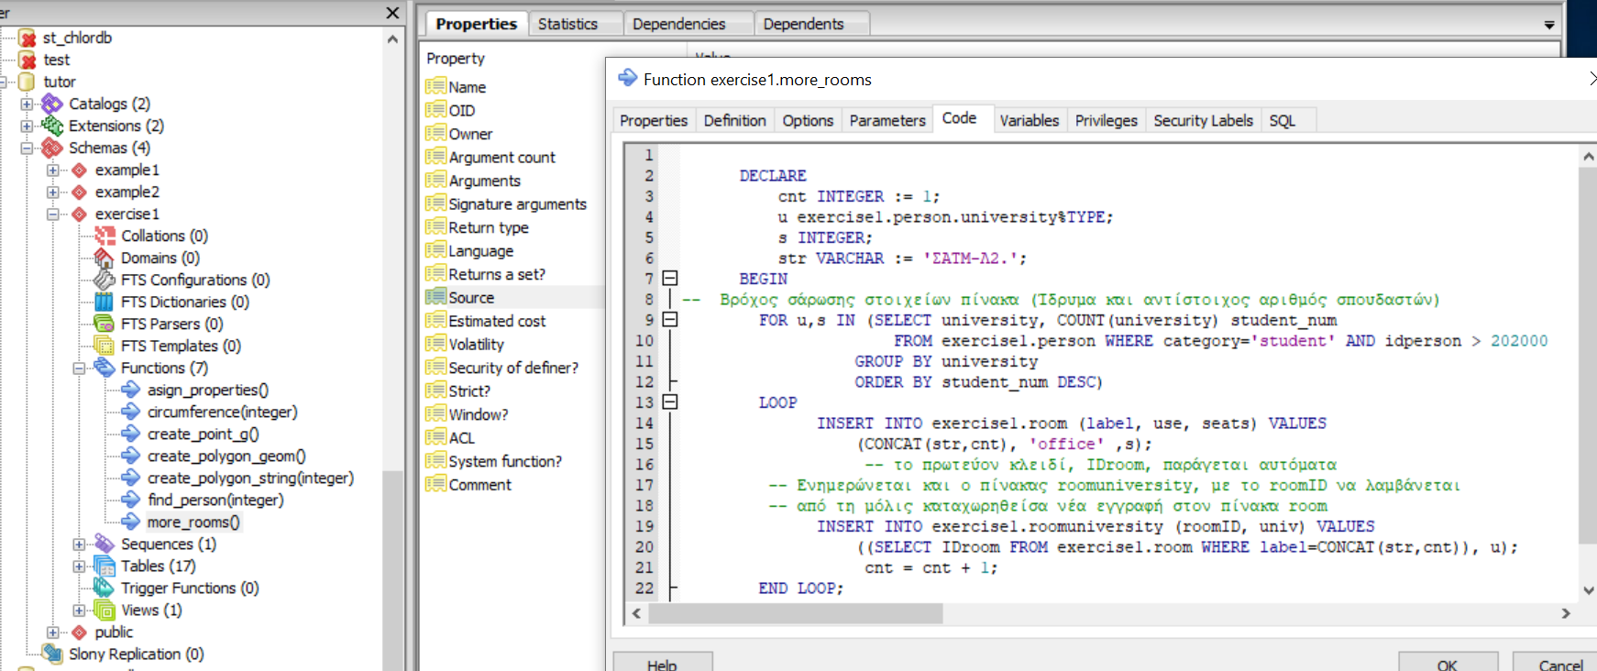
PL/pgSQL (cont.)
Functions PL/pgSQL in the PgAdmin UI

Slide 13
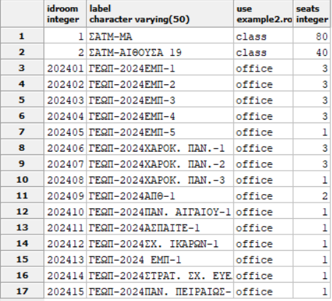
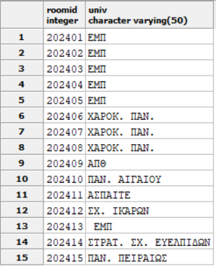
PL/pgSQL (cont.)
Example (cont): Tables room and roomuniversity

