Slide 1
Posted-Price Mechanisms and
Prophet Inequalities
Brendan Lucier, Microsoft Research
WINE: Conference on Web and Internet Economics
December 11, 2016

Slide 2
The Plan
Introduction to Prophet Inequalities
Application to posted-price mechanisms
Extensions I: single-parameter problems
Extensions II: multi-dimensional problems

Slide 3

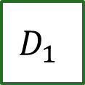




Prophet Inequality
The gambler’s problem:
$$D_{1}$$
$$D_{2}$$
$$D_{3}$$
$$D_{4}$$
$$D_{5}$$

Slide 4
Prophet Inequality
The gambler’s problem:
$20
$$D_{1}$$
$$D_{2}$$
$$D_{3}$$
$$D_{4}$$
$$D_{5}$$
Keep: win $20, game stops.
Discard: prize is lost, game
continues with next box.

Slide 5
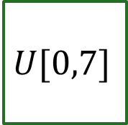
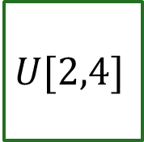

Let’s Play…
2.66
3.95
1.41
3.66
$$U[2,4]$$
$$U[2,4]$$
$$U[1,5]$$
$$U[0,7]$$

Slide 6
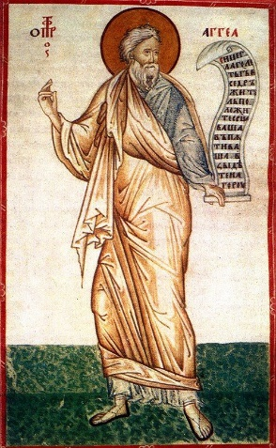
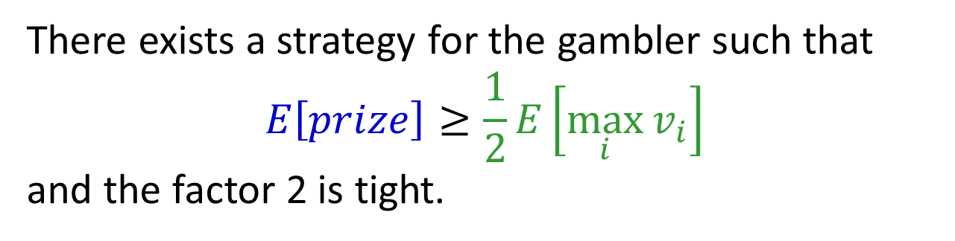
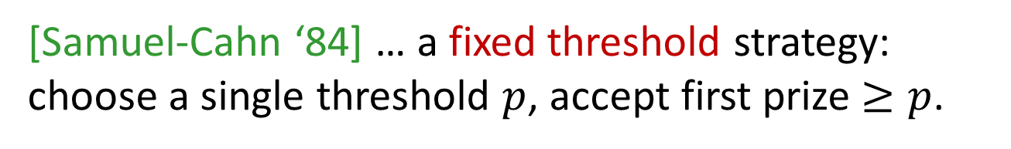
Prophet Inequality
Theorem: [Krengel, Sucheston, Garling ‘77]
There exists a strategy for the gambler such that
$$E\left[prize\right]≥\frac{1}{2}E\left[\max_{i}{v_{i}}\right]$$
and the factor 2 is tight.
[Samuel-Cahn ‘84] … a fixed threshold strategy:
choose a single threshold $p$, accept first prize $≥p$.
Notes:
Prophet Haggai

Slide 7

Lower Bound: 2 is Tight
$\frac{1}{ε}$ w.p. $ε$
0 otherwise
1

Slide 8

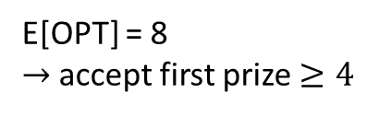
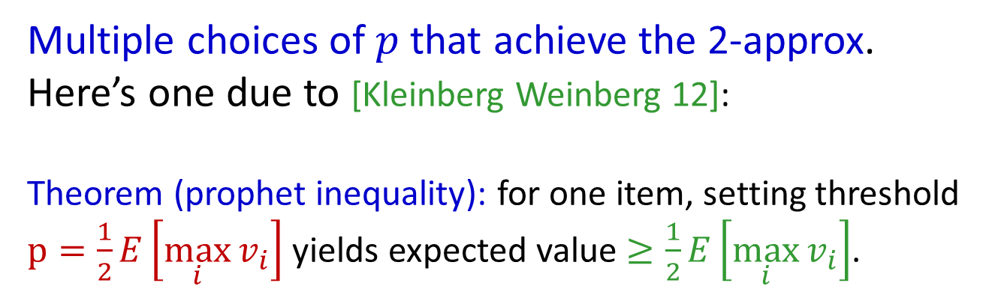
Prophet Inequality
Multiple choices of $p$ that achieve the 2-approx.
Here’s one due to [Kleinberg Weinberg 12]:
Theorem (prophet inequality): for one item, setting threshold $p=\frac{1}{2}E\left[\max_{i}{v_{i}}\right]$ yields expected value $≥\frac{1}{2}E\left[\max_{i}{v_{i}}\right]$.
Example:
10 w.p. 1/2
8 w.p. 1/4
6 w.p. 1/8
2 w.p. 1/8
OPT =
1 or 6
0 or 8
2 or 10
E[OPT] = 8
$→$accept first prize $≥4$
(each box: prizes equally likely)
Notes:
Note: not optimal! (Price 2 is better)
Also: comparison with optimal ex-post, not with the optimal price!
Also note: threshold p depends on the set of distributions, but not the arrival order! Compare with secretary problems: arbitrary values, but random arrival order.

Slide 9
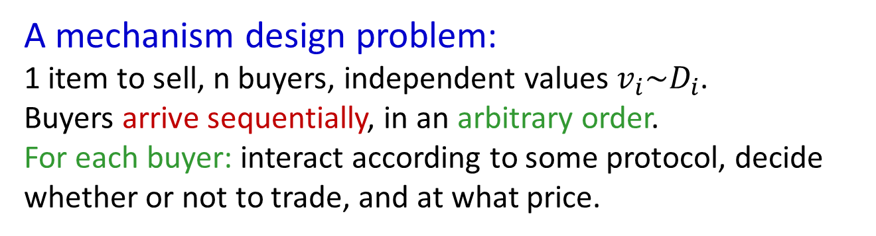
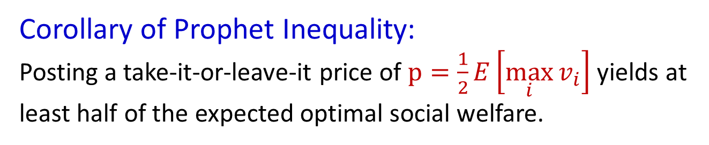
Application: Posted Pricing
A mechanism design problem:
1 item to sell, n buyers, independent values $v_{i}\sim D_{i}$.
Buyers arrive sequentially, in an arbitrary order.
For each buyer: interact according to some protocol, decide whether or not to trade, and at what price.
Corollary of Prophet Inequality:
Posting a take-it-or-leave-it price of $p=\frac{1}{2}E\left[\max_{i}{v_{i}}\right]$ yields at least half of the expected optimal social welfare.
[Hajiaghayi Kleinberg Sandholm ’07]
Notes:
An immediate corollary

Slide 10
Posted Pricing (Con’t)
What about revenue?
[Chawla Hartline Malec Sivan ’10]: Can apply prophet inequality to virtual values to achieve half of optimal revenue.
Beyond selling a single item?
Copies model: [Chawla Hartline Kleinberg ’07] Multiple items for sale, a buyer with independent values for each, unit-demand.
A natural mapping between two problems:
Buyers:
Items:
Buyers:
Items:
1
1
1
2
2
1
m
m
Notes:
Todo: tricks to get to a single posted price?
Is there more to say here? Look at course notes…
Put references, citations…

Slide 11
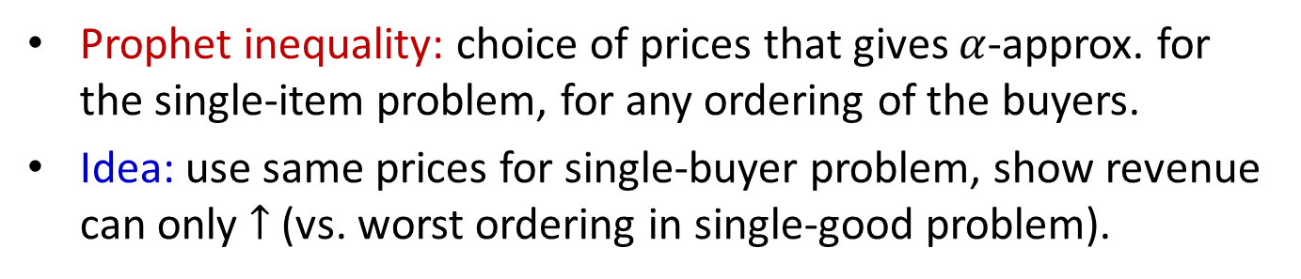
Posted Pricing (Con’t)
A natural mapping between two problems:
Buyers:
Items:
Buyers:
Items:
1
1
1
2
2
1
m
m
Prophet inequality: choice of prices that gives $α$-approx. for the single-item problem, for any ordering of the buyers.
Idea: use same prices for single-buyer problem, show revenue can only $↑$ (vs. worst ordering in single-good problem).
Result: O(1) approx. to optimal revenue for unit-demand buyers with independent item values. [Chawla Hartline Kleinberg ’07, Chawla Hartline Malec Sivan ’10], [Kleinberg Weinberg ’12]
Notes:
Notable – first approx. revenue results for multi-dimensional preferences!!

Slide 12
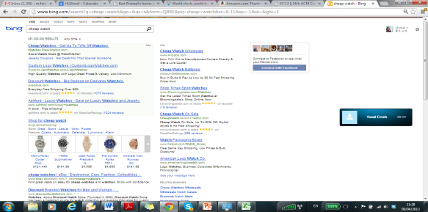
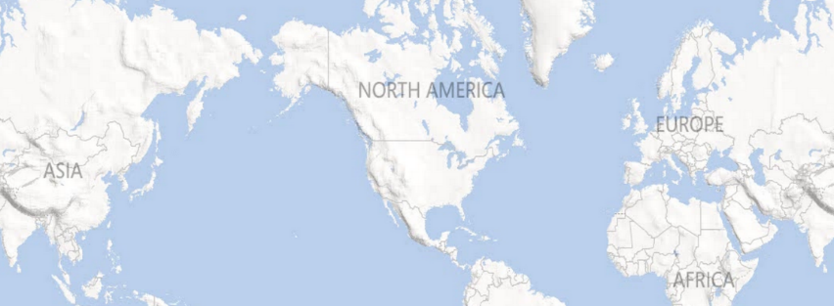
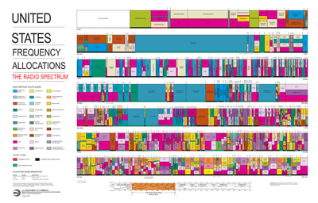
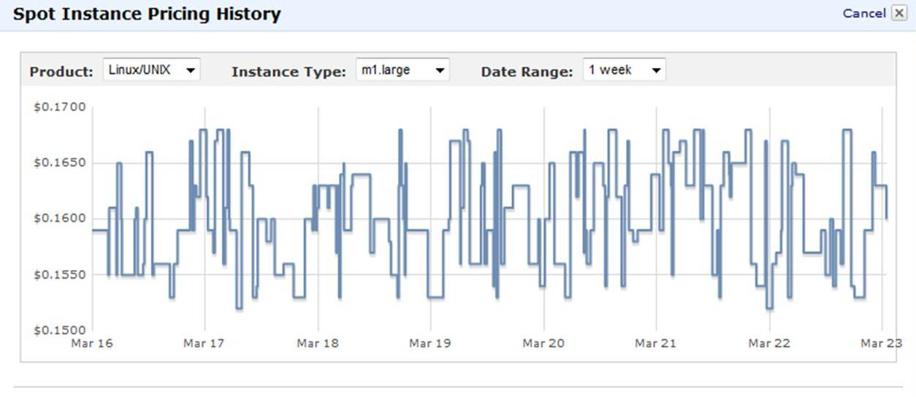
Other Allocation Problems?
Online Ad Space
Network Bandwidth
Cloud Resources
Notes:
Maybe use this visualization for “different types of allocation problems”

Slide 13
Why Pricing?
Simple – Transparent, easy to describe.
Strategyproof, coalition-proof.
Distributed – Buyers can arrive sequentially. Minimal coordination required.
Flexible – Often order-oblivious. Tunable.
Dynamic vs static, anonymous vs personalized.
Pricing items vs Pricing bundles.
Notes:
Compare with second-price auction (collusion, centralized vs. distributed)
In this setting, a second-price auction is probably easy to run. But what about in more complex settings…?
The goal: posted-pricing as an approach to sell more complex types of resources. The approach: prove new prophet inequalities!

Slide 14

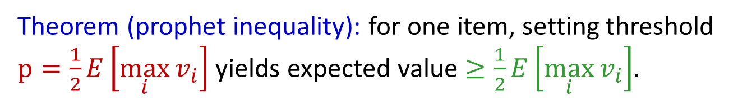
Prophet Inequality: Proof
Theorem (prophet inequality): for one item, setting threshold $p=\frac{1}{2}E\left[\max_{i}{v_{i}}\right]$ yields expected value $≥\frac{1}{2}E\left[\max_{i}{v_{i}}\right]$.
What can go wrong?
If price is
Too low: a low-value buyer might purchase the item, blocking a subsequent high-value buyer.
Too high: no buyers purchase.

Slide 15
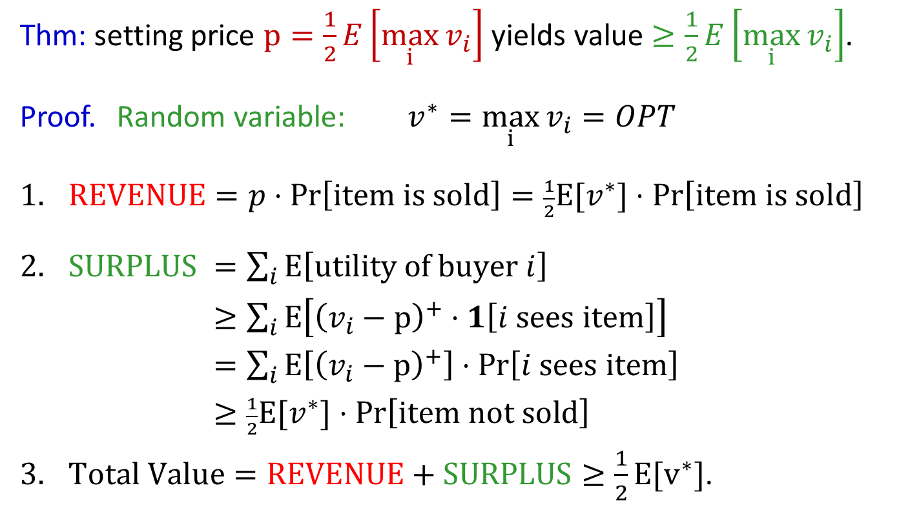
Prophet Inequality: Proof
Thm: setting price $p=\frac{1}{2}E\left[\max_{i}{v_{i}}\right]$ yields value $≥\frac{1}{2}E\left[\max_{i}{v_{i}}\right]$.
Proof. Random variable: $v^{∗}=\max_{i}{v_{i}}=OPT$
$REVENUE=p⋅\operatorname{Pr}\left[\text{item} \text{is} \text{sold}\right]=\frac{1}{2}E[v^{∗}]⋅\operatorname{Pr}\left[\text{i}\text{tem} \text{is} \text{sold}\right]$
$SURPLUS$ $=\sum_{i}{E\left[\text{utility} \text{of} \text{buyer} i\right]}$
$≥\sum_{i}{E\left[{\left(v_{i}−p\right)}^{+}⋅1\left[i \text{sees} \text{item}\right]\right]}$
$=\sum_{i}{E\left[{\left(v_{i}−p\right)}^{+}\right]⋅Pr\left[i \text{sees} \text{item}\right]}$
$≥\frac{1}{2}E[v^{∗}]⋅Pr\left[\text{ite}\text{m} \text{not} \text{sold}\right]$
$Total Value=REVENUE+SURPLUS≥\frac{1}{2}E[v^{∗}]$.
Notes:
Important: linearity of expectation trick.
-> Idea: if prob of not selling is high, then prob. That max-valued player can buy is high. Since expected value of max-valued player is high, and price is low, surplus must be high!
[ equality: independence, and doesn’t depend on value. Next line: dominance. Then just take the sum. ]
Note: very similar to proof of smoothness, for those who are familiar with that!! More on that later…

Slide 16

Prophet Inequality: Proof
Thm: for one item, price $p=\frac{1}{2}E\left[OPT\right]$ yields value $≥\frac{1}{2}E\left[OPT\right]$.
Summary:
Price is high enough that expected revenue offsets the
expected optimal value in events where the item is sold.
Price is low enough that expected buyer surplus offsets the expected optimal value in events where the item is unsold.

Slide 17
Extensions I: Single-Parameter
Notes:
Compare with second-price auction (collusion, centralized vs. distributed)
In this setting, a second-price auction is probably easy to run. But what about in more complex settings…?
The goal: posted-pricing as an approach to sell more complex types of resources. The approach: prove new prophet inequalities!

Slide 18



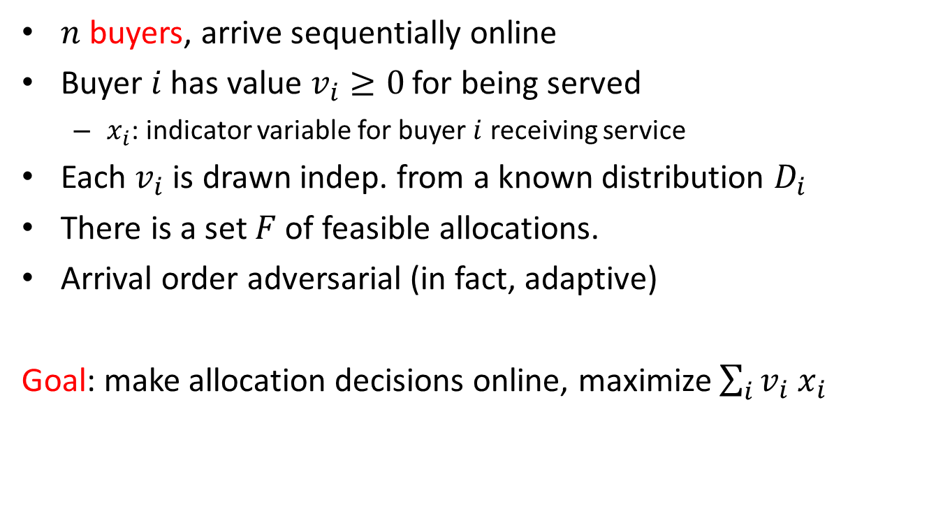
Buyers:
Values:
Single-Parameter Model
1
$$v_{1}\sim D_{1}$$
Sequential allocation
2
$$v_{2}\sim D_{2}$$
$n$ buyers, arrive sequentially online
Buyer $i$ has value $v_{i}≥0$ for being served
  $x_{i}$: indicator variable for buyer $i$ receiving service
Each $v_{i}$ is drawn indep. from a known distribution $D_{i}$
There is a set $F$ of feasible allocations.
Arrival order adversarial (in fact, adaptive)
Goal: make allocation decisions online, maximize $\sum_{i}{v_{i} x_{i}}$
n
$$v_{n}\sim D_{n}$$
Notes:
This talk: theoretical abstraction --- CA problem

Slide 19
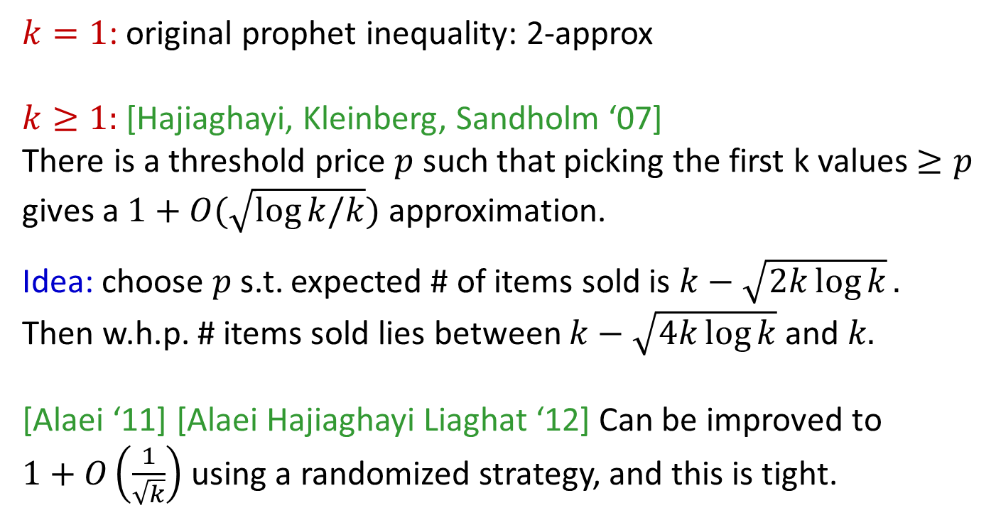
Extension 1: Cardinality Constraint
Constraint: allocate to at most $k$ buyers
$k=1$: original prophet inequality: 2-approx
$k≥1:$ [Hajiaghayi, Kleinberg, Sandholm ‘07]
There is a threshold price $p$ such that picking the first k values $≥p$
gives a $1+O(\sqrt{log⁡k/k})$approximation.
Idea: choose $p$ s.t. expected # of items sold is $k−\sqrt{2k\log{k}}.$
Then w.h.p. # items sold lies between $k−\sqrt{4k\log{k}}$ and 𝑘.
[Alaei ‘11] [Alaei Hajiaghayi Liaghat ‘12] Can be improved to
$1+O\left(\frac{1}{\sqrt{k}}\right)$ using a randomized strategy, and this is tight.
Notes:
If k is greater than 1, the problem gets EASIER. Why? Concentration (Hoeffding inequality). Get tight bound up to logs.
Can interpret as: come up with right threshold for a fractional relaxation of the problem, and the canonical rounding doesn’t do too badly.
Idea of Alaei improvement: same approach, but do the randomized rounding more carefully.

Slide 20
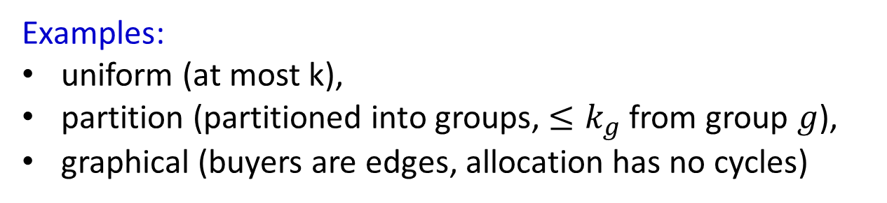
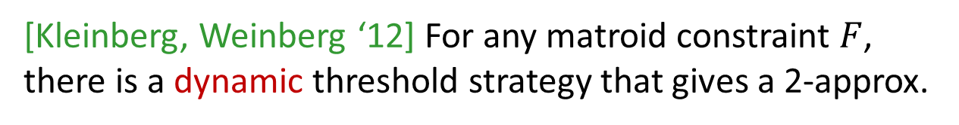
Extension 2: Matroid Constraint
Examples:
uniform (at most k),
partition (partitioned into groups, $≤k_{g}$ from group $g$),
graphical (buyers are edges, allocation has no cycles)
[Kleinberg, Weinberg ‘12] For any matroid constraint $F$, there is a dynamic threshold strategy that gives a 2-approx.
Dynamic: the price offered to each buyer can depend on
a) the index of the buyer being considered, and
b) the allocations chosen (or not chosen) in previous rounds
Notes:
Matroids: generalizes this even further

Slide 21
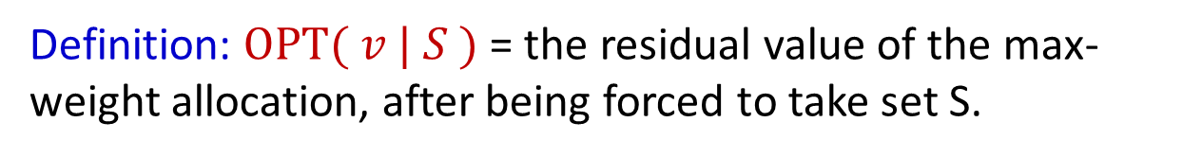
Extension 2: Matroid Constraint
Definition: $\text{OPT}( v | S )$ = the residual value of the max-weight allocation, after being forced to take set S.
Example: feasibility constraint is “take at most 3”
6
2
5
7
1
S
$\text{OPT}( v | S )$ = 6+7 = 13
Notes:
Example: choose 2 of 3 elements with value drawn U[0,1]

Slide 22
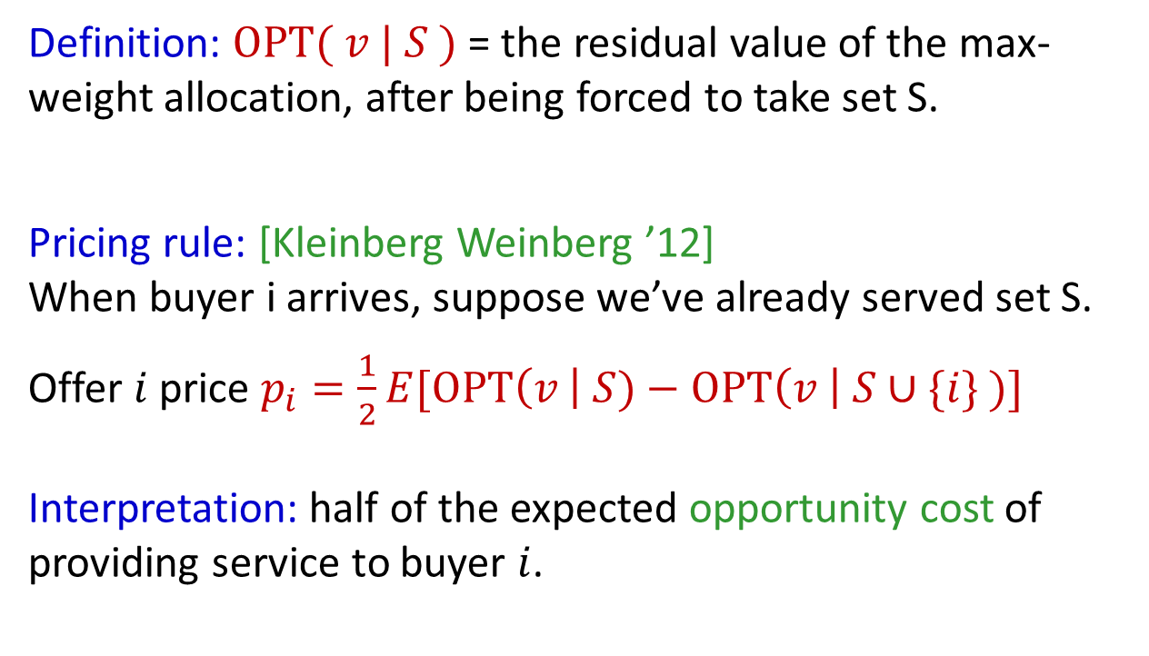
Extension 2: Matroid Constraint
Definition: $\text{OPT}( v | S )$ = the residual value of the max-weight allocation, after being forced to take set S.
Pricing rule: [Kleinberg Weinberg ’12]
When buyer i arrives, suppose we’ve already served set S.
Offer $i$ price $p_{i}=\frac{1}{2}E[\text{OPT}\left(v \right| S)−\text{OPT}\left(v \right| S∪\{i\} )]$
Interpretation: half of the expected opportunity cost of providing service to buyer $i$.
Notes:
Example: choose 2 of 3 elements with value drawn U[0,1]

Slide 23

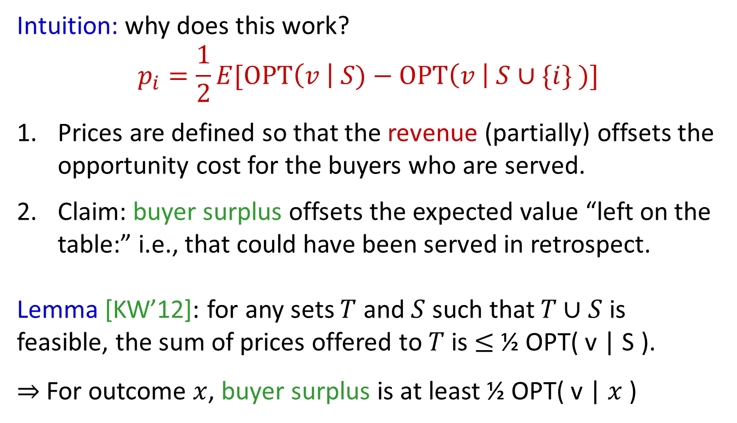
Proof Sketch
Intuition: why does this work?
$$p_{i}=\frac{1}{2}E[\text{OPT}\left(v \right| S)−\text{OPT}\left(v \right| S∪\{i\} )]$$
Prices are defined so that the revenue (partially) offsets the opportunity cost for the buyers who are served.
Claim: buyer surplus offsets the expected value “left on the table:” i.e., that could have been served in retrospect.
Lemma [KW’12]: for any sets $T$ and $S$ such that $T∪S$ is feasible, the sum of prices offered to $T$ is $≤$ ½ OPT( v | S ).
$⇒$ For outcome $x$, buyer surplus is at least ½ OPT( v | $x$ )
Notes:
Idea: similar to the original prophet inequality proof.

Slide 24
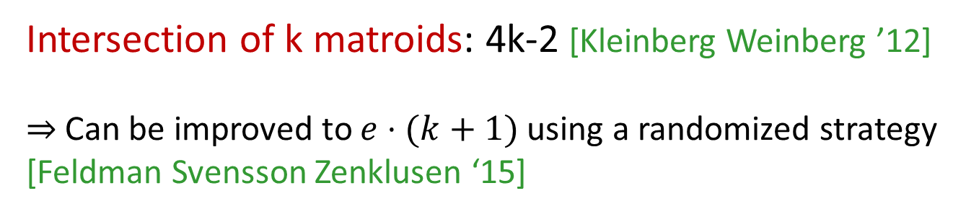
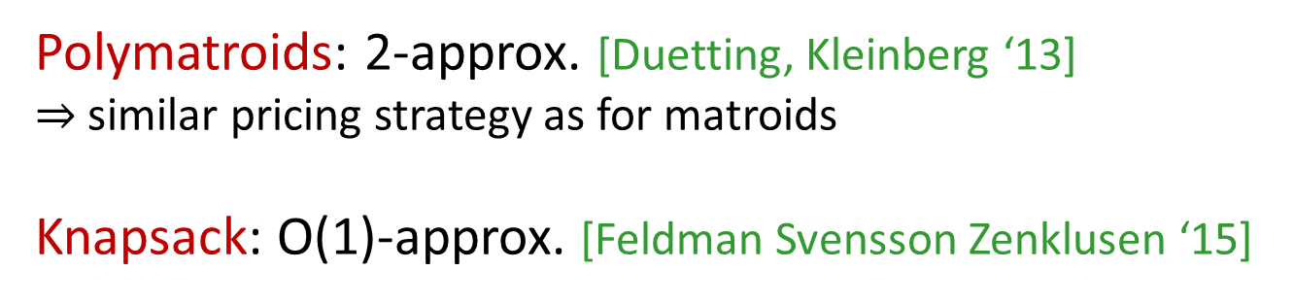
… Even More Constraints
Intersection of k matroids: 4k-2 [Kleinberg Weinberg ’12]
$⇒$Can be improved to $e⋅(k+1)$ using a randomized strategy
[Feldman Svensson Zenklusen ‘15]
Polymatroids: 2-approx. [Duetting, Kleinberg ‘13]
$⇒$ similar pricing strategy as for matroids
Knapsack: O(1)-approx. [Feldman Svensson Zenklusen ‘15]
Notes:
Matroids: generalizes this even further

Slide 25


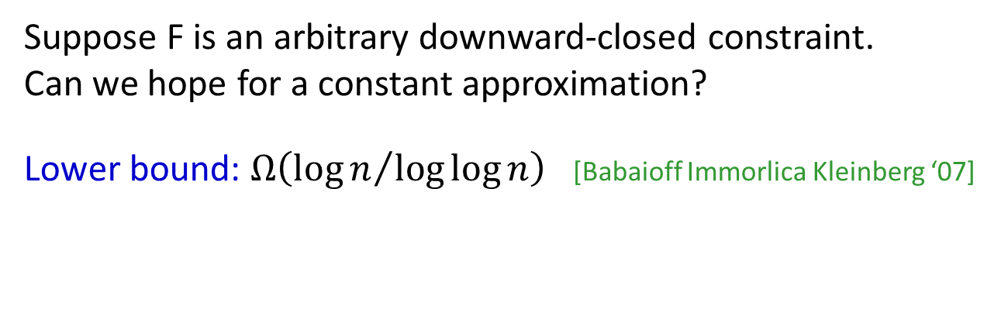
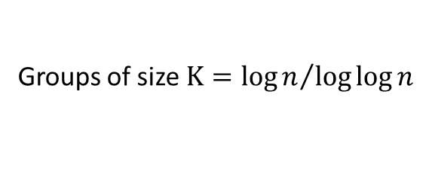



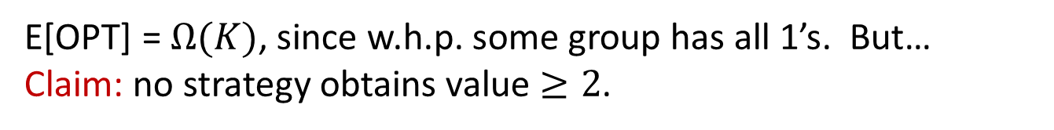
All The Constraints?
Suppose F is an arbitrary downward-closed constraint.
Can we hope for a constant approximation?
Lower bound: $Ω\left({\log{n}}/{\log{\log{n}}}\right)$ [Babaioff Immorlica Kleinberg ‘07]
…
$$D$$
$$D$$
$$D$$
$$D$$
$$D$$
$$D$$
$$D$$
$$D$$
$$D$$
$$D$$
$$D$$
$$D$$
Groups of size $K={\log{n}}/{\log{\log{n}}}$
$D:$ $1 \text{w}\text{.}\text{p}\text{. }1/K$, otherwise $0$
Feasibility constraint: can allocate to buyers in at most 1 group.
E[OPT] = $Ω(K)$, since w.h.p. some group has all 1’s. But…
Claim: no strategy obtains value $≥2$.
Notes:
Matroids: generalizes this even further

Slide 26
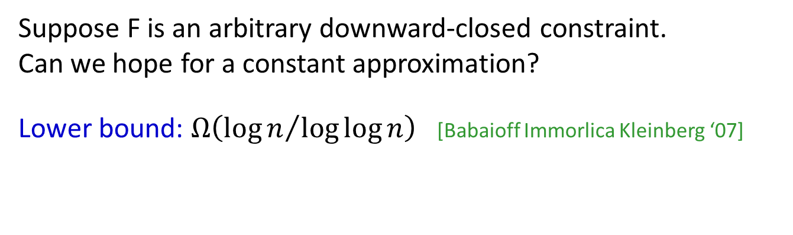
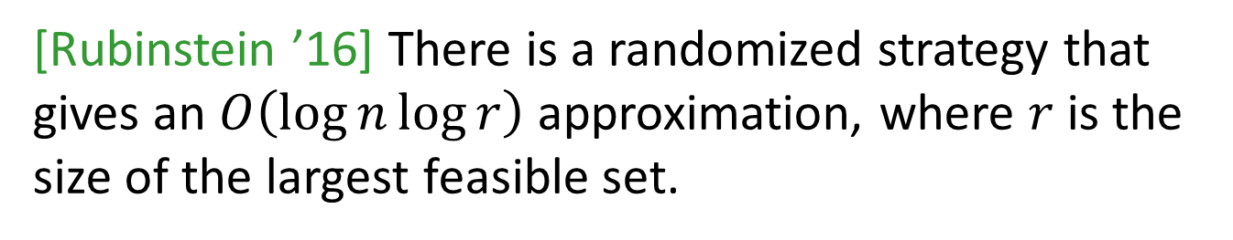
All The Constraints?
Suppose F is an arbitrary downward-closed constraint.
Can we hope for a constant approximation?
Lower bound: $Ω\left({\log{n}}/{\log{\log{n}}}\right)$ [Babaioff Immorlica Kleinberg ‘07]
[Rubinstein ’16] There is a randomized strategy that gives an $O\left(\log{n\log{r}}\right)$ approximation, where $r$ is the size of the largest feasible set.
Notes:
Matroids: generalizes this even further

Slide 27
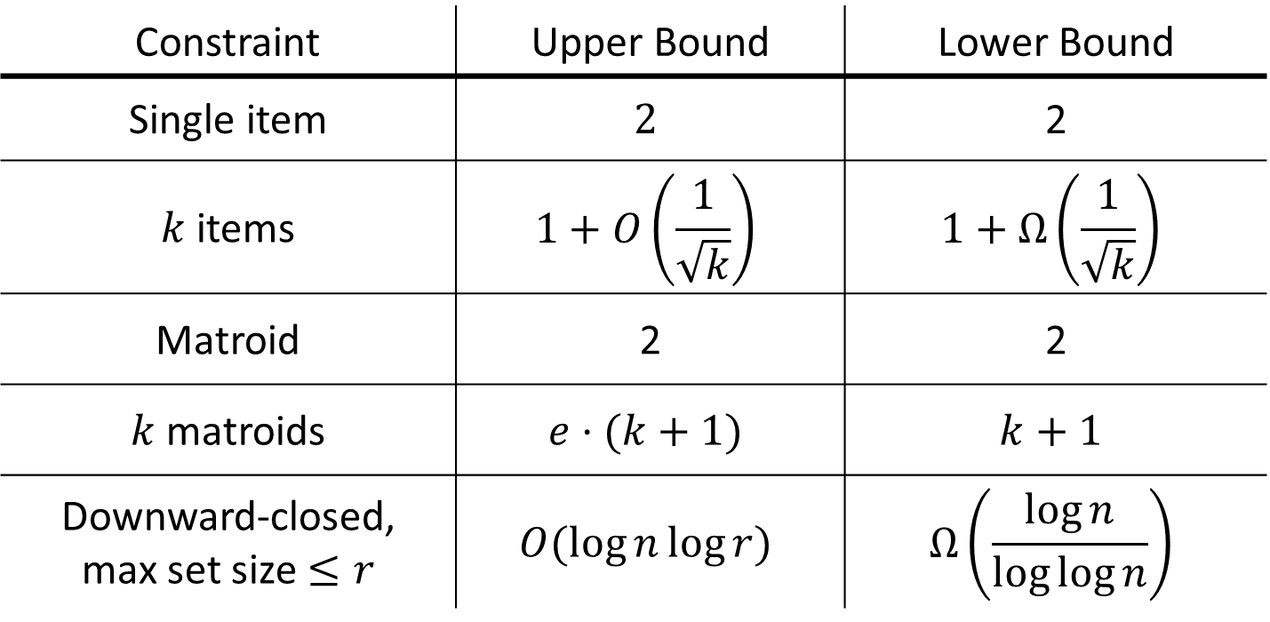
Summary
Constraint | Upper Bound | Lower Bound
Single item | $$2$$ | 2
$k$ items | $$1+O\left(\frac{1}{\sqrt{k}}\right)$$ | $$1+Ω\left(\frac{1}{\sqrt{k}}\right)$$
Matroid | 2 | 2
$k$ matroids | $$e⋅(k+1)$$ | $$k+1$$
Downward-closed, max set size $≤r$ | $$O(\log{n\log{r}})$$ | $$Ω\left(\frac{\log{n}}{\log{\log{n}}}\right)$$
Directly imply posted-price mechanisms for welfare, revenue

Slide 28
Extensions II: Multi-Dimensional
Based on [Feldman Gravin L. ‘15], [Duetting Feldman Kesselheim L. ‘16]
Notes:
Compare with second-price auction (collusion, centralized vs. distributed)
In this setting, a second-price auction is probably easy to run. But what about in more complex settings…?
The goal: posted-pricing as an approach to sell more complex types of resources. The approach: prove new prophet inequalities!

Slide 29
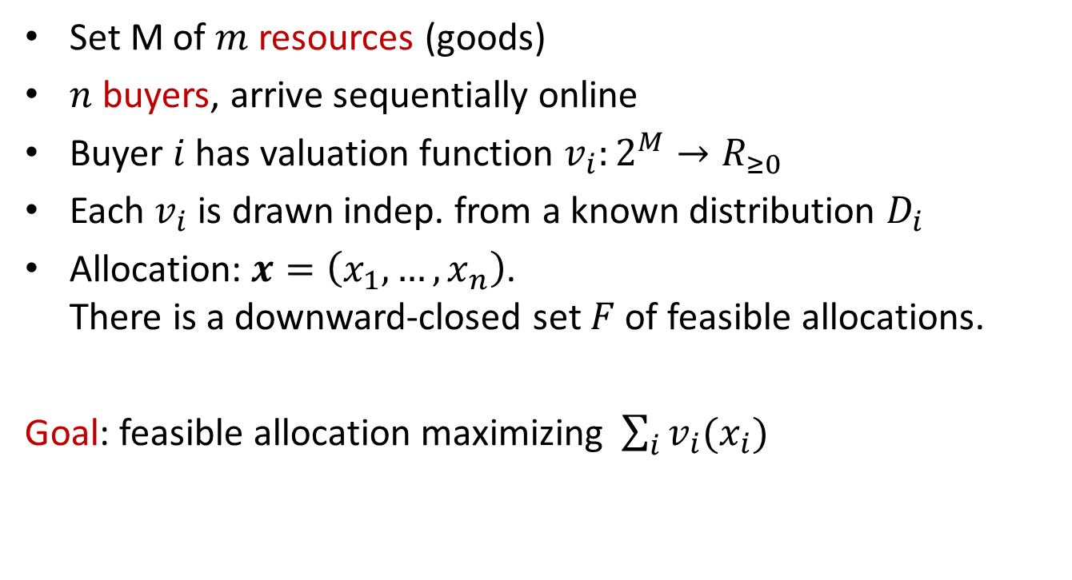
Buyers:
Goods:
A General Model
1
1
Combinatorial allocation
2
2
Set M of $m$ resources (goods)
$n$ buyers, arrive sequentially online
Buyer $i$ has valuation function $v_{i}:2^{M}→R_{≥0}$
Each $v_{i}$ is drawn indep. from a known distribution $D_{i}$
Allocation: $x=\left(x_{1},…,x_{n}\right)$.
There is a downward-closed set $F$ of feasible allocations.
Goal: feasible allocation maximizing $\sum_{i}{v_{i}(x_{i})}$
n
m
Notes:
This talk: theoretical abstraction --- CA problem

Slide 30
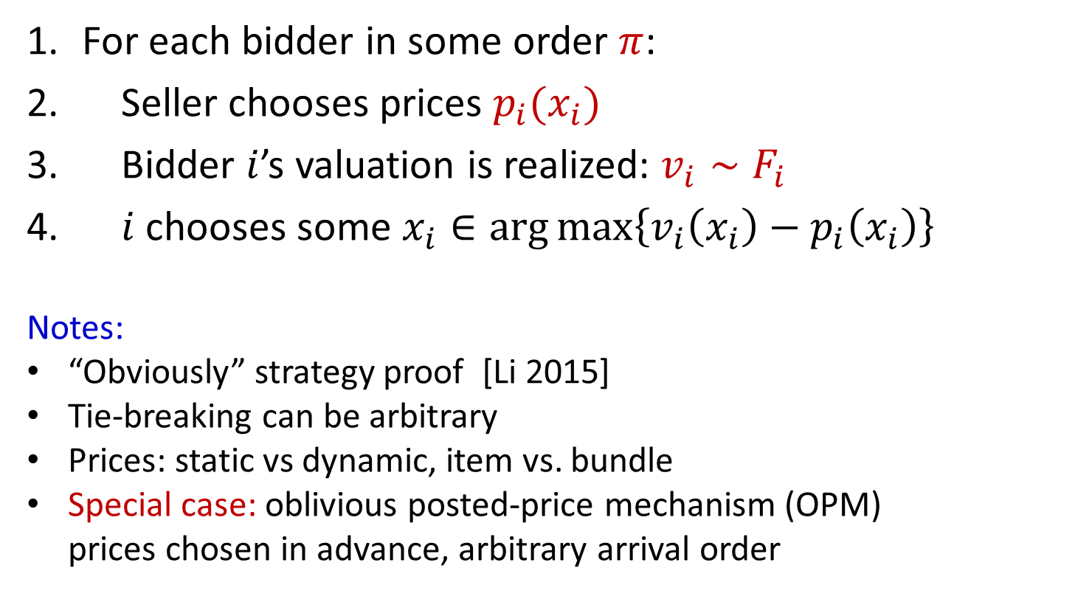
Posted Price Mechanism
For each bidder in some order $π$:
Seller chooses prices $p_{i}(x_{i})$
Bidder $i$’s valuation is realized: $v_{i}∼F_{i}$
$i$chooses some $x_{i}∈\arg{\max\left\{v_{i}\left(x_{i}\right)−p_{i}\left(x_{i}\right)\right\}}$
Notes:
“Obviously” strategy proof [Li 2015]
Tie-breaking can be arbitrary
Prices: static vs dynamic, item vs. bundle
Special case: oblivious posted-price mechanism (OPM)
prices chosen in advance, arbitrary arrival order
Notes:
Shengwu Li
Note: a single price vector, fixed for all time, used for all buyers. Supermarket model!

Slide 31
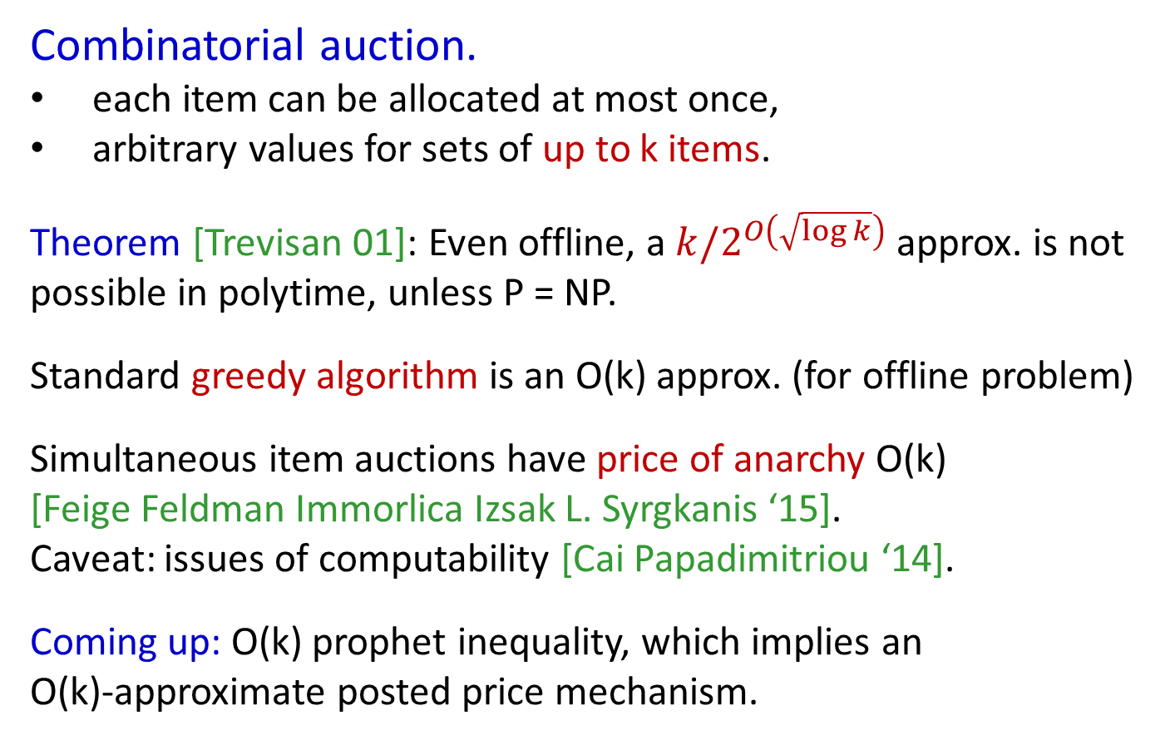
Buyers:
Goods:
Running Example
1
1
2
2
Combinatorial auction.
each item can be allocated at most once,
arbitrary values for sets of up to k items.
Theorem [Trevisan 01]: Even offline, a $k/2^{O\left(\sqrt{\log{k}}\right)}$ approx. is not possible in polytime, unless P = NP.
Standard greedy algorithm is an O(k) approx. (for offline problem)
Simultaneous item auctions have price of anarchy O(k)
[Feige Feldman Immorlica Izsak L. Syrgkanis ‘15].
Caveat: issues of computability [Cai Papadimitriou ‘14].
Coming up: O(k) prophet inequality, which implies an
O(k)-approximate posted price mechanism.
n
m
Notes:
Mention mech. design results here as well (PoA of k, best truthful auction is m / logm )

Slide 32
Combinatorial Auction
Example: k=2, point-mass distributions
Buyer 1: value 4 for {B,C}.
Buyer 2: value 100 for {A,B} or {A,C}.
Optimal allocation:
Allocate to buyer 2, OPT = 100.
Choice of item prices?
$100
A
$100
B
C
$4
Idea: apply ideas from prophet inequality proof?
Notes:
Non-trivial even if values are known in advance. Ask the audience…

Slide 33


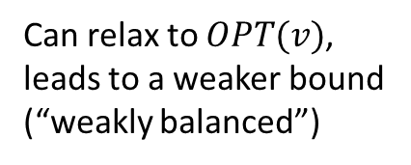
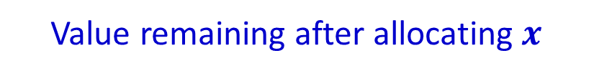

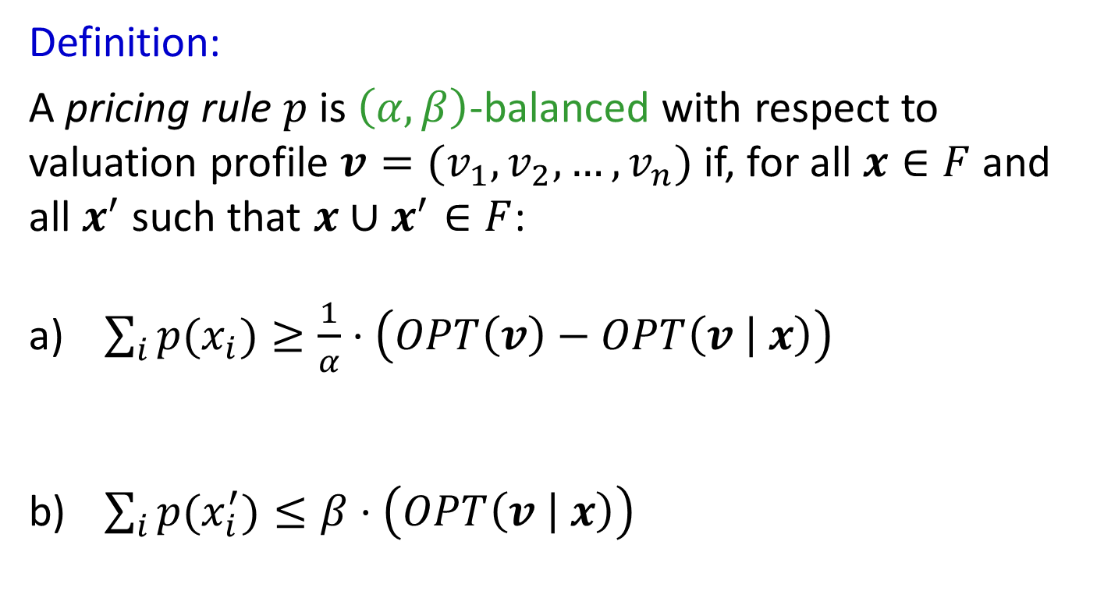
Balanced Prices
Definition:
A pricing rule $p$ is $\left(α,β\right)$-balanced with respect to valuation profile $v=(v_{1},v_{2},…,v_{n})$ if, for all $x∈F$ and all $x^{′}$ such that ${x∪x}^{′}∈F$:
$\sum_{i}{p(x_{i})}≥\frac{1}{α}⋅\left(OPT\left(v\right)−OPT\left(v | x\right)\right)$
$\sum_{i}{p(x_{i}^{′})}≤β⋅\left(OPT\left(v | x\right)\right)$
Optimal welfare after removing $x$
Value lost due to allocating $x$
Can relax to $OPT(v)$,
leads to a weaker bound
(“weakly balanced”)
Value remaining after allocating $x$
Notes:
Goal: encode and generalize the goldilocks condition from single-dimensional extensions.
Explain notation on the fly

Slide 34
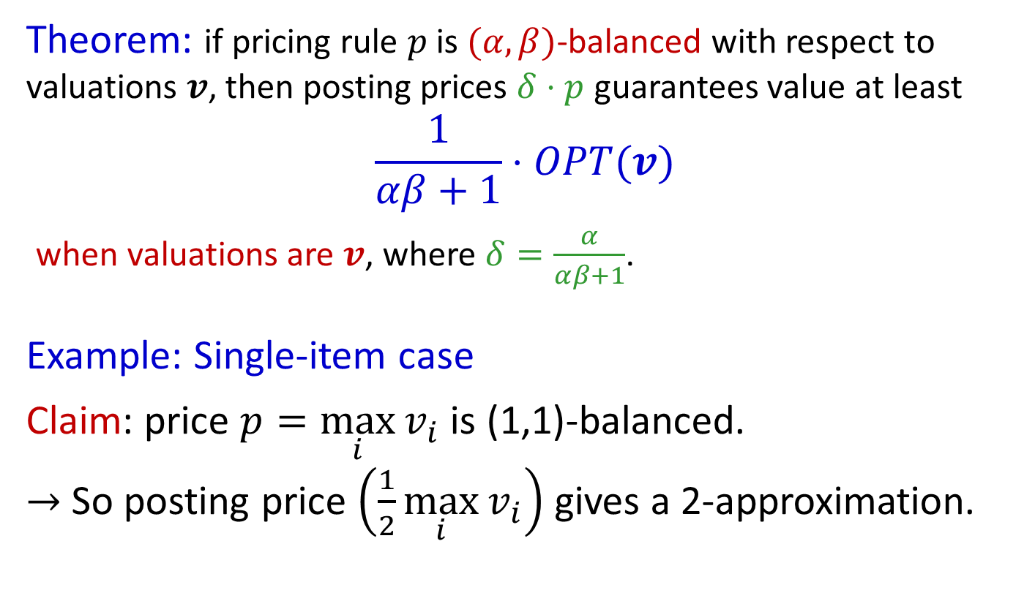
Balanced Prices
Theorem: if pricing rule $p$ is $(α,β)$-balanced with respect to valuations $v$, then posting prices $δ⋅p$ guarantees value at least
$$\frac{1}{αβ+1}⋅OPT(v)$$
when valuations are $v$, where $δ=\frac{α}{αβ+1}$.
Example: Single-item case
Claim: price $p=\max_{i}{v_{i}}$ is (1,1)-balanced.
$→$ So posting price $\left(\frac{1}{2}\max_{i}{v_{i}}\right)$ gives a 2-approximation.
Notes:
Work through the claim with the audience

Slide 35
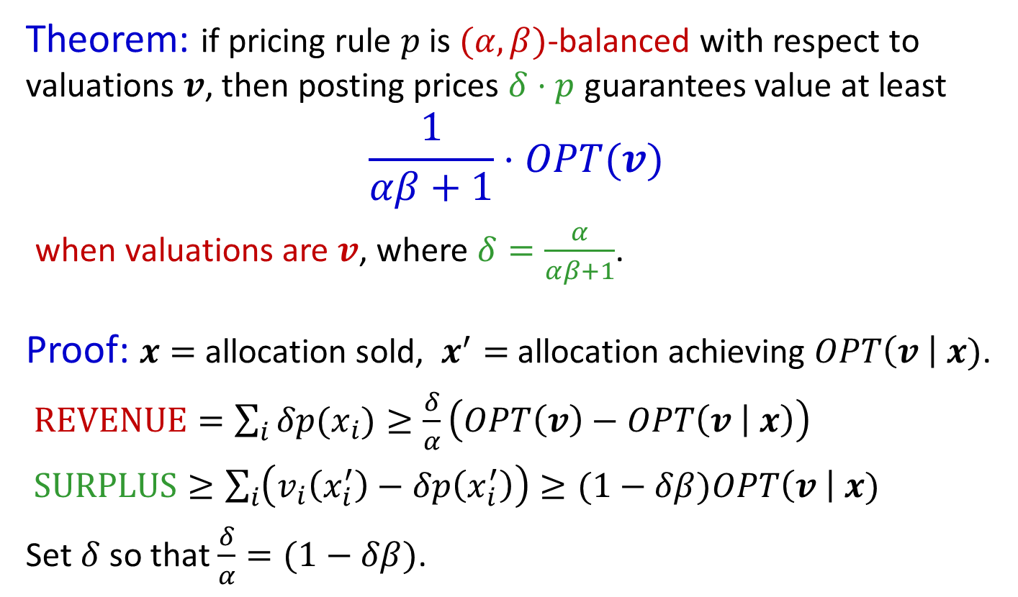
Balanced Prices
Theorem: if pricing rule $p$ is $(α,β)$-balanced with respect to valuations $v$, then posting prices $δ⋅p$ guarantees value at least
$$\frac{1}{αβ+1}⋅OPT(v)$$
when valuations are $v$, where $δ=\frac{α}{αβ+1}$.
Proof: $x=$ allocation sold, $x^{′}=$ allocation achieving $OPT\left(v \right| x)$.
$REVENUE=\sum_{i}{δp(x_{i})}≥\frac{δ}{α}\left(OPT\left(v\right)−OPT\left(v | x\right)\right)$
$SURPLUS≥\sum_{i}{\left(v_{i}\left(x_{i}^{′}\right)−δp\left(x_{i}^{′}\right)\right)}≥(1−δβ)OPT\left(v \right| x)$
Set $δ$ so that $\frac{δ}{α}=(1−δβ)$.

Slide 36

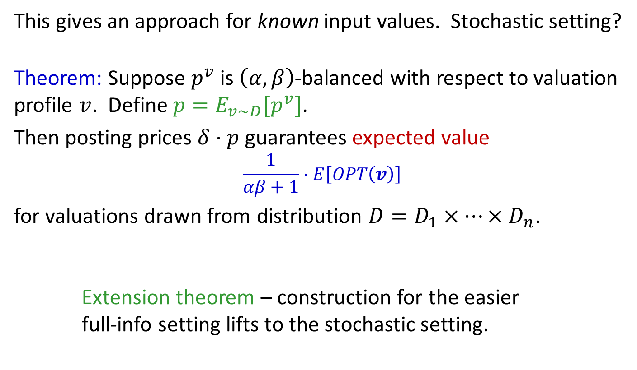
Balanced Prices
This gives an approach for known input values. Stochastic setting?
Theorem: Suppose $p^{v}$ is $\left(α,β\right)$-balanced with respect to valuation profile $v$. Define $p=E_{v\sim D}[p^{v}]$.
Then posting prices $δ⋅p$ guarantees expected value
$$\frac{1}{αβ+1}⋅E\left[OPT\left(v\right)\right]$$
for valuations drawn from distribution $D=D_{1}×…×D_{n}$.
Extension theorem – construction for the easier
full-info setting lifts to the stochastic setting.
Weakly balanced prices
gives $\frac{1}{4αβ}⋅E[OPT\left(v\right)]$

Slide 37

Constructing Balanced Prices
$30
Back to $m$ items, max alloc. $k$
Fix valuation profile $v$.
$x^{∗}=$OPT allocation.
$7
$10
$9

Slide 38
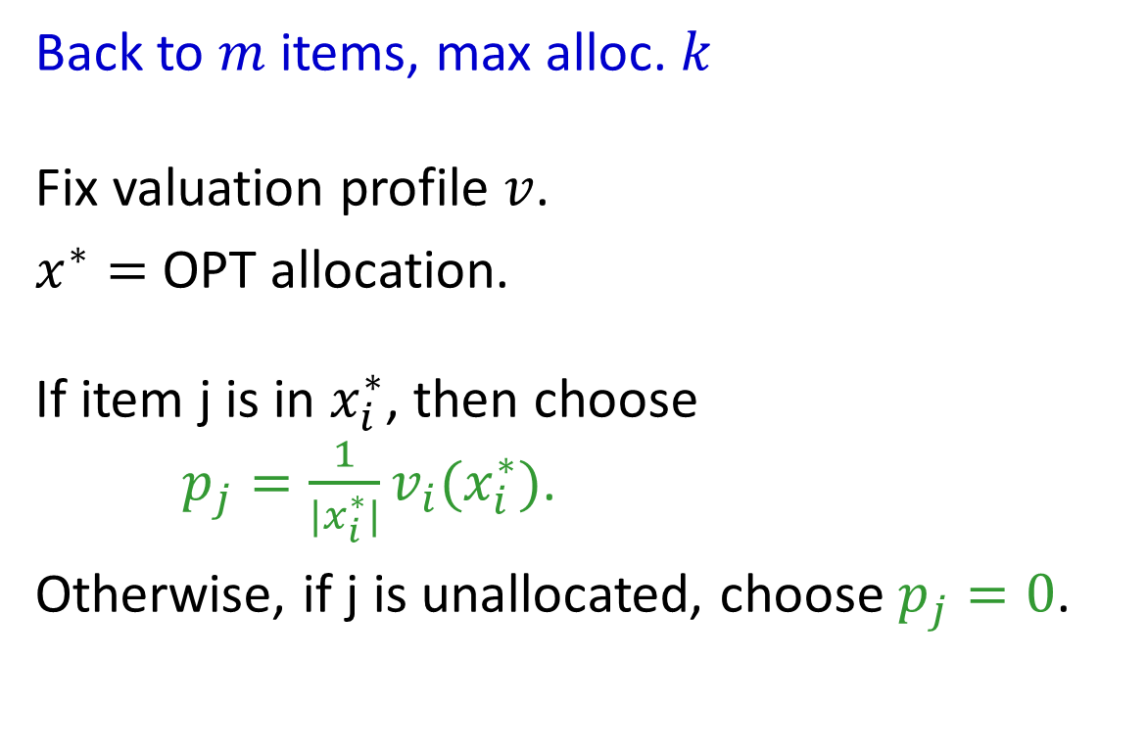
Constructing Balanced Prices
$30
Back to $m$ items, max alloc. $k$
Fix valuation profile $v$.
$x^{∗}=$OPT allocation.
If item j is in $x_{i}^{∗}$, then choose
$p_{j}=\frac{1}{|x_{i}^{∗}|}v_{i}(x_{i}^{∗})$.
Otherwise, if j is unallocated, choose $p_{j}=0$.
$7
$10
$9

Slide 39
Constructing Balanced Prices
$30
Back to $m$ items, max alloc. $k$
Fix valuation profile $v$.
$x^{∗}=$OPT allocation.
If item j is in $x_{i}^{∗}$, then choose
$p_{j}=\frac{1}{|x_{i}^{∗}|}v_{i}(x_{i}^{∗})$.
Otherwise, if j is unallocated, choose $p_{j}=0$.
10
10
10
$7
7
5
5
$10
3
3
3
$9

Slide 40
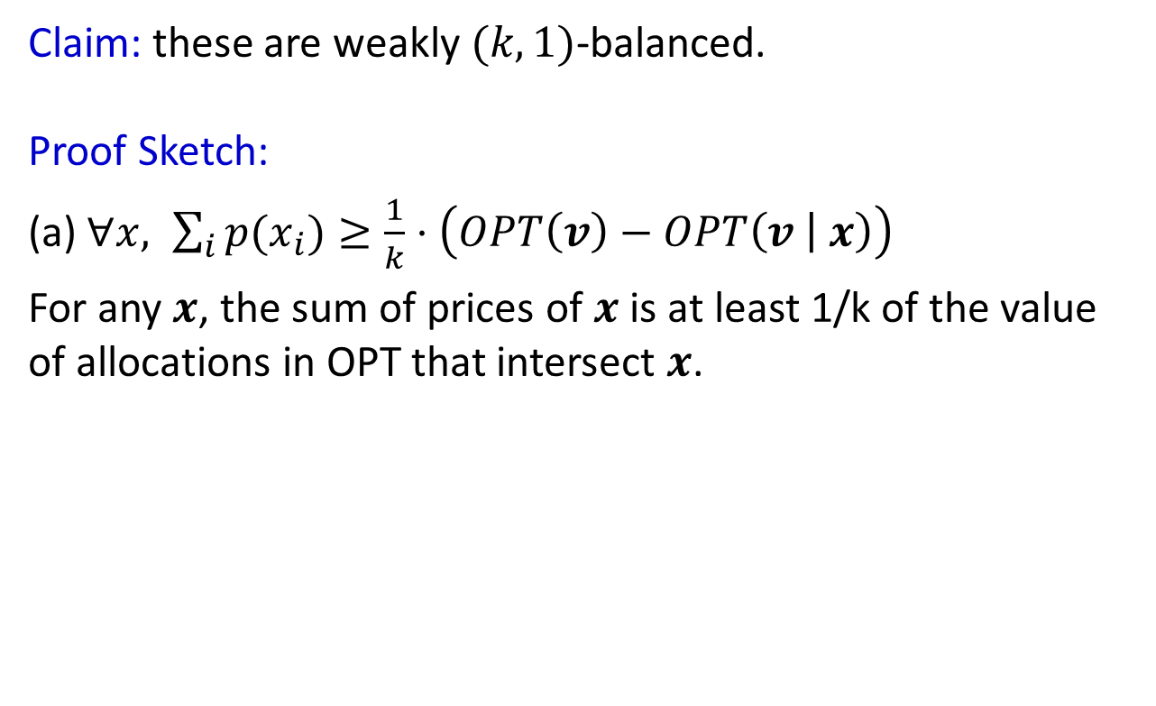

$$x$$
Balanced Prices
$30
10
10
10
$7
7
5
5
$10
Claim: these are weakly $(k,1)$-balanced.
Proof Sketch:
(a) $∀x, \sum_{i}{p(x_{i})}≥\frac{1}{k}⋅\left(OPT\left(v\right)−OPT\left(v | x\right)\right)$
For any $x$, the sum of prices of $x$ is at least 1/k of the value of allocations in OPT that intersect $x$.
3
3
3
$9

Slide 41
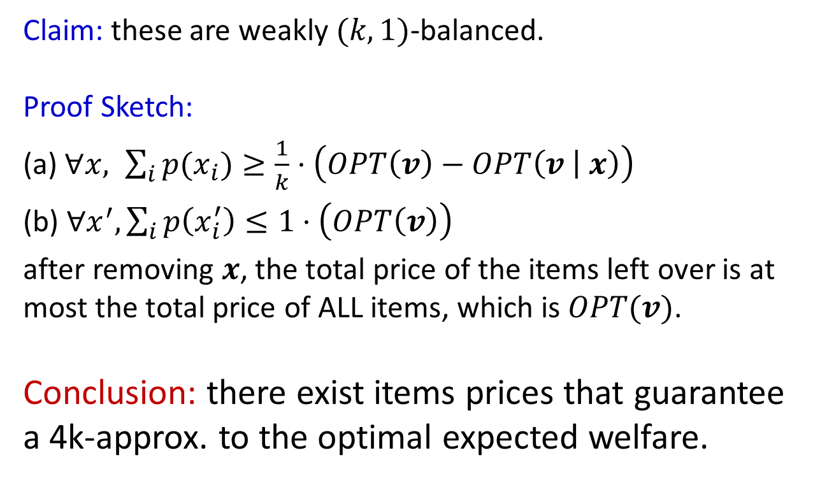
$$x$$
Balanced Prices
$30
10
10
10
$7
7
5
5
$10
Claim: these are weakly $(k,1)$-balanced.
Proof Sketch:
(a) $∀x, \sum_{i}{p(x_{i})}≥\frac{1}{k}⋅\left(OPT\left(v\right)−OPT\left(v | x\right)\right)$
(b) $∀x^{′}, \sum_{i}{p\left(x_{i}^{′}\right)}≤1⋅\left(OPT\left(v\right)\right)$
after removing $x$, the total price of the items left over is at most the total price of ALL items, which is $OPT(v)$.
Conclusion: there exist items prices that guarantee a 4k-approx. to the optimal expected welfare.
3
3
3
$9

Slide 42
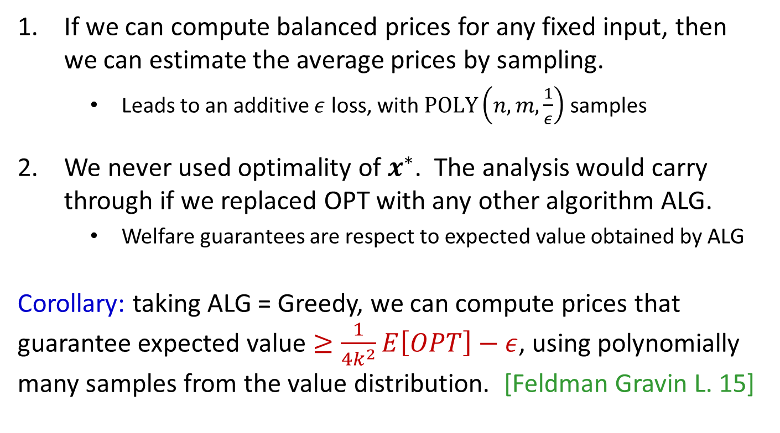
10
10
10
What about computation?
7
5
5
3
3
3
If we can compute balanced prices for any fixed input, then
we can estimate the average prices by sampling.
    Leads to an additive $ε$ loss, with $\text{POLY}\left(n,m,\frac{1}{ε}\right)$ samples
We never used optimality of $x^{∗}$. The analysis would carry through if we replaced OPT with any other algorithm ALG.
    Welfare guarantees are respect to expected value obtained by ALG
Corollary: taking ALG = Greedy, we can compute prices that guarantee expected value $≥\frac{1}{{4k}^{2}}E\left[OPT\right]−ε$, using polynomially many samples from the value distribution. [Feldman Gravin L. 15]
Notes:
Here’s a direct corollary. Appeared in an earlier paper.

Slide 43
What about computation?
We can do better!
Pricing rule extends naturally to fractional allocations.
Optimal fractional allocation:
$100
$100
weight 0.5
weight 0.5
weight 0.5
$4

Slide 44
What about computation?
We can do better!
Pricing rule extends naturally to fractional allocations.
Optimal fractional allocation:
$100
$100
50
50
0
50
0
0
50
2
2
weight 0.5
weight 0.5
weight 0.5
$4

Slide 45
What about computation?
We can do better!
Pricing rule extends naturally to fractional allocations.
Optimal fractional allocation:
$100
50
$100
50
50
0
50
0
0
50
2
2
26
26
weight 0.5
weight 0.5
weight 0.5
$4

Slide 46
What about computation?
$100
50
$100
We can do better!
Pricing rule extends naturally
to fractional allocations.
Resulting prices are (k,1)-balanced
for the fractional problem, and can
be computed in polytime* (solving LP)
We can therefore compute prices, in polynomial time, that give a 4k approx., if buyers can buy fractional allocations.
26
26
$4
*Polynomially many demand queries to the valuations

Slide 47
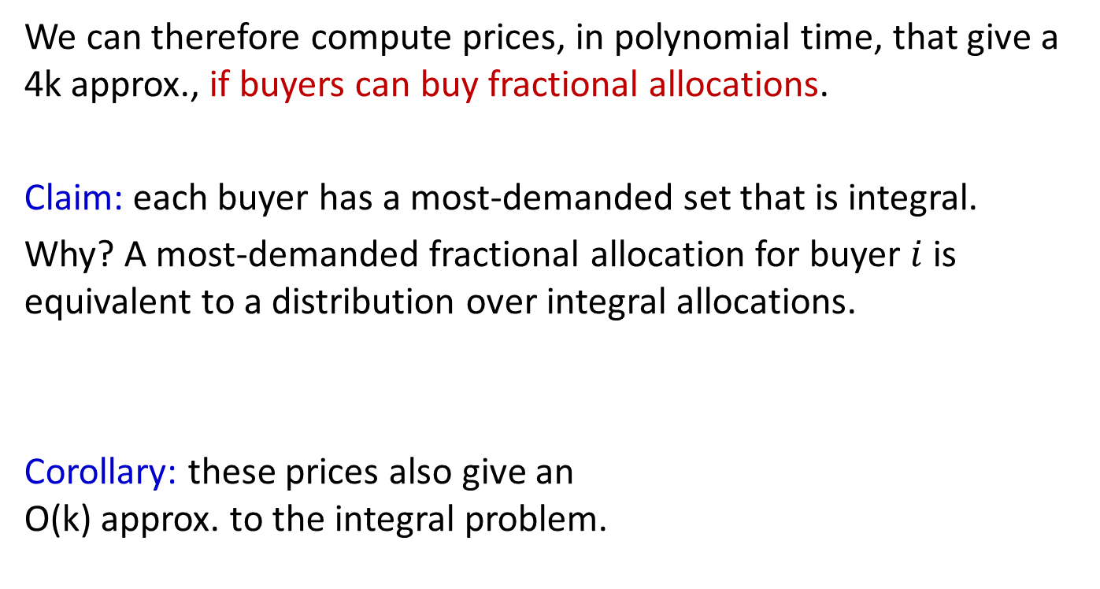
What about computation?
We can therefore compute prices, in polynomial time, that give a 4k approx., if buyers can buy fractional allocations.
Claim: each buyer has a most-demanded set that is integral.
Why? A most-demanded fractional allocation for buyer $i$ is equivalent to a distribution over integral allocations.
Corollary: these prices also give an
O(k) approx. to the integral problem.
$100
50
$100
26
26
$4
Notes:
Go through claim with the audience…

Slide 48
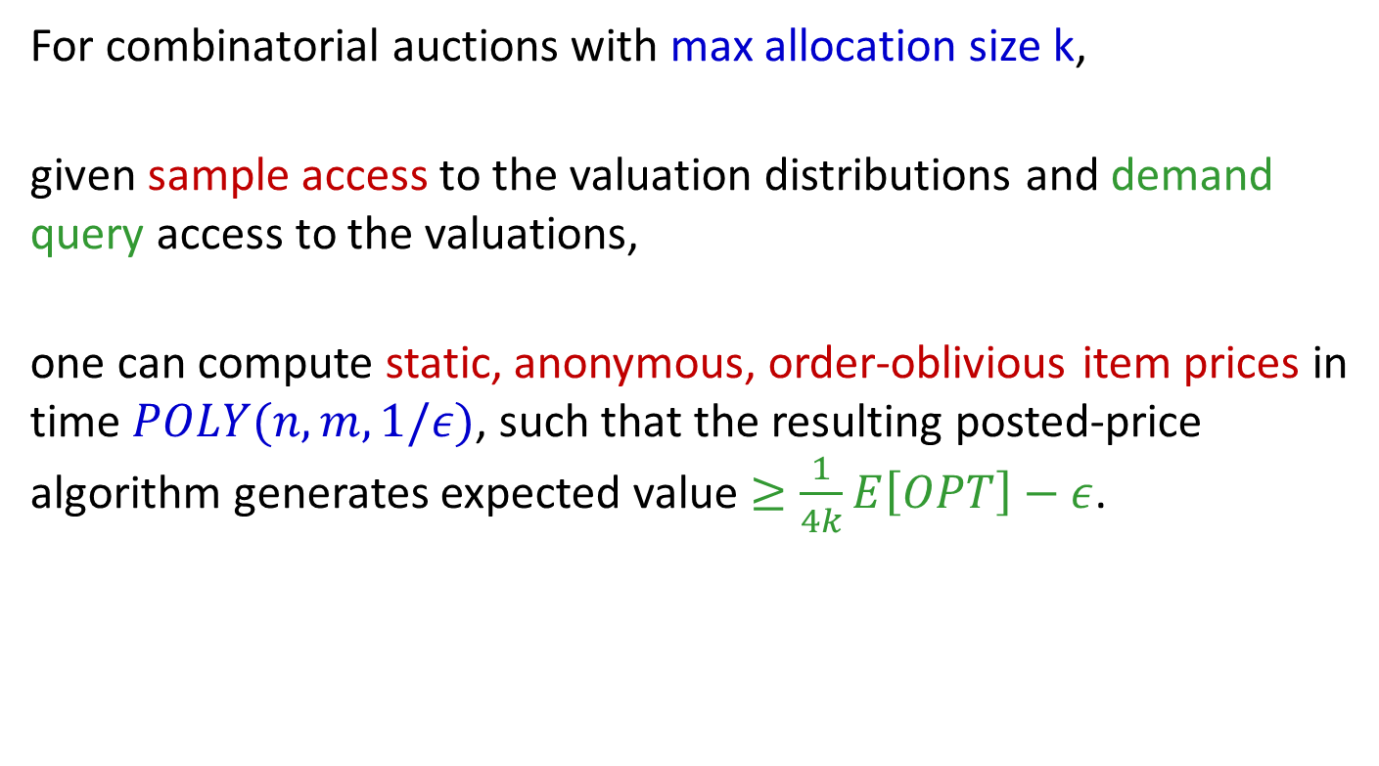
Putting it all together
For combinatorial auctions with max allocation size k,
given sample access to the valuation distributions and demand query access to the valuations,
one can compute static, anonymous, order-oblivious item prices in time $POLY(n,m,1/ε)$, such that the resulting posted-price algorithm generates expected value $≥\frac{1}{4k}E\left[OPT\right]−ε$.
Notes:
Discuss relationship to mechanism design

Slide 49

Other applications
Problem | Approx. | Price Model
Combinatorial auction, XOS valuations | $$2$$ | Static item prices
Bounded complements (MPH-k) [Feige et al. 2014] | $$4k−2$$ | Static item prices
Submodular valuations, matroid constraints | $2$ (existential) 4 (polytime) | Dynamic prices
Knapsack constraints, max size $≤$ capacity/2 | 3 | Static prices
d-sparse Packing Integer Programs | 8d | Static prices

Slide 50
Prices vs Auctions
A Connection: literature on price of anarchy in auctions.
For many of these problems, a simple, non-truthful auction achieves the same bound as its price of anarchy.
Proof technique: smoothness [Roughgarden 12] [Syrgkanis Tardos 13]
Condition (b) of balancedness is equivalent to smoothness in single-parameter problems [Duetting Kesselheim 15]
In many applications, construction of balanced prices mirrors
existing proofs of PoA using smoothness.
Comparison: posted prices are prior-dependent, but truthful.
Notes:
Come back to what we foreshadowed earlier: this analysis is essentially smoothness.
Table on previous slide wouldn’t be out of place in a smoothness talk. Here’s why.

Slide 51

Open Questions
Combinatorial Auctions with subadditive valuations
  Best known: O(log m). Is O(1) possible?
Combinatorial Auctions, alloc. size k
  Gap: $(k+1)$vs. $e\left(k+1\right)$ for single-minded.
O(1) static prices for matroids?
Dependence on $r$ for arbitrary downward-closed constraints?
Generalize improvement for large markets?
  In the large (fractional) limit, market-clearing prices exist.
  What about large but finite allocation problems?
  $\left(1+O\left(\frac{1}{\sqrt{k}}\right)\right)$for unit-demand [Alaei, Hajiaghayi, Liaghat ‘12]. Beyond?
Breaking News!
Lower bound [Feldman Svensson Zenklusen]
Thanks!
Notes:
Note: “a price setting solution” is ambiguous. Lots of variations here…

Slide 52
Additional Notes
Extension theorem applies to personalized, dynamic, and/or bundle prices that are balanced.
    The final prices used in the posted price algorithm
    inherit these properties from the balanced prices.
Balanced prices compose: if two markets each have balanced prices, then those prices are also balanced in the combined market.
    Can construct prices for complex multi-item markets
    by pricing simpler submarkets, then combining.

