Slide 1

NATIONAL TECHNICAL UNIVERSITY OF ATHENS
Laboratory of Mining and Environmental Technology
“innovations and technologies in the stone sector”
M. Menegaki
NTUA Professor

Slide 2
Innovation
Innovation is the production of a new or significantly improved product (good or service), or the application of a new process, or a new marketing method, or a new organisational method to business practices, workplace organisation or external relations (OECD & Eurostat, 2005)
Innovation can be divided into technological (products and processes) and non-technological (organisation and marketing).
Innovation, in all its forms, involves a significant differentiation in existing goods or services, production processes, organisational structures and practices of the firm, marketing methods, etc.

Slide 3
Innovation
Innovation should:
Be linked to financial performance.
Lead to improved products and processes with better safety standards.
Contribute to the improvement of the environmental performance of the company.
Have wider benefits for society.
In this light, innovation in the stone sector must "embrace" the entire production chain, from initial research to the distribution of the final product to the consumer...

Slide 4
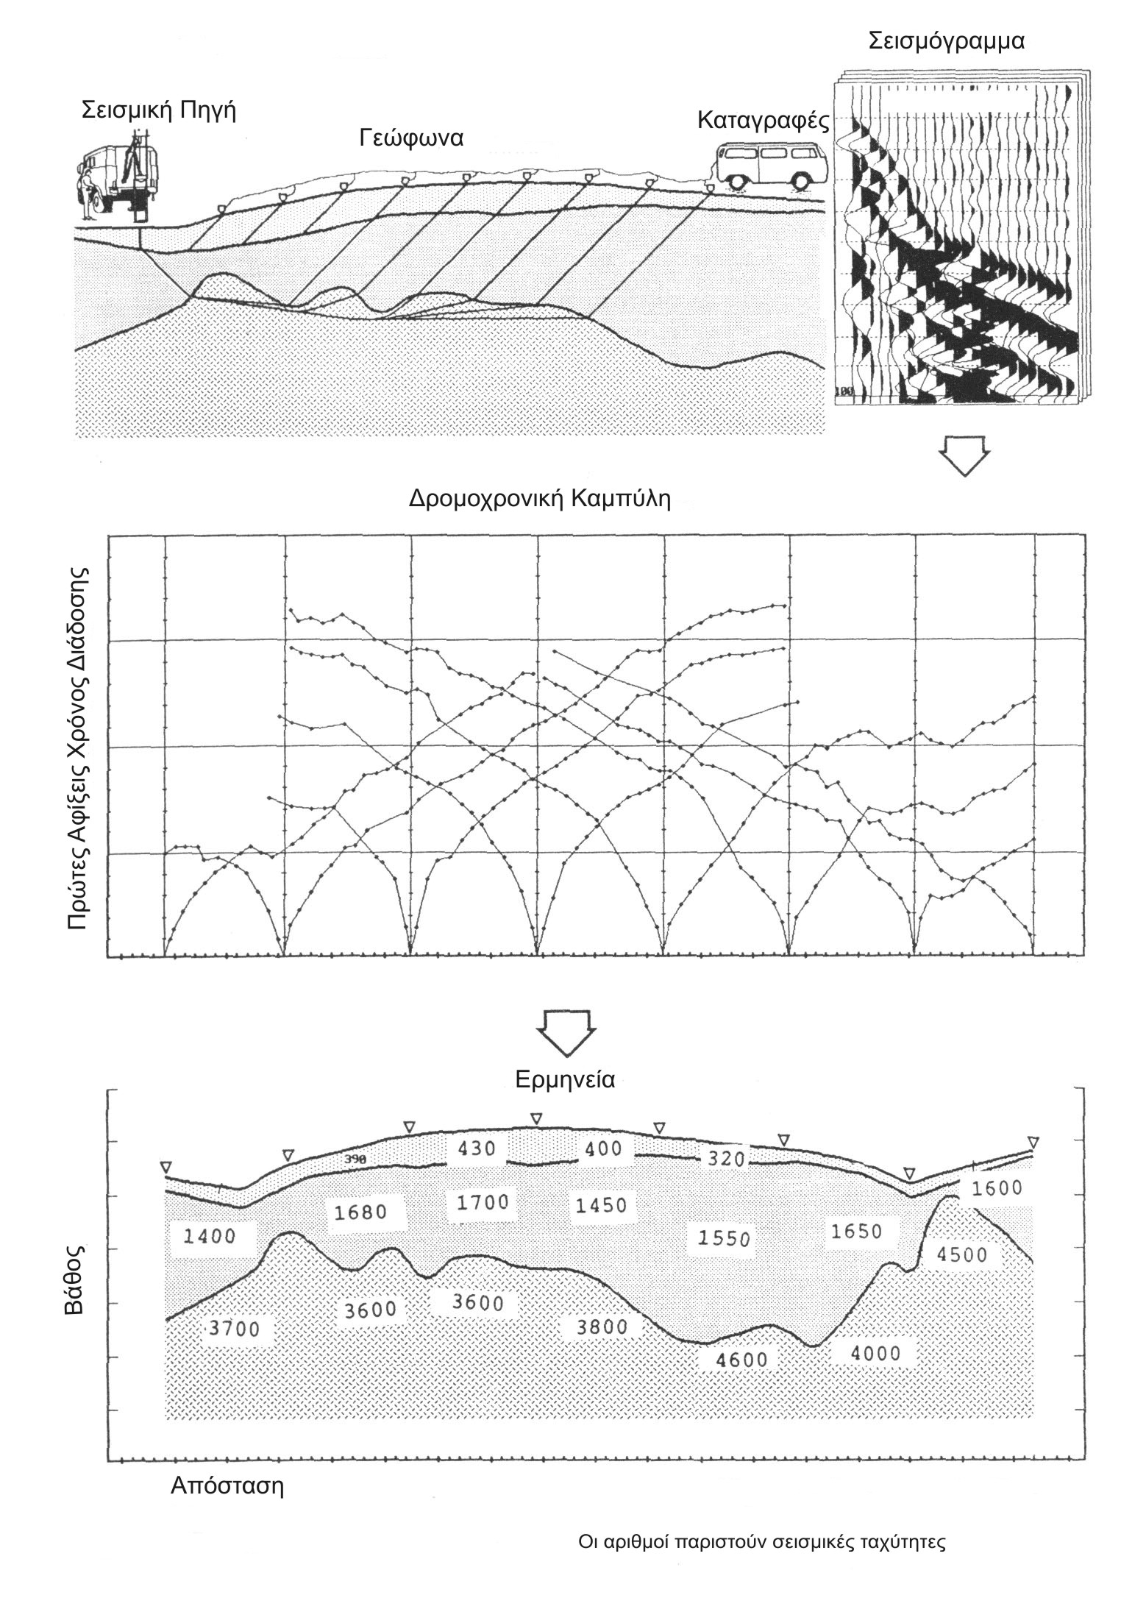
Innovation in research
Geophysical models
Seismic reflection
Disturbed rock zone
Competent rock zone

Slide 5
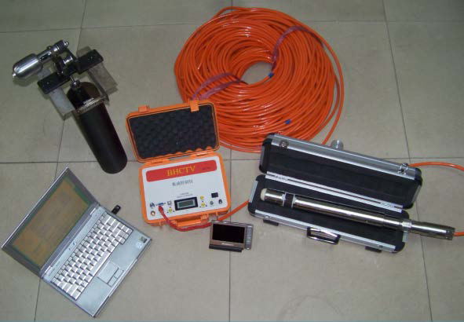
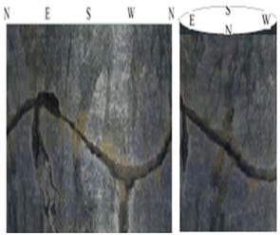
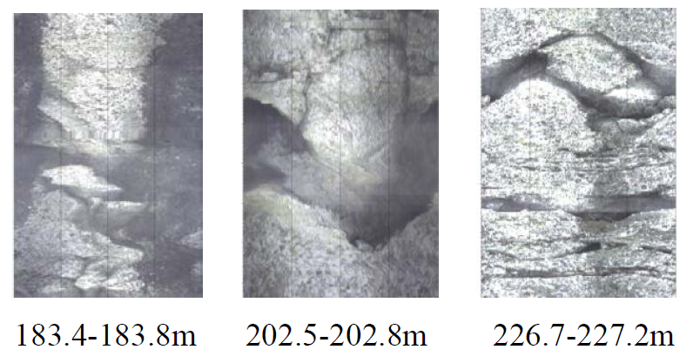
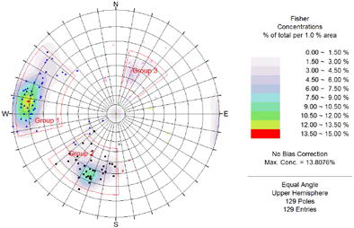
Innovation in research
Digital drilling camera
Logging system
Illustration of borehole walls
Occurrences of discontinuity systems in the drill hole

Slide 6
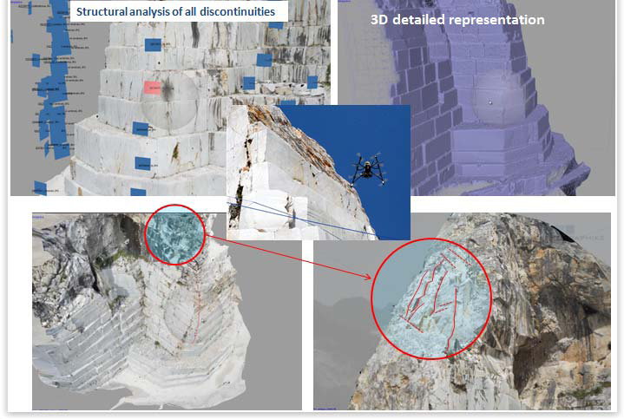
Innovation in research
Aerial photogrammetry with DRONE and LASER techniques
Discontinuity analysis
3D illustration

Slide 7
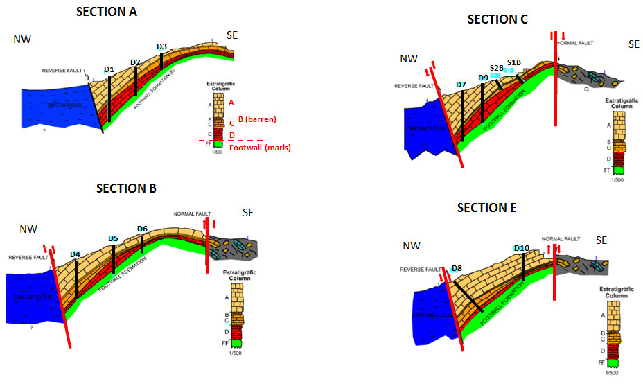
Innovation in research
Geological models
Πηγή: Cosi, 2014

Slide 8
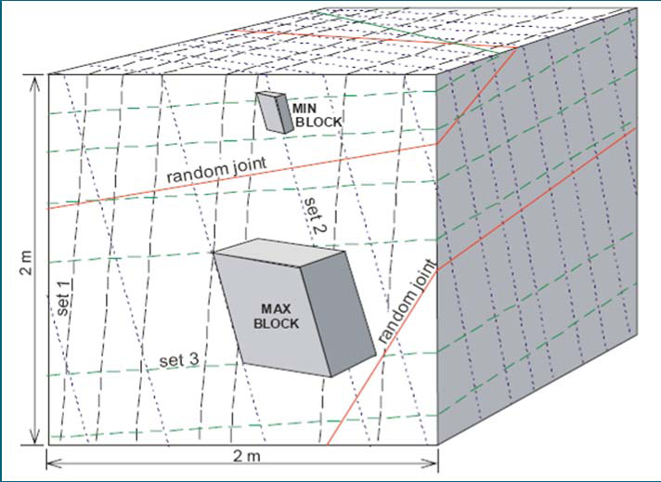
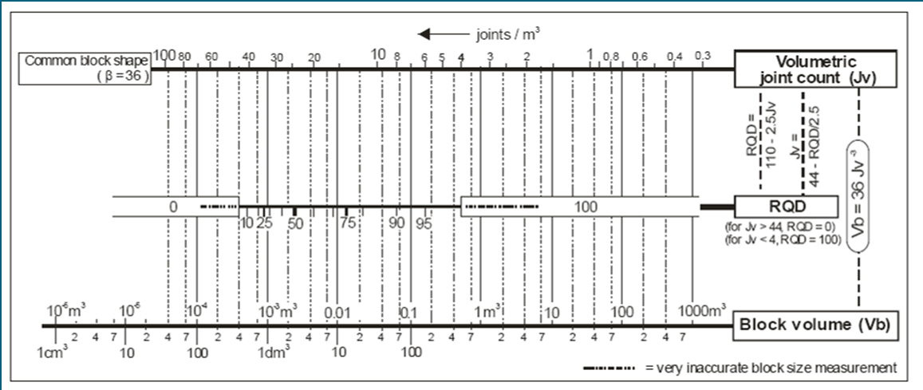
Innovation in research
Improvement of the recovery rate assessment
Macroscopic observation + Geophysical survey + Sections + Drillhole data + Geomechanical characteristics
Schematic illustration of minimum and maximum intact block size
Source: Palmstrom, 2001

Slide 9
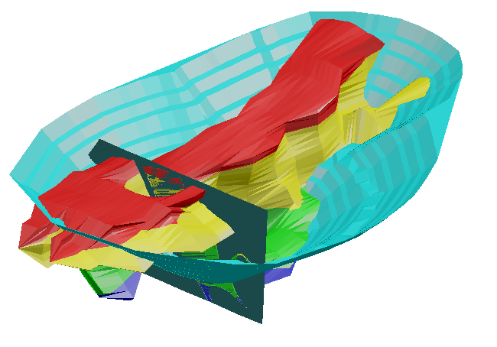
Innovation in design
Use of mining software
Ore deposit model
Fracture location

Slide 10
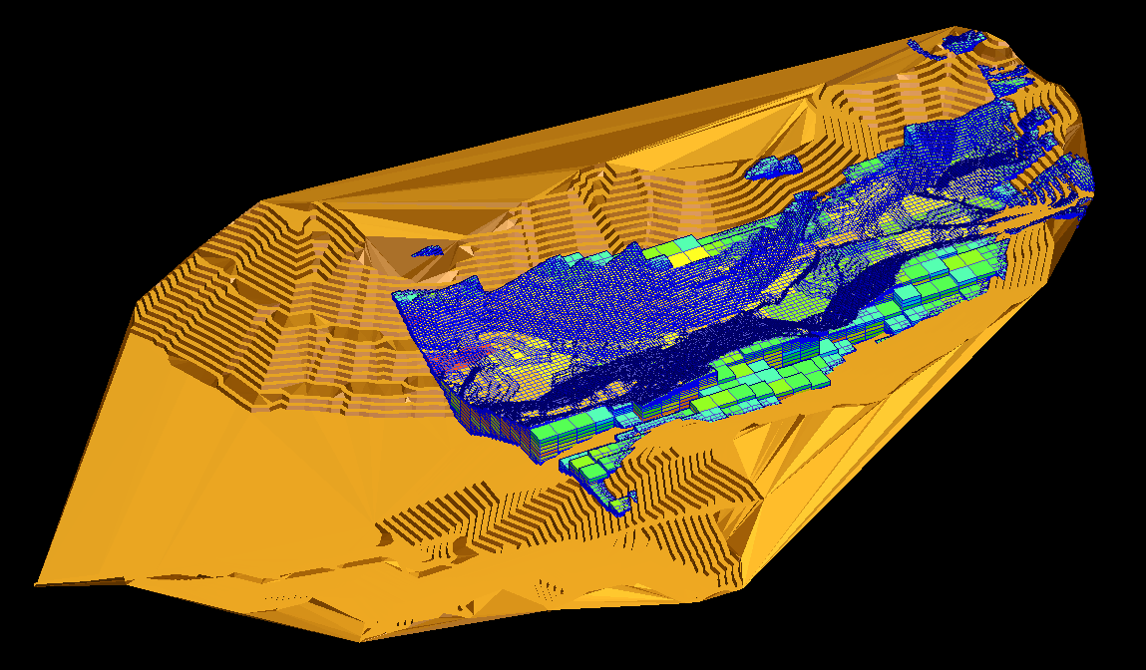
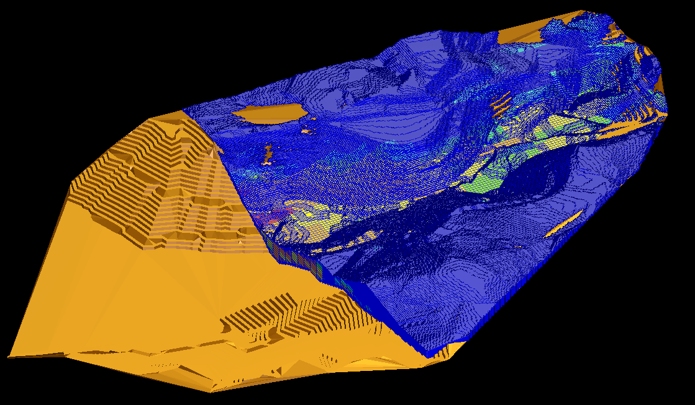
Innovation in design
Use of mining software
In the case of stone quarries, "tectonism determines the cut off grade"

Slide 11
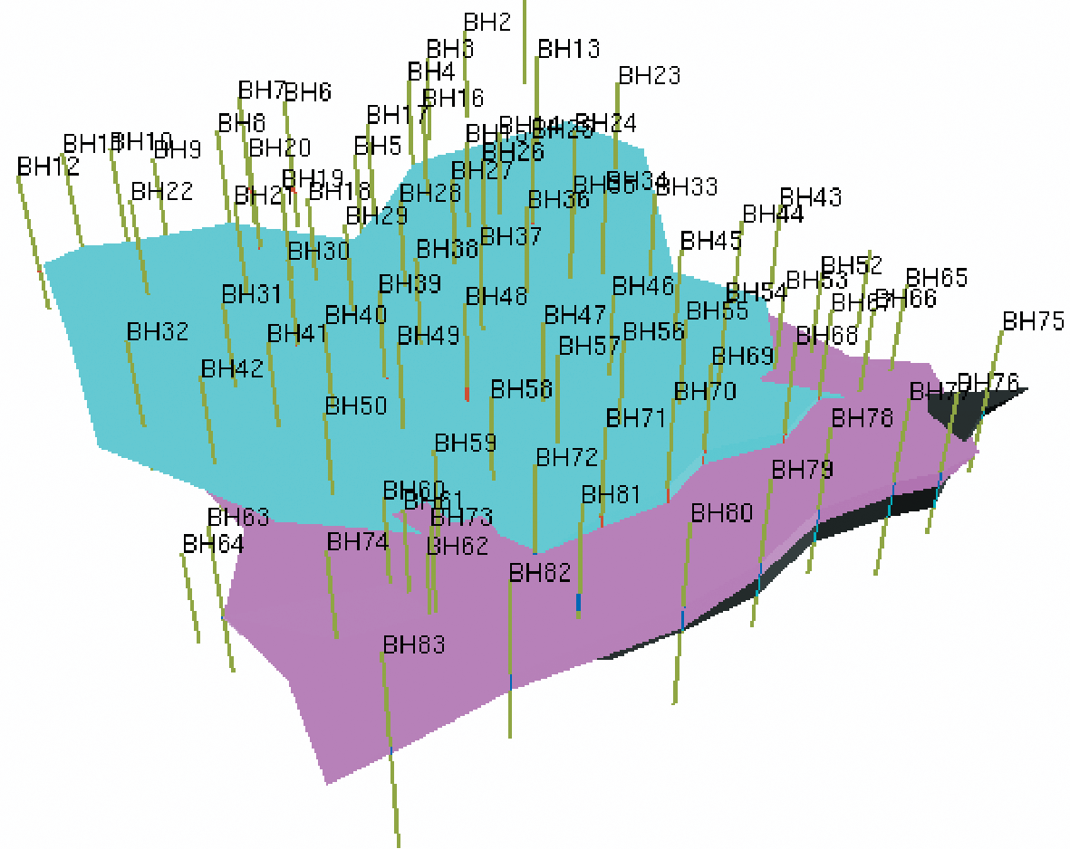
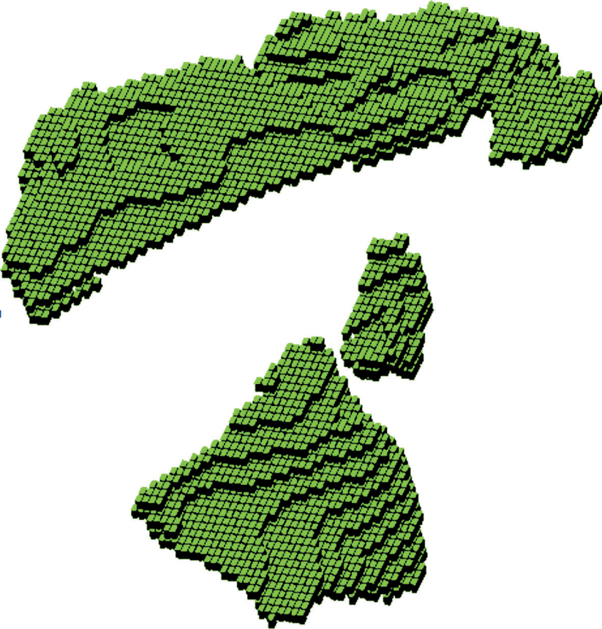
Innovation in design
Use of mining software
Geological model of a marble deposit
Blocks with positive financial value

Slide 12
Innovation in design
Focus on environmental performance
The environmental performance of the business is also closely linked to better economic performance, as international studies show that businesses with good environmental indicators show:
higher profitability ratios
higher shareholder returns
attracting capital at lower cost

Slide 13
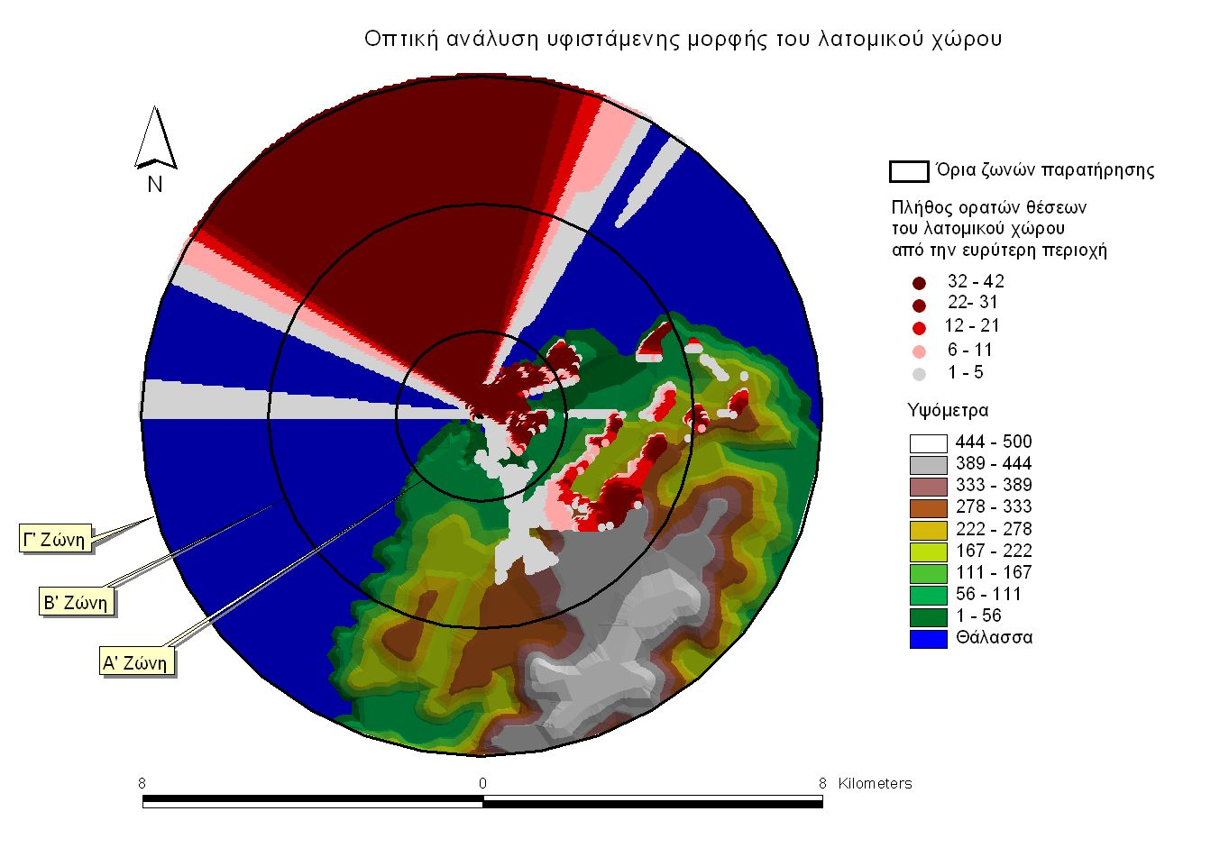
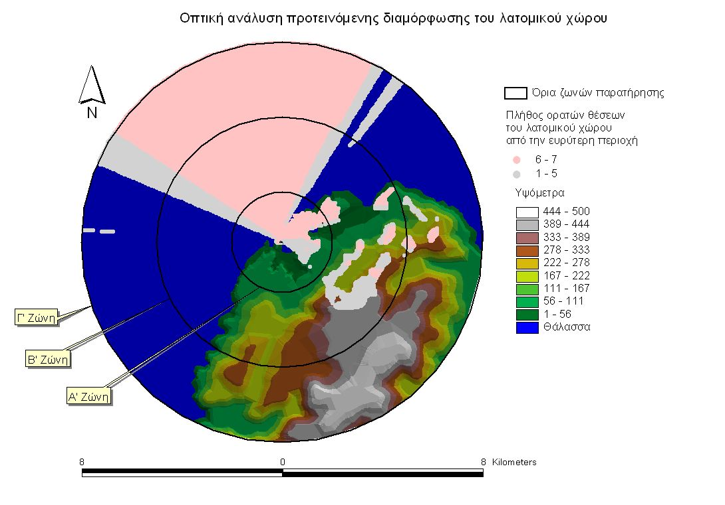
Innovation in design
Application of modern methods for the assessment of visual impact
Implementation of the LETOPID methodology in an aggregate quarry

Slide 14
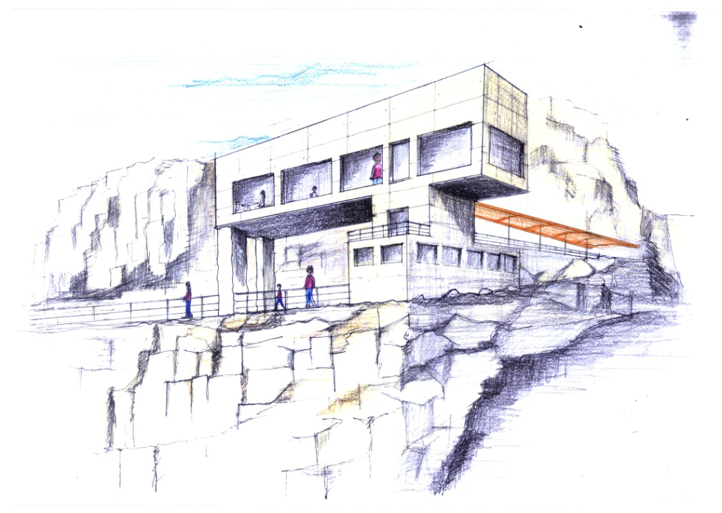
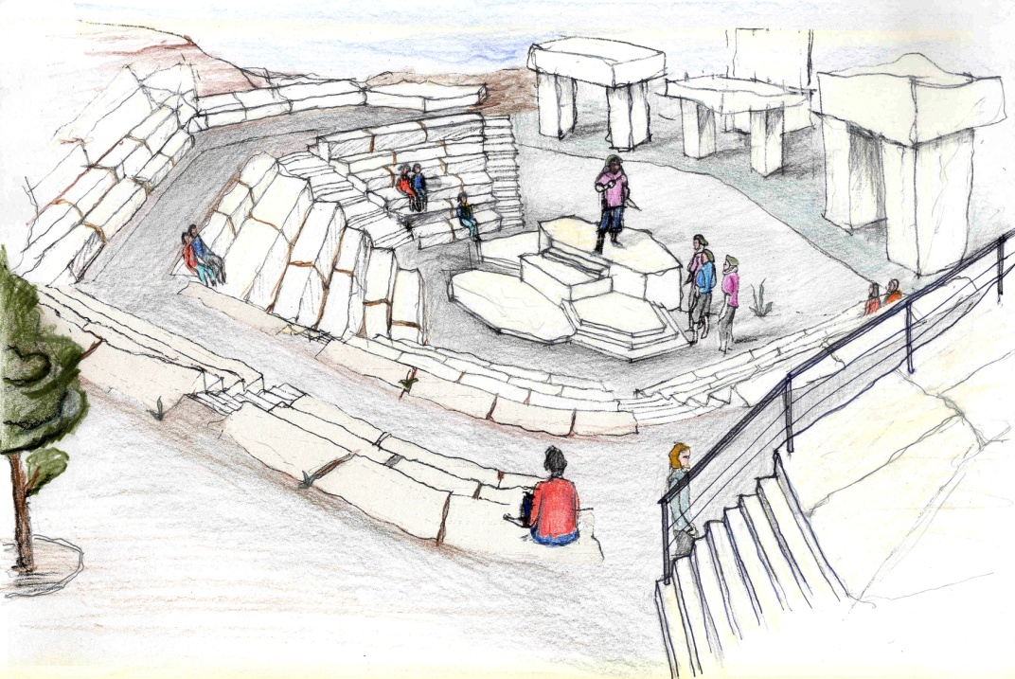
Innovation in design
Restoration planning together with exploitation can be a lever to mitigate public oppositions and disputes with the competent authorities and enhance the good reputation of the company, which brings multiple benefits.

Slide 15
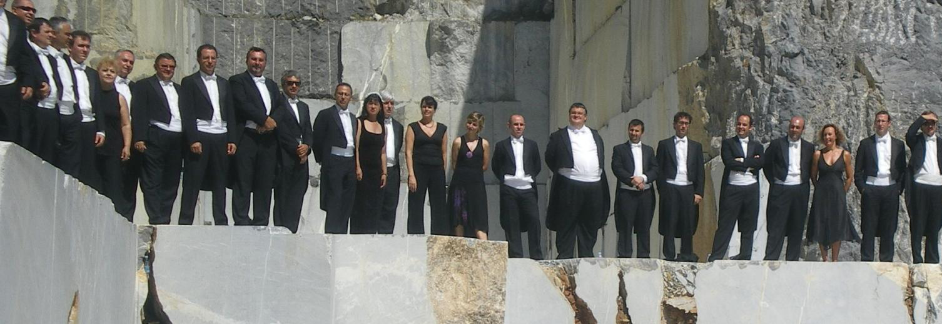
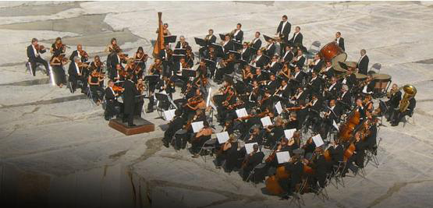
Concert of the Basque Symphony Orchestra in a marble quarry in Spain for the inauguration of a TV channel

Slide 16
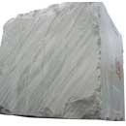

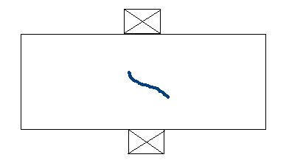



Innovation in exploitation
Discontinuities detection with Non Destructive Techniques (NDT)
Trigger pulse
Reflection
Ultrasound device
Discontinuity
Limitation of the method applicability to small blocks up to 2 m

Slide 17
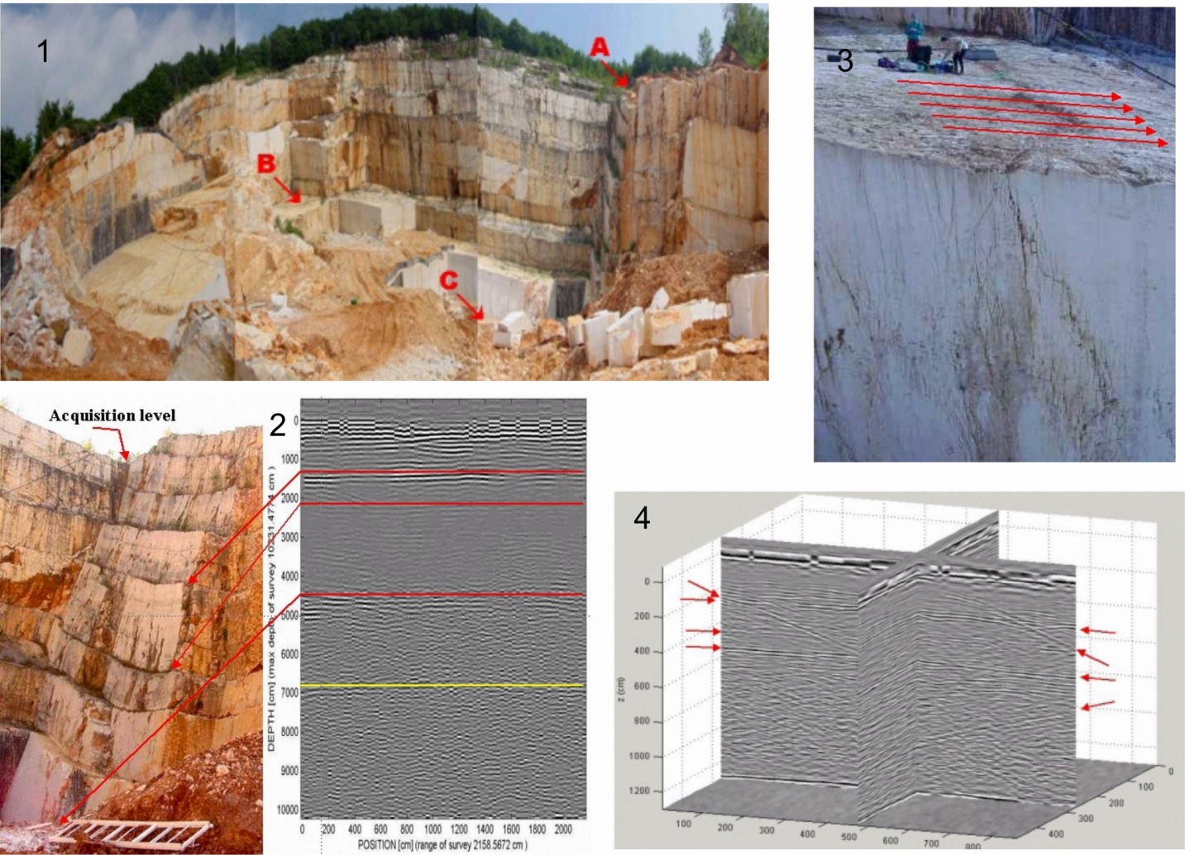
Innovation in exploitation
Discontinuities detection with Non Destructive Techniques (NDT)
Use of
Ground Penetrating Radar
Reflection areas

Slide 18
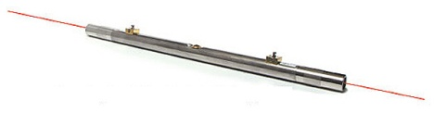
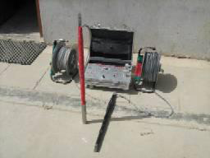
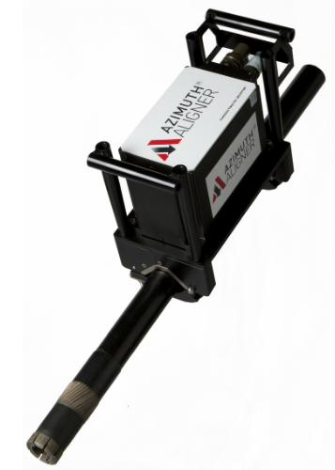
Innovation in exploitation
Technological equipment
Use of drilling equipment with increased drilling speed and reduced noise and vibration levels
Optimization of the intersection finding and alignment process of holes
Transmitter and receiver system for locating the position of the hole with an accuracy of 90%(Hole finder, R.K. Marble )
Laser for alignment

Slide 19
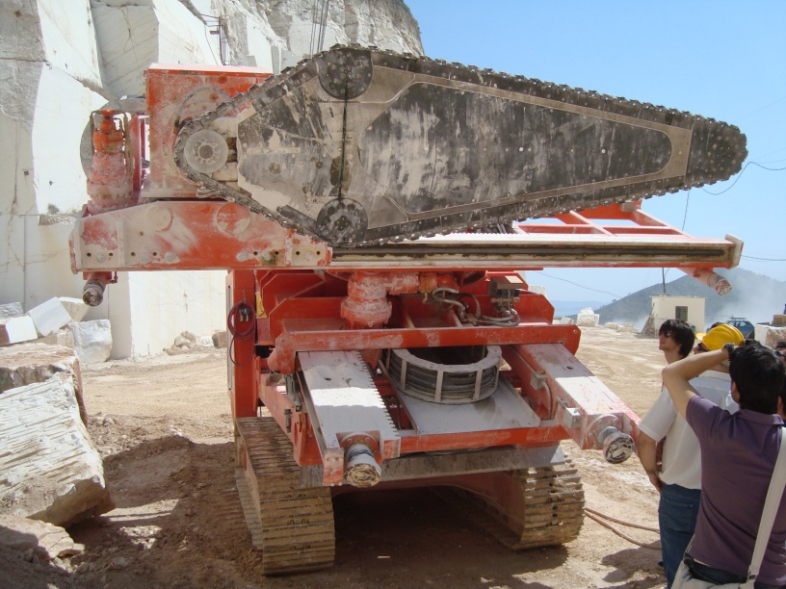
Innovation in exploitation
Technological equipment
Use of equipment traditionally used in underground works, in the case that the conditions and characteristics of the rock allow for it

Slide 20
Innovation in exploitation
Technological equipment
Total Volume: 810 m³

Slide 21
Innovation in exploitation
Technological equipment
Total Volume : 201,6 m³

Slide 22
Works to be done | Wire cutting combined with soft blasting |  |  | Wire cutting combined with chain sawing
 | Length, surface, volume or hours | Cost per unit | Total cost for blocks | Length, surface, volume or hours | Cost per unit | Total cost for blocks
Diamond wire cutting (side cut) | 270 m² | 2.41 €/m² | 650.70 € | 72 m² | 2.41 €/m² | 173.52 €
Diamond wire cutting (heading cut) | 54 m² | 2.41 €/m² | 130.14 € | 16.8 m² | 2.41 €/m² | 40.49 €
Chain sawing |  |  |  | 33.6 m² | 17.35 €/m² | 582.96 €
Horizontal drilling (heading cut) | 45 m | 9.93 €/m | 446.85 €
Horizontal drilling (side cut) | 9 m | 9.93 €/m | 89.37 €
Vertical drilling (side cut) | 36 m | 9.93 €/m | 357.48 €
Vertical drilling (heading cut) | 12 m | 9.93 €/m | 119.16 € | 6 m | 9.93 €/m | 59.58 €
Water consumption | 38.88 m³ | 4 €/m³ | 155.52 € | 10.66 m³ | 4 €/m³ | 42.64 €
Line drilling | 540 m | 2.65 €/m | 1431.00 €
Fuse needed | 1100 m | 0.17 €/m | 187.00 €
Charge time needed | 0.75 h | 12.5 €/h | 9.38 €
Time for picking up the wire | 6 h |  | 75.00 € | 1 h | 12.5 €/h | 12.5 €
Crane usage | 3 h | 30.91 €/h | 92.73 € | 1.5 h | 30.91 €/h | 46.37 €
Total cost | 3,744.33 € |  |  | 958.05 €
Total cost /m² | 4.62 € |  |  | 4.75 €
Καινοτομία στην εξόρυξη
Τεχνολογικός εξοπλισμός

Slide 23
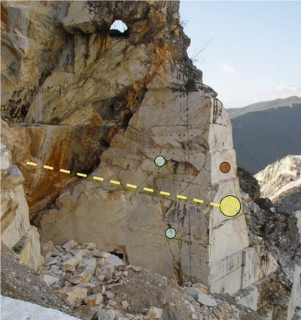
Innovation in exploitation
Technological equipment
Real-time geotechnical monitoring (Carrara)
Clinometer
Borehole extensiometer
Crack meters)

Slide 24
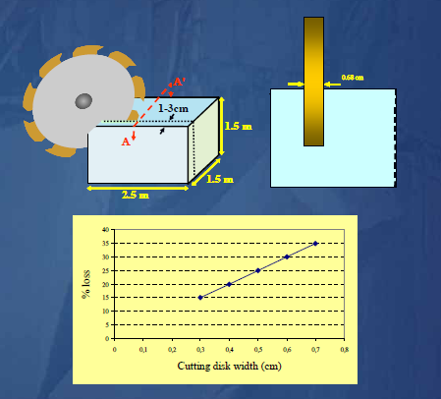
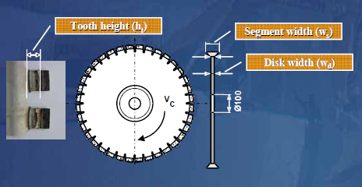
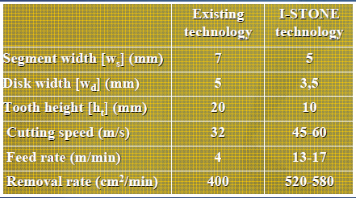
Innovation in processing
Use of cutting discs with a smaller thickness
Manufacture of thinner cutting discs under the I-STONE EU project

Slide 25
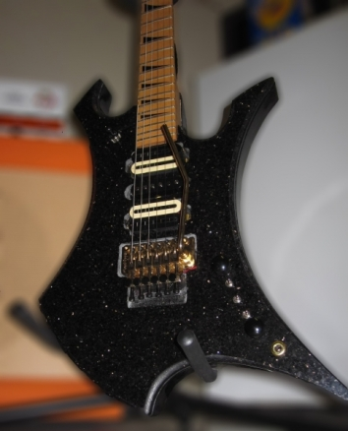
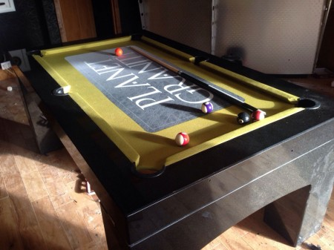
Innovation in processing
Use of CNC for the production of new prototype products

Slide 26
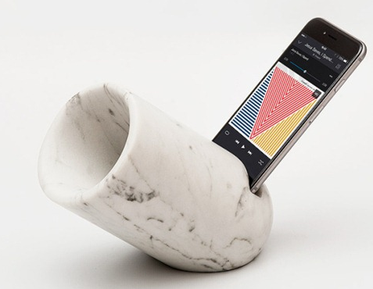
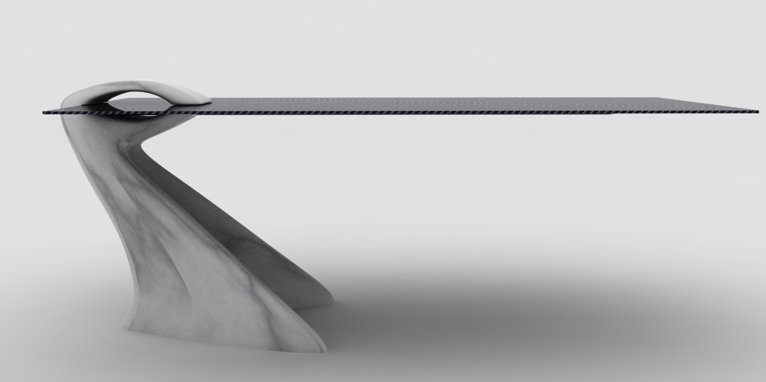
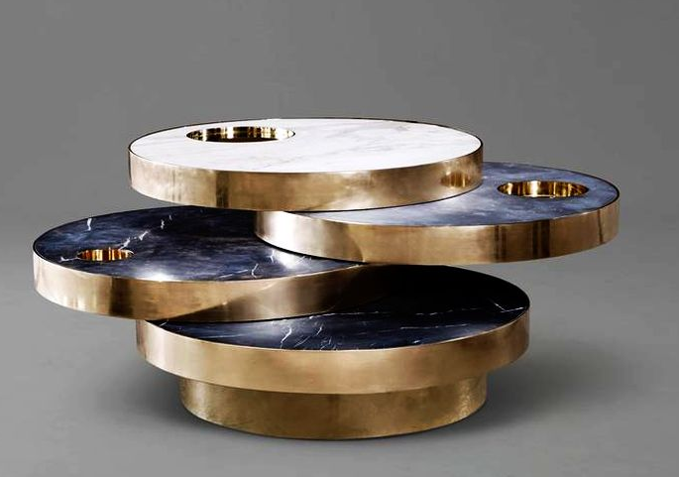
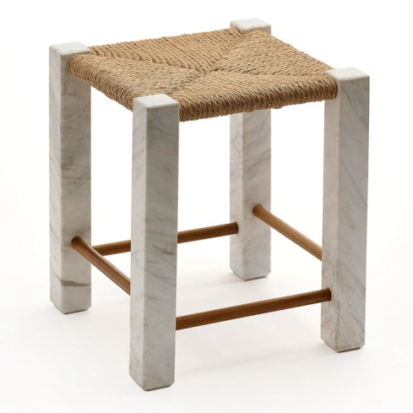
Change in philosophy
Artistic creations and utilitarian objects of high aesthetics
Speaker for
iphone
Table from Carrara marble and και carbon fibre
Table Solaris
Stool Volakas

Slide 27
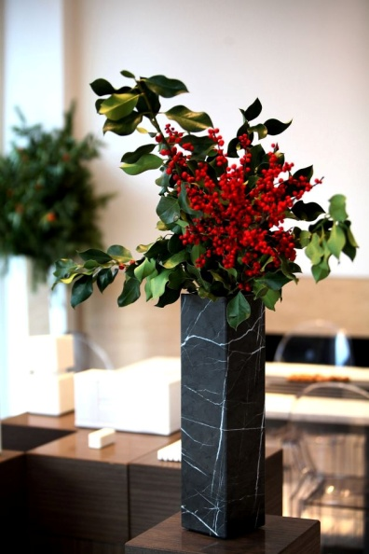

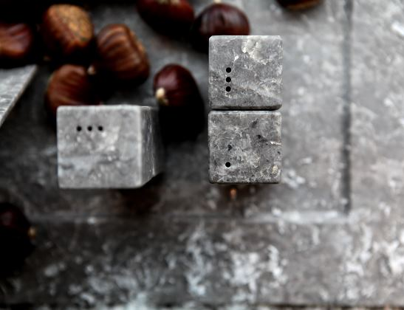
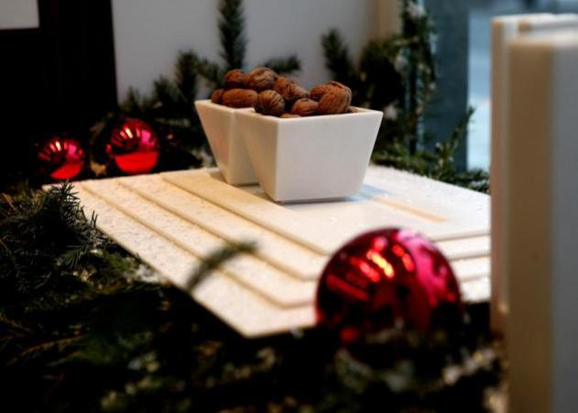
Change in philosophy
Artistic creations and utilitarian objects of high aesthetics
ΙKTINOS MARMARON – SPIROS SOULIS DESIGNS

Slide 28
Change in philosophy
Emphasis on advertising and product promotion
"Marble everywhere? Yes! Can you imagine marble objects like salt cellars in the kitchen?"
http://www.tlife.gr/Article/deco-iktinos/0-126-71545.html
"The other side of marble. From the not so "everyday" Parthenon to the most wanted objects of global design."
http://www.iefimerida.gr/news/197375/i-alli-opsi-toy-marmaroy-fotistika-piata-kai-axesoyar-eikones

Slide 29
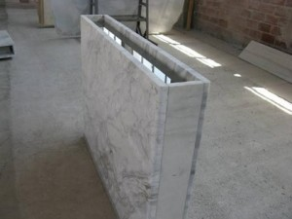
Change in philosophy
Smart applications that offer practical solutions
Solar mass wall made of marble by Masmarbles company

Slide 30
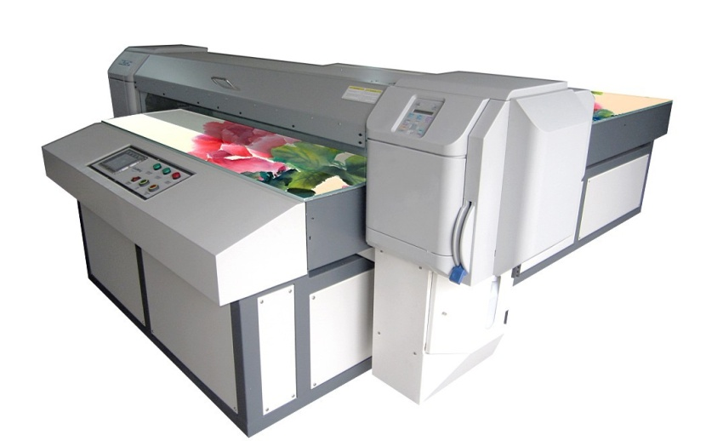
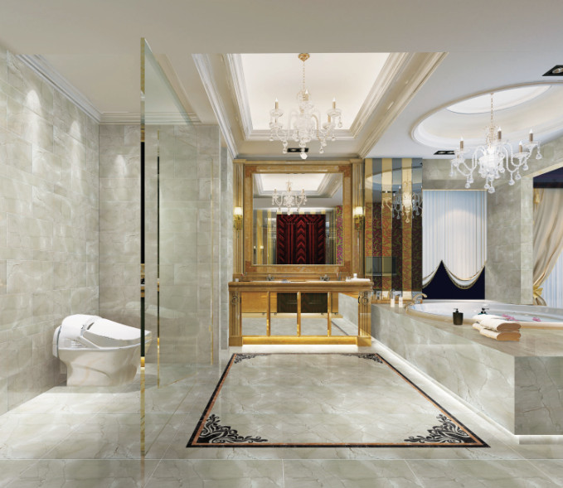
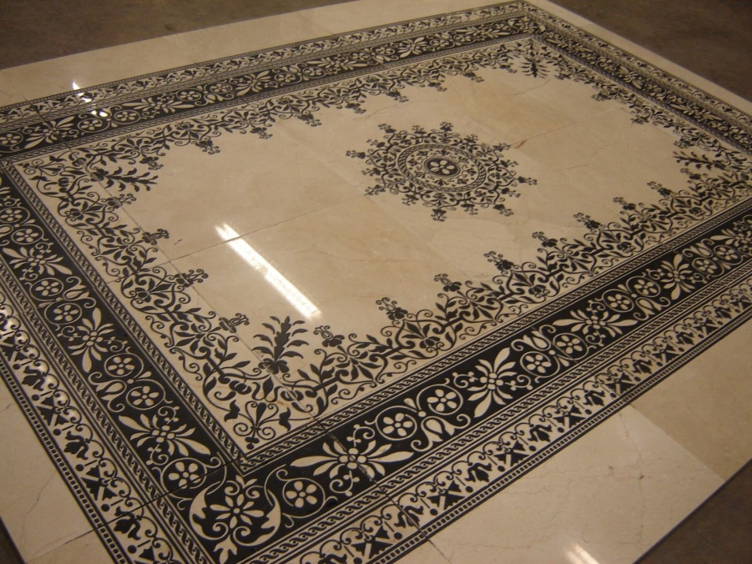
Change in philosophy
Creation of new products through marble colouring using laser or special printers

Slide 31
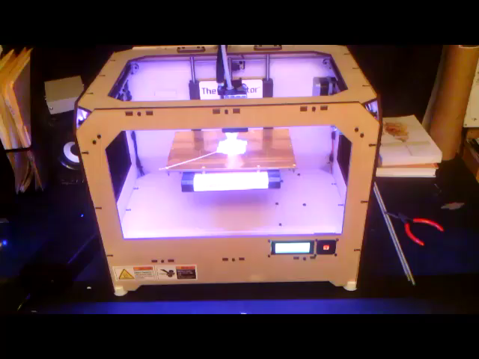
Change in philosophy
Utilisation of waste in 3D printing techniques

Slide 32
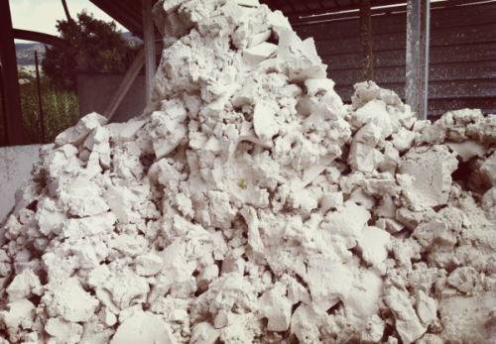
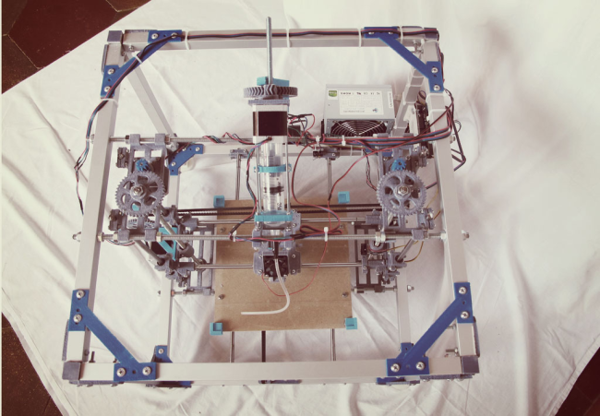
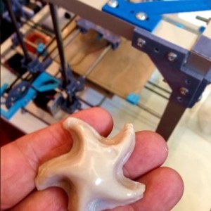
Change in philosophy
Utilisation of waste in 3D printing techniques
Production of special and demanding marble constructions
New products of high added value
Material: marble powder with special resins

Slide 33
Change in philosophy
From vertically integrated production to vertically integrated customer service
The I-STONE EU project (FP6- NMP2-CT-2005-515762) estimated that around 5% of decorative stone products in the EU need repair/replacement every year.
The damage suffered is basically due to:
  the choice of unsuitable materials for the specific use
  malpractice during installation
  poor/insufficient maintenance of the products

Slide 34
Change in philosophy
From vertically integrated production to vertically integrated customer service
Most owners and building maintenance crews are unaware of basic information about the daily care and safe cleaning of decorative stones
Businesses need to bridge the gap between producer and end consumer through:
  Reforming their image to the outside world through the internet
  Standardized services to the end customer: study, material proposal, sale, installation

Slide 35
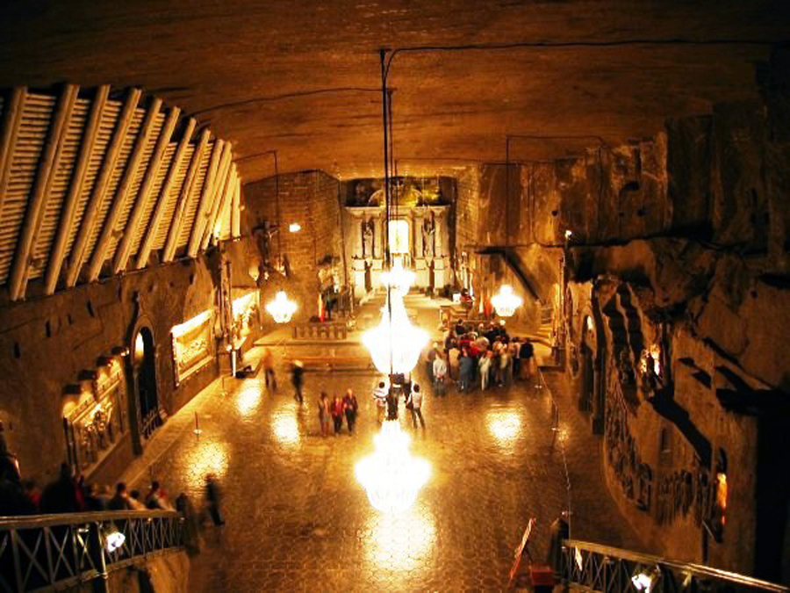
Change in philosophy
Underground quarries with post-mining site exploitation
Underground salt mine in Poland: UNESCO World Heritage Site
with 1.2 million visitors every year

Slide 36
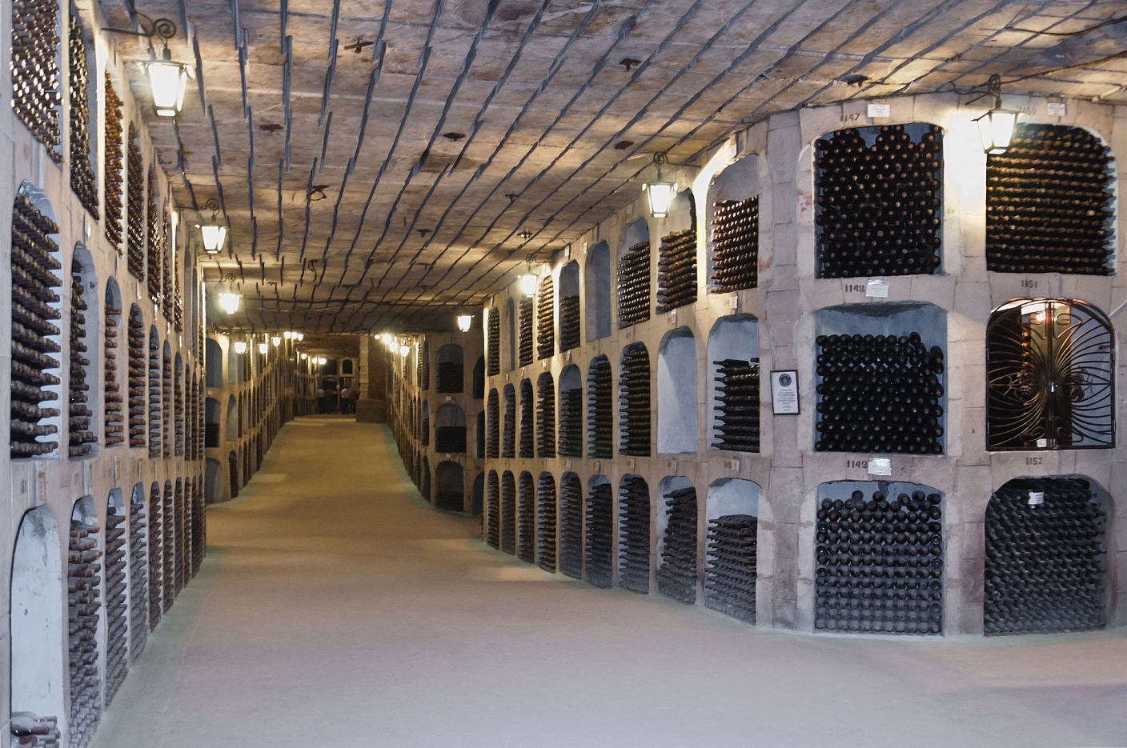
Change in philosophy
Underground quarries with post-mining site exploitation
Moldova: The world's largest collection of wines in old underground quarries

Slide 37
Summarizing…
Innovation in the marble sector can "embrace" the whole production chain, from initial research to the distribution of the final product to the consumer.
Broadening partnerships and transferring know-how from other related or unrelated sectors can offer new perspectives.
The industry has proven and continues to prove that, despite adversity, it can respond to difficult demands and circumstances.

