Slide 1

NATIONAL TECHNICAL UNIVERSITY OF ATHENS
LABORATORY OF MINING & ENVIRONMENTAL TECHNOLOGY
Restoration vs rehabilitation in marble quarries. A case study in Greece.
Post-Mining 2003, Impacts and Risk management
D.C. KALIAMPAKOS, A.A. MAVRIKOS

Slide 2
The Problem
Over 3.000 abandoned quarries.
Abandoned quarries are related to environmental problems such as:
Visual pollution.
Air pollution.
Post-Mining 2003, Impacts and Risk management

Slide 3
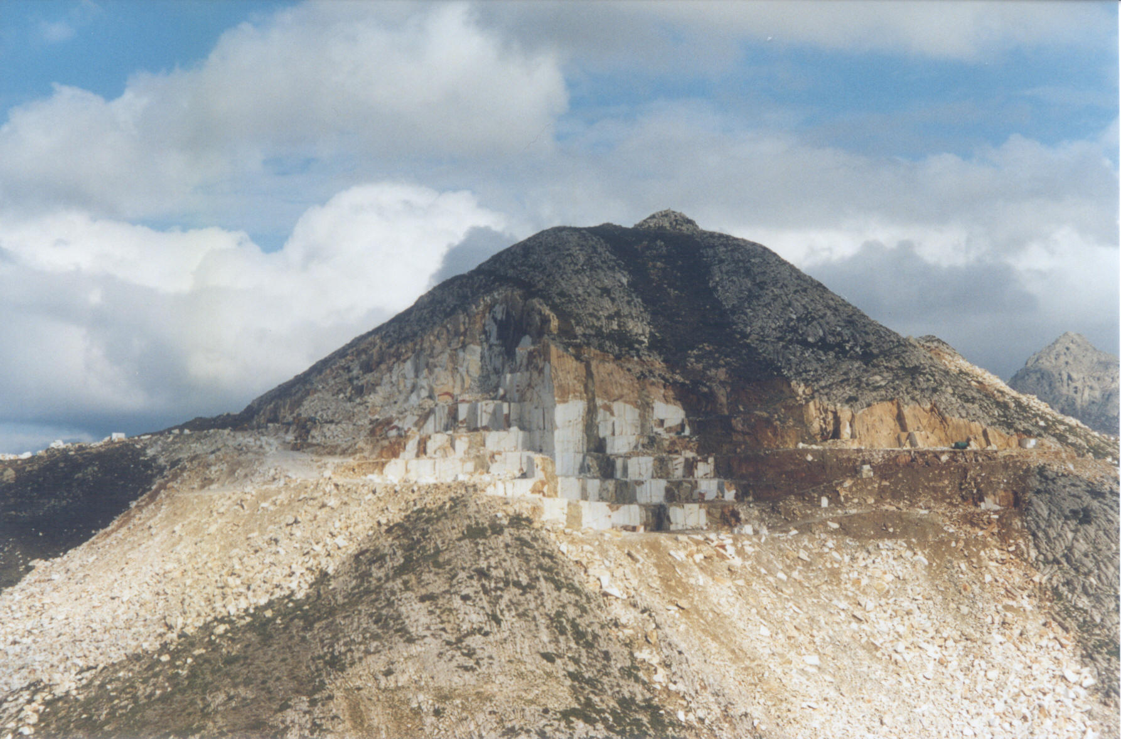
Abandoned small-sized marble quarry
Post-Mining 2003, Impacts and Risk management

Slide 4
The Roots of the Problem
Mining companies’ former behaviour.
Legislation.
Post-Mining 2003, Impacts and Risk management

Slide 5
Why re-vegetation cannot be effective
The smooth and flat surfaces of the benches, that wire-saw cutting produces are subjected to soil erosion.
The hard surface of the marble hinders the development of an adequate root system and the plants eventually shrivel.
The climatic conditions deteriorate the above conditions.
Post-Mining 2003, Impacts and Risk management

Slide 6
A different approach….
Post-Mining 2003, Impacts and Risk management

Slide 7
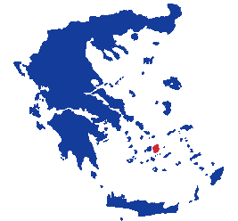
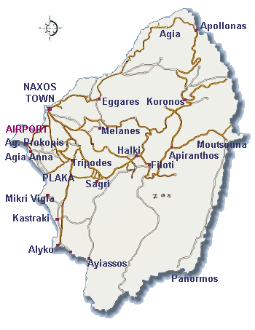
Location
: Marble quarry
  : Ancient marble
  quarries
Post-Mining 2003, Impacts and Risk management

Slide 8
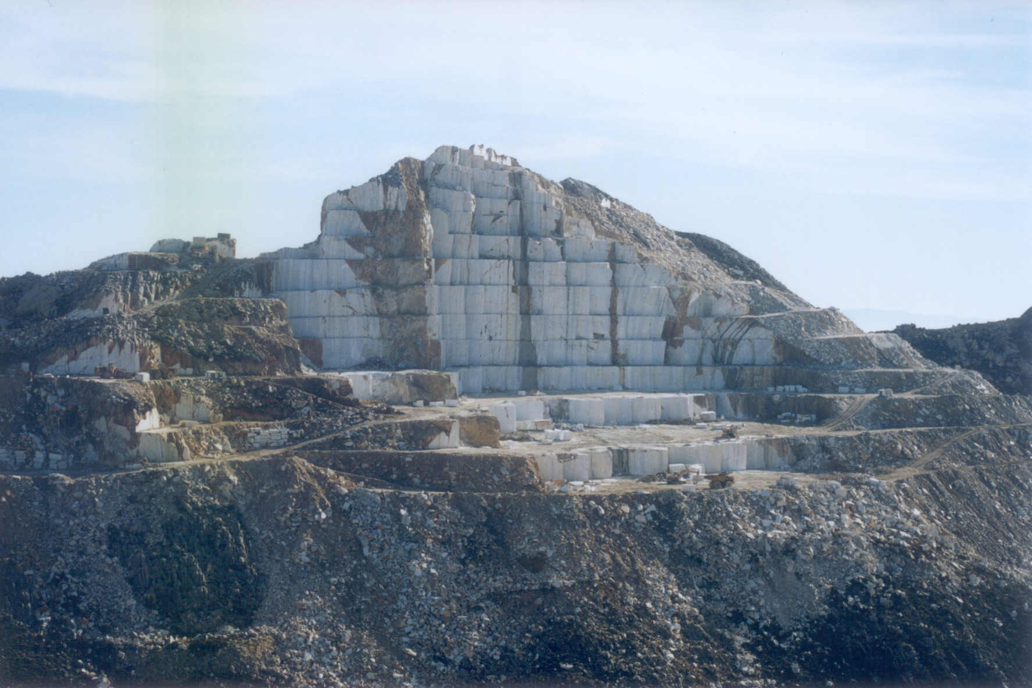
The quarry on the island of Naxos
Post-Mining 2003, Impacts and Risk management

Slide 9
General Considerations
The rehabilitation proposal took into account:
The development of a new and interesting landscape.
The historical and cultural background of the island.
The climatic conditions of the area.
Post-Mining 2003, Impacts and Risk management

Slide 10
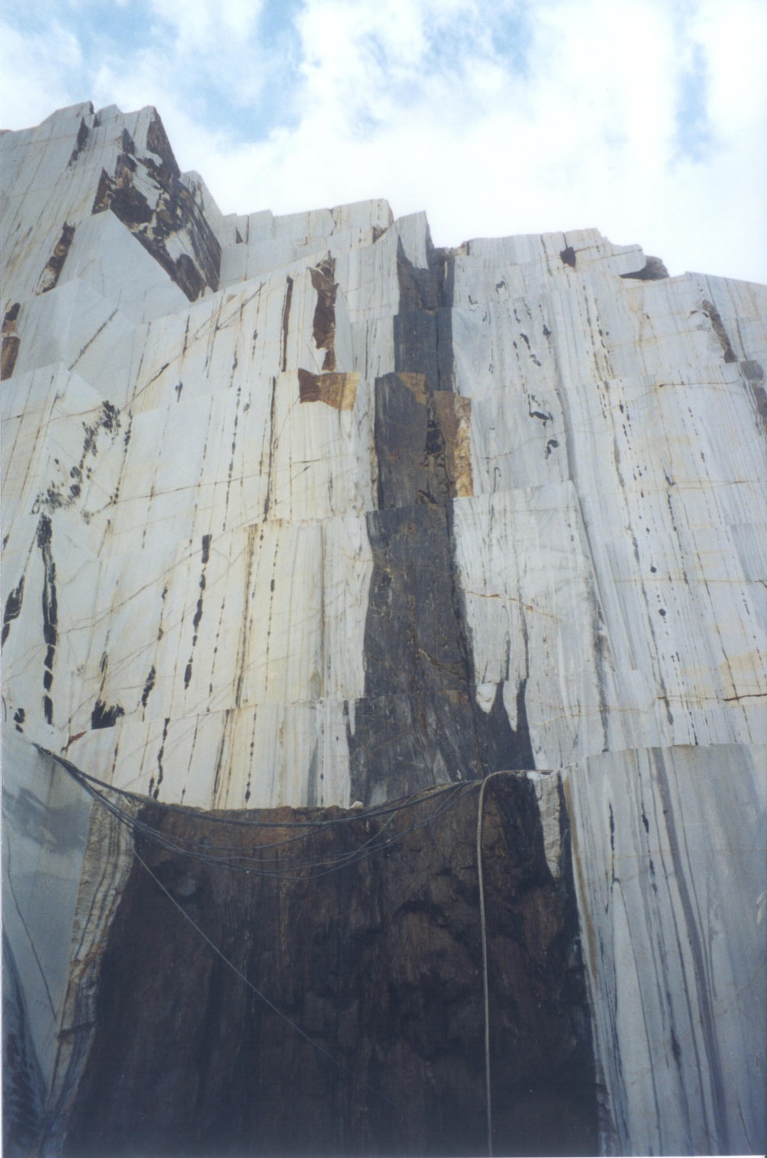
The New Landscape
Post-Mining 2003, Impacts and Risk management

Slide 11
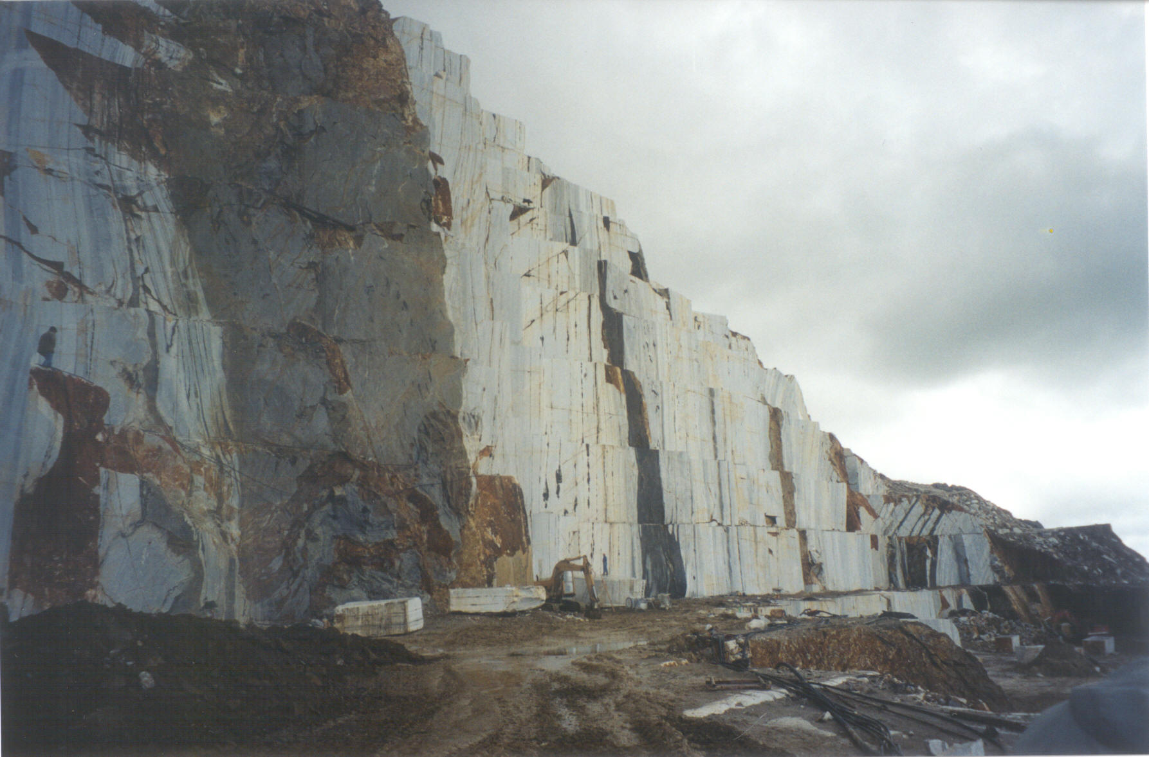
The New Landscape
Post-Mining 2003, Impacts and Risk management

Slide 12
Ancient Quarries
Archaeological researchers claim that quarrying on the island of Naxos has a history of over 3000 years.
Near the contemporary marble quarry there have been found many ancient quarry sites.
The ancient quarries were vital for the island’s economy.
Post-Mining 2003, Impacts and Risk management

Slide 13
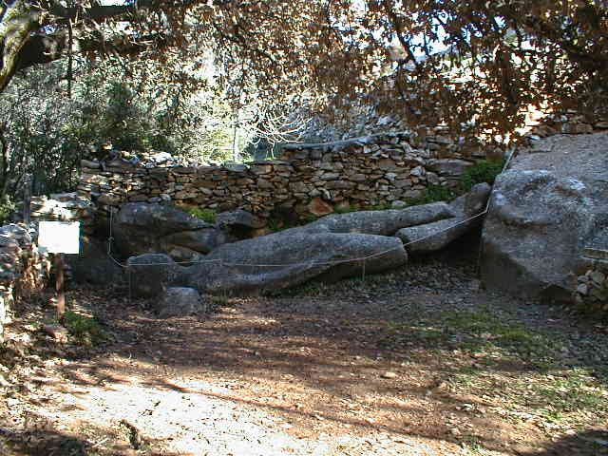
The Greek Kouros
Carved around 600 B.C., it is 6,4 m high.
Post-Mining 2003, Impacts and Risk management

Slide 14
Rehabilitation Scheme
The scheme suggests the modification of an area in the quarry so as to establish new land-uses, both recreational and cultural.
The main element of the area is an open-air theatre. The theatre, along with the orchestra, covers an area of 1.000 m² and it has a capacity of approximately 1000 seats. The theatre can host theatrical plays, concerts etc.
The area would consist of several supplementary elements such as a wooden reception kiosk, a café etc.
Post-Mining 2003, Impacts and Risk management

Slide 15
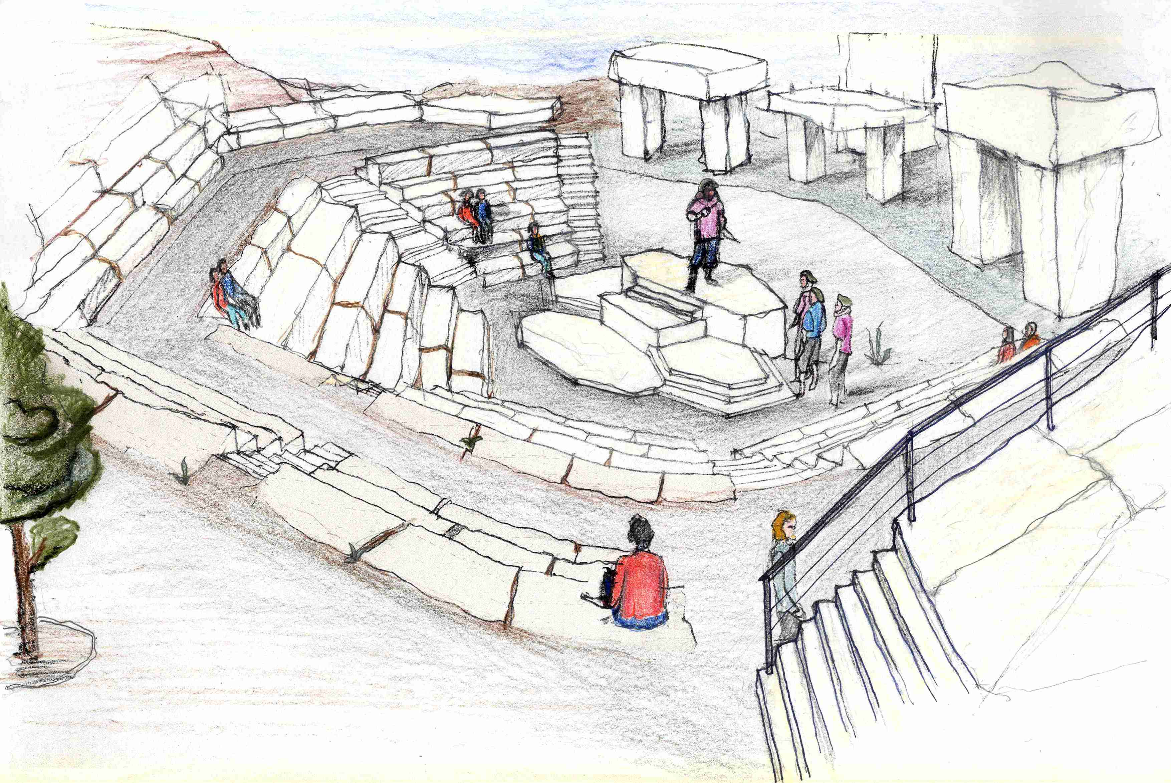
Perspective view of the proposed theatre
Post-Mining 2003, Impacts and Risk management

Slide 16
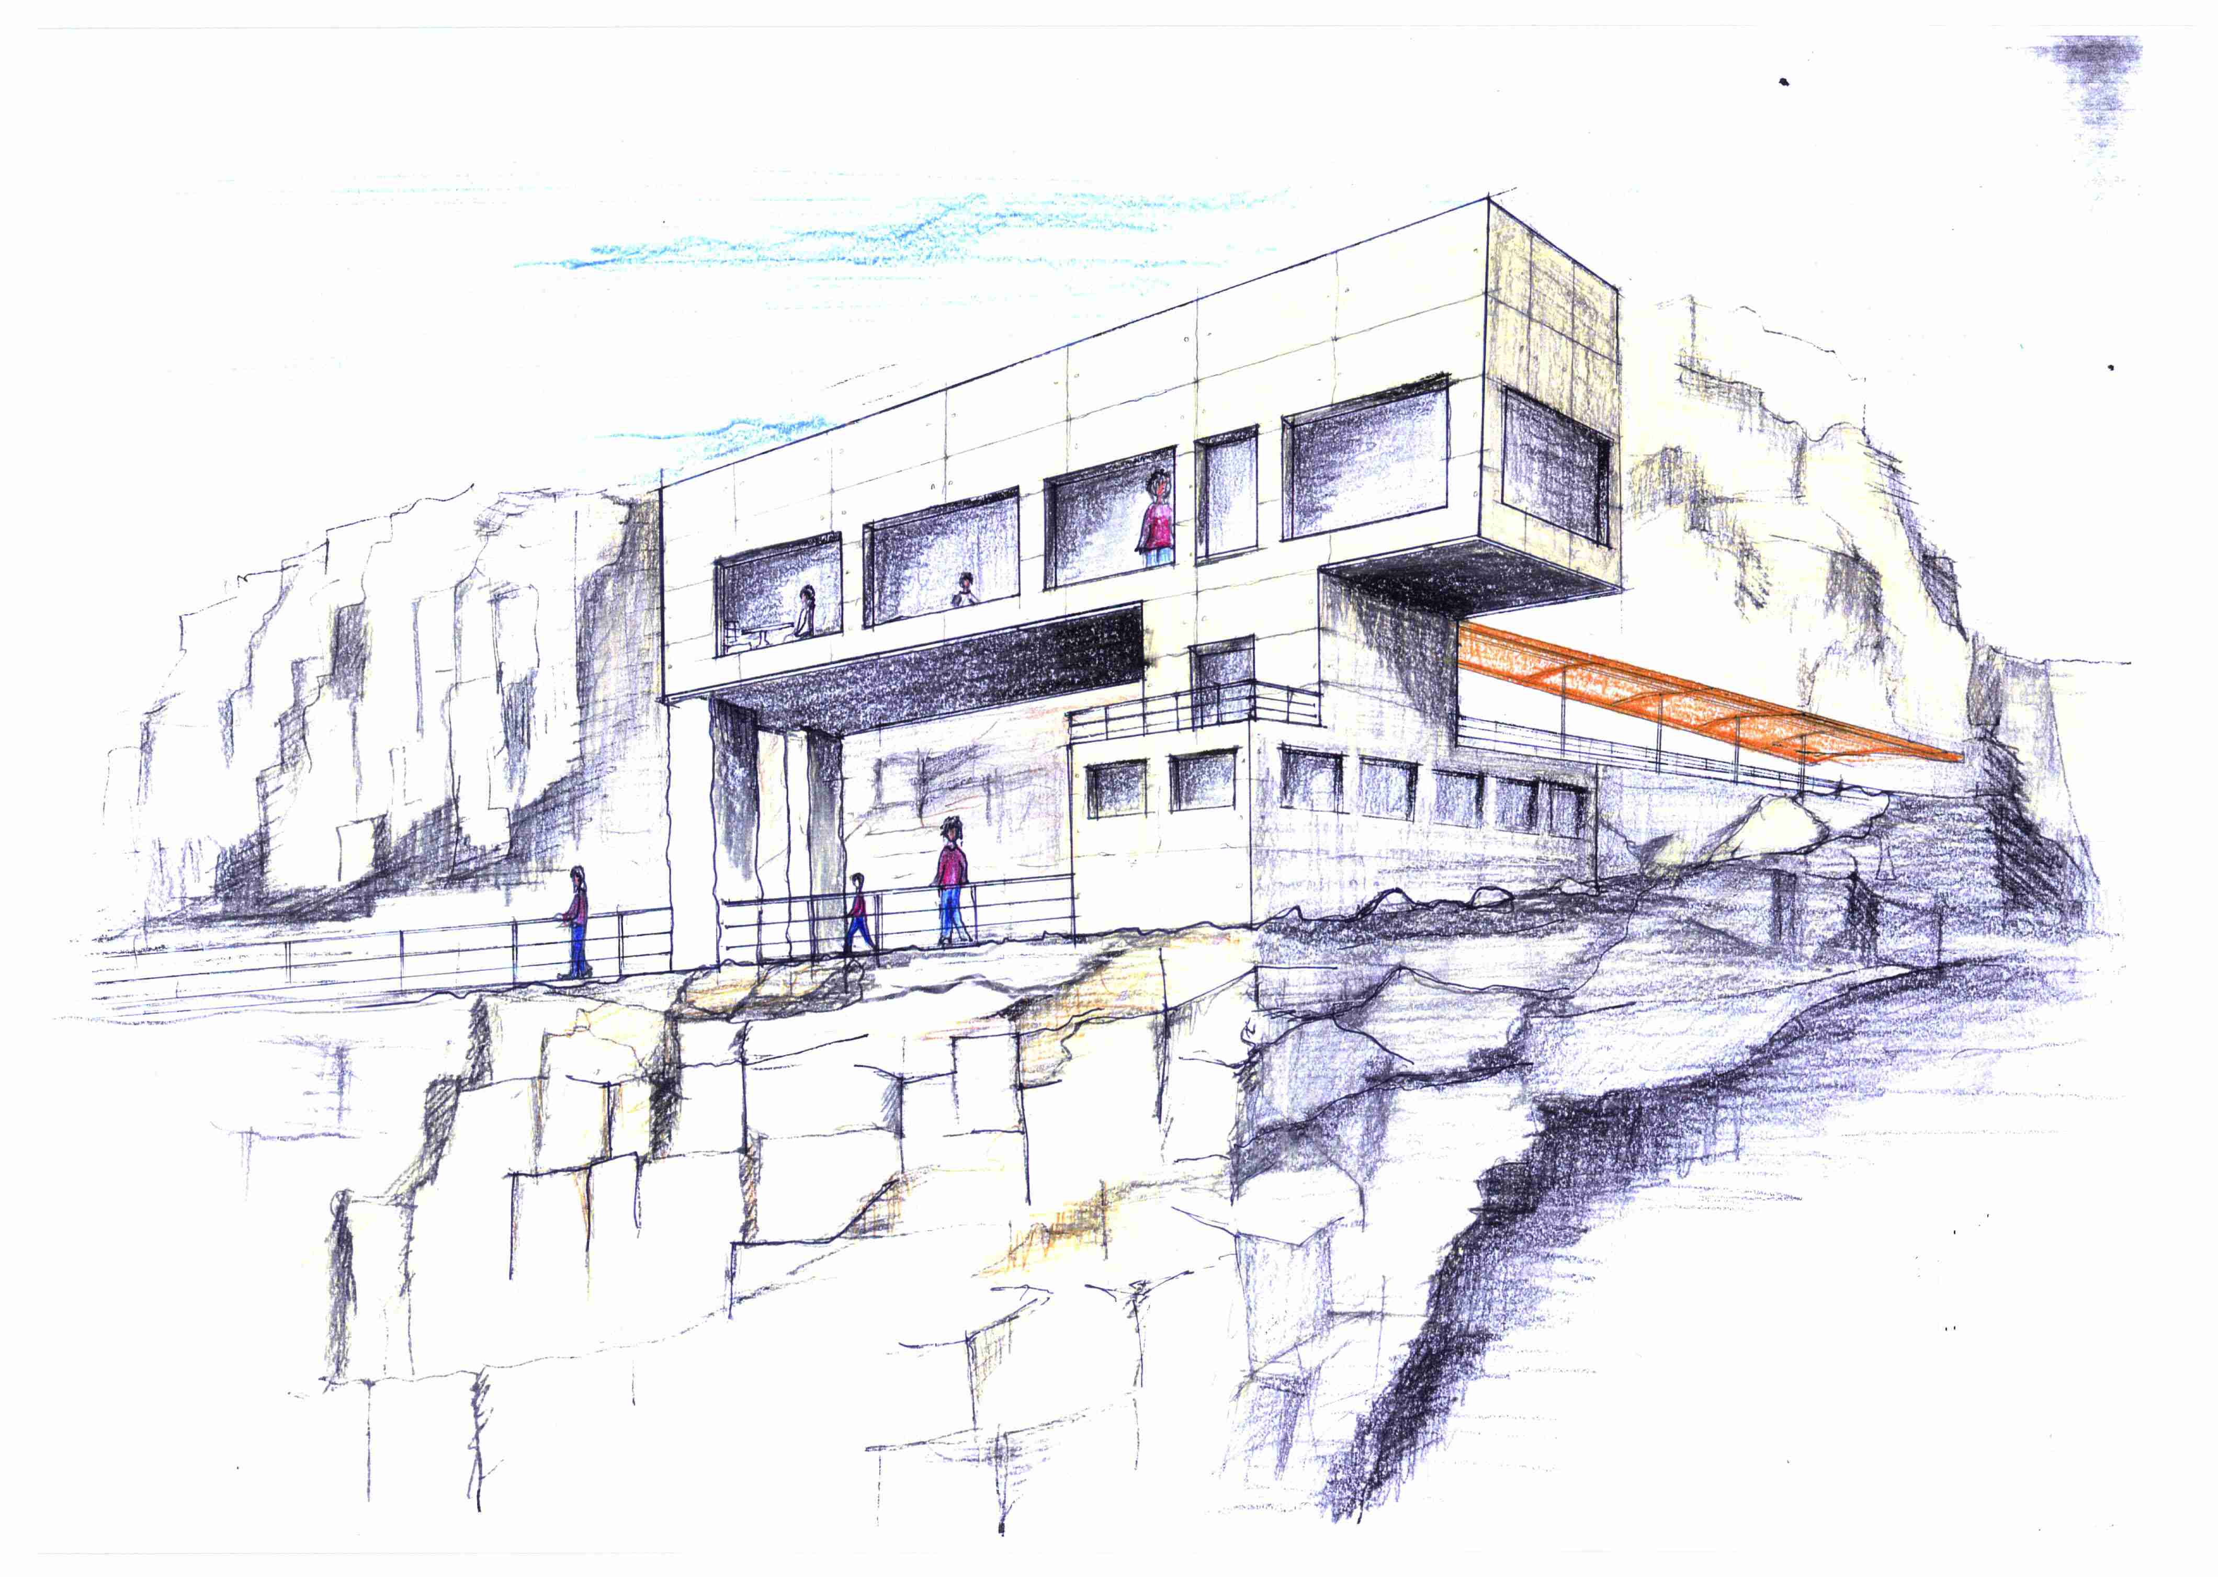
The café
Post-Mining 2003, Impacts and Risk management

Slide 17
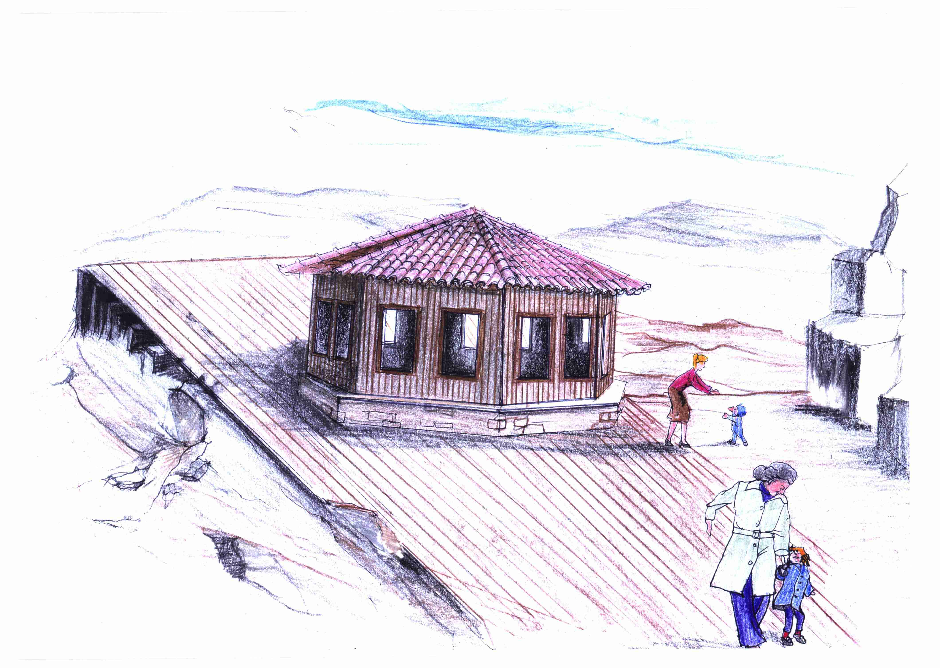
Reception kiosk
Post-Mining 2003, Impacts and Risk management

Slide 18
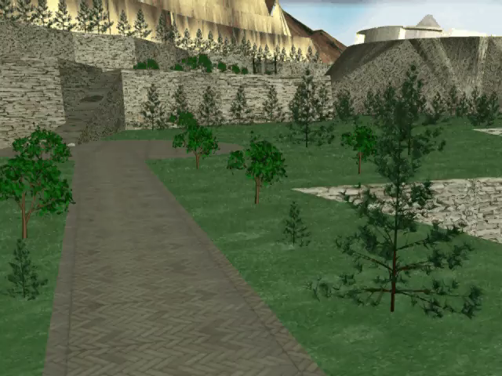
Post-Mining 2003, Impacts and Risk management

Slide 19
The two alternatives
Plan 1: It is a typical restoration plan according to current legislation guidelines. Hence, it suggests the extensive backfilling of the quarry’s benches with soil after the closure of the quarry and the re-vegetation of the site.
Plan 2: It is a rehabilitation scheme that suggests the establishment of new land-uses inside the quarry so as both cultural and recreational activities can take place.
Post-Mining 2003, Impacts and Risk management

Slide 20
What is the best ?
Post-Mining 2003, Impacts and Risk management

Slide 21
Methodology for the Comparison
The comparison is conducted on the grounds of Fuzzy Analytical Hierarchy Process, which is an expansion of the popular AHP technique by means of fuzzy set theory.
The AHP simplifies the analysis of complex problems due to two concepts:
(1) Decomposition of the problem into a manageable structure (hierarchy) of different levels (goal, criteria, subcriteria, alternatives)
(2) Evaluation of the elements at each level by making pairwise comparisons.
Post-Mining 2003, Impacts and Risk management

Slide 22
Structure incorporating hierarchy of criteria
Post-Mining 2003, Impacts and Risk management

Slide 23
Implementation of the Methodology
The implementation of the methodology includes four steps:
Objectives: definition of the problem and the objectives
Criteria: description of the main parameters interfering with the problem
Weighting of the criteria
Evaluation and ranking: use of the criteria and weights to meet the objectives
Post-Mining 2003, Impacts and Risk management

Slide 24
Implementation of the Methodology
Objectives
Financial return (F)
Environmental improvement (E)
Social benefits (S)
Technical concerns (T)
The priorities were: F = 0,25, E = 0,30, S = 0,30, T = 0,15
Post-Mining 2003, Impacts and Risk management

Slide 25
Implementation of the Methodology
Criteria
Financial return includes: revenues (F1), construction cost (F2) and maintenance cost (F3).
Environmental improvement includes: physical environment (E1), cultural environment (E2) and landscape and aesthetics (E3).
Social benefits include: regional development (S1), regional cohesion (S2) and employment (S3).
Technical concerns include: flexibility (T1), effectiveness (T2) and conformity with the law (T3).
Post-Mining 2003, Impacts and Risk management

Slide 26
Weighting of the Criteria
Pairwise assessments are made according to preference, importance, or likelihood.
Fuzzy numbers are used to calculate the comparative weights among the criteria of the hierarchy.
Numerical Values | Definition
1 3 5 7 9 2,4,6,8 Reciprocals | Equally important or preferred Slightly more important or preferred Strongly more important or preferred Very strongly more important or preferred Extremely more important or preferred Intermediate values to reflect compromise Used to reflect dominance of the second alternative as compared with the first
Post-Mining 2003, Impacts and Risk management

Slide 27
Results of the Analysis
 | Socio-Environmental scenario
Plan 1 | 0,246
Plan 2 | 0,754
Final ranking of the two alternatives
The results advocate that the proposed rehabilitation scheme is superior to re-vegetation, especially with regards to socio-environmental aspects.
Post-Mining 2003, Impacts and Risk management

Slide 28
Conclusions
The presented methodology provides an effective and integrated framework for the assessment of different alternatives.
The establishment of new land-uses, instead of re-vegetation, seems to be a more attractive solution for the rehabilitation of marble quarries, in many cases.
The proposed rehabilitation scheme allows for a number of parameters (the needs of the local community, the historical and cultural background of the area, the particular features of the marble quarry etc.) to be considered.
Post-Mining 2003, Impacts and Risk management

