Slide 1
Spatial Databases
About Indexes in the Databases
Notes:
What is an index?
If we would like to search for a keyword in a book we can go to its index at the last pages where keywords are listed in alphabetical order. We locate the desired word in it and get the page where this keyword appear.
A database index operates exactly like that. For all records of a table and for a particular field of it (primary key or other), we create a look-up table (index) in alphabetical order of that field, associated with a pointer to the place this record is stored in memory or the disk. Usually, the pointer points at the beginning of a block of records (like the page in a book, containing the keyword)*. As soon as the block is retrieved in the main memory, it is searched sequentially for locating the desired record.
* Data stored in a disk is organized in pages or blocks. The block is the minimum unit of data that is transferred from the main memory to the permanent storage (e.g. a disk) and there is always a pointer associated with each block containing its physical location. This transfer is the most time-consuming one, so we do everything we can iin order to minimize the number of such transfers.

Slide 2
The main question
What does a query like the following do?
CREATE INDEX zones_idx ON network.zones
USING GIST (sector);
Notes:
We should notice that building and using an index in a database is done automatically, by the DBMS, not by us. We have just to issue a query/command like this (for the case of a Spatial Database) and then the rest is left to the DBMS.
Here we are telling the system to create an index (and give it a name, zones_idx) on table `zones` within the schema `network` using the method of Generalized index search tree (GIST).
But first let’s see how it works in a Relational Database.

Slide 3
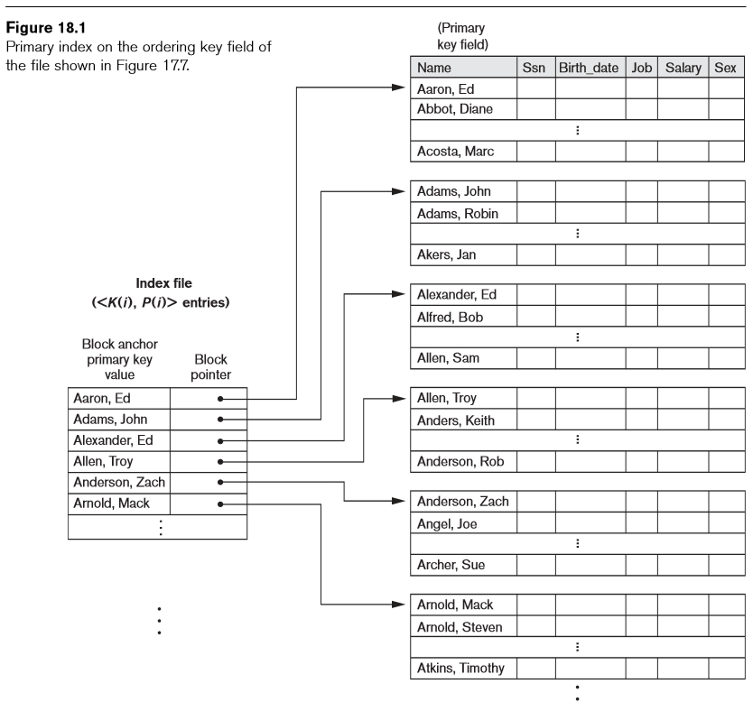
Primary indexes in Relational Db systems
data block (usually 512-4K bytes)
Index on the Primary Key (PK)
Data records: sorted according to the PK
Index: pointers to the first record of a block («sparse» index)
[Elmasri, 6th ed. Chap. 18]
Notes:
Lets see the case of a Primary Index, that is an index created for the PK. Records are sorted in alphabetical or numerical order of the PK, Due to that, we built an index which is sparse, ie. only for the records being first in the respective blocks.
This is a block of data records (4 in this particular example) and this is a block of index entries (more than 4, of course, because the index records are usually much smaller than the data records).
If we are looking for a person called Alfred, for example, …

Slide 4
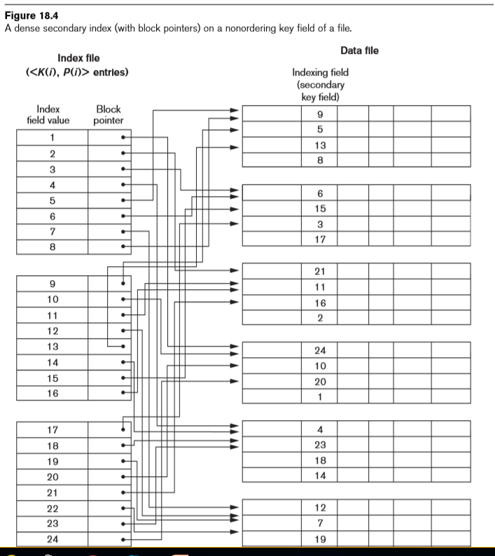
Secondary indexes
data block (usually 512-4K bytes)
Index on a Secondary Key (SK)
Data: non-sorted according to the SK
Index: pointers to each record («dense» index)
The index records are sorted
[Elmasri, 6th ed. Chap. 18 ]
Notes:
A secondary index is build on a field of the table other than the PK. Usually, there is no sorting of the records according to that field. So we have to build a dense index, containing an index record for each data record. Then, we sort the index table according to the respective field. etc.
…

Slide 5
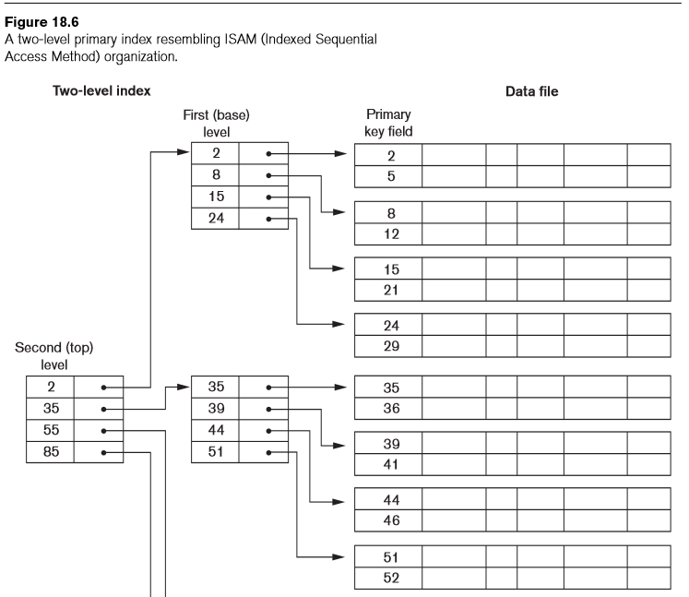
Multilevel indexes
Main features
They are applicable in both, dense and sparse cases
If K is the first level with sorted keys (K=0, for a primary index, K=1, for secondary indexes), in the levels K+1, K+2, … we get sequential thinning in the pointers (as much as the block size allows).
Search of logarithmic complexity is obtained
[Elmasri, 6th ed. Chap. 18]
Notes:
Multilevel indexes can be build for both, primary fields or secondary fields, with the first level being sparse or dense, respectively. After the first level, the index entries will be sorted, anyway, so sparse index tables follow, as in the example shown here…
This way, a logarithmic order of search complexity is approached.
We should notice that a binary search can be performed on a sorted index table. What is binary search? We go to the middle of the table and compare its value with the sought key value. According to the result of this comparison, we choose the first or the second half, respectively. Get the middle of the selected half, compare the new value and continue this way until we locate the desired key.

Slide 6
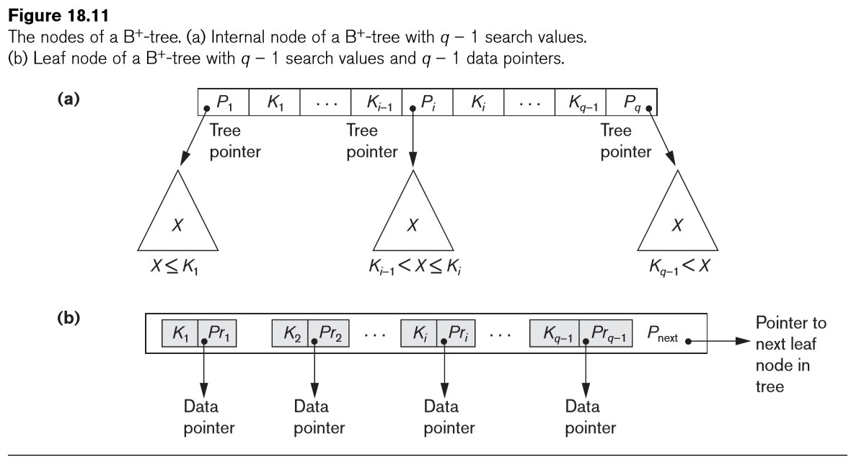
Multilevel indexes using B⁺-trees
sparse, for primary key,
dense, for secondary
(unsorted) key
[Elmasri, 6th ed. Chap. 18]

Slide 7
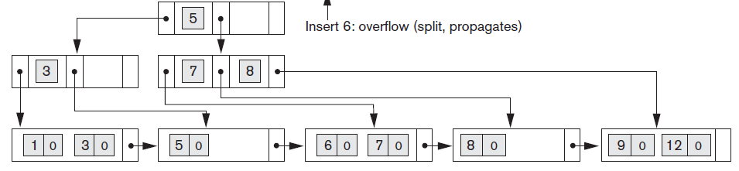
Multilevel indexes using B⁺-trees (cont)
Example
[See. Elmasri, Figure 18.12, for gradual creation with sequential insertions)

Slide 8
Spatial indexes using R-trees
Based on minimum bounding boxes (mbb) of the geospatial objects
Searching: queries are answered in two steps:
  Filter-step: Determine the mbb’s involved
  Refine-step: Check the objects themselves, of the limited set of mbb’s of the first step
The indexes (here with R-trees) are about the mbb’s (in the first step)
Notes:
What is the problem with spatial objects? No way to sort them. So, we use approximations of them suitable for sorting somehow. Such approximations are the Minimum Bounding Boxes (MBB).
Using MBBs we can tell if an object is further east or west of another... Similarly, if it is further north or south, by just comparing the coordinates of their two diagonal points of the respective MBBs.

Slide 9
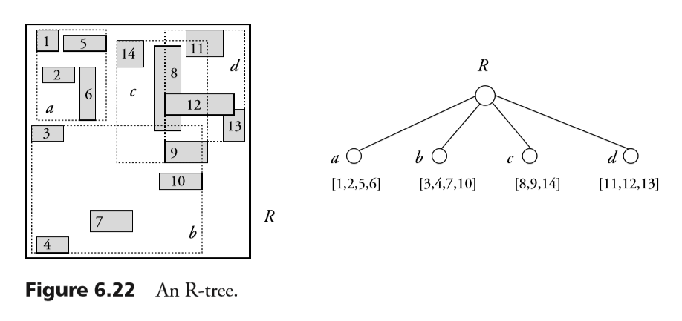
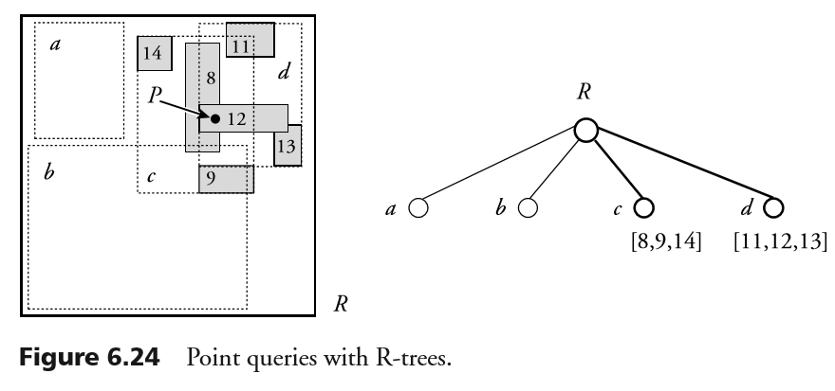
Spatial indexes using R-trees (cont)
(R from Rectangle)
Structure
Balanced search tree
At every tree level elements of the next level are grouped
Parameters (for each node):
  Minimum number of elements, m
  Maximum number of elements, M
  m <= (M+1)/2
  For the root: m>=2
P
Searching
Which mbb contain point Ρ;
Start from the root
For each internal node, Find all children that contain Ρ
At leaves, determine all mbb that contain Ρ
[Rigaux et.al, Spatial Databases with Application to GIS,
Kaufmann 2002, chapter 6]

Slide 10
Resources
[1], Chapter 18 (Indexing Structures for Files)
[2], Chapter 6 (Spatial Access Methods)
[3], R-Trees: A Dynamic Index Structure for Spatial Searching
[4], R-trees

Slide 11
Bibliography
Books
[1] Elmasri, Navathe, Fundamentals of Database Systems, 6th edition, Addison-Wesley, 2011
[2]Philippe Rigaux, Michel Scholl, Agnes Voisard, Spatial Databases –With Applications to GIS, Morgan Kaufmann, 2002, pp. 237-257
Articles
[3] A. Guttman, R-Trees: A Dynamic Index Structure for Spatial Searching, In: Proc. ACM SIGMOD Intl. Symp. on the Management of Data, 1984, pp. 45-57
Lectures
[4] geodatabase_TUB_Lect11-Index_Rtree.pdf (course site)

