Slide 1

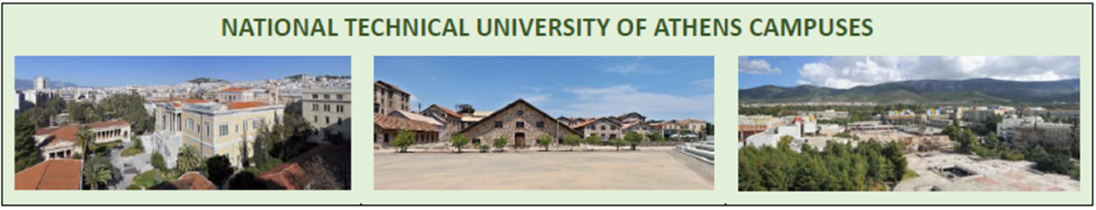
Professor Katerina Adam, SMME
EULiST NTUA Coordinator
Friday, June 23, 2023

Slide 2



TOPICS ADDRESSED
Academics and teaching staff members will share best practices with students for monitoring the contribution of renewable resources in the energy mix, towards sustainable EULiST campuses.
Thematic areas of the program:
  Promotion of research on clean energy technology, aligned with SDG 7 to ensure access to affordable, reliable, sustainable energy for all
  European Green Deal
  European Education Area’s Focus Topic “Green Education”.

Slide 3
STRUCTURE
Action 1
Online lectures
Action 2
Onsite workshops @ Athens NTUA
Action 3
Self-working time
31.05/07.06/14.06, 2023
19.06 – 26.06, 2023
July – August 2023
Action 4
Action 5
Online Mentoring
September 2023
Online projects presentation
13th October 2023

Slide 4



ACTION 2 – AGENDA | ONSITE WORKSHOPS | ATHENS NTUA
Monday, June 19th 2023
NTUA – Patission Complex
10.00 – 17.00 EEST
Tuesday, June 20th 2023
NTUA – Zografou Campus
09.00 – 16.00 EEST
Wednesday, June 21st 2023
NTUA – Zografou Campus
09.00 – 16.00 EEST
Thursday, June 22nd 2023
Lavreotiki UNESCO Global Geopark
08.00 – 16.00 EEST

Slide 5

ACTION 2 – AGENDA | ONSITE WORKSHOPS | ATHENS NTUA, cont.
Friday, June 23rd 2023
NTUA – Zografou Campus
10.00 – 17.00 EEST
Saturday, June 24th 2023
Athens City Centre
11.00 – 14.00 (lunch) EEST
Sunday, June 25th 2023
Students group meetings |NTUA campuses and facilities closed due to general elections in Greece
Monday, June 26th 2023
NTUA – Zografou Campus
10.30 – 19.00 EEST

Slide 6
ACTION 2 – AGENDA | ONSITE WORKSHOPS | ATHENS NTUA, cont.
JUNE 23rd, 2023 ‖ 10.00 -17.00 (EEST)
10:00 | Meeting point at Zografou Campus School of Rural, Surveying and Geoinformatics Engineering (SRSGE), “Vei” Building | PIN: 37.97554978425205, 23.779725735365506
10:00 – 11.00 | Introduction to NTUA 3D Digital Campus Modelling Prof. Efi Dimopoulou, School of Rural, Surveying and Geoinformatics Engineering | Auditorium B1 Vei Building SRSGE
11.00 – 12.00 | Impact of clean energy to climate change adaptation and resilience Prof. Maria Papadopoulou, School of Rural, Surveying and Geoinformatics Engineering
12.00 —12.30 | Discussion - Interaction | Auditorium B1
12.30 – 13.00 | Quick Lunch Break | Cafeteria at SRSGE Zografou Campus
13.00 – 13.30 | Private guided tour at GaiοOrama | Mineralogical Museum gaio-ORAMA School of Mining & Metallurgical Engineering https://en.museum.metal.ntua.gr/
13.30 – 15.30 | Drafting your Project Prof. Katerina Adam, School of Mining & Metallurgical Engineering

Slide 7
STUDENTS PARTICIPANTS, ½

Slide 8
STUDENTS PARTICIPANTS, 2/2
Online – background
Onsite - Best practices: tools, methodologies, use cases (e.g., National Gallery, Laurio,..)
Outcomes and future trends
C
Patel | LUT/male | Energy / mechanical engineer PhD
Gudabova | STU/female | Architecture and Design
Chripkova | STU/female | Architecture and Design
Illesova | STU/female | Architecture and Design
Antoneas | NTUA/male | Mechanical Enginneering PhD
D
Barbanov | LUT/male | Energy Technology
Shlarmann | LUH/female | Landscape architecture and Environmental Planning
Giusti | UNIVAQ/female | Architectural Engineering/ Design for Sustainability PhD
Theodoropoulos | NTUA/male | RS&Geoinformatics Engineering PhD
Orfanos | NTUA/male | Mechanical Enginneering PhD

Slide 9
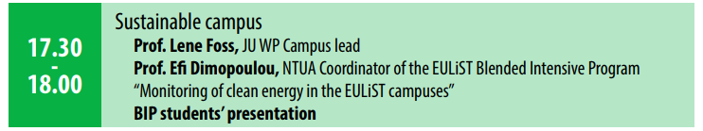

Slide 10
What are we looking for the Open Session on Monday
Online – background
Onsite - Best practices: tools, methodologies, use cases
Projects selected
Road Map for the Projects Development

Slide 11
NTUA BIB Project, KEYNOTES, 23/06/2023
Scope
The scope of the BIB Project is to:
reinforce the significance of energy-efficient building design and the role of students in shaping the future of sustainable architecture.
encourage further research and innovation in developing and implementing effective measures for zero or positive energy buildings.

Slide 12
NTUA BIB Project, KEYNOTES, 23/06/2023
Methodology
Following the presentations of the online and onsite courses, the students should specify the significance of energy-efficient buildings and the need for sustainable practices in the face of climate change.
The proposed prototype building will be defined as a building of four different uses (office, library, residential use and conference room). Each building use will be situated in four different cities, each of them representing one of four specific European climatic zones (see online presentation 2023_06_14_EULIST_ik2.pptx, uploaded on Helios portal).

Slide 13
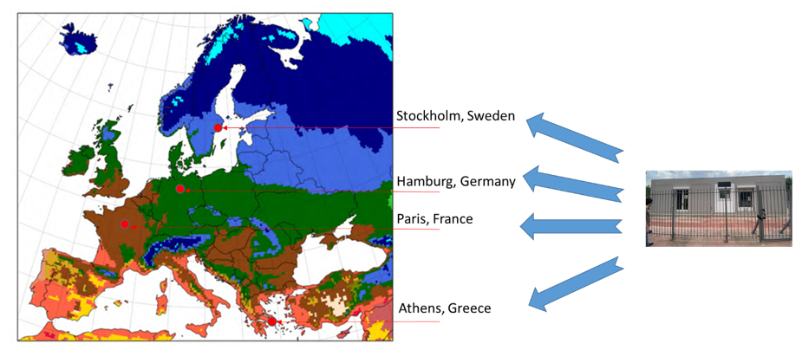
NTUA BIB Project, KEYNOTES, 23/06/2023

Slide 14
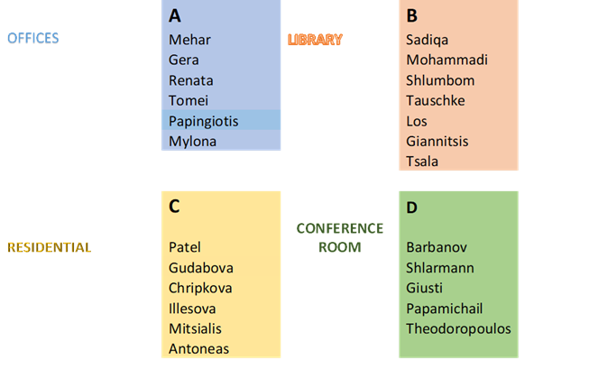
NTUA BIB Project, KEYNOTES, 23/06/2023
Every group should analyze the designated prototype building and evaluate how the given measures influence energy consumption, energy savings and thermal comfort, specific to the assigned use and European climatic zone.

Slide 15
NTUA BIB Project, KEYNOTES, 23/06/2023
STEP 1: Prototype Building Setup - Simulation run
STEP 2: Energy Optimization
STEP 3: Documentation and Analysis

Slide 16
NTUA BIB Project, KEYNOTES, 23/06/2023
Outcomes
Summarize the findings from the analysis of prototype buildings in various European climatic zones.
Emphasize the importance of considering climatic factors when implementing energy-efficient measures.
Highlight the significance of optimizing energy consumption, achieving energy savings, and maintaining thermal comfort in sustainable building design across diverse climatic zones.

Slide 17
Preparation of the Presentation of Open Session on Monday

Slide 18
What are we looking for the Open Session on Monday
Online – background
Onsite - Best practices: tools, methodologies, use cases
Projects selected
Road Map for the Projects Development

Slide 19

Professor Katerina Adam, SMME,
EULiST NTUA Coodinator
katadam@metal.ntua.gr, eulist@mail. ntua.gr
Thanks for your attention

