Slide 1
Regret minimization and applications to solving games
Tuomas Sandholm and Brian Zhang

Slide 2
Focus of this lecture
We focus on Nash equilibrium in two-player zero-sum games
But, these techniques apply to other problems as well, e.g.:
  Best response computation
  Quantal response equilibrium
  [Farina, Kroer, and Sandholm; “Online Convex Optimization for Sequential Decision Processes and Extensive-Form Games, AAAI’17]
  Near-safe opponent exploitation
  [same as above]
  Coarse-correlated equilibrium in multiplayer games
  Playing better than a given strategy, but like it
  [Farina, Kroer & Sandholm, T. Regret Minimization in Behaviorally-Constrained Zero-Sum Games. ICML-17; Jacob, Wu, Farina, Lerer, Hu, Bakhtin, Andreas, Brown; Modeling Strong and Human-Like Gameplay with KL-Regularized Search. ICML’22]
Notes:
opponent exploitation – if I figure out my opponent is playing suboptimally, how can I take advantage of that without risking too much?

Slide 3
Part One
Nash Equilibria in Normal-Form Games

Slide 4
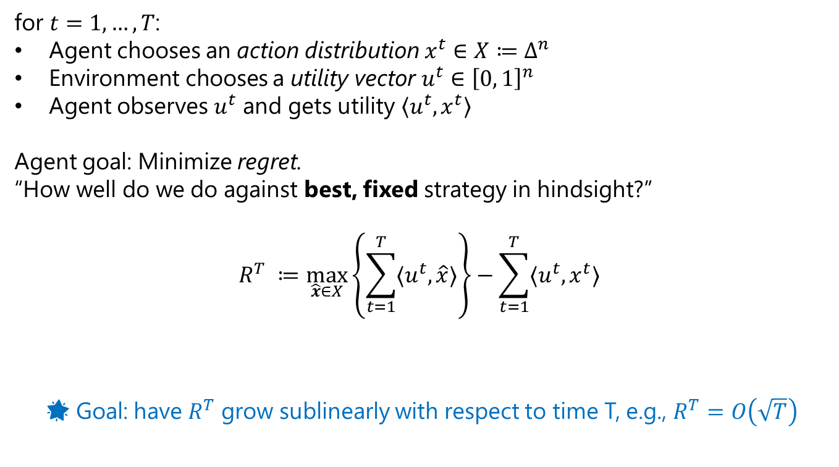
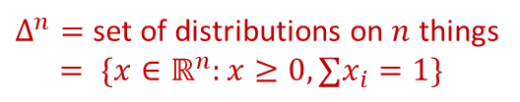
Regret Minimization
for $t=1,…,T$:
Agent chooses an action distribution $x^{t}∈X≔Δ^{n}$
Environment chooses a utility vector $u^{t}∈{\left[0, 1\right]}^{n}$
Agent observes $u^{t}$ and gets utility $\left\langle u^{t},x^{t}\right\rangle$
Agent goal: Minimize regret.
“How well do we do against best, fixed strategy in hindsight?”
$$R^{T} ≔\max_{\hat{x}∈X}\left\{\sum_{t=1}^{T}{{〈u}^{t},\hat{x}〉}\right\}−\sum_{t=1}^{T}{{〈u}^{t},x^{t}〉 }$$
🌟 Goal: have $R^{T}$ grow sublinearly with respect to time T, e.g., $R^{T}=O\left(\sqrt{T}\right)$
$Δ^{n}=$ set of distributions on $n$ things
$= \{x∈ℝ^{n}:x≥0,∑x_{i}=1\}$
Maximum utility that was
achievable by the best fixed
action in hindsight
Utility that was actually accumulated
  No assumption on utilities!
  Must handle adversarial environments

Slide 5
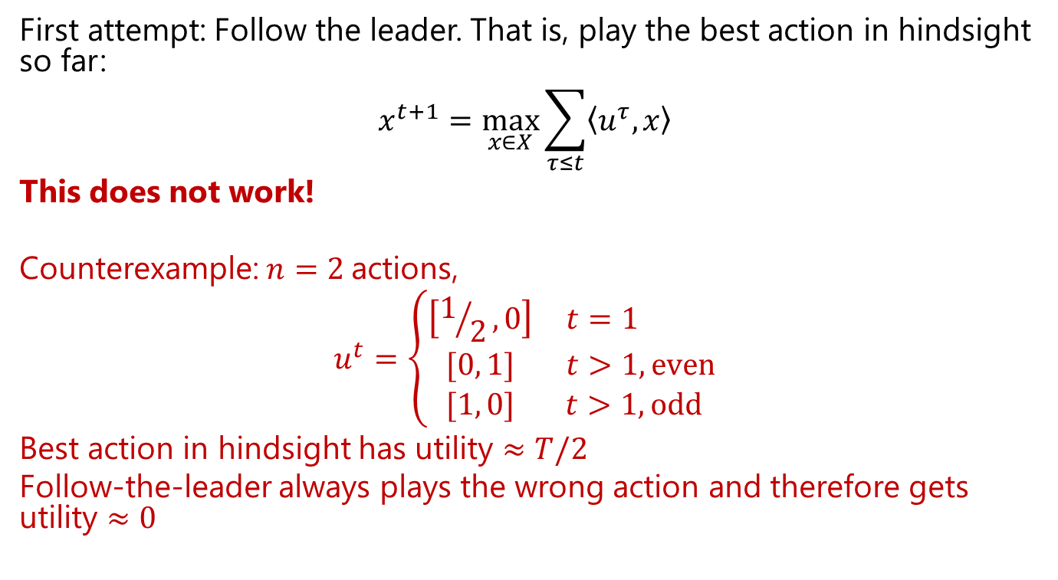
Regret Minimization:
Follow the Leader
First attempt: Follow the leader. That is, play the best action in hindsight so far:
$$x^{t+1}=\max_{x∈X}{\sum_{τ≤t}{\left\langle u^{τ},x\right\rangle }}$$
This does not work!
Counterexample: $n=2$actions,
$$u^{t}=\left\{\begin{matrix}\left[1/2,0\right] & t=1 \\ [0, 1] & t>1, even \\ [1, 0] & t>1, odd \end{matrix}\right.$$
Best action in hindsight has utility $≈T/2$
Follow-the-leader always plays the wrong action and therefore gets utility $≈0$

Slide 6



Recap: Zero-Sum Normal-Form Games
🌟 SIMULTANEOUS
(No turns)
0.2
0 | -1 | +1
+1 | 0 | -1
-1 | +1 | 0
0.5
🌟 Strategy for a player is just a probability distribution over actions
0.3

Slide 7
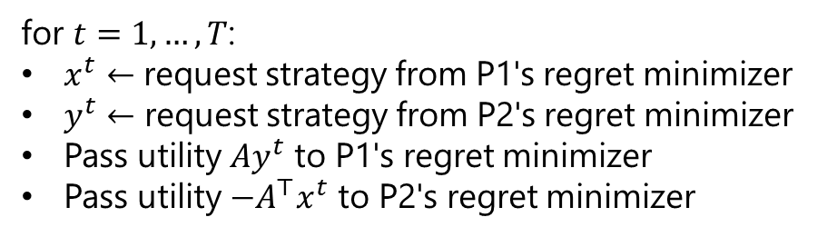
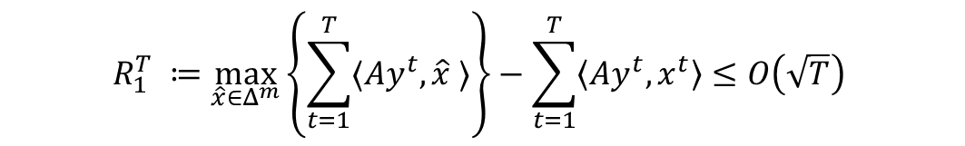
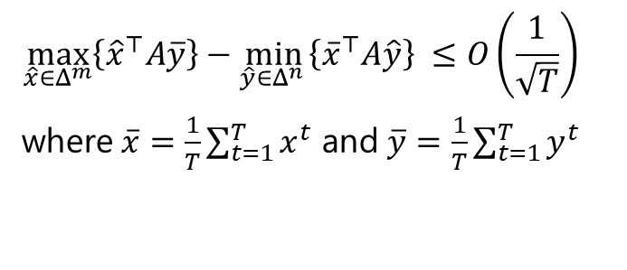
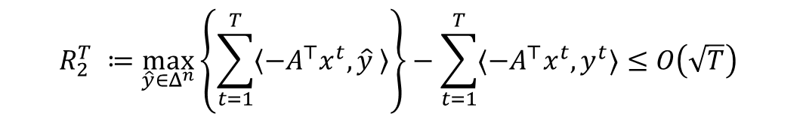
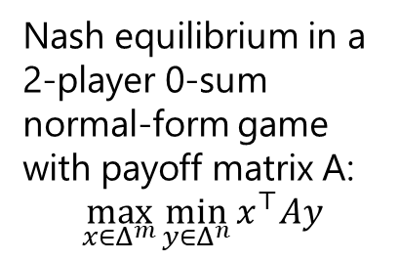
What does regret minimization have to do with zero-sum games?
Nash equilibrium in a 2-player 0-sum normal-form game with payoff matrix A:
$$\max_{x∈Δ^{m}}\min_{y∈Δ^{n}}{x^{⊤}Ay}$$
🌟 IDEA: Self-play. Make two regret minimizers play each other
for $t=1,…,T$:
$x^{t}←$ request strategy from P1's regret minimizer
$y^{t}←$ request strategy from P2's regret minimizer
Pass utility $Ay^{t}$ to P1's regret minimizer
Pass utility $−A^{⊤}x^{t}$ to P2's regret minimizer
$$R_{1}^{T} ≔\max_{\hat{x}∈Δ^{m}}\left\{\sum_{t=1}^{T}{〈Ay^{t}, \hat{x} 〉}\right\}−\sum_{t=1}^{T}{\left\langle Ay^{t}, x^{t}\right\rangle }≤O\left(\sqrt{T}\right)$$
Add these two lines and
divide by T to get the average
$$R_{2}^{T} ≔\max_{\hat{y}∈Δ^{n}}\left\{\sum_{t=1}^{T}{\left\langle {−A}^{⊤}x^{t}, \hat{y} \right\rangle }\right\}−\sum_{t=1}^{T}{〈{−A}^{⊤}x^{t}, y^{t}〉≤O\left(\sqrt{T}\right)}$$
$$\max_{\hat{x}∈Δ^{m}}\left\{{\hat{x}}^{⊤}A\overline{y}\right\}−\min_{\hat{y}∈Δ^{n} }\left\{{\overline{x}}^{⊤}A\hat{y}\right\} ≤O\left(\frac{1}{\sqrt{T}}\right)$$
where $\overline{x}=\frac{1}{T}\sum_{t=1}^{T}{x^{t}}$ and $\overline{y}=\frac{1}{T}\sum_{t=1}^{T}{y^{t}}$
🌟 TAKEAWAY
The average strategies converge to a Nash equilibrium!

Slide 8
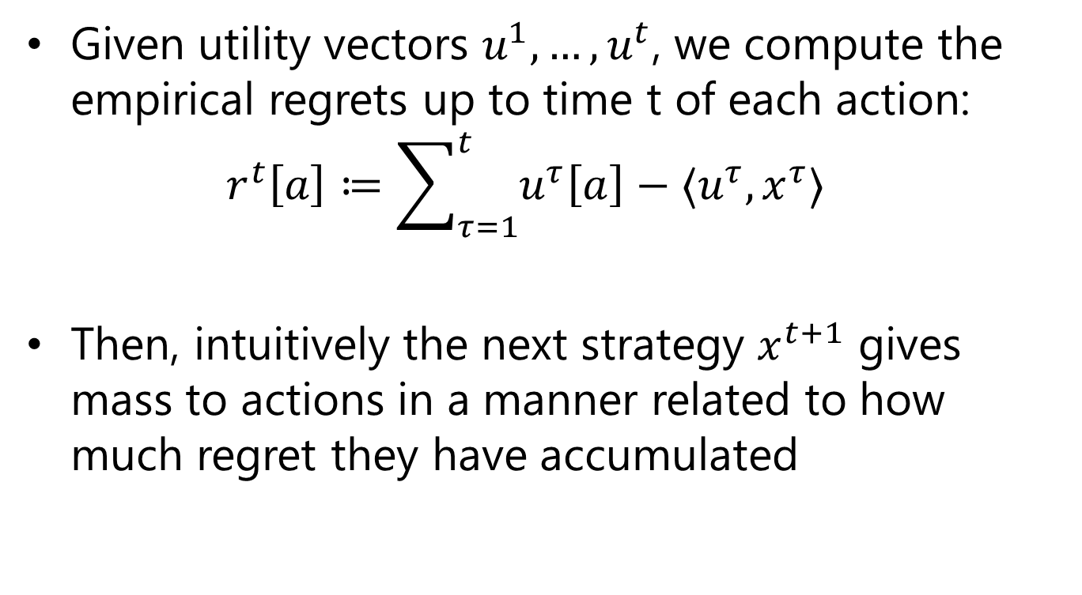
A Common Template for Regret Minimizers
Given utility vectors $u^{1}, …,u^{t}$, we compute the empirical regrets up to time t of each action:
$r^{t}\left[a\right]≔\sum_{τ=1}^{t}{u^{τ}\left[a\right]−⟨u^{τ},x^{τ}⟩}$
Then, intuitively the next strategy $x^{t+1}$ gives mass to actions in a manner related to how much regret they have accumulated

Slide 9
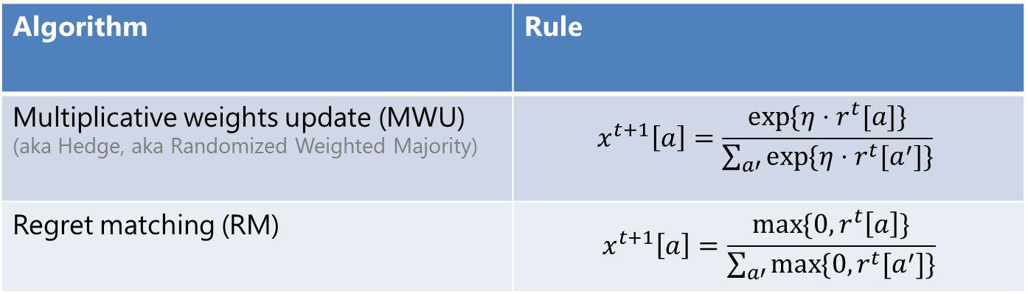

A Common Template for Regret Minimizers
Empirical regret:
$$r^{t}\left[a\right]≔\sum_{τ=1}^{t}{u^{τ}\left[a\right]−\left\langle u^{τ},x^{τ}\right\rangle }$$
Then, intuitively the next strategy $x^{t+1}$ gives mass to actions somewhat proportionally to how much regret they have accumulated
Hyperparameter
(“learning rate”)
Algorithm | Rule
Multiplicative weights update (MWU) (aka Hedge, aka Randomized Weighted Majority) | $$x^{t+1}\left[a\right]=\frac{\exp{{\{η⋅r}^{t}[a]\}}}{\sum_{a′}{\exp{{\{η⋅r}^{t}[a^{′}]\}}}}$$
Regret matching (RM) | $$x^{t+1}\left[a\right]=\frac{\max{\{0,}r^{t}\left[a\right]\}}{\sum_{a′}{\max{{\{0, r}^{t}[a^{′}]\}}}}$$
Note: MWU is a particular instance of a very general algorithm called “Online mirror descent”, which can be applied to all convex strategy sets and guarantees sublinear regret

Slide 10
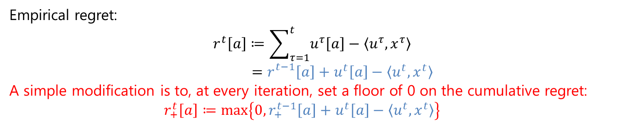
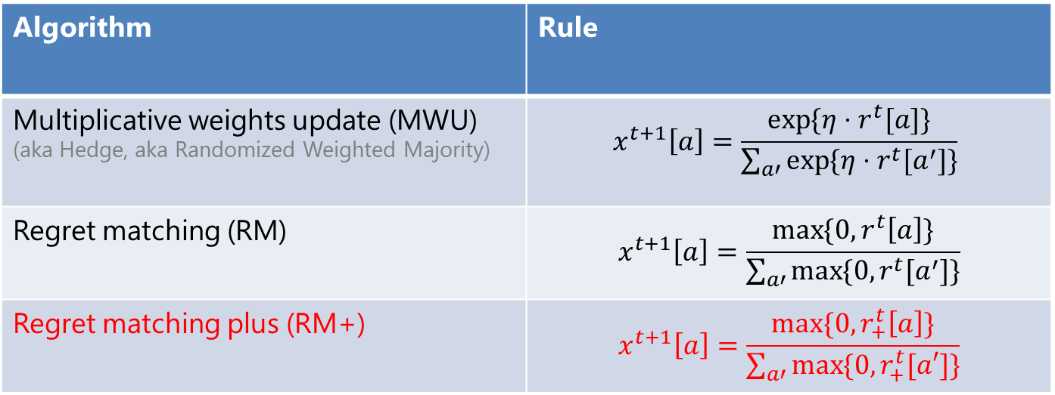
A Common Template for Regret Minimizers
Empirical regret:
$$r^{t}\left[a\right]≔\sum_{τ=1}^{t}{u^{τ}\left[a\right]−\left\langle u^{τ},x^{τ}\right\rangle }$$
$$=r_{}^{t−1}\left[a\right]+u^{t}\left[a\right]−\left\langle u^{t},x^{t}\right\rangle$$
A simple modification is to, at every iteration, set a floor of 0 on the cumulative regret:
$$r_{+}^{t}\left[a\right]≔\max\left\{0, r_{+}^{t−1}\left[a\right]+u^{t}\left[a\right]−\left\langle u^{t},x^{t}\right\rangle \right\}$$
Algorithm | Rule
Multiplicative weights update (MWU) (aka Hedge, aka Randomized Weighted Majority) | $$x^{t+1}\left[a\right]=\frac{\exp{{\{η⋅r}^{t}[a]\}}}{\sum_{a′}{\exp{{\{η⋅r}^{t}[a^{′}]\}}}}$$
Regret matching (RM) | $$x^{t+1}\left[a\right]=\frac{\max{\{0,}r^{t}\left[a\right]\}}{\sum_{a′}{\max{{\{0, r}^{t}[a^{′}]\}}}}$$
Regret matching plus (RM+) | $$x^{t+1}\left[a\right]=\frac{max⁡\{0, r_{+}^{t}\left[a\right]\}}{\sum_{a′}{\max{\{0,r_{+}^{t}[a′]\}}}}$$
Notes:
regret matching plus is "reactive", in a sense.

Slide 11
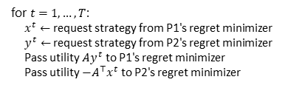
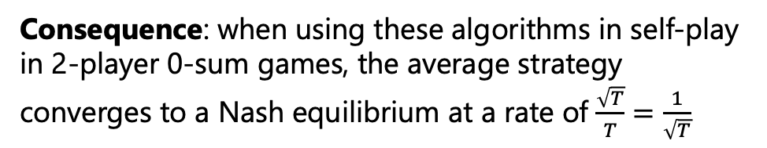
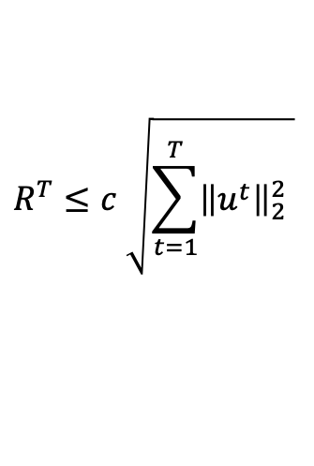
A Common Template for Regret Minimizers
All of these algorithms guarantee that after seeing any number T of utilities $u^{1}, …, u^{T}$, the regret cumulated by the algorithm satisfies
Remember:
This holds without any assumption about the way the utilities are selected by the environment!
$$R^{T}≤c \sqrt{\sum_{t=1}^{T}{{\left\|u^{t}\right\|}_{2}^{2} }}$$
Constant that depends on number of actions
So, assuming that the utility vectors have bounded norms $\left\|u^{t}\right\|≤B$ (this is always the case when playing finite games), then $R^{T}≤cB\sqrt{T}$
Consequence: when using these algorithms in self-play in 2-player 0-sum games, the average strategy converges to a Nash equilibrium at a rate of $\frac{\sqrt{T}}{T}=\frac{1}{\sqrt{T}}$
Reminder: Self-play
for $t=1,…,T$:
  $x^{t}←$ request strategy from P1's regret minimizer
  $y^{t}←$ request strategy from P2's regret minimizer
  Pass utility $Ay^{t}$ to P1's regret minimizer
  Pass utility $−A^{⊤}x^{t}$ to P2's regret minimizer

Slide 12
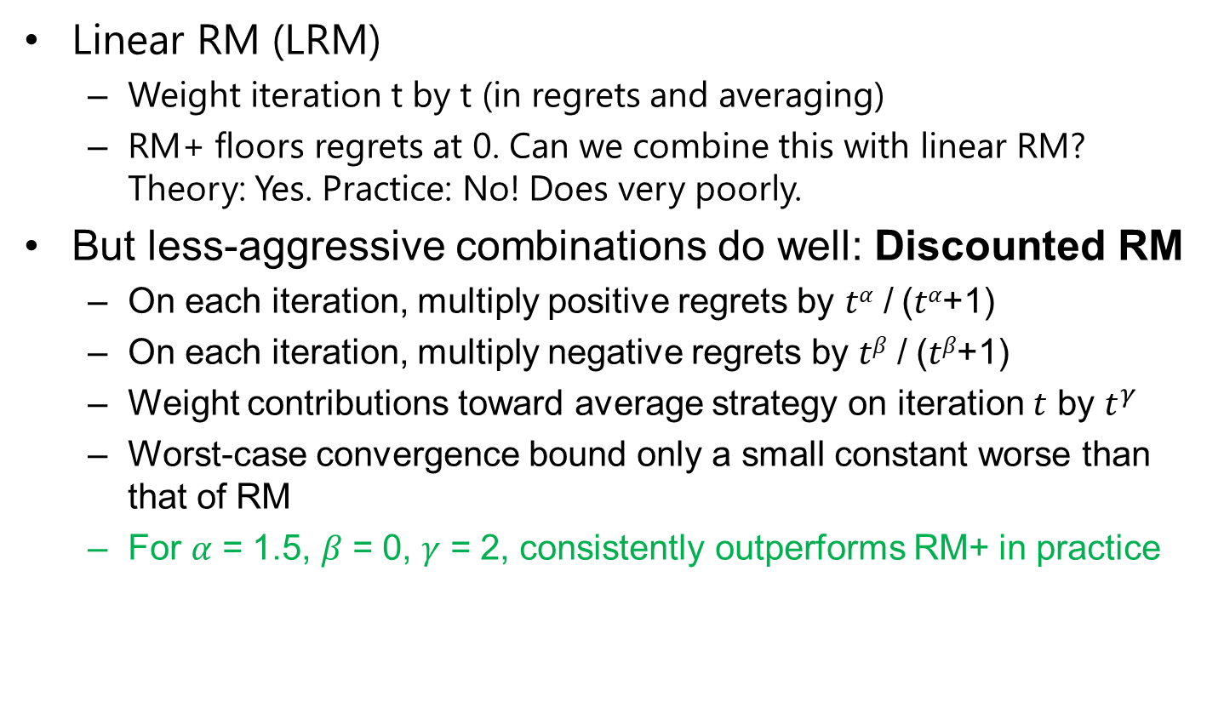
State-of-the-art variant in practice: Discounted RM (DRM)
Linear RM (LRM)
  Weight iteration t by t (in regrets and averaging)
  RM+ floors regrets at 0. Can we combine this with linear RM? Theory: Yes. Practice: No! Does very poorly.
But less-aggressive combinations do well: Discounted RM
  On each iteration, multiply positive regrets by 𝑡^{𝛼} / (𝑡^{𝛼}+1)
  On each iteration, multiply negative regrets by 𝑡^{𝛽} / (𝑡^{𝛽}+1)
  Weight contributions toward average strategy on iteration $t$ by $t^{γ}$
  Worst-case convergence bound only a small constant worse than that of RM
  For 𝛼 = 1.5, 𝛽 = 0, 𝛾 = 2, consistently outperforms RM+ in practice
[Brown & Sandholm, Solving Imperfect-Information Games via Discounted Regret Minimization, AAAI’19]

Slide 13
What Regret Minimizers are Used in Practice?
Multiplicative Weights Update (MWU)
Regret Matching (RM)
& Regret Matching+ (RM+)
✔ Special case of OMD, that works for general convex sets
✔ Widely used & understood
❌ Slow in practice for games
❌ Hyperparameters (stepsize)
✔ Can incorporate optimism
about future losses to
converge faster in 2-player 0-sum
games
❌ Only for simplex domains
❌ Not as well studied
✔ Tuned for game solving
✔ No hyperparameters
✔ Incredibly effective
❓ Unknown… Until recently
✔
🌟Modern variants of this, such as DCFR, are the standard in extensive-form game solving!
[Farina et al., Faster Game Solving via Predictive Blackwell Approachability: Connecting Regret Matching and Mirror Descent, AAAI 2021]

Slide 14
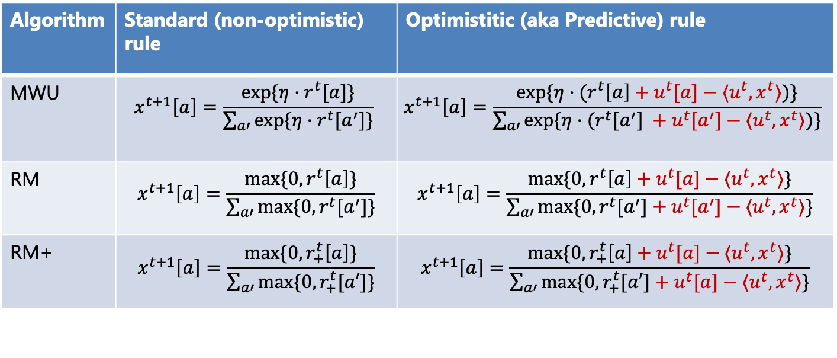
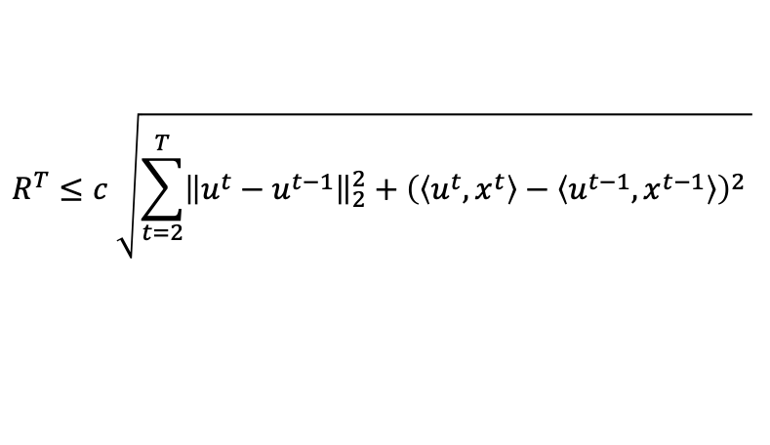
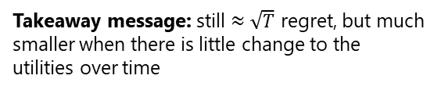
Optimistic regret minimizers
Algorithm | Standard (non-optimistic) rule | Optimistitic (aka Predictive) rule
MWU | $$x^{t+1}\left[a\right]=\frac{\exp{{\{η⋅r}^{t}[a]\}}}{\sum_{a′}{\exp{{\{η⋅r}^{t}[a^{′}]\}}}}$$ | $$x^{t+1}\left[a\right]=\frac{\exp{{\{η⋅(r}^{t}\left[a\right]+u^{t}[a]−⟨u^{t},x^{t}⟩)\}}}{\sum_{a′}{\exp{{\{η⋅(r}^{t}[a^{′}] +u^{t}[a^{′}]−⟨u^{t},x^{t}⟩)\}}}}$$
RM | $$x^{t+1}\left[a\right]=\frac{\max{\{0,}r^{t}\left[a\right]\}}{\sum_{a′}{\max{{\{0, r}^{t}[a^{′}]\}}}}$$ | $$x^{t+1}\left[a\right]=\frac{\max{{\{0,r}^{t}\left[a\right]+u^{t}[a]−⟨u^{t},x^{t}⟩\}}}{\sum_{a′}{\max{{\{0,r}^{t}[a^{′}]+u^{t}[a^{′}]−⟨u^{t},x^{t}⟩\}}}}$$
RM+ | $$x^{t+1}\left[a\right]=\frac{max⁡\{0, r_{+}^{t}\left[a\right]\}}{\sum_{a′}{\max{\{0,r_{+}^{t}[a′]\}}}}$$ | $$x^{t+1}\left[a\right]=\frac{max⁡\{0, r_{+}^{t}\left[a\right]+u^{t}[a]−⟨u^{t},x^{t}⟩\}}{\sum_{a′}{\max{\{0,r_{+}^{t}[a′]+u^{t}[a]−⟨u^{t},x^{t}⟩\}}}}$$
Typically, one-line change in implementation
All of these algorithms guarantee that after seeing any number T of utilities $u^{1}, …, u^{T}$, the regret cumulated by the algorithm satisfies
Remember:
This holds without any assumption about the way the utilities are selected by the environment!
$$R^{T}≤c \sqrt{\sum_{t=2}^{T}{{\left\|u^{t}−u^{t−1}\right\|}_{2}^{2}+{\left(\left\langle u^{t}, x^{t}\right\rangle −\left\langle u^{t−1}, x^{t−1}\right\rangle \right)}^{2} }}$$
Takeaway message: still $≈\sqrt{T}$ regret, but much smaller when there is little change to the utilities over time

Slide 15
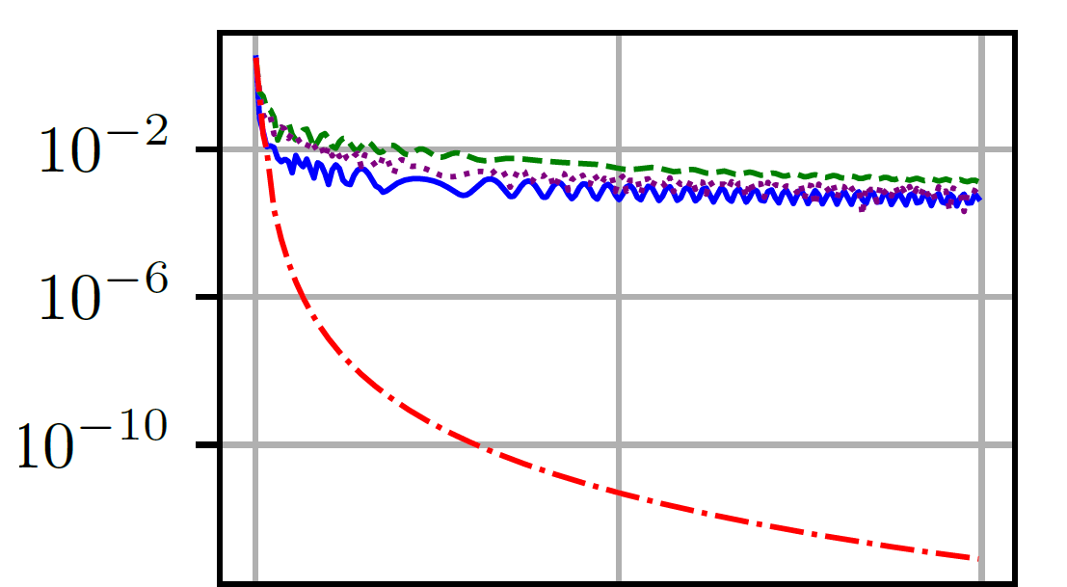
Nash gap / exploitability
Green dashed: Linear RM
Violet dotted: Discounted RM
RM+
Optimistic RM+
Self-play iterations
(RM was omitted as it is typically much slower than RM+)
[Farina, Kroer, and Sandholm; Faster Game Solving via Predictive Blackwell Approachability:
Connecting Regret Matching and Mirror Descent, AAAI’21]

Slide 16
In general, Discounted RM and Optimistic RM+ are the fastest in practice
  For some games, like poker, Discounted RM is empirically consistently faster than Optimistic RM+
  For many other games, Optimistic RM+ is significantly faster
[Farina, Kroer, and Sandholm; Faster Game Solving via Predictive Blackwell Approachability:
Connecting Regret Matching and Mirror Descent, AAAI’21]

Slide 17
We Stand on the Shoulders of Giants
Blackwell Approachability (used in the correctness proof of RM/RM+):
[Blackwell, An analog of the minmax theorem for vector payoffs, Pacific J. of Math. 1956]
Regret Matching and Regret Matching Plus:
[Hart & Mas-Colell, A Simple Adaptive Procedure Leading to Correlated Equilibrium, Econometrica 2000]
[Tammelin, Solving large imperfect information games using CFR+, ArXiv 2014]
[Bowling et al., Heads-up Limit Hold’em Poker is Solved, Science 2015]
Predictivity:
[Chiang et al., Online optimization with gradual variations, COLT 2012]
[Rakhlin & Sridharan, Online Learning with Predictable Sequences, COLT 2013]
[Farina et al., Faster Game Solving via Predictive Blackwell Approachability: Connecting Regret Matching and Mirror Descent, ArXiv 2020]

Slide 18
Part Two
From Normal-Form to Extensive-Form
(Nash Equilibria in Extensive-Form Games)

Slide 19
From Normal-Form to
Extensive-Form Games
Can capture sequential and simultaneous moves
Private information
We assume perfect recall: no player forgets what the player knew earlier
1
Exit
Play
0.5
2
R P S
1
1
1
R P S
R P S
R P S
0 +1 -1
-1 0 +1
+1 -1 0
Notes:
Explain game: it's RPS plus an exit action for Max

Slide 20
Counterfactual Regret Minimization (CFR): The Gist
🌟 IDEA: Run one regret minimizer at each information set!
Question: What utility should we give to each infoset's regret minimizer at each time step?
1
Exit
Play
Attempt 1: Use "Q-values" (conditional values upon reaching the information set)
0.5
2
Problem: Opponent's strategy can change!
R P S
Consider this infoset for P2, and suppose that P1 plays
90% (Exit, Rock)
10% (Play, Paper)
1
1
1
R P S
R P S
R P S
Regret minimizer receiving Q-value losses would play Paper, but it should play Scissors instead.
0 +1 -1
-1 0 +1
+1 -1 0
We should use some sort of "weighted" value!

Slide 21
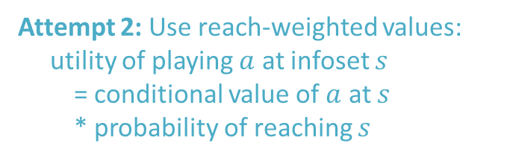
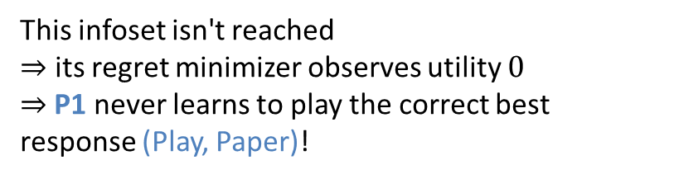

Counterfactual Regret Minimization (CFR): The Gist
🌟 IDEA: Run one regret minimizer at each information set!
Question: What utility should we give to each infoset's regret minimizer at each time step?
1
Exit
Play
Attempt 2: Use reach-weighted values:
utility of playing $a$ at infoset $s$
  = conditional value of $a$ at $s$
  * probability of reaching $s$
0.5
2
R P S
Problem: Our strategy can change before $s$
1
1
1
Suppose that P2 always plays Rock
and P1 is currently playing (Exit, Scissors)
R P S
R P S
R P S
0 +1 -1
-1 0 +1
+1 -1 0
This infoset isn't reached
$⇒$ its regret minimizer observes utility $0$
$⇒$P1 never learns to play the correct best response (Play, Paper)!
(This idea came up on your homework! In the language there, (Exit, Scissors) is locally optimal but not globally optimal.)

Slide 22
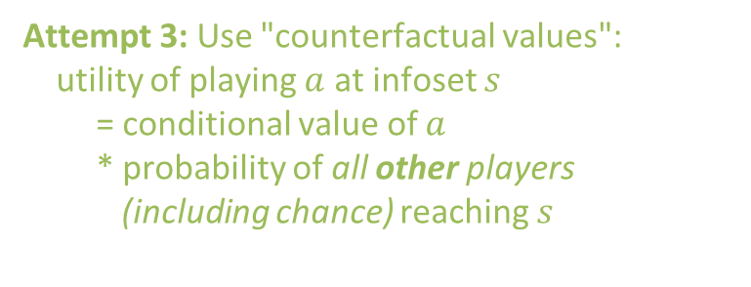
Counterfactual Regret Minimization (CFR): The Gist
🌟 IDEA: Run one regret minimizer at each information set!
Question: What utility should we give to each infoset's regret minimizer at each time step?
1
Exit
Play
Attempt 3: Use "counterfactual values":
utility of playing $a$ at infoset $s$
  = conditional value of $a$
  * probability of all other players
  (including chance) reaching $s$
0.5
2
R P S
1
1
1
🌟 THIS WORKS!
This is the algorithm called counterfactual regret minimization
R P S
R P S
R P S
0 +1 -1
-1 0 +1
+1 -1 0

Slide 23
Now: More details on CFR
Running example for this part: Kuhn poker
C
JQ
QJ
KQ
JK
QK
KJ
1
1
1
1
1
1
check
check
check
check
bet
check
bet
check
bet
bet
bet
bet
2
2
2
2
2
2
2
2
2
2
2
2
check
fold
check
fold
check
fold
check
fold
check
fold
check
fold
bet
bet
bet
bet
call
bet
call
bet
call
call
call
call
+1
+2
+1
-2
+1
1
+1
+2
+1
1
+1
+2
-1
1
+1
-2
-1
1
+1
-2
+1
1
-1
1
fold
fold
fold
fold
fold
fold
call
call
call
call
call
call
-1
+2
-1
-2
-1
-2
-1
+2
-1
-2
-1
+2
⚠️ Information sets for red player (Player 2) are not shown
Notes:
Explain the game!

Slide 24
Two Representations
Decision points
C
Observation points
JQ
QJ
KQ
JK
QK
KJ
1
1
1
1
1
1
Jack
Queen
King
check
check
check
check
bet
check
bet
check
bet
bet
bet
bet
2
2
2
2
2
2
2
2
check
check
check
2
2
2
2
check
fold
bet
bet
bet
check
fold
check
fold
check
fold
check
fold
check
fold
bet
bet
bet
bet
call
bet
call
bet
call
call
call
call
bet
bet
bet
+1
+2
+1
-2
+1
1
+1
+2
+1
1
+1
+2
-1
1
+1
-2
-1
1
+1
-2
+1
1
-1
1
fold
fold
fold
fold
fold
fold
fold
fold
fold
call
call
call
call
call
call
call
call
call
-1
+2
-1
-2
-1
-2
-1
+2
-1
-2
-1
+2
Game tree
Each node belongs to a specific player or chance
Tree-Form (Sequential) Decision Problem
aka. sequence-form decision problem
aka. treeplex
(for P1)
Represents the game from viewpoint of one player
This is the representation in regret minimization

Slide 25
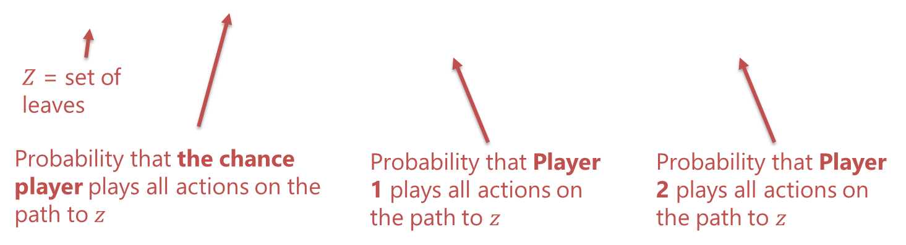
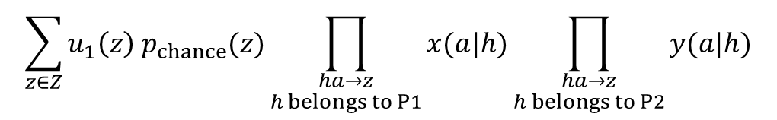
Strategies
🌟 First attempt:
Assign local probabilities at each decision point
Jack
Queen
King
check
check
check
✔ Set of strategies is convex
❌ Expected utility of game is
not bilinear
bet
bet
bet
0.1
0.9
0.5
0.5
0.75
0.25
bet
bet
bet
fold
fold
call
fold
0.8
call
0.2
0.4
0.6
0.1
call
0.9
$$\sum_{z∈Z}{u_{1}\left(z\right) p_{chance}(z)\prod_{\begin{aligned}ha→z \\ h belongs to P1\end{aligned}}{x(a|h)}\prod_{\begin{aligned}ha→z \\ h belongs to P2\end{aligned}}{y(a|h)}}$$

Slide 26
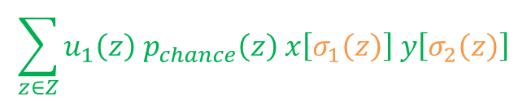
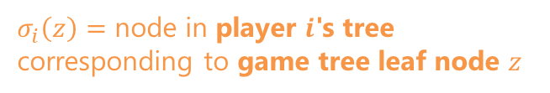
Sequence-Form Strategies
🌟 Second attempt:
Store probabilities for whole sequences of actions
Jack
Queen
King
0.1
0.9
0.5
0.5
0.75
0.25
✔ Set of strategies is convex
✔ Expected utility of game is
bilinear
check
check
check
0.1
0.5
0.5
0.75
0.25
0.9
bet
bet
bet
bet
bet
bet
0.8
0.2
0.4
0.6
0.1
0.9
fold
0.02
fold
0.3
fold
0.08
call
0.2
call
0.075
call
0.675
$$\sum_{z∈Z}{u_{1}\left(z\right) p_{chance}\left(z\right) x\left[σ_{1}\left(z\right)\right] y\left[σ_{2}\left(z\right)\right]}$$
$σ_{i}\left(z\right)=$ node in player $i$'s tree corresponding to game tree leaf node $z$
[Romanovskii, Reduction of a game with complete memory to a matrix game, 1961]
[Koller et al., Fast algorithms for finding randomized strategies in game trees, STOC 1994]

Slide 27

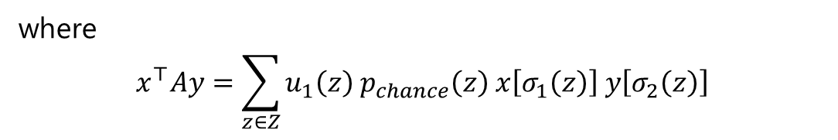
Sequence-Form Strategies
🌟 Consequence: a lot of results carry over from normal form games when using sequence-form strategies!
✔ Nash equilibrium is a bilinear saddle point problem
$$\min_{x∈X}\max_{y∈Y}{x^{⊤}Ay}$$
where
$$x^{⊤}Ay=\sum_{z∈Z}{u_{1}\left(z\right) p_{chance}\left(z\right) x\left[σ_{1}\left(z\right)\right] y\left[σ_{2}\left(z\right)\right]}$$
✔ As long as we can construct regret minimizers for the sets of
sequence-form strategies, we can use them to converge to
Nash equilibrium in self play

Slide 28
Sequence-Form Strategies
🌟 Consequence: a lot of results carry over from normal form games when using sequence-form strategies!
✔ Nash equilibrium is a bilinear saddle point problem
$$\min_{x∈X}\max_{y∈Y}{x^{⊤}Ay}$$
where
$$x^{⊤}Ay=\sum_{z∈Z}{u_{1}\left(z\right) p_{chance}\left(z\right) x\left[σ_{1}\left(z\right)\right] y\left[σ_{2}\left(z\right)\right]}$$
Aside: The above saddle-point problem can be written as a linear program by dualizing the inner minimization, and the LP can then be solved using standard LP solvers. This is a polynomial-time algorithm for solving extensive-form games. Our focus today is on regret minimization, which turns out to be faster on large games than linear programs in practice.

Slide 29
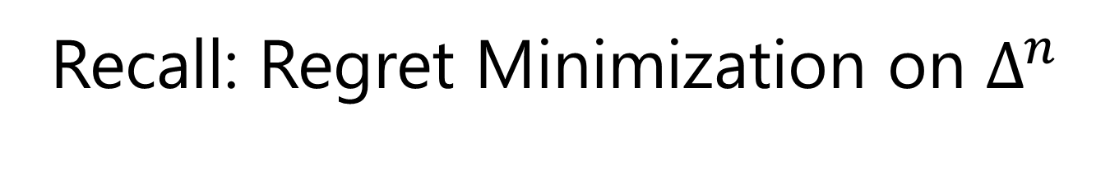
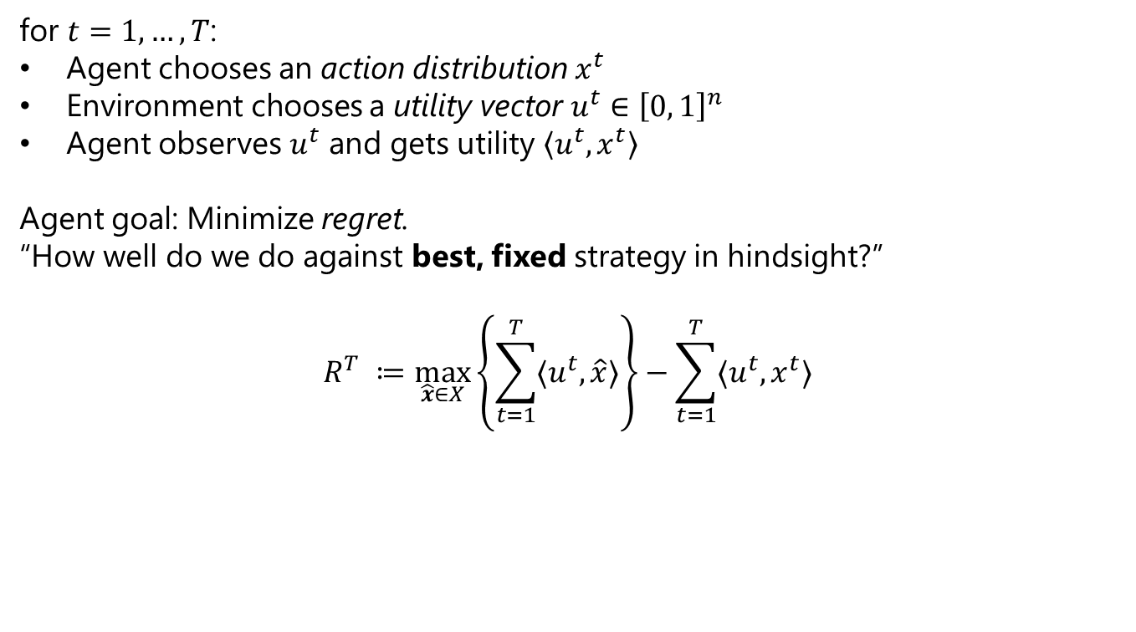
Recall: Regret Minimization on $Δ^{n}$
for $t=1,…,T$:
Agent chooses an action distribution $x^{t}$
Environment chooses a utility vector $u^{t}∈{\left[0, 1\right]}^{n}$
Agent observes $u^{t}$ and gets utility $\left\langle u^{t},x^{t}\right\rangle$
Agent goal: Minimize regret.
“How well do we do against best, fixed strategy in hindsight?”
$$R^{T} ≔\max_{\hat{x}∈X}\left\{\sum_{t=1}^{T}{{〈u}^{t},\hat{x}〉}\right\}−\sum_{t=1}^{T}{{〈u}^{t},x^{t}〉 }$$
Maximum utility that was
achievable by the best fixed
action in hindsight
Utility that was actually accumulated

Slide 30
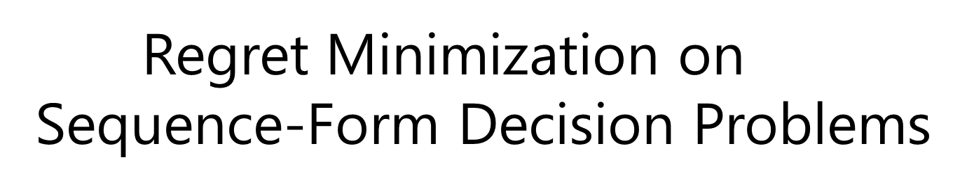
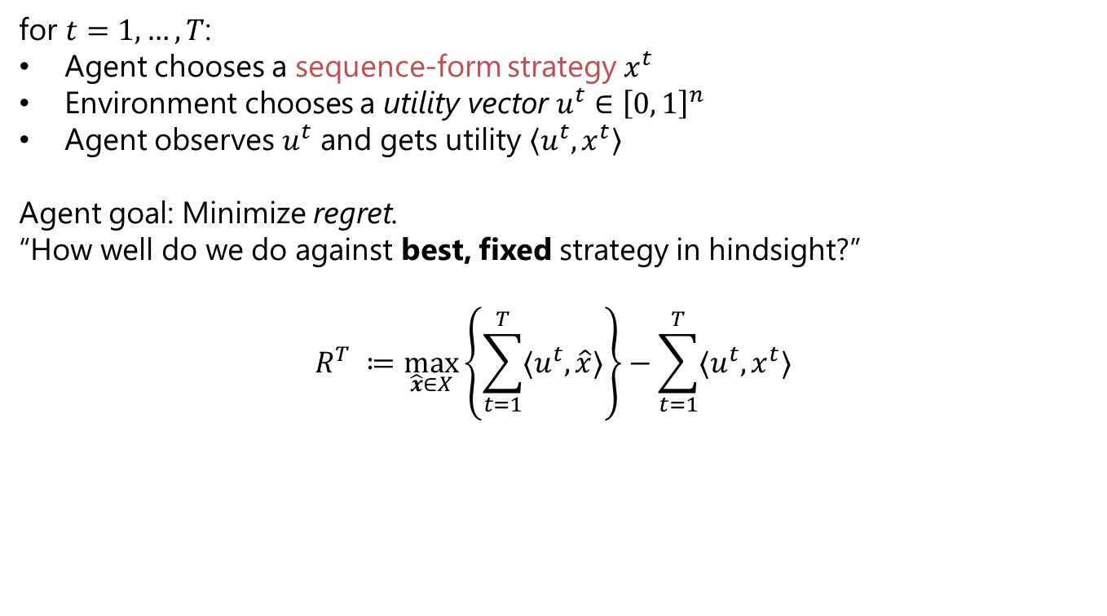
Regret Minimization on $Δ^{n}$
Sequence-Form Decision Problems
for $t=1,…,T$:
Agent chooses a sequence-form strategy $x^{t}$
Environment chooses a utility vector $u^{t}∈{\left[0, 1\right]}^{n}$
Agent observes $u^{t}$ and gets utility $\left\langle u^{t},x^{t}\right\rangle$
Agent goal: Minimize regret.
“How well do we do against best, fixed strategy in hindsight?”
$$R^{T} ≔\max_{\hat{x}∈X}\left\{\sum_{t=1}^{T}{{〈u}^{t},\hat{x}〉}\right\}−\sum_{t=1}^{T}{{〈u}^{t},x^{t}〉 }$$
Maximum utility that was
achievable by the best fixed
action in hindsight
Utility that was actually accumulated
  If we can do regret minimization for sequence-form strategy spaces,
  then we can solve zero-sum extensive-form games!

Slide 31
Counterfactual Regret Minimization
🌟 IDEA: Run one regret minimizer at each decision point!
Each decision point's regret minimizer treats all other decision points below itself as part of the environment
Jack
Queen
King
check
bet
check
bet
check
bet
bet
bet
bet
fold
call
fold
call
fold
call

Slide 32
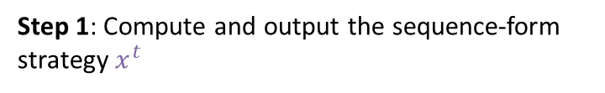
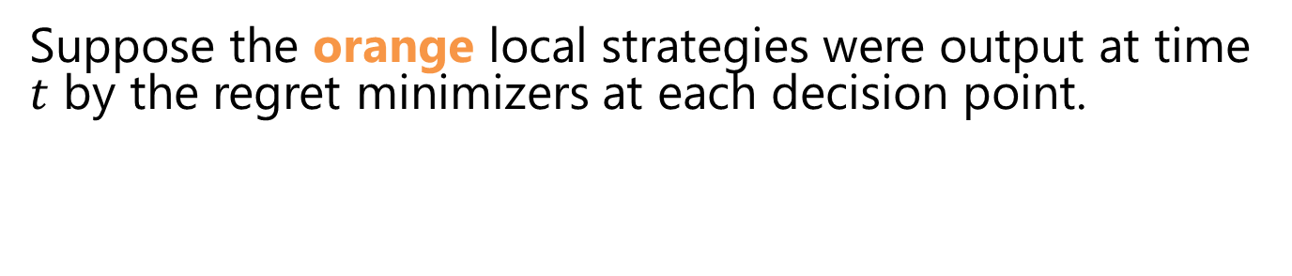
Counterfactual Regret Minimization
Suppose the orange local strategies were output at time $t$ by the regret minimizers at each decision point.
.
Step 1: Compute and output the sequence-form strategy $x^{t}$
1.0
Jack
Queen
King
check
check
check
0.1
0.1
bet
0.5
0.5
bet
0.75
0.75
bet
0.9
0.9
0.5
0.5
0.25
0.25
bet
bet
bet
fold
call
fold
call
fold
call
0.8
0.08
0.2
0.02
0.4
0.2
0.6
0.3
0.1
0.075
0.9
0.675

Slide 33
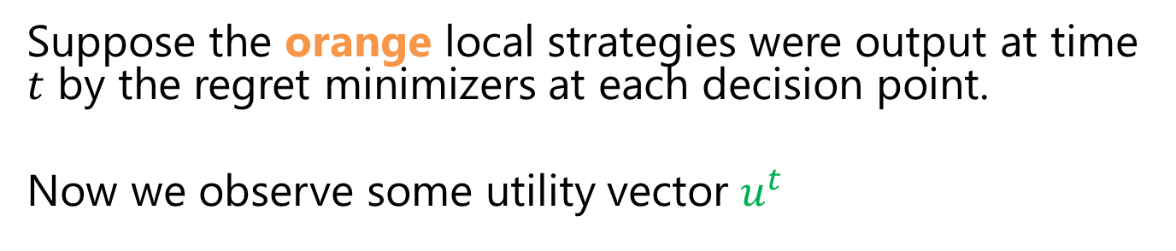
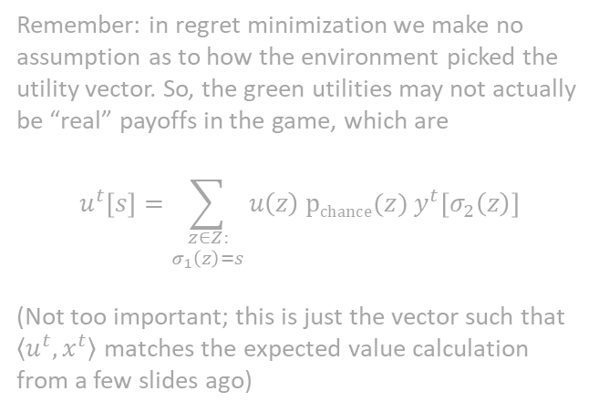
Counterfactual Regret Minimization
Suppose the orange local strategies were output at time $t$ by the regret minimizers at each decision point.
Now we observe some utility vector $u^{t}$
0.0
Jack
Queen
King
Remember: in regret minimization we make no assumption as to how the environment picked the utility vector. So, the green utilities may not actually be “real” payoffs in the game, which are
$$u^{t}\left[s\right]=\sum_{\begin{aligned}z∈Z: \\ σ_{1}\left(z\right)=s\end{aligned}}{u\left(z\right) pchance(z) y^{t}\left[σ_{2}\left(z\right)\right]}$$
(Not too important; this is just the vector such that $\left\langle u^{t},x^{t}\right\rangle$ matches the expected value calculation from a few slides ago)
check
check
check
0.1
2.0
bet
0.5
0.0
bet
0.75
1.0
bet
0.9
-1.5
0.5
-0.4
0.25
0.0
bet
bet
bet
fold
call
fold
call
fold
call
0.8
1.2
0.2
-0.6
0.4
-0.5
0.6
1.1
0.1
-2.5
0.9
1.6

Slide 34

Counterfactual Regret Minimization
Suppose the orange local strategies were output at time $t$ by the regret minimizers at each decision point.
Now we observe some utility vector $u^{t}$
Step 2: Compute counterfactual utilities
At observation points and leaves:
counterfactual utility =
sum of counterfactual utilities of children +
utility value given at that observation point
At decision points:
counterfactual utility =
expected counterfactual utility of children
under local strategy at that decision point
0.0
Jack
Queen
King
check
check
check
0.1
2.0
bet
0.5
0.0
bet
0.75
1.0
bet
0.9
-1.5
0.5
-0.4
0.25
0.0
bet
bet
bet
fold
call
fold
call
fold
call
0.8
1.2
0.2
-0.6
0.4
-0.5
0.6
1.1
0.1
-2.5
0.9
1.6

Slide 35
Counterfactual Regret Minimization
Suppose the orange local strategies were output at time $t$ by the regret minimizers at each decision point.
Now we observe some utility vector $u^{t}$
Step 2: Compute counterfactual utilities
At observation points and leaves:
counterfactual utility =
sum of counterfactual utilities of children +
utility value given at that observation point
At decision points:
counterfactual utility =
expected counterfactual utility of children
under local strategy at that decision point
0.0
0.6065
Jack
Queen
King
-1.066
0.03
1.6425
check
check
check
0.1
2.0
2.84
bet
0.5
0.0
0.46
bet
0.75
1.0
2.19
bet
0.9
-1.5
-1.5
0.5
-0.4
-0.4
0.25
0.0
0.0
bet
bet
bet
0.84
0.46
1.19
fold
call
fold
call
fold
call
0.8
1.2
1.2
0.2
-0.6
-0.6
0.4
-0.5
-0.5
0.6
1.1
1.1
0.1
-2.5
-2.5
0.9
1.6
1.6

Slide 36
Counterfactual Regret Minimization
Suppose the orange local strategies were output at time $t$ by the regret minimizers at each decision point.
Now we observe some utility vector $u^{t}$
0.0
0.6065
Step 2: Feed the counterfactual utilities to the regret minimizers at each decision point
Note: Steps 1 & 2 can be done in a single bottom-up pass
Remember: this will work no matter the choice of regret minimizers (MWU, RM, RM+, Discounted RM, Optimistic RM+, etc). We can also use different regret minimizers at different nodes, unlike the original CFR paper, which used RM
Jack
Queen
King
-1.066
0.03
1.6425
check
check
check
0.1
2.0
2.84
bet
0.5
0.0
0.46
bet
0.75
1.0
2.19
bet
0.9
-1.5
-1.5
0.5
-0.4
-0.4
0.25
0.0
0.0
bet
bet
bet
0.84
0.46
1.19
fold
call
fold
call
fold
call
0.8
1.2
1.2
0.2
-0.6
-0.6
0.4
-0.5
-0.5
0.6
1.1
1.1
0.1
-2.5
-2.5
0.9
1.6
1.6

Slide 37
Counterfactual Regret Minimization
Suppose the orange local strategies were output at time $t$ by the regret minimizers at each decision point.
Now we observe some utility vector $u^{t}$
0.0
0.6065
Step 2: Feed the counterfactual utilities to the regret minimizers at each decision point
Jack
Queen
King
-1.066
0.03
1.6425
Example:
Feed utilities (2.19, 0) to the regret minimizer for this decision point
check
check
check
0.1
2.0
2.84
bet
0.5
0.0
0.46
bet
0.75
1.0
2.19
bet
0.9
-1.5
-1.5
0.5
-0.4
-0.4
0.25
0.0
0.0
bet
bet
bet
0.84
0.46
1.19
fold
call
fold
call
fold
call
0.8
1.2
1.2
0.2
-0.6
-0.6
0.4
-0.5
-0.5
0.6
1.1
1.1
0.1
-2.5
-2.5
0.9
1.6
1.6

Slide 38
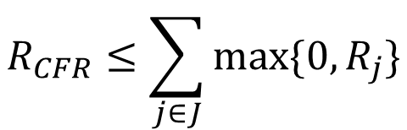
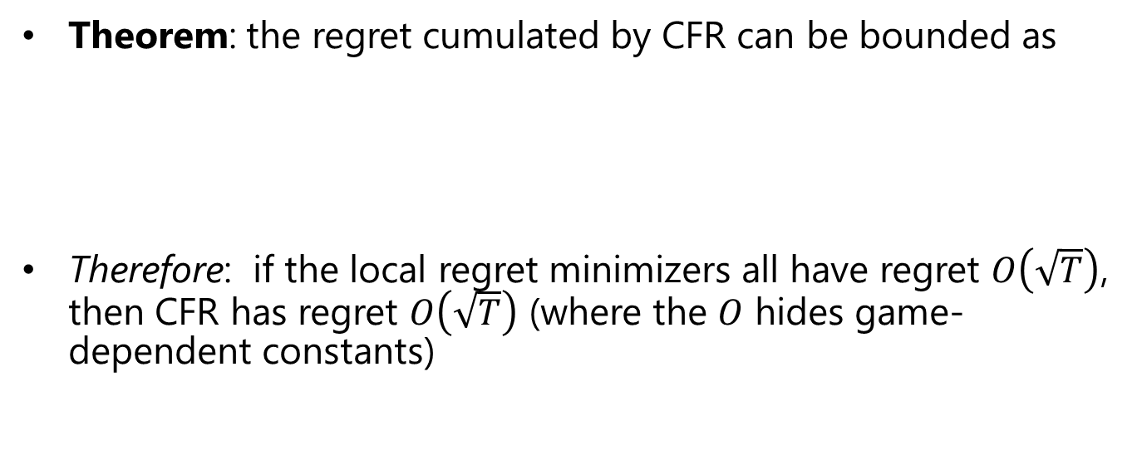
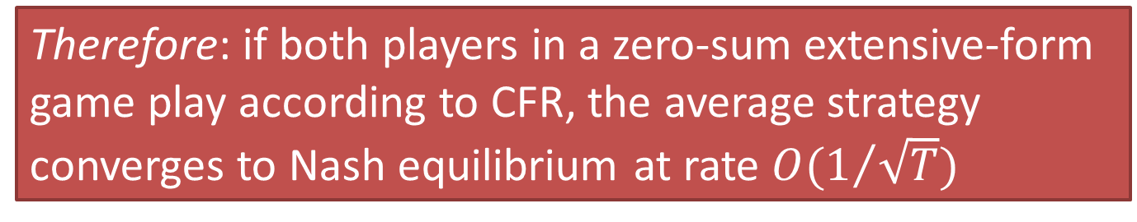
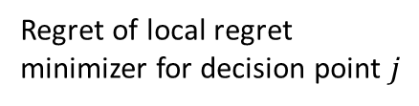
CFR Guarantees
Theorem: the regret cumulated by CFR can be bounded as
Therefore: if the local regret minimizers all have regret $O\left(\sqrt{T}\right)$, then CFR has regret $O\left(\sqrt{T}\right)$ (where the $O$ hides game-dependent constants)
$$R_{CFR}≤\sum_{j∈J}{\max{\{0, R_{j}\}}}$$
Regret of local regret
minimizer for decision point $j$
Decision points
Therefore: if both players in a zero-sum extensive-form game play according to CFR, the average strategy converges to Nash equilibrium at rate $O(1/{\sqrt{T}})$
[Farina, Kroer & Sandholm, Regret Circuits: Composability of Regret Minimizers, ICML 2019]

Slide 39
CFR in Self-Play on a Game Tree
When putting together all the pieces of the puzzle [*** TODO: CFR in self-play***], this is what an iteration of the CFR algorithm looks like
[*** TODO: VIZ ***]

Slide 40
Why is CFR Superior in Practice?
🌟 … to second-order methods (which can offer convergence rate 1/e^{T} )?
  Does not require solving large linear systems
  Second-order methods (interior point, …) don’t fit in memory for large games
🌟 … to general-purpose regret minimizers (FTRL & OMD)?
  CFR uses an approach local to each decision point (easier to parallelize, warm-start, etc.)
    [Brown & Sandholm, Reduced Space and Faster Convergence in Imperfect-Information Games via Pruning. ICML-17]
    [Brown & Sandholm, Strategy-based warm starting for regret minimization in games, AAAI 2016]
  No need for expensive projections onto feasible strategy polytope (think projected gradient descent)

Slide 41
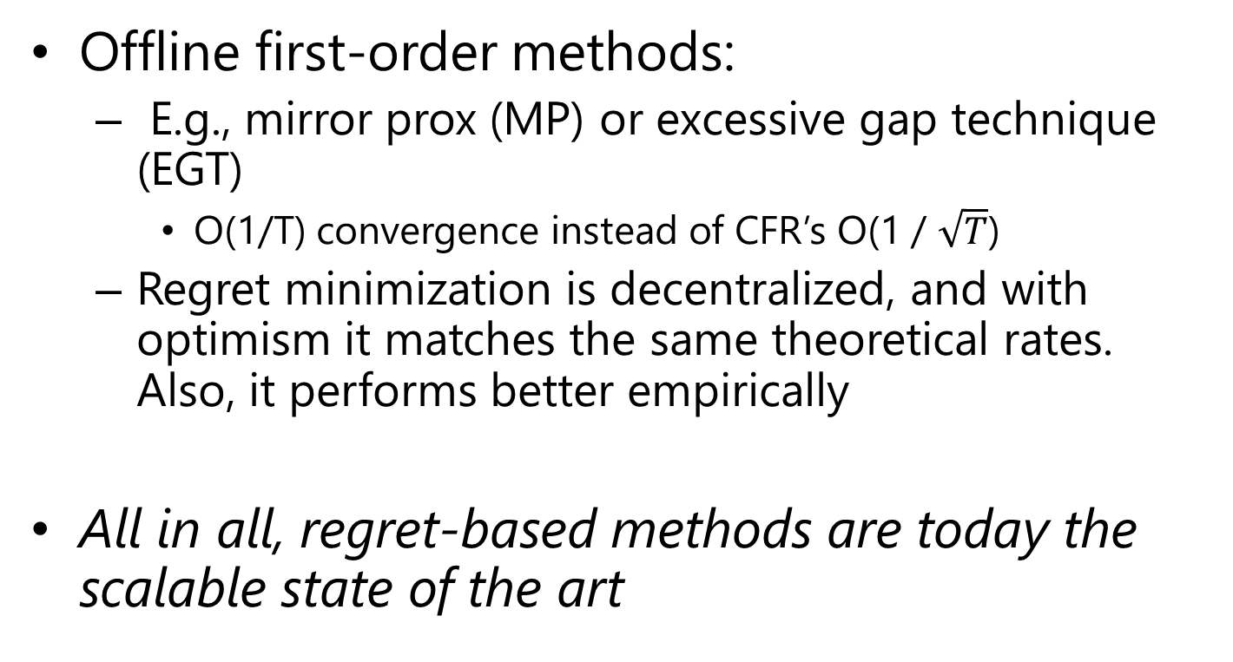
Other approaches
Offline first-order methods:
  E.g., mirror prox (MP) or excessive gap technique (EGT)
    O(1/T) convergence instead of CFR’s O(1 / $\sqrt{T}$)
  Regret minimization is decentralized, and with optimism it matches the same theoretical rates. Also, it performs better empirically
All in all, regret-based methods are today the scalable state of the art

Slide 42
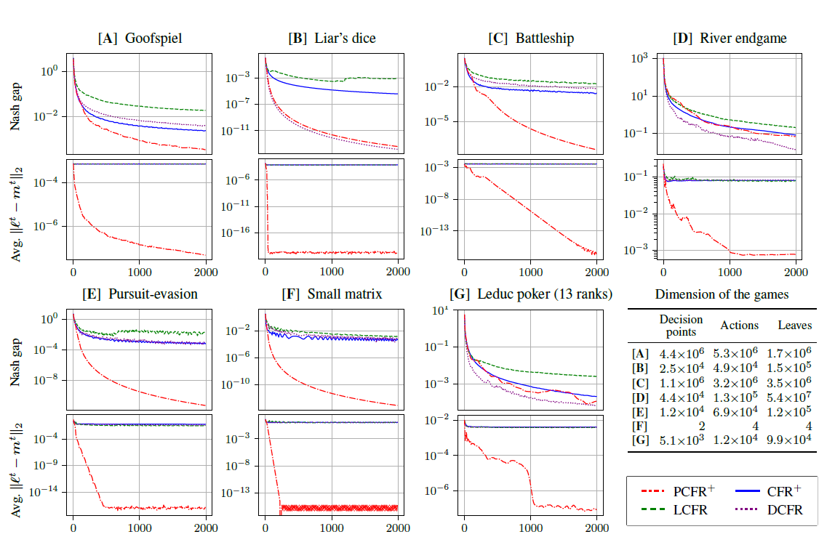
CFR Framework + Predictivity

Slide 43
Important Takeaways
🌟You can construct a regret minimizer for
sequential decision making problems by
combining regret minimizers for individual
decision points
  Improvements on simplex domains carry over to
  extensive-form domains!
🌟Predictivity works well also in extensive-form
domains

Slide 44
Techniques to Further Increase Scalability of CFR
Using utility estimators
  Similar idea as stochastic gradient descent vs gradient descent
  Instead of exactly computing the green numbers (gradients of the utility function), we use cheap unbiased estimators
  Popular estimator: sample a trajectory in the game tree and use importance sampling
  “Monte Carlo CFR” [Monte Carlo Sampling for Regret Minimization in Extensive Games; Lanctot, Waugh, Zinkevich, Bowling NIPS 2009]
  Even better algorithm, ESCHER, does not use importance sampling [McAleer, Farina, Lanctot & Sandholm ICLR-23]

Slide 45
Techniques to Further Increase Scalability of CFR
Temporary pruning
  Idea: During CFR traversals,
      Prune actions (and their subtrees) that have negative cumulative regret
      Project in how many iterations at the earliest the cumulative regret can turn positive, and catch up that subtree’s iterates then
        Cath up as if we had played a best response throughout the CFR iterations to the opponent’s average strategy in that subtree
        If the regret is still negative, re-project, etc.
  Can be implemented without storing the pruned subtrees => space advantage
  Theorem. In a zero-sum game, if both players choose
  strategies according to CFR with this kind of pruning, conducting T iterations traverses only
  O(|S|T + |H| ln(T)) nodes
All game paths (i.e., information sets)
Game paths that are part of some best response to some equilibrium
[Brown & Sandholm, Reduced Space and Faster Convergence in Imperfect-Information Games via Pruning. ICML-17]

Slide 46
Techniques to Further Increase Scalability of CFR
Sparsification
  Idea: compute a low-rank factorization of the payoff matrix of the game
  For some games, a low-rank factorization is guaranteed to exist, and can dramatically speed up the algorithms
[Zhang & Sandholm, Sparsified linear programming for zero-sum equilibrium finding. ICML 2020]
[Farina & Sandholm, Fast Payoff Matrix Sparsification Techniques for Structured Extensive-Form Games. AAAI 2022]

Slide 47
Bibliographic Remarks
Regret Circuits:
[Farina et al., Online convex optimization for sequential decision processes and extensive-form games, AAAI 2019]
[Farina et al., Regret Circuits: Composability of Regret Minimizers, ICML 2019]
  - Note: we also consider more convexity-preserving operations than just convex hulls & Cartesian products

