Slide 1
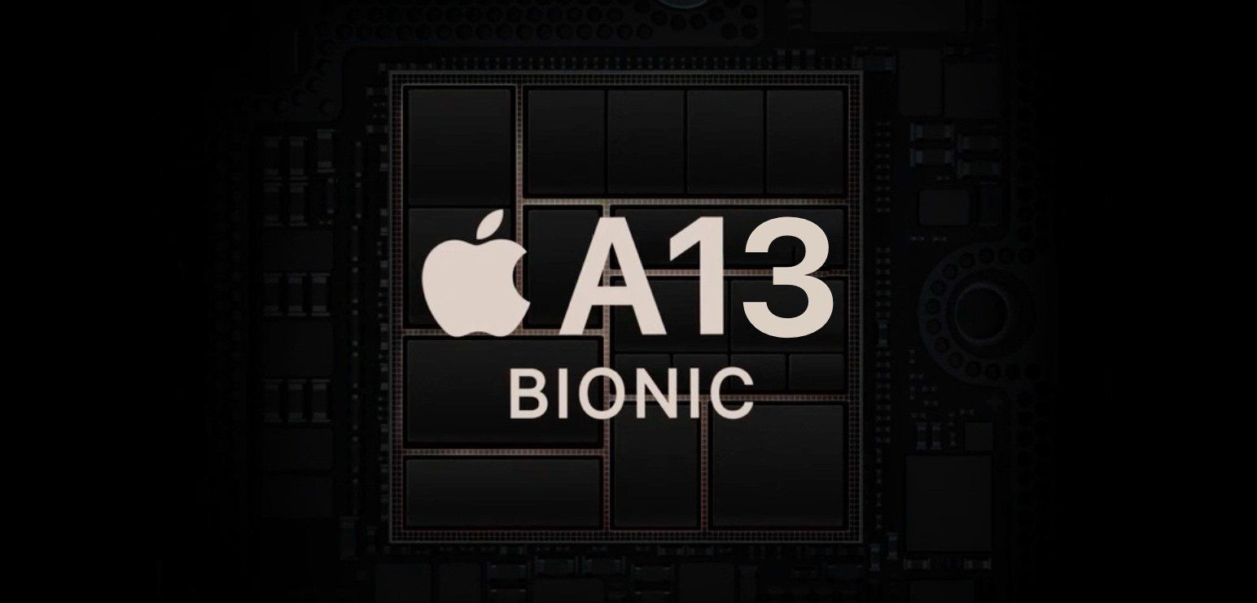
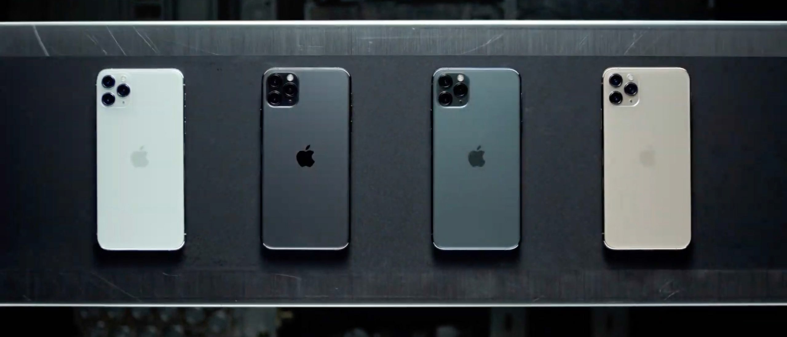
“The most powerful chip ever in a smartphone”

Slide 2
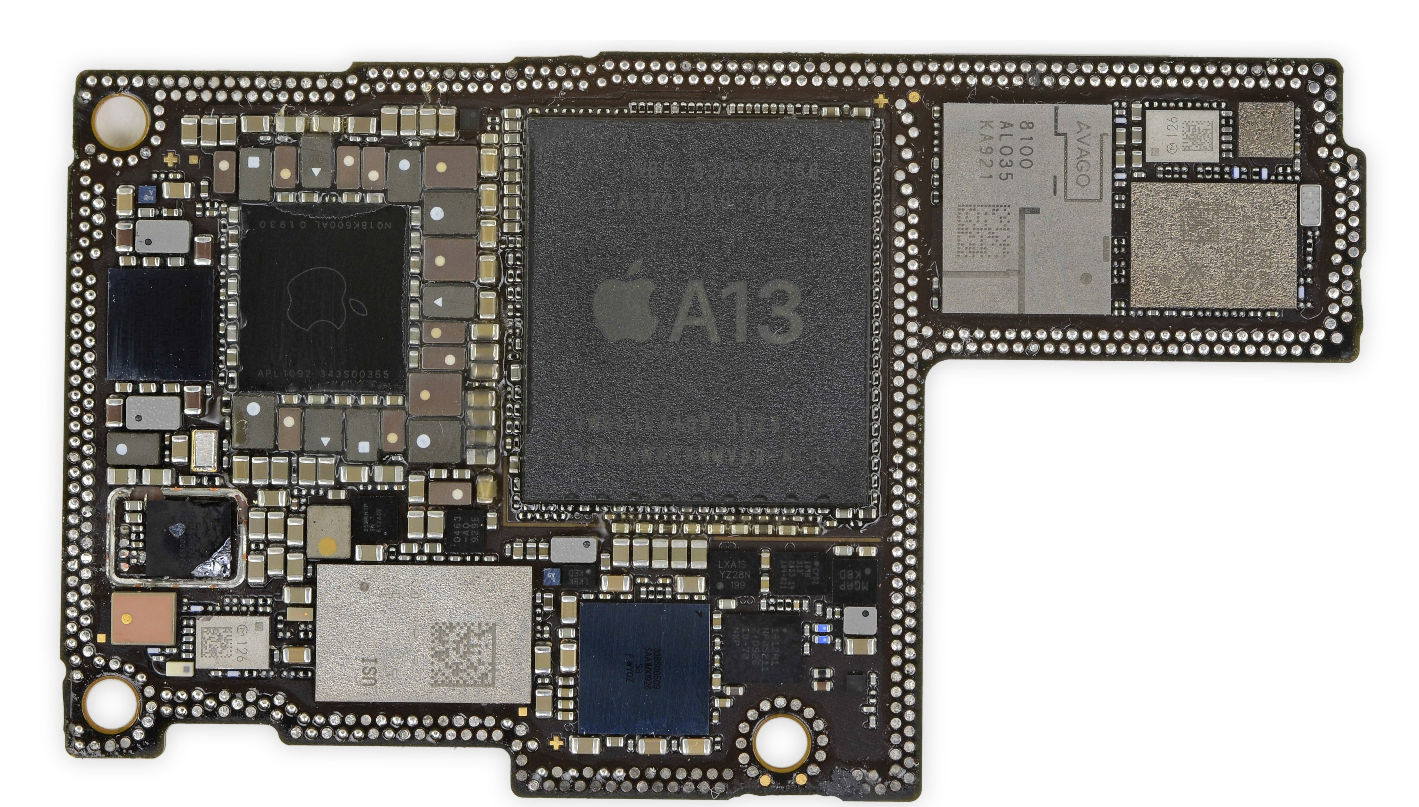
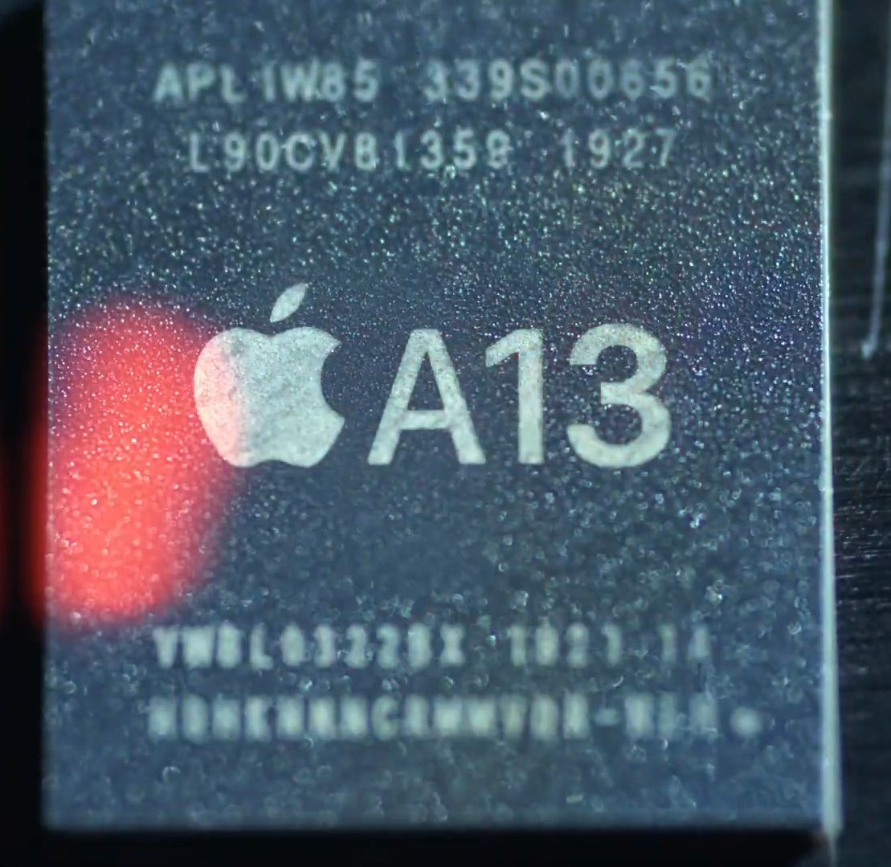
Manufacturing
A13 BIONIC
▸
System on Chip, designed by Apple
▸
Manufactured by Taiwan Semiconductor Manufacturing Company (TSMC)
▸
7nm FinFet technology
▸
How much transistors?

Slide 3
Manufacturing
A13 BIONIC
▸
System on Chip, designed by Apple
▸
Manufactured by Taiwan Semiconductor Manufacturing Company (TSMC)
▸
7nm FinFet technology
▸
How much transistors?
▸ 8.5 BILLION

Slide 4
Technical Characteristics
A13 BIONIC
▸
Architecture: 64-bit ARMv8.3-A (RISC = lower cost, energy consumption and heat dissipation)
▸
6-core CPU (fastest ever!)
▸
4 energy-efficient cores (Thunder) for basic operations
▸
2 high-performance cores (Lightning) at 2.65 GHz (4K video, gaming)
▸
4-core GPU (fastest ever!)
▸
8-core Neural Engine (a custom block of silicon separate from the CPU and GPU, focused on accelerating Machine Learning computations, ex. Face ID, Animoji)
▸
CPU features 2 Machine Learning Accelerators (processors for artificial intelligence applications), thus CPU is capable of executing 1 trillion ops/sec
▸
Machine Learning Controller chooses between CPU, GPU, NE for balancing power efficiency and performance

Slide 5
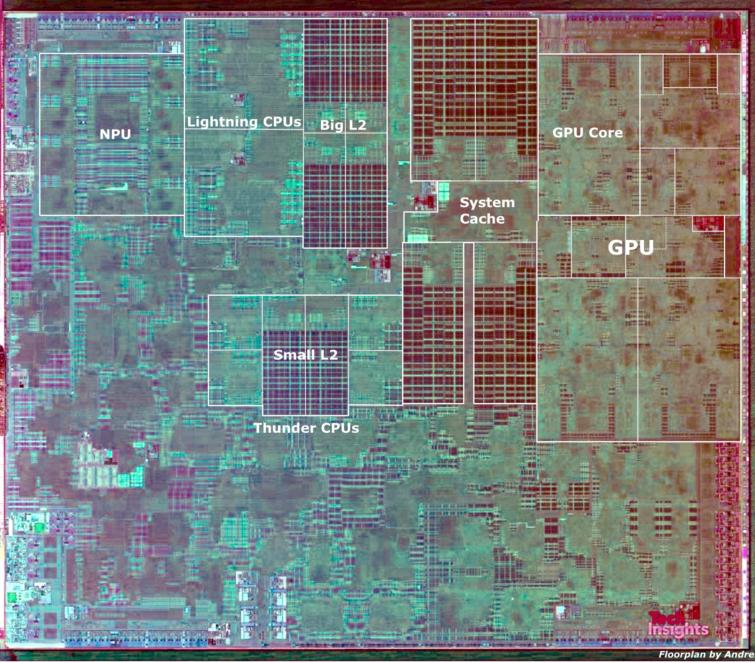
It’s all about the die…

Slide 6
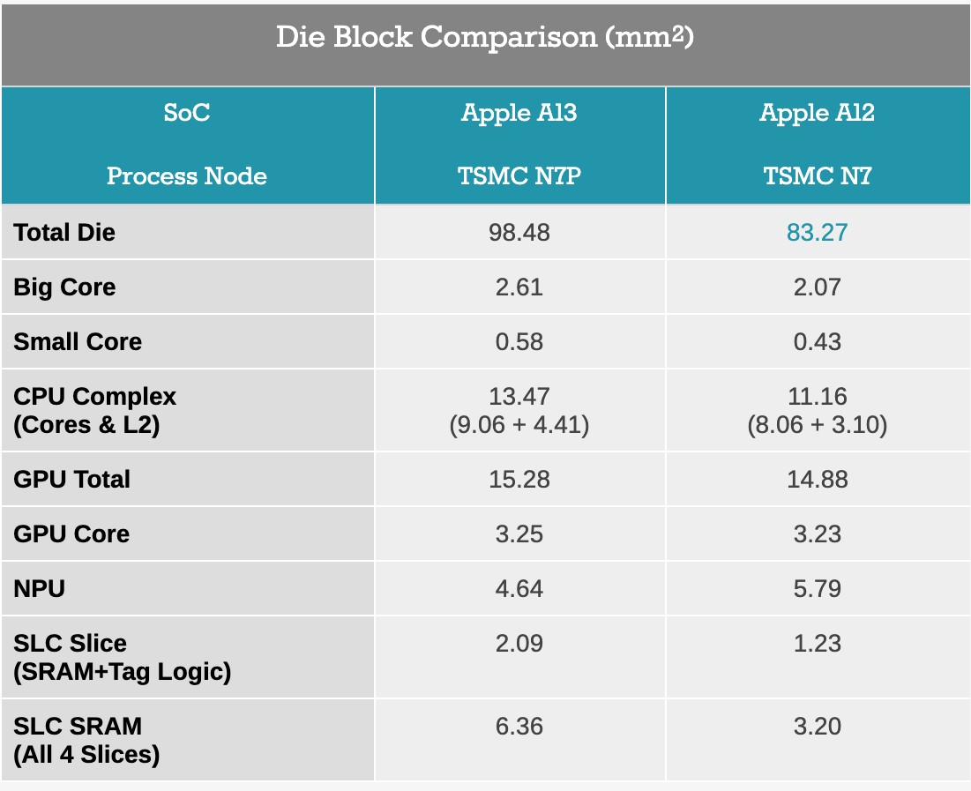
Physical layer comparison (A13 vs A12)
A13 BIONIC
Same technology with more capabilities leads to a small increase of dimensions

Slide 7
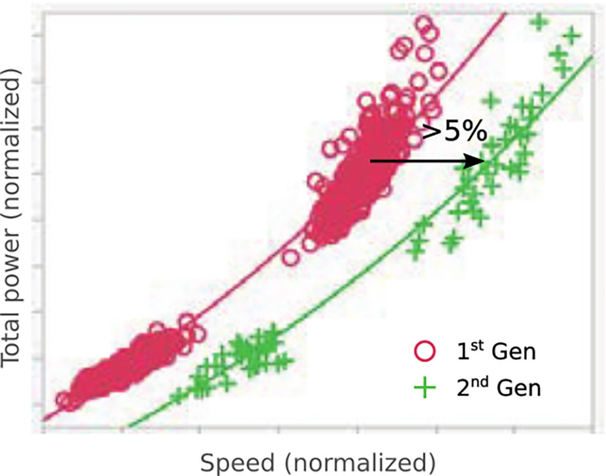
A step up (not a massive one) from A12 Bionic (iPhone XS)
ΚΕΙΜΕΝΟ
▸
2nd generation of 7nm technology (7NP) means smaller, more tightly packed transistors that leak less power thus, less power draw at the same clock speeds.

Slide 8
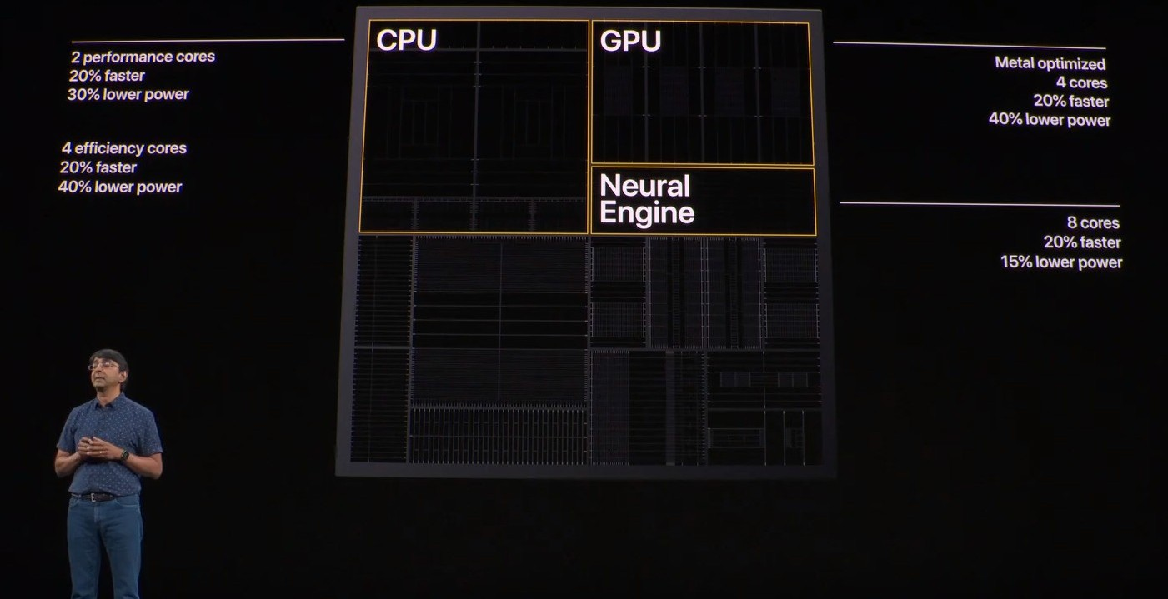
A13 BIONIC
A step up (not a massive one) from A12 Bionic (iPhone XS)
▸
1.6 billion transistors more
▸
30% more efficient which led to 4 hours extra battery life
▸
AMX blocks (MLA) is a new built specific-hardware inside the CPU that is 6x times faster in matrix multiplication than the CPU alone.

Slide 9
How is possible that A13 is 6x times faster than A12 when seemingly are the same chips?
The answer is optimisation and efficiency
The new chip is smarter and faster and yet it somehow manages to consume less power than its predecessor.

Slide 10
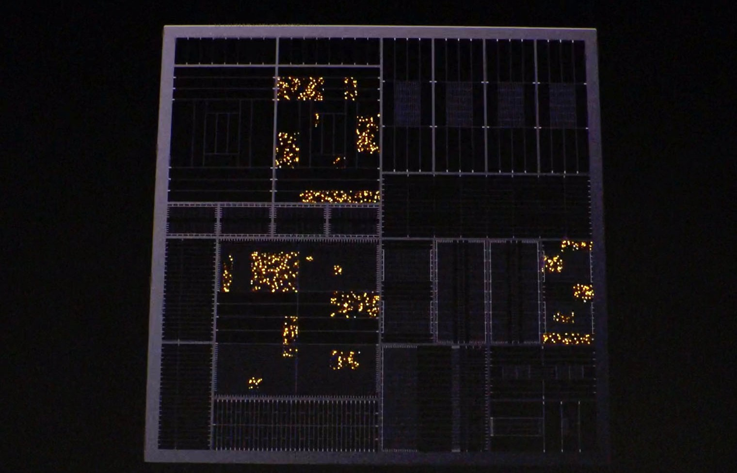
A13 BIONIC
Power Efficiency
▸
A13 Bionic is the most power efficient chip it’s ever made.
▸
Apple’s chip engineers managed to squeeze more Performance per Watt out of the chip
▸
It has hundreds of voltage gates that can shut off power to major parts of the chip when not in use and hundreds of thousands of clock gates which disable logic gates that aren’t in use.

Slide 11
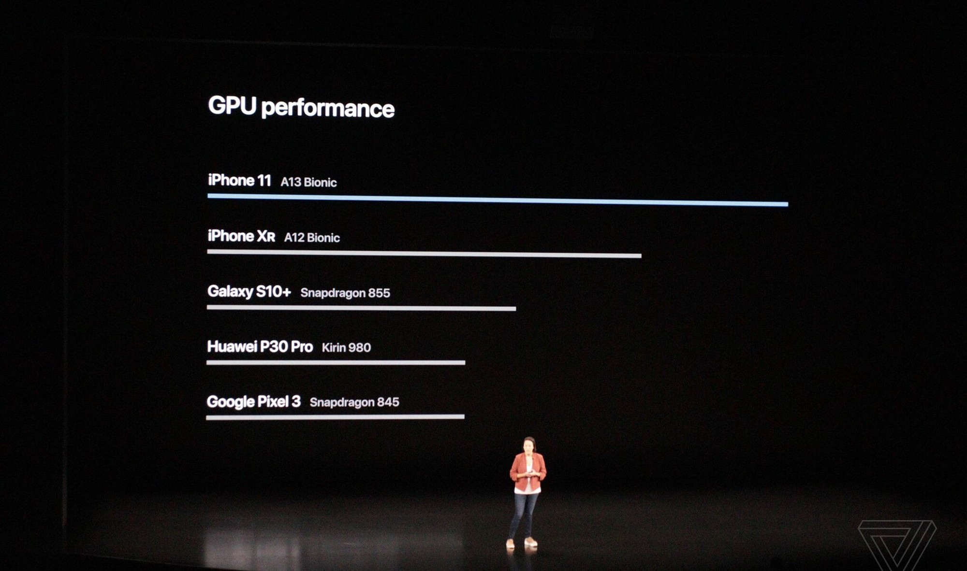
A13 BIONIC
Competition
▸
Samsung (Exynos 9825): 2 high-performance cores at 2.73GHz, 2 cores at 2.4 GHZ and 4 efficiency- focused cores at 1.9 GHz
▸
Huawei (Kirin 990 5G): 2 high-performance cores at 2.86 GHz, 2 two-cores at 2.35 GHz and 4 efficiency- focused cores at 1.95 GHz. 16-core GPU and neural engine with 3 cores. Contains 10.3 billion transistors.
Do these chips perform better than A13?

Slide 12
Lead over the competition
A13 BIONIC
▸
There may be one particular metric (some benchmarks) by which competing chips are faster, but nobody comes close to the intersection of CPU, GPU, and ML performance (the reality is that we hardly use the entire capacity of the chips)
▸
Although Apple's cores aren't the biggest, they continue to lead in mobile performance
▸
The two big processors on A13 easily outperform its rivals’ designs.
▸
Apple’s processors consume power more efficiently
What is the real advantage of Apple?
Tight integration into the device
Development strategy for squeezing more runtime out of its batteries Boosting the performance of key apps.

Slide 13
Tight integration into the device
A13 BIONIC
Real advantage over competitors comes from owning the entire vertical stack: the software, the system hardware, and the chip design
▸
Apple’s tight integration between its hardware and software still give it the edge when it comes to performance
▸
Apple’s secret lies in the way all of these various parts of the chip work together in a way that conserves battery power
▸
Example:
If a developer working on the iPhone's camera software sees a lot of utilization of the GPU, then he can work with a GPU architect to figure out a better way of doing things

Slide 14
Boosting the performance of key apps
A13 BIONIC
▸
Example:
The CPU team will study how applications are being used on iOS and then use the data to optimise future CPU designs. Thus, the next device will be better at doing the things that most people do on their iPhones.
▸
For applications that don't need the additional performance, you can run at the performance of last year's and just do it at a much lower power
▸
As we tap and swipe, Apple’s engineers are paying attention, retooling their designs, and working on a chip for next year that will entice us to upgrade all over again.

Slide 15
"Steve came to the conclusion that the only way for Apple to really differentiate and deliver something truly unique and truly great, you have to own your own silicon”
Johny Srouji, Senior VP, Hardware technologies
https://www.wired.com/story/apple-a13-bionic-chip-iphone/
https://www.anandtech.com/show/14892/the-apple-iphone-11-pro-and-max-review/2
Apple.com Wikipedia.com Theverge.com trustedreviews.com macworld.com theinquirer.net

