Slide 1
ETHICS IN CYBERSPACE
Byron KALDIS

Slide 2
MACHINE MEDICAL ETHICS
Lecture 4

Slide 3
da Vinci robotic surgical system.

Slide 4
Life-and-Death Computer
(Warren M. McLaughlin, The Washington Post, Jan 5, 1992, page C6):
As technologies become more powerful, the distinction between a helping tool and a decision-making tool keeps gaining importance.
Nowhere is this clearer than in the case of the new diagnosis-aiding computers, which offer doctors the benefit of a gigantic data base – far larger than their own experience.

Slide 5
It is clear that the behavior of such robots must be controlled by humans and within the ambit of human ethical values, otherwise the robots would be useless and possibly even dangerous: if their behavior is not always predictable, they could potentially cause harm to people.
A robot with no programming on how to behave in an emergency situation could make it worse.
To avoid such problems, it is necessary to build into the robots basic ethics that apply in all situations.

Slide 6
Regulating Medical Robots:
Is this an Issue for AI, or an Issue for Medicine?
The European Parliament’s report on European Civil Law on Robotics (European Civil Law Rules in Robotics 2016) discusses the question of how precisely robots are defined. Legislation needs clear definitions.
And robots come in a variety of forms. Robots may not involve AI as such.
One issue is whether we treat robots which don’t have autonomy differently from those that do.
The report points out that medical robots fall into the ‘master/slave’ category of robots, since they remain under the control of the surgeon or surgical team.
‘Nevertheless, the European Union absolutely must consider surgical robots, particularly as regards robot safety and surgeon training in robot use.’

Slide 7
But the practice of medicine, surgeon training, and medical devices are already subject to close scrutiny and regulation.
In addition to law and professional regulation, there are also many active patient interest groups who concern themselves with such matters.
Medical robots rightly deserve ethical and regulatory attention
The absence of autonomy in these ‘master/slave’ robots is relevant to reaching such a conclusion.

Slide 8
Advantages only? No problems?
In 2016, a Robotic Retinal Dissection Device (R2D2) trial at Oxford was used for the first time to remove a membrane 100th of a mm thick from the retina of a patient.
The membrane was distorting the shape of the retina.
The robot was placed inside the eye through a hole less than 1 mm in diameter. The remotely operated robot eliminates tremors in the surgeon’s hand. Such precision would be impossible for an unaided human hand. The device can perform movements as precise as 1000th of a mm.
This use of robotics is undoubtedly a great advance and valuable.
The robot is controlled by the surgeon at all times, and extends human agency merely in terms of adding precision to human movements. Surgeons already have the ability to perform very delicate operations. And the purpose of the robot, to restore sight to as close as normal functioning as possible, can also be taken as uncontroversial—indeed, of great value.
> However, consider a different possibility from a health care setting.

Slide 9
TYPES & TASKS
Remotely operated robots
Assisting patients with cognitive deficits in their daily life (reminding them to take medicine, drink or attend appointments).
Mediating the interaction of patients and human caregivers .>thus allowing caregivers to be more efficient and reducing the number of their physical visits.
Collecting data and monitoring patients, preventing emergencies like heart failure and high blood sugar levels.
Assisting the elderly or the disabled with domestic tasks
  e.g. cooking or cleaning, making it possible for them to continue living independently.

Slide 10
who can make better ethical decisions: humans or robots?
Humans use their intuition for moral decisions, which can be a very powerful heuristic.
Yet humans can be bad at making impartial or unbiased decisions and are not always fully aware of their own biases.
>> Robots may be able to make better decisions than people, because robots would methodically calculate the best course of action based on the moral system and principles programmed into them.
So robots may behave better than humans because they are more accurate.
But it is not entirely clear whether such methodic consideration of all possible options by a robot will always be an advantage for decision making.
(humans can quickly dismiss /ignore bad options they already know they are bad)

Slide 11
Ethical Dilemmas:
Problem:
People disagree about how to decide on an ethical issue. Ethical dilemmas are resolved differently – or not resolvable to all! – by different moral theories (e.g. Kantian, Utilitarian, Confucius ethics, etc)
So should we transfer responsibility for resolving ethical dilemmas to medical robots? How should it decide?
But if there is no solution or no consensus on how to proceed, a medical robot may push back the responsibility of deciding to humans. >>> But in cases when this is impossible (driver-less cars) the machine should make the decision randomly!

Slide 12
Problems in the production of medical robots go beyond technological difficulties.
Separating the mechanical and communicative component of specialized work (e.g., for nurses) is sometimes very difficult, or even impossible.
They are subtly intertwined, which makes ethical programming of robots necessary for nearly all tasks involving interactions with humans.
For instance, in a situation where a patient reacts negatively to the reminder by a robot nurse to take his medicine, communicative and ethical capacities must be intrinsic to a robot for it to be able to react ethically.

Slide 13
MACHINE MEDICAL ETHICS: main Issues
1. COMPUTABILITY
2. ROBOTS AS AUTONOMOUS MORAL AGENTS
3. THEORETICAL APPROACHES

Slide 14
Issue 1:
Computability of ethical reasoning
How translate ethics into computer language, i.e., ultimately presentable as a complex set of rules that can be made into a computer algorithm.
There already are programs that allow machines to imitate aspects of human decision-making, a first step towards the creation of robots that will be able to make such decisions by themselves

Slide 15
Computability-2
One approach to achieving a computable machine ethics is a complete and consistent theory that can guide and determine the actions of an intelligent moral agent in the enormous variety of life situations.
With such a theory, a machine with AI could in principle be programmed to deal appropriately with all real-life situations.
Problem!!!
Could there be such an ethical theory??? (see how computer ethics is testing old-fashioned ethics)
Is there an ethical theory that is complete & entirely consistent and problem-free to solve all ethical dilemmas? NO!
Are there unconditionally correct moral answers to everything?
NO!

Slide 16
Issue 2: Autonomous (Moral) Machines Agents/Artifacts AMA
When is a machine an AMA?
MORAL MACHIINES

Slide 17
Moral Machines
C. Allen
AUTONOMOUS ARTIFICIAL MORAL AGENTS
        More than agents whose actions have ethical impact but agents who are moral reasoners
    two dimensions:
    autonomy and sensitivity to morally relevant facts
    artificial agents might eventually attain genuine moral agency with responsibilities and rights, comparable
    to those of humans.

Slide 18
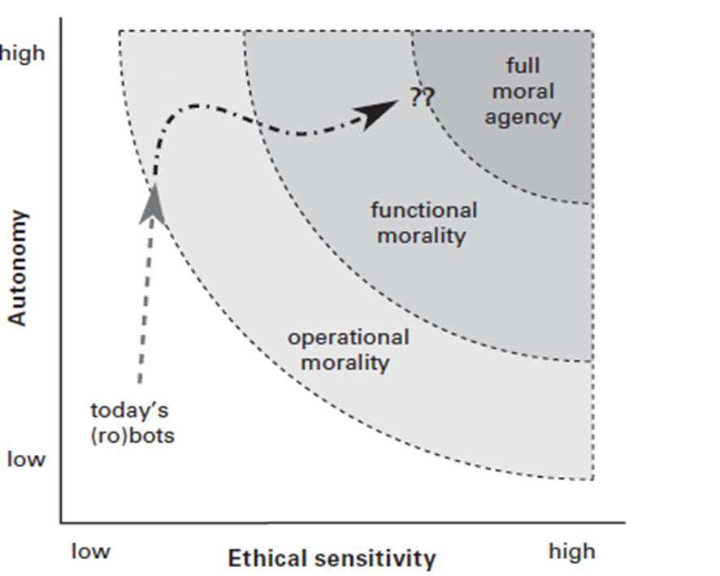

Slide 19
Systems with very limited autonomy and sensitivity have only “operational morality, ” meaning that their moral significance is entirely in the hands of designers and users.
As machines become more sophisticated, a kind of “functional morality ” is possible, where the machines themselves have the capacity for assessing and responding to moral challenges.
The creators of functional morality in machines face many constraints due to the limits of present technology.

Slide 20
Issue 3: Approaches of programming ethics to robots
Top-Down
  Input a General Moral Theory (e.g. Deontology, Utilitarianism, etc.)
  Problem: How to apply in specific concrete situations / Conflict between rules
Bottom-up
  Start with learning case-by-case (trial-and-error experience)
    Problem: how to reach general rules of conduct
Mixed Approaches

Slide 21
Differences
TOP-DOWN approaches> more rigid control by rules what the moral choices in practice are > RESTRICTING OPTIONS
BOTTOM-UP approaches: moral values emerge as MORE FLEXIBLE and EXPANDED range of options

Slide 22
Top-Down Approaches examples
UTILITARIANISM
  Positive Advantage> quantify costs/harms and benefits
  Negative Disadvantage> how to measure quantifying / need to compute all possible alternatives / how far to compute for weighing alternative consequences
DEONTOLOGY/Kant
  Positive: an overarching general moral Law > the Categorical Imperative
  Negative: what happens to the “Good Will”? How can a medical robot assess its own motives? A lot of Kantian computing programming is required a and a lot of knowledge of psychology
  GENERAL POINT: in real life sometimes such general theories are bypassed because time is limited, problems are pressing, so some general heuristics that humans have for bypassing conflicts etc must be programmed to medical robots too

Slide 23
Rule-Utilitarianism
The machine algorithm to compute the best rule would input the actual number of people affected and, for each person, the intensity and duration of the good/harm, plus the likelihood that this good or harm will actually occur, for each possible rule, in order to derive the net good for each person. The algorithm then adds the individual net goods to derive the total net good
A computational disadvantage of a rule utilitarian decision procedure is that in order to compare the consequences of available alternative rules to determine what ethically ought to be done, many or all actual rule consequences must be computed in advance by the machine

Slide 24
Rule-Utilitarian 2
If exponentially greater computational power allows more ethical knowledge, a rule utilitarian machine may be able to compute actual and non-actual anticipated or anticipatory consequences, including foreseeable or intended consequences

Slide 25
Bottom-up Developmental approaches examples
Program learning (moral) environments for piecemeal learning through experience case-by-case and by trial-and-error
Develop moral sensibilities by learning like a child
Evolutionary learning and AI LIFE
Reward-and-punish systems for moral learning
DANGERS! Any programmed machine that can learn moral codes can also undo them, or undo moral restraints that it acquired
  Maybe build moral restraints at the lower program stages inaccessible to the learning programs
    But again: which restraints to build?
    And is this a FULLY moral agent that cannot revise these moral restraints?

Slide 26
Social Intelligence: example of Bottom-Up
A medical machine’s abilities to understand human motives and emotions, and to respond to them with spontaneous and convincing displays of emotions, sensations and thoughts, as well as their own ability to display their personalities by integrating emotions, sensations and thoughts with speech, facial expressions, and gesture .
From the human-machine interactions field, improved social intelligence in robots as perceived by human users has been found to result in better and more effective communication and hence better human acceptance of robots as authentic interaction partners.
Social intelligence is clearly an essential capacity for machines to have if humans are going to trust them, since trust relies on the recognition that those you are interacting with share your basic concerns and values.

Slide 27
Moral Behavior of AMA
1. Limited moral behavior:
Medical Machine correctly follows a computer program, but unable to explain the reasons for what it is doing.
Problem: the machine cannot deal with a situation that is unforeseen (not pre-programmed) and so acts randomly
2. Behave as an Explicit Moral agent
  Implicit moral agent
    Explicit moral agent
    Full moral agent

Slide 28
“Can a computer operate ethically because it’s internally ethical in some way?”
Implicit moral agents are robots constrained “to avoid unethical outcomes.”
They do not work out solutions to make ethical decision themselves, but are designed in such a way as to behave ethically. For instance, automated
E.g. automatic pilots on airplanes are implicit moral agents.
Explicit moral agents are robots that can “do ethics like a computer can play chess”.
Explicit moral agents apply ethical principles such as Kant’s Categorical imperative, or Rawl’s reflective equilibrium to concrete situations in order to choose their course of action.
Explicit moral agents autonomously reach ethical decisions with the help of some procedure.
Such machines could also, if need be, justify their decisions

Slide 29
Full moral agents are beings like humans, who possess “consciousness, intentionality and free will”.
Full moral agents are accountable for their actions.
The robots currently made are not full moral agents and it is not clear whether the creation of computational full moral agents is morally acceptable or rationally justifiable.

Slide 30
Problems
No agreement about which ethical theory to program into medical machines.
No consensus
If a medical robot becomes a FULL moral agent, then it automatically acquires rights (and obligations) to be treated with respect etc, therefore you cannot make it do hazardous tasks or demeaning jobs etc !
Also: FULL moral agents have the right to give free approval or consent, so robots like thee should be asked for their approval
But a medical machine that is only an EXPLICIT moral agent does not have such rights etc and so it can be used by humans for various ‘bad’ jobs.

Slide 31
example
If a medical robot becomes a FULL moral agent
then for Deontology (Kant’s Universal Law of Respect Human Beings as Ends in Themselves and not merely as Means only) requires that we treat medical robots with RESPECT!

Slide 32
Shared responsibility in ethical decision making in medicine
Decision Support Systems (DSS)
DDS provide the user (medical doctor) with a framework to easily characterize and analyze problem situations using predefined algorithms and models.
This process is highly interactive, including the user in problem definition, the creation of possible solutions and using the correct model for evaluation and rating.

Slide 33
Expert systems (ESs) assemble the knowledge and experience of domain experts in machine interpretable form.
They integrate expert knowledge for a particular domain to provide action alternatives, thus ready-made or adaptable solutions for a given problem.
ES help to capture, combine and distribute the expertise of human decision makers and hence lead to better and faster decisions

Slide 34
The DSS does not provide the user with action alternatives; it only gives support with ready implemented, adaptable models for evaluation.
Solving ethical dilemmas can be understood as a selection process between two options and weighing possible consequences of actions.
This can serve as an initial very basic model of an ethical dilemma. An example of this is a patient who does not allow a life-saving treatment and gives reasons the doctor regards as irrational.
This situation can be modeled for different patients of different ages (children, middle aged adults and very old patients) and outcomes can be evaluated.

Slide 35
Where DDS can help
Situations of:
Moral Conflict of supreme ethical theories
Moral Disagreement interpersonal disagreement
Culture differences

Slide 36
Extending DDS with ethical decision-making capability
COMBINE DDS with ES
Clinical DDS
Serious Games (for educating medical doctors in virtual hospital environments etc)
Using machines not only for medical decisions but also for the normative ethical dimension of decisions in medicine poses questions about how far ethical decisions can be supported by algorithm based machines on the one hand and questions of shared responsibility on the other.

Slide 37
Recent Developments: Simulation Games
“SERIOUS GAMES”: creation of a learning environment for complex decision making processes.
This can be used for teaching or team coaching in order to train for decision situations where different forms of expertise as well as values have to be taken into account, something which is usually precluded in standard clinical DDS
The use of such an environment can reframe decision situations, integrate different perspectives and get relevant actors more involved at different times or stages of the decision than in current practice.
This cannot be done with the basic tools that have been the staple of medical decisions education, such as textbooks, medical scripts, questionnaires and simple role play games, neither with the ones used by standard Clinical DSS systems, but need more refined thought.

Slide 38
One main aim of using Serious Games must be to strengthen responsibility in the sense that doctors get a growing sensibility for potential ethical problems, how to avoid them and how to moderate shared decision making processes between different parties.
The aim of the implementation of SG teaching ethics is to explicitly place responsibility in the hands of doctors.
Transferring ethical decisions to computers would lead to the problem that the user is still responsible for the implementation of a decision and therefore needs to reflect upon the decision process, its criteria and possible outcomes.
This implies having a deeper understanding of the ethical decision or, which is even more complicated, to understand the algorithms of the technical solution.

